Slide 1
Open Data for Agriculture – for whom and by whom?
Strengthening farmer organisations to use technology to increase and sustain agricultural growth.
Francois Laureys – Lead Advisor Agriculture flaureys@iicd.org

Slide 2
ICT4Economic Development ICT4Education
ABOUT IICD
ICT4Health
ICT4Water and Climate Resilience
IICD is an expert foundation with 18 years of experience in building digital capacities and enabling the drivers of social change through ICT. IICD currently works in 14 countries in Africa and Latin America.
Mali
Burkina Faso Ghana
Suriname
Congo Brazzaville
Ethiopia Kenya
Tanzania Malawi
Uganda
Peru
Zimbabwe
Zambia
Bolivia
PARTNERS
IN AGRICULTURE

Slide 3
Road mapping - thinking backward along the chain (example: precision agriculture)
Open data NL – ministries of Foreign Affairs and Economic Affairs trying to align policy and political agenda’s, activities and programmes around OD and Food Security, Agriculture, Trade etc.
1) Start with the desired impacts (what do we want to accomplish?); 2) which outcomes are required?; 3) which outputs are needed?; 4) which activities should we undertake?; 5) Which inputs are needed? In red: activities related to Open Data inputs
Input | Activity | Output | Outcome | Impact
Open Data on: Topography Farms/parcellation Land use Crop rotation Crop yield Soils and fertility Meteorological conditions Etc. Standards Open remote sensing images Technical infrastructures and processing | Mapping, sensing, guidance, tracking Stock taking Data collection and linkage (sensor) technology development, Research Dissemination Education and training Organising synergy within and between sectors of activity (including research and consultancy) | Increased crop yield Decreased labour costs Decreased inputs of fertilizer Improved farmers’ skills Improved public / private collaboration Strengthening of professional skills knowledge workers in data/information sector New / improved data and technologies Scientific publications | More efficient agricultural production | Contribution to food security and sustainable development at national and global levels
 |  |  | Less environmental pollution
 |  |  | Increased innovation potential and international reputation of Dutch agricultural sector
 |  |  | Increased innovation potential and international reputation of Dutch data related knowledge sector

Slide 4
Impact
Inclusive and sustainable growth of agricultural sector
Outcomes
Improved production and stability of agricultural systems that are sustainable
Improved productivity and earning capacity of local smallholders
Stronger, more diverse, and more stable rural economy
Outputs
More sustainable production systems
More resilient production systems
Empowered households and smallholders
Enabling environment
Activities
Extension services targeted at sustainability
Improve access to technology, capital, inputs, markets, information
Community development
Develop/improve risk management, social security and insurance systems
Diversify rural economy
Training and capacity building
Empowerment of women and smallholders
Improve network connectivity
(data)
Inputs
Data on expected production & logistics & variety choices
Data on markets and legal conditions
Standards and portals with available data and information
Data and forecasts on expected production and trade

Slide 5
Farmer-driven Information Systems
Farmer database (e.g. farmer registration, information on farmer, farm and plots, production, expenses, inputs etc.)

Slide 6
Farmer-driven Information Systems
Channels:
web-to-phone, radio, TV, USB-sticks, meetings etc.
Farmer database (e.g. information on farmer, farm and plots, production, expenses, inputs etc.)

Slide 7
Farmer-driven Information Systems
Production levels
Input quantities
Credit weight
Extension advice
Weather
Pests
Earth observation
Soil data
Market prices
Offer & demand
Data and information services
Channels:
web-to-phone, radio, TV, USB-sticks, meetings etc.
Farmer database (e.g. information on farmer, farm and plots, production, expenses, inputs etc.)

Slide 8
Farmer-driven Information Systems
Production levels
Input types & quantities
Credit weight
Extension advice
Weather
Pests
Earth observation
Soil data
Market prices
Etc.
External stakeholders
Data and information services
Channels:
Web(-to-)phone, radio, TV, USB-sticks, meetings etc.
Transporters
Processors
Traders
Input suppliers
Policy makers
Credit suppliers
Research
Etc.
Farmer database (e.g. information on farmer, farm and plots, production, expenses, inputs etc.)

Slide 9
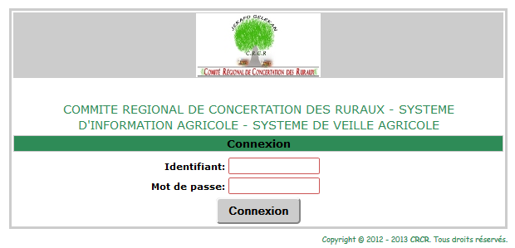
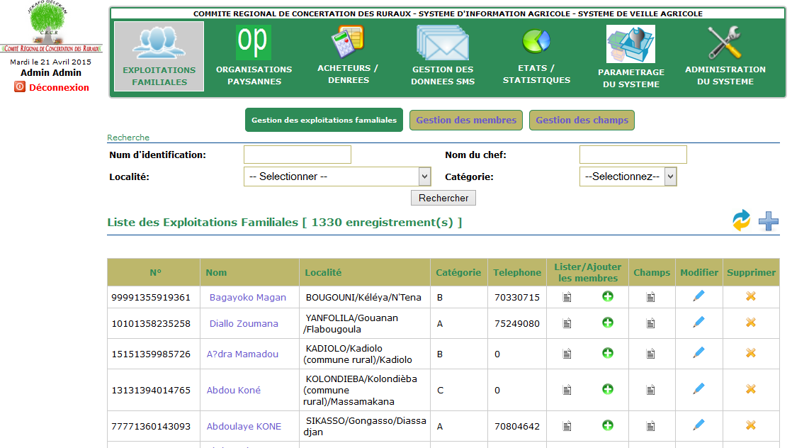
SIA platform Mali

Slide 10
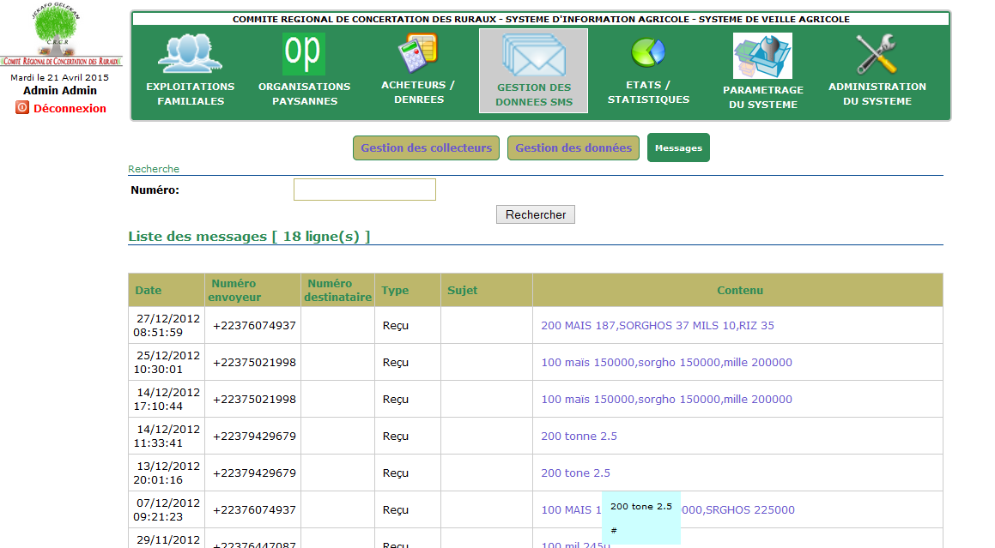

Slide 11
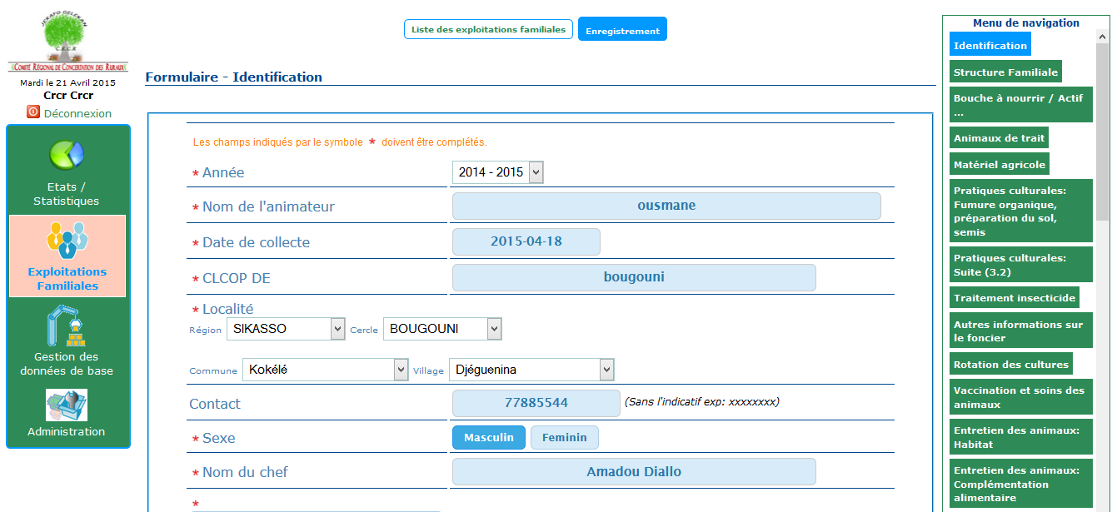

Slide 12
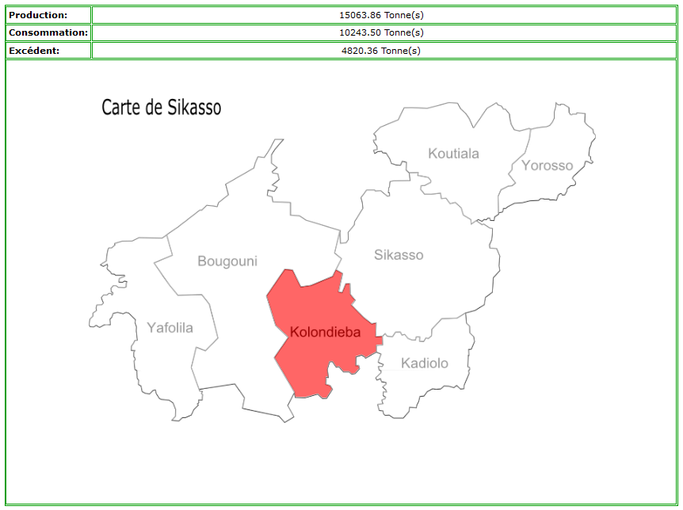

Slide 13
International Institute for Communication and Development
www.iicd.org

