Slide 1

Mainstreaming eSkilling: The Philippine Experience
DEPARTMENT OF SCIENCE AND TECHNOLOGY
INFORMATION AND COMMUNICATIONS TECHNOLOGY OFFICE

Slide 2

Outline of Presentation
Strategic Thrust and Objectives on eSkilling
Policy Framework: National ICT Competency Standards (NICS)
Projects and Projects
Challenges & Lessons Learned

Slide 3
Strategic Thrust
“Investing in People: Digital Literacy for All”
It is every citizen’s right, men and women, to have equal access to quality education, training and skills development opportunities through formal and/or alternative means.
Philippine Digital Strategy 2011-2016

Slide 4
Objectives
Produce more globally competent workforce, possessing 21st century skills, through the use of ICT;
Improve the capacity of government workforce to effectively develop and manage government ICT infrastructure and systems
Raise digital literacy in the country to enable a culture of competent, confident, responsible, and participatory use of ICT

Slide 5

Policy framework: national ict competency standards (NICS)

Slide 6
National ICT Competency Standards [NICS]
Provides a common framework of expectations by defining the knowledge, skills and attitude that an individual must possess to be efficient, effective and productive;
Used for performance management, professional development and professionalization of human capital in government, industry and academe
Notes:
government & business are assured of manpower with the guaranteed ability to perform;
educators can discern the competencies on which curriculum is based;
workers understand what is expected to be performed and be more efficient & productive; and
students know what they need to be able to do

Slide 7
National ICT Competency Standards [NICS]
    Developed 14 NICS for various job roles
    Formulated Competency Levels: Basic, Intermediate and Advance
    Mapped to the ASEAN ICT Skills Standards: Definition and Certification [ISSDaC]

Slide 8

National ICT Competency Standards [NICS]
Competency Cluster Groups
Cluster Group 3 | Enterprise Architect Project Manager Career Executive Service Officer Government Chief Information Officer Information Systems Auditor
Cluster Group 2 | Application Developers Network Specialists Webmasters Information Security Specialist
Cluster Group 1 | Basic Advanced Teachers Civil Servants CeC Knowledge Workers

Slide 9
National ICT Competency Standards [NICS]
Competency Levels
LEVEL | DESCRIPTION
1 Basic | Has basic knowledge and skills which is adequate to perform a given task(s) under supervision of management
2 Intermediate | Has professional knowledge and skills to perform a given task (s) independently, and if required, can supervise others
3 Advanced | Has professional knowledge and skills both technical and management to lead a team in an inexperienced environment

Slide 10
Projects and Activities

Slide 11
eSkill Upgrading for Targeted ICT Professionals in the Government Sector

Slide 12
Seminars and Workshops
E Government Project Management
Social Media for Development
ICT Development Essentials for Government Managers
ICT Resource and Acquisition – Project Terms of Reference
Information Security and Privacy
ICT for Disaster Risk Reduction, Climate Change, Green Growth and Sustainable Development
Information Systems Strategic Planning
Enterprise Architecture & E-Services Strategic Planning
Managing ICT Services in Government – IT Infrastructure Library
ICT Courses
Java Programming
Systems Analysis and Design

Slide 13
eSkill Upgrading for Targeted Organizations

Slide 14
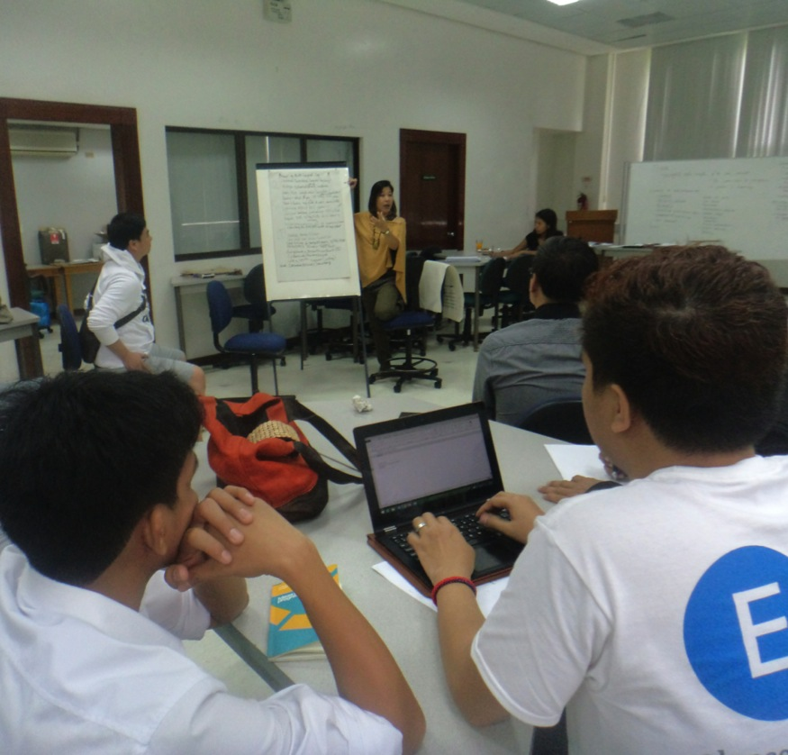
Capability Development Workshop for ICT Councils
Training workshops for Level 3 ICT Councils, which are still under development and still lack maturity.
Isabela
Capiz
  Lanao del Norte

Slide 15
eSkill Upgrading for Targeted ICT Professionals

Slide 16
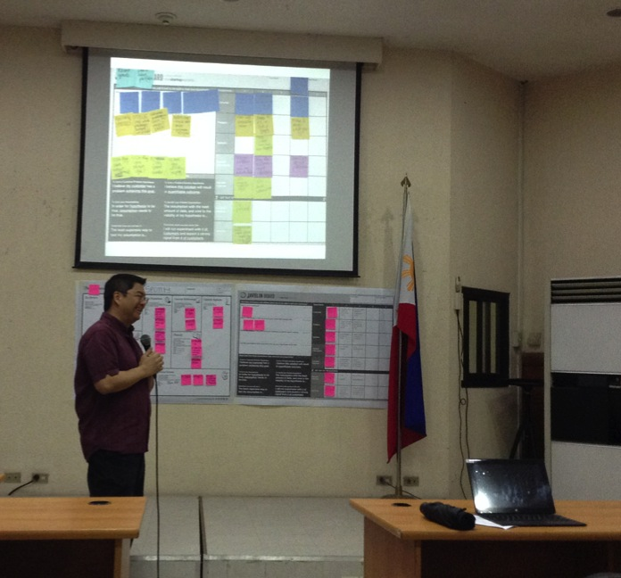
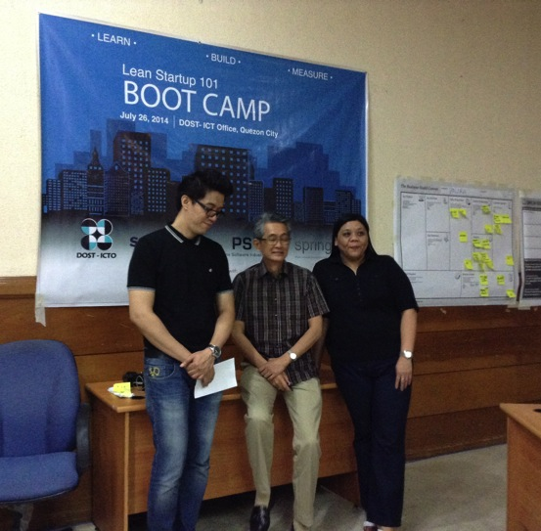
Lean Startup
101 Bootcamp
Baguio*
This training workshops are designed for college instructors and professors who could serve as mentors of students who would join the Philippine Startup Challenge.
NCR
Iloilo City
Cebu
Cagayan de Oro City
Davao

Slide 17
ICT Scholarship and Training Program
Courses Offered:
Mobile and Embedded Software Development
Game Design and Development
Lean Six Sigma
Business Analytics (New)
Medical Coding
Partnership among DOST-ICTO, TESDA, ICT and IT-BPM Industry and Training Provider

Slide 18
Training for Work Scholarship Program (TWSP)
The TWSP is directed towards:
  filling up the skills gaps and job requirements of priority industries and sectors with high employment demand,
  improving the reach of quality technical vocational education to the grassroots ;and
  encouraging technical-vocational institutions to offer programs in higher qualifications catering to in-demand industry requirements
Courses offered focus on "Key Employment Generators" (KEGs) in the areas of … IT-business process management, semiconductor and electronics,… and emerging sectors

Slide 19
Courses on Information Technology
Software Development Fundamentals
Web Development (HTML)
Game Development (2D & 3D)
Animation (3D Digital)
CAD/CAM Operation
Implemented by Technical Education and Skills Development Authority

Slide 20
eSkill Upgrading for Targeted Special Sector

Slide 21
Trainings
Basic IT Literacy for Persons with Disability
Basic IT with collaboration tools (i.e. word processing, powerpoint and social media) for Senior Citizens
Basic IT with collaboration tools (i.e. word processing, powerpoint and social media) for Out of School Youth
Training for Special Education Teachers

Slide 22
Challenges & Lessons Learned
Strengthen multi-stakeholder collaboration and public private partnerships
Development of a national database on digital literacy and related information
Assessment of eSkilling Policy and Program
Implement an incentive-based eSkilling Program, especially for government ICT workers
Notes:
Promote public-private partnership in the provision of education and professional training
Institutionalize and leverage multi-stakeholder collaborations and partnerships with local, regional and international groups
Conduct of baseline survey/study eSkilling, productivity levels

Slide 23
THANK YOU

