Slide 1
Severe weather in Africa and impact of current telecom capability on Early Warning Systems WMO African severe weather demonstration projects success and limitations Abdoulaye Harou (WMO)/ David Thomas (WMO
WMO; WDS

Slide 2
Main SWFDP Goals
Improve Severe Weather Forecasting
Improve lead-time of Warnings
Improve interaction of NMHSs with users: media, disaster management, civil protection authorities
Identify areas for improvement and requirements for the Basic Systems
Improve the skill of products from WMO operational centres through feedback
Capacity building

Slide 3
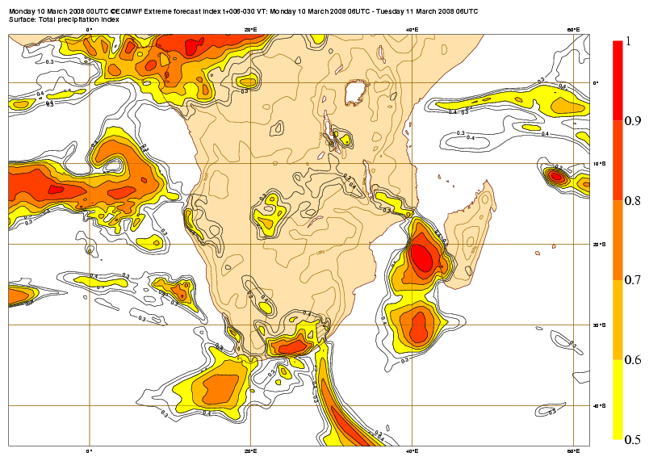
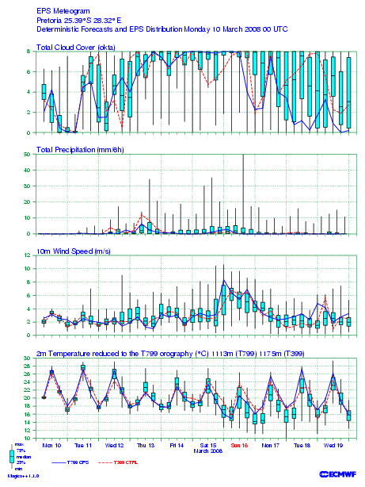
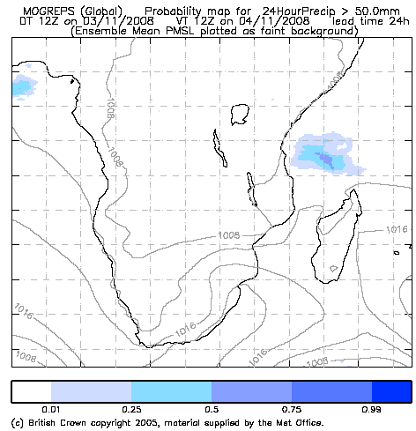
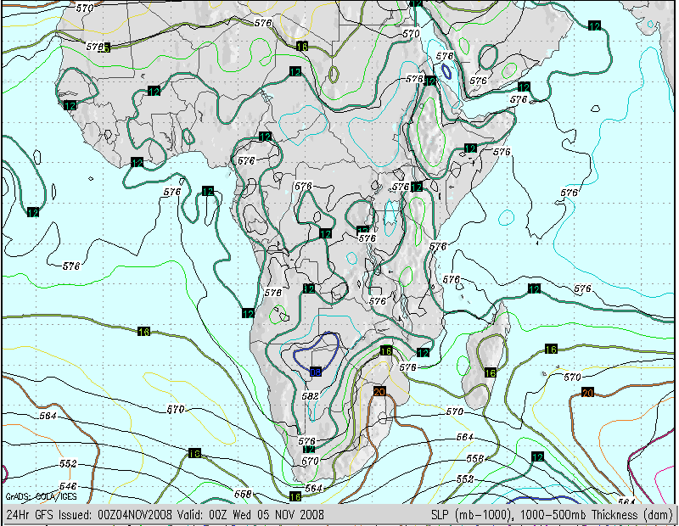
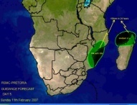
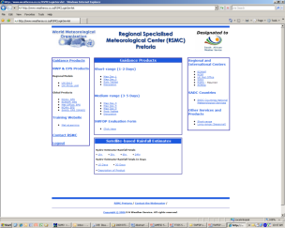
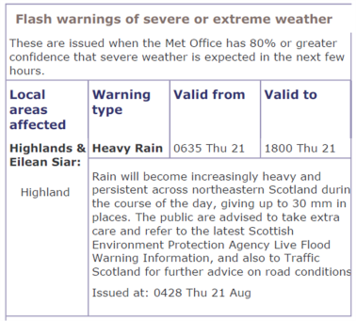
Global NWP centres to provide available NWP and EPS products, including in the form of probabilities
SWFDP Cascading Forecasting Process
Regional centre interprets information from global centres, Prepare guidance forecasts for NMHSs, run LAM to refine products
NMHSs reassess info and issue country forecasts and warnings to Disaster Management Offices, media and public etc. if needed

Slide 4
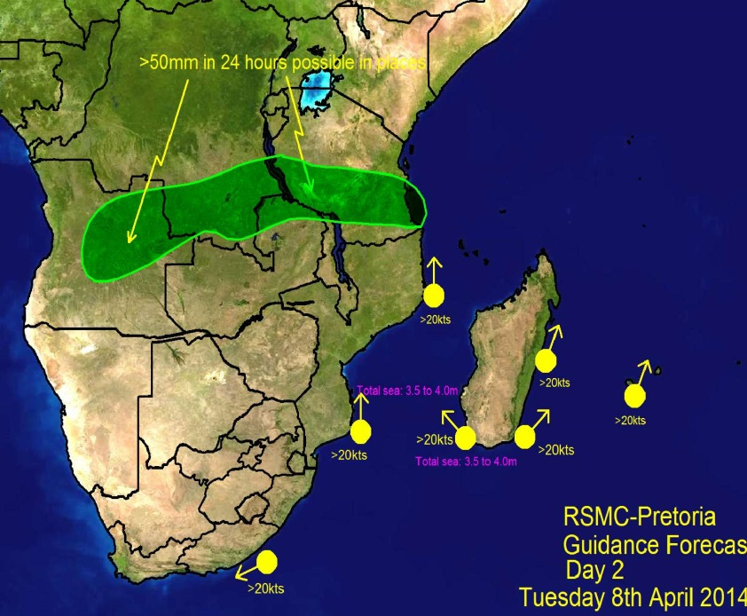
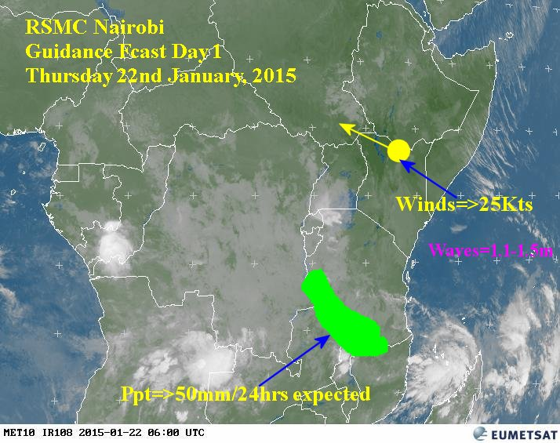
SWFDP – Africa
South Africa -16 Countries : Angola, Botswana, Democratic Republic of the Congo, Malawi, Mauritius, Madagascar, Mozambique, Namibia, Lesotho, Seychelles, South Africa, Swaziland, Tanzania, Zambia, Zimbabwe, Comoros
Eastern Africa - 7 Countries: Burundi, Ethiopia, Kenya, Rwanda, South Sudan, Tanzania and Uganda
West Africa: In Development
WMO
(Since 2006)

Slide 5
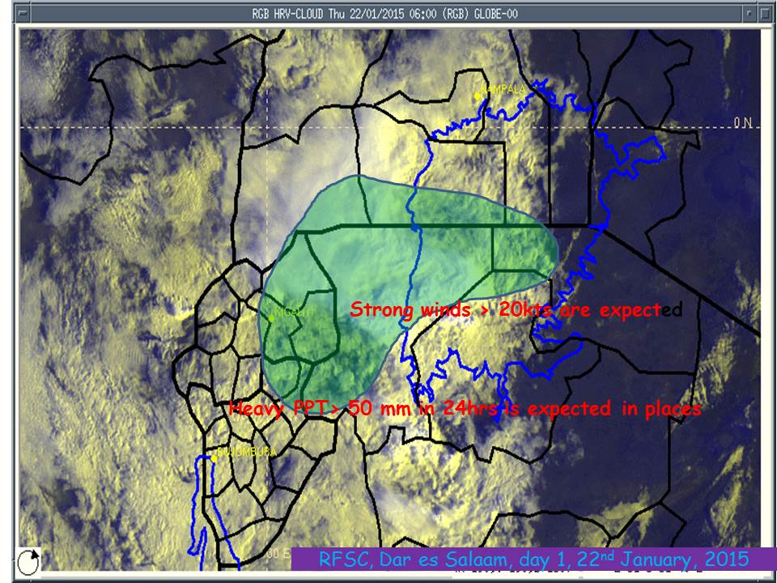
SWFDP Eastern Africa
(Since 2010)
Benefitting Countries (7):
Burundi, Ethiopia, Kenya, Rwanda, South Sudan, Tanzania and Uganda
Global Centres: ECMWF, UKMO, NOAA/NCEP , DWD
Regional Centre: RSMC Nairobi, RFSC Dar Es Salaam (Lake Victoria basin)
(Supported by Norwegian funds)

Slide 6
Issues around accessing and sharing information
Weather business create huge amount of data (Satellites, Radars, Surface & upper air observations etc). Accessing these data facilitates the development of accurate weather information and warnings
High quality Numerical Weather Information is shared through internet but in most countries the availability or adequacy of Internet is the sore point
The dissemination of warnings through internet is also hampered by the lack of Internet connection
Where Fiber is available, the cost for accessing adequate Internet connection is prohibitive for many National Meteorological Services

Slide 7
Presentation by Mr Thomas follows

Slide 8
Africa historically relies extensively on V-SAT links in many parts
ASECNA centres
High bandwidth central service Senegal supporting:
VSAT-64kps / TCP/IP to most centres
Other NMHS typically using
Fixed line or VSAT less than 64kps for dedicated networks
VSAT 256kps lines for internet access
Larger centres have fixed links through coastal fibre network (Eg Pretoria)
High reliance on Sat Broadcast (EUMETSAT/Puma/etc)
High reliance on Satellite Data Collection Systems (EUMETSAT)

Slide 9
Toulouse
Rome
Moscow
Madrid
Algiers
Casablanca
New Delhi
Western
Sahara
Tunis
Canary
Tripoli
Cairo
Jeddah
Offenbach
Nouakchott
Toulouse
Khartoum
Dakar
Niamey
Asmara
Banjul
Bamako
Djibouti
Bissau
Ouagadougou
N'djamena
Conakry
Addis Ababa
Sal
Bangui
Freetown
Accra
Cotonou
Lagos
Entebbe
Mogadiscio
Monrovia
Nairobi
Abidjan
Lome
Douala
Kigali
Malabo
Bujumbura
Seychelles
Libreville
Dar Es Salaam
Brazzaville
Washington
Lusaka
Sao Tome
Kinshasa
Lilongwe
Mauritius
Luanda
RTH
Harare
NMC
Ascension
Windhoek
Gaberone
Moroni
St Denis
Centre in other region
St. Helena
Pretoria
Maputo
Antananarivo
MTN circuit
Maseru
Manzini
Kerguelen
New
Amsterdam
Regional circuit
Interregional circuit
Figure 1 Regional Meteorological Telecommunication Network for Region I (Africa)

Slide 10
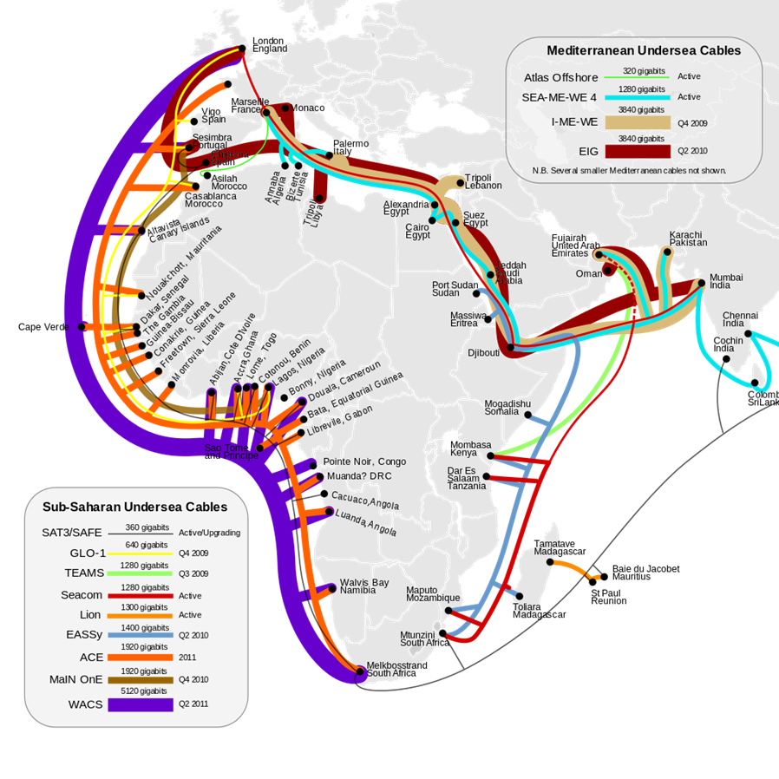
Coastal centres first to benefit from fiber rollout
GISCs Pretoria and Casablanca have MPLS connections to Europe

Slide 11
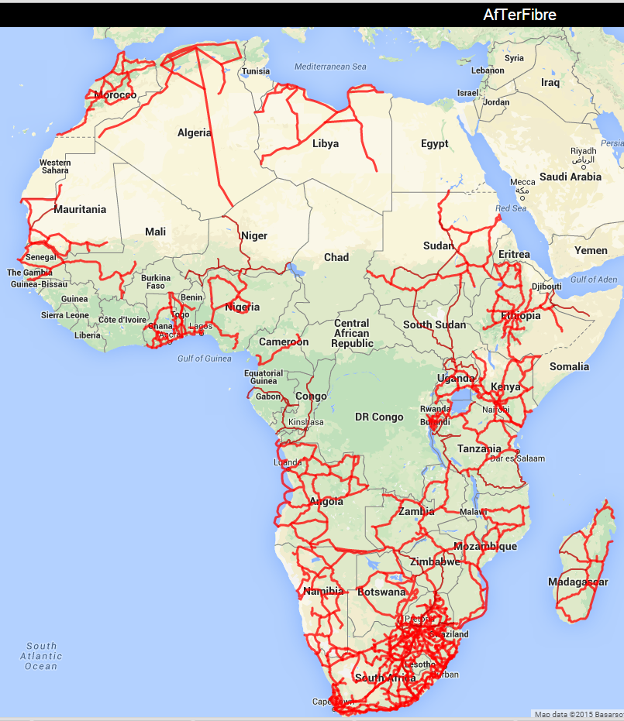
Fibre is being rolled out in Africa
Source: http://afterfibre.net/
For country details - see http://en.wikipedia.org/wiki/List_of_terrestrial_fibre_optic_cable_projects_in_Africa
Varies from single to multiple in suppliers in each country
Wouldn’t it be nice to get Telco's to support NMHS needs

Slide 12
Regional WIGOS and WIS implementation
Acknowledged that supplies and infrastructure were problematic for observation availability, but
Identified that communications is a larger factor in missing observations
Consistent with the Southern African Development Community - Meteorological theme group
http://www.sadc.int/themes/meteorology-climate/
SADC master plan (2012)
(http://www.sadc.int/files/1313/5293/3533/Regional_Infrastructure_Development_Master_Plan_Meteorology_Sector_Plan.pdf)

Slide 13
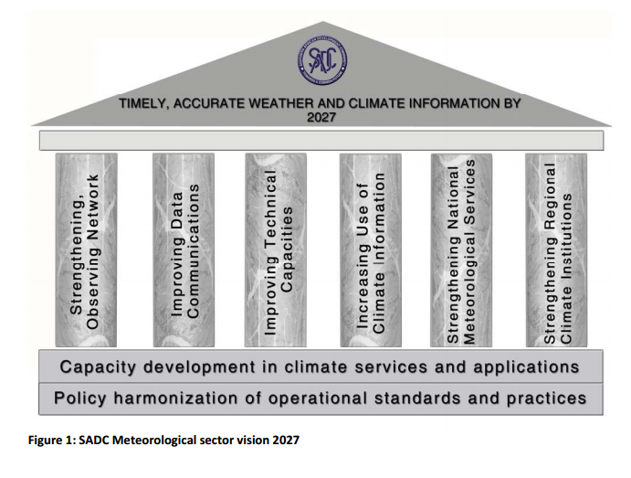
SADC - Meteorology sector Vision 2027
The telecommunication infrastructure available to the NMSs does not support adequate transfer of data inside or outside the countries.
Many do not have dependable access to the internet to consistently reach out to users for feedback on their products.

Slide 14
Thank You

