Slide 1
Need for Connectivity in Africa WMO Perspective Dr Amos Makarau Director General of Meteorological Services Department of Zimbabwe, President of WMO Regional Association for Africa Mr Peiliang Shi Director , WMO Information System Branch
WMO; WDS

Slide 2
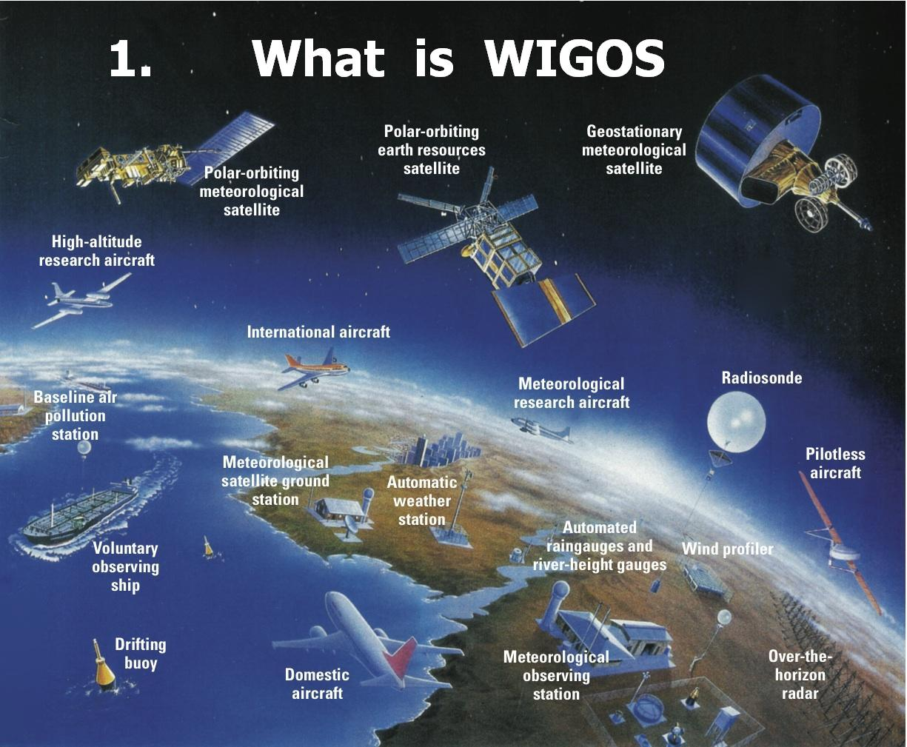

Slide 3
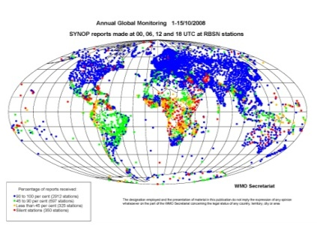
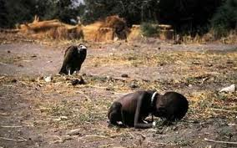

Slide 4
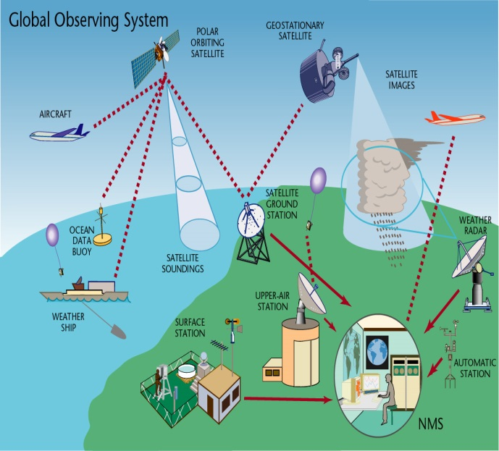
Africa’s Vision on Weather and Climate Service provision
Meteorological products and services, including weather forecasts, warnings and advisories are timely, affordable to, accessible and easily understood by, all anywhere and anytime.
Africa has mainstreamed climate in its socio-economic development agenda
Bottom line: climate resilient society, communications, speed, early warning

Slide 5
Roles of WMO and National Meteorological and Hydrological Services
Protection of lives and property on land, water and in the air;
Contributions to sustainable development;
Enhancing quality of life

Slide 6
Challenges Africa is facing in provision of weather, water and climate information
Erratic and slow transmission of data from meteorological observing sites within the countries;
Varied modes of transmission of this data (mostly SSB, land line, radio, TV, postal):
Mobile and satellite technology is in its infancy and is costly;
Exchange of meteorological data and products regionally and globally still unsatisfactorily low; to many silent stations;
Accessibility of weather forecasts, alerts/ warnings and early warning to all is highly problematic, particularly in remote areas;

Slide 7
Challenges … (Cntd)
Extreme weather events are becoming more severe, frequent and prolonged;
34 countries in Africa are Least Developed Countries (UN) and are having difficulties in copies with these extremes;
Over 60% of populations are in rural and remote areas where development is lagging behind;

Slide 8
Why we need to invest in connectivity urgently in Africa ?
Africa is the most vulnerable continent with respect to impacts of extreme weather and climate change;
Disasters, most of which are weather related, are increasing and are projected to becoming more extreme;
Africa’s population is rapidly increasing and economic growth is promising, yet still threatened by Weather and Climate Extremes and Climate Change impacts;

Slide 9
Final word…
Connectivity will empower Africa nations and protect its people and economic assets and develop new opportunities for social and economic growth.
ICT connectivity for weather and climate services
is a must for building Africa climate resilience and
sustain its growth
Together ITU, WMO, and private sector we can
achieve it today

Slide 10
Thank You

