Slide 1


Information Sharing for Greater Cyber Resilience
Rob Dartnall
Director

Slide 2
Pick a Quote
If you want to go quickly, go alone. If you want to go far, go together
It is literally true that you can succeed best and quickest by helping others to succeed
Knowledge is Power
Strength in Numbers
The whole is greater than the sum of the parts
A problem shared is a problem halved
…

Slide 3
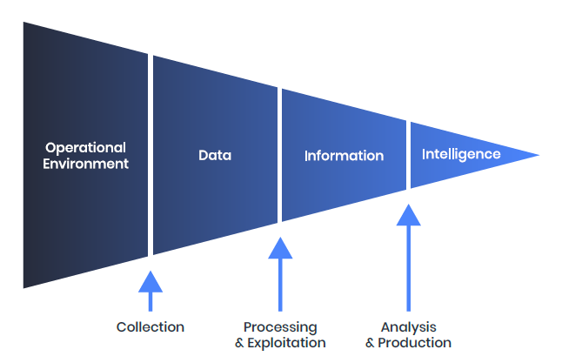
Getting On The Same Page - Terminology
Types
Levels
Strategic
Global Threat Trends
Regional or Sector trends
Horizon Scanning
C-Suite Awareness
Security Policy
Risk Management
Security Strategy
Security Investment
Operational
Threat Actor Campaigns
Threat Actor Modus Operandi
Emerging Trends
Red Team Scenarios
Incident Response
Security Architecture
Threat Modelling
Vulnerability Management
Tactical
File hashes
Malicious IPs and domains
Behaviour strings
SOC/SIEM monitoring and detection
Endpoint, Mailbox & Network detection tooling
Threat Hunting
ALL ARE IMPORTANT

Slide 4
So What Is ‘Cyber Information Sharing’….
Cyber Information Sharing is the ability to share data, information or intelligence, of different levels, in different formats, across different mediums to multiple audiences in multiple disciplines in an accurate and timely manner, in order to make informed decisions to drive security and resilience.

Slide 5
What It Is And What It Is Not
The European Cyber Resilience Board said it should…
It should not be…
…Not ‘reinvent the wheel;’, should re-use proven components (commercial / open source) and use best practice
…go beyond just recirculating known tactical IOCs (data) and add value through dissemination of strategic information
…be practical and easy to implement
…have strong usability to encourage strong uptake and usage a cross members
…allow any costs to be aggregated and shared across members
…allow members to implement at their own pace
And we would add…
…build trust
…share burden
…adapt, evolve, innovate and grow
…complex to create or participate
…restrictive based on participant size or maturity
…purely technical focused, serving only 1 audience
…expensive or restrictive, preventing adoption
…static and not evolve based on changing community requirements
…be purely about technology solutions and platforms, but include physical, virtual and verbal briefings
…siloed from other interconnected communities or sectors / industries
….one size fits all

Slide 6
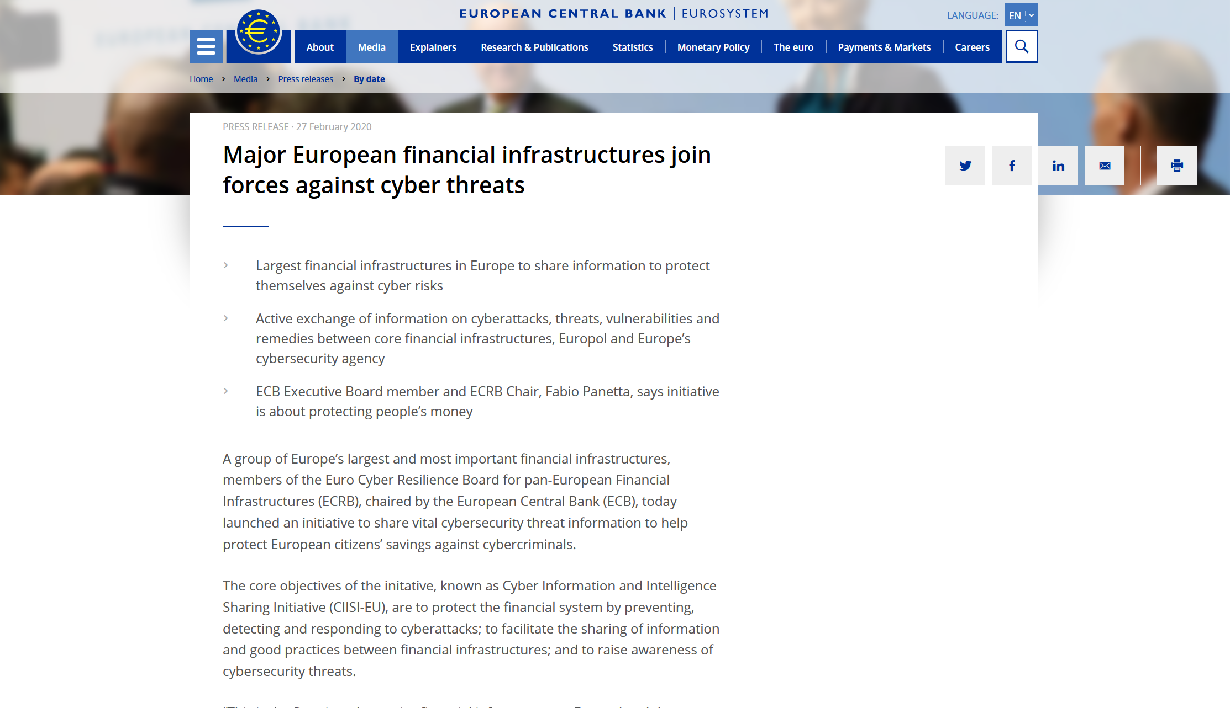
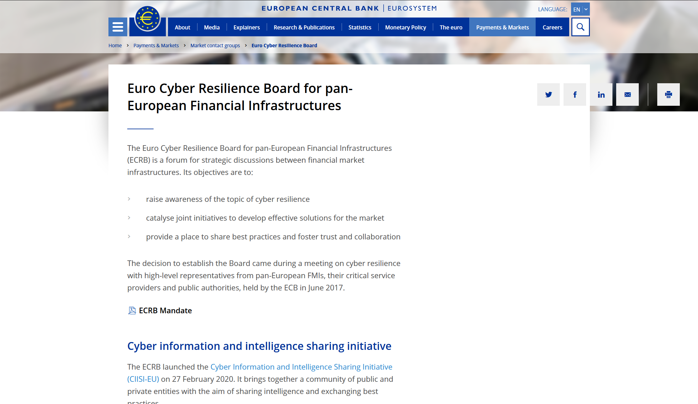
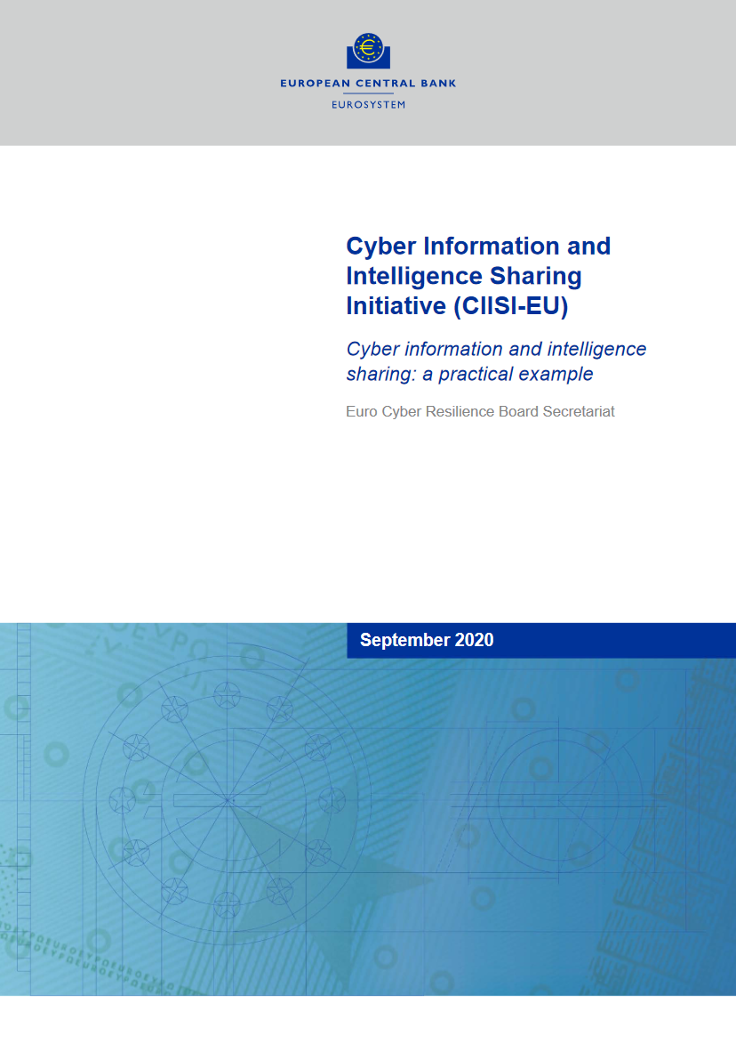
Setting The Standard - A Living Example – CIISI-EU

Slide 7
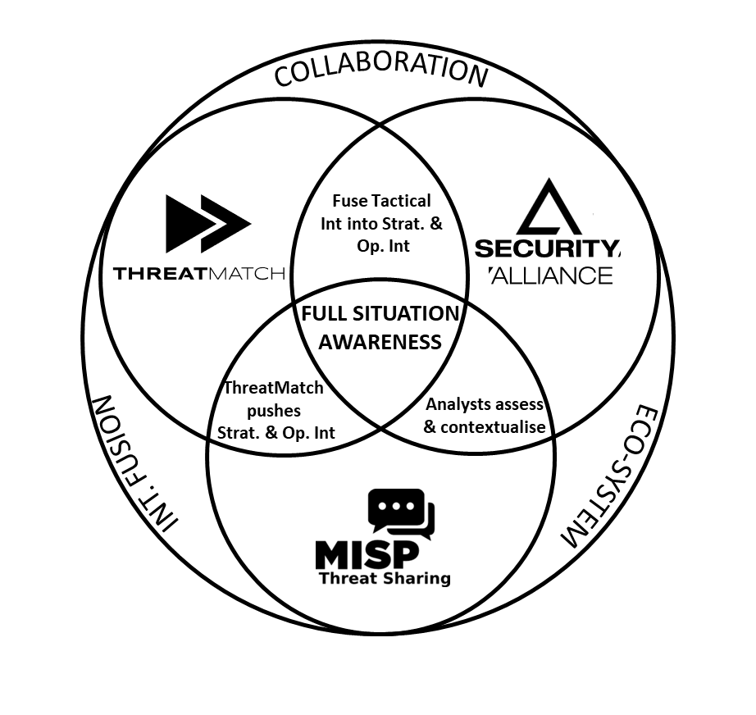
CIISI-EU Composition
The community is made up of the European ‘Financial Market Infrastructure’ providers
There is the ‘whole community’, but also the ability to break down into sub-communities, groups can be broken down by;
  Sector
  Sub-sector
  Job role
  Trusted Group
  TLP level
  …what ever is required (bespoke)
They share tactical, operational and strategic data, information and intelligence via technology solutions (e.g. ThreatMatch) and attend monthly and ad-hoc meetings for verbal briefings
Briefings completed by SecAlliance and members
Joint and ad-hoc research to answer community challenges
Exchanges
Central
Banks
FMI
MISP
Policing
Agency
Central
Bank
Infrastru
-cture
Clearing
Settlements

Slide 8
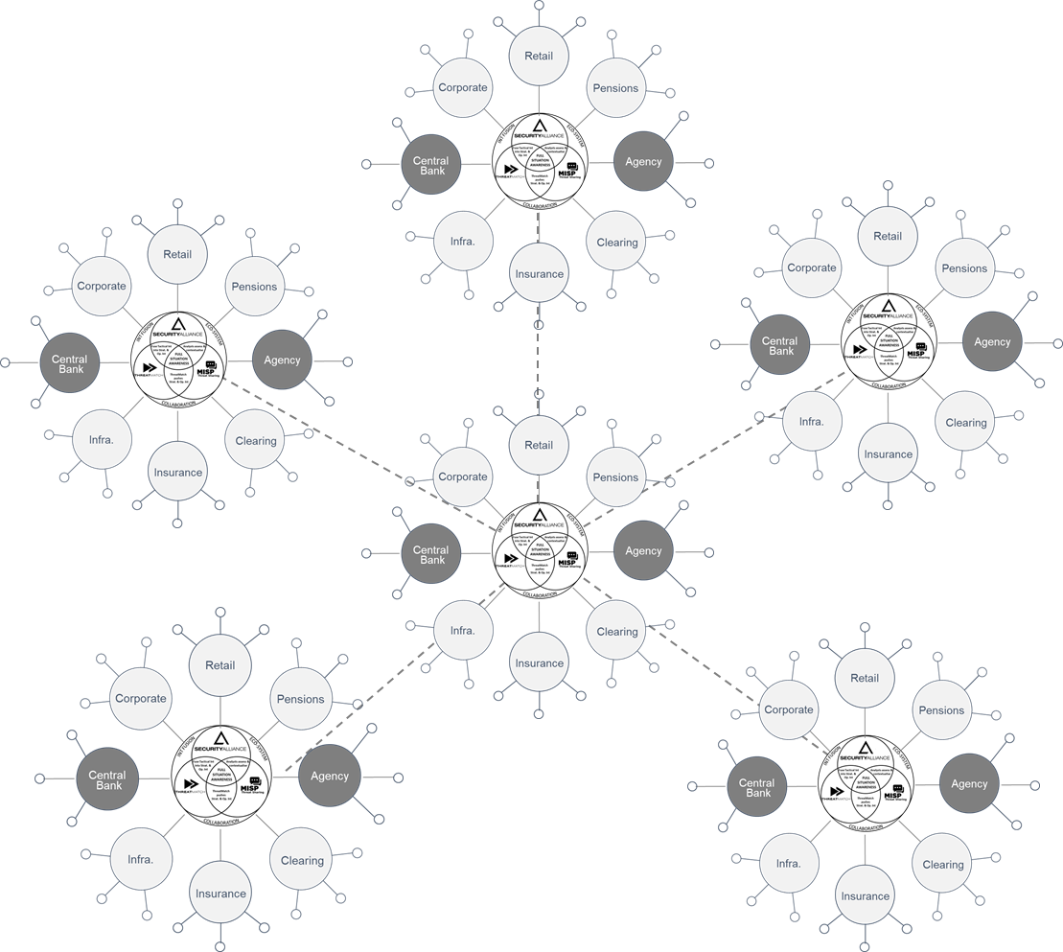
CIISI-EU Composition
The community is made up of the European ‘Financial Market Infrastructure’ providers
There is the ‘whole community’, but also the ability to break down into sub-communities, groups can be broken down by;
  Sector
  Sub-sector
  Job role
  Trusted Group
  TLP level
  …what ever is required (bespoke)
They share tactical, operational and strategic data, information and intelligence via technology solutions (e.g. ThreatMatch) and attend monthly and ad-hoc meetings for verbal briefings
Briefings completed by SecAlliance and members
Joint and ad-hoc research to answer community challenges
The composition and set up allows direct technology integration with other ‘trusted partners’ and sharing communities

Slide 9
CIISI Outputs
Continuous Alerting and Reporting to Threats to the community
6 Monthly Int and Information Workshops
6 Monthly Int and Information Workshops
6 Monthly Threat Landscape Update
6 Monthly Threat Landscape Update
Monthly
VTC
Monthly
VTC
Quarterly
F2F
Monthly
VTC
Monthly
VTC
Quarterly
F2F
Monthly
VTC
Monthly
VTC
Quarterly
F2F
Monthly
VTC
Monthly
VTC
Quarterly
F2F
Monthly
Reporting
Monthly
Reporting
Monthly
Reporting
Monthly
Reporting
Monthly
Reporting
Monthly
Reporting
Monthly
Reporting
Monthly
Reporting
Monthly
Reporting
Monthly
Reporting
Monthly
Reporting
Monthly
Reporting
Ad-hoc calls, briefings, workshops, research papers and briefings

Slide 10
But Why?
If you want to go quickly, go alone. If you want to go far, go together.
In cyber and security, “quickly” is a ‘oxymoron’ – there is no quickly
It is literally true that you can succeed best and quickest by helping others to succeed
Whilst those around you are being targeted (i.e. peers to suppliers) you are never secure
Knowledge is Power
How can you be resilient if you do not know what you are being resilient from? How can you adapt and overcome without knowing how the threat is changing?
Strength in Numbers
Time to change the ratio. ‘1 Vs 10’ or ‘20 Vs 10’
The whole is greater than the sum of the parts
A participant can go from no support capability to having access to 50+ specialists, overnight
A problem shared is a problem halved
A lot, LOT more than halved. Cost, time, resource…all become optimized

Slide 11
To Summarise
There is no better information or intelligence, anywhere in the world, than direct knowledge from a peer facing the same challenge, in the same environment. There is no ‘individual resilience’. With no barrier to entry, Cyber Information and Intelligence Sharing Communities are the best enabler for driving industry, sector, national or regional cyber resilience.

Slide 12

Contact
Rob Dartnall
Director of Intelligence
+44 (0) 7736 468 727
rob.dartnall@secalliance.com

Slide 13

About Security Alliance
Security Alliance is a threat intelligence product and services company, formed in 2007. We are a fully qualified and accredited security consultancy, as well as an intelligence portal vendor.
We deal in real intelligence, gathered, analysed and curated by true intelligence experts with real-world experience. We pride ourselves on the quality of our intelligence product and services, and the strong relationships built with our clients and partners.
It is our objective to help clients manage and reduce business risks, and build relevant intelligence-led security strategies, on a continuous basis. We help our clients understand their greatest threats, and develop their own intelligence capabilities.
ABOUT
CLIENTS
Security Alliance is trusted by the most critical, most targeted organisations in the world including:
Financial Services: Central Banks, Retail Banks, Clearing Houses, Exchanges
Critical National Infrastructure: Energy Providers, Transportation, Infrastructure builders, Government Departments
Multi-national technology conglomerates: Manufacturing, Defense, Telecommunications
Our cyber intelligence team is made up of seasoned intelligence professionals with diverse backgrounds, ranging from conventional intelligence, law enforcement and consulting, to research and academia.
Intelligence Sharing Communities
Designed, implemented and manage world-leading intelligence sharing communities for central banks across Europe.
Intelligence Operating Model Design
Conducted intelligence maturity assessments for some of the world’s largest and most systemically important financial services organisations. Our consultants have also supported the design of industry-leading intelligence fusion centres.
Intelligence Framework Creation
Security Alliance has been central in the creation and ongoing steering of core industry frameworks and professional bodies for threat intelligence.
EXPERIENCE

Slide 14

Who we are | What we do
Cyber Threat Intelligence Experts & Innovators
Foundations in Conventional Intelligence
Highly Qualified Intelligence Team
Certified Intelligence Services
Industry Regulator Alignment
Cyber Resiliency Assessments
Intelligence Capability Development
Threat Intelligence Platform Provider
Cyber Intelligence Consultancy
Cyber Intelligence Research

