Slide 1
ITU-D Tech Talks
18 February 2021

Slide 2
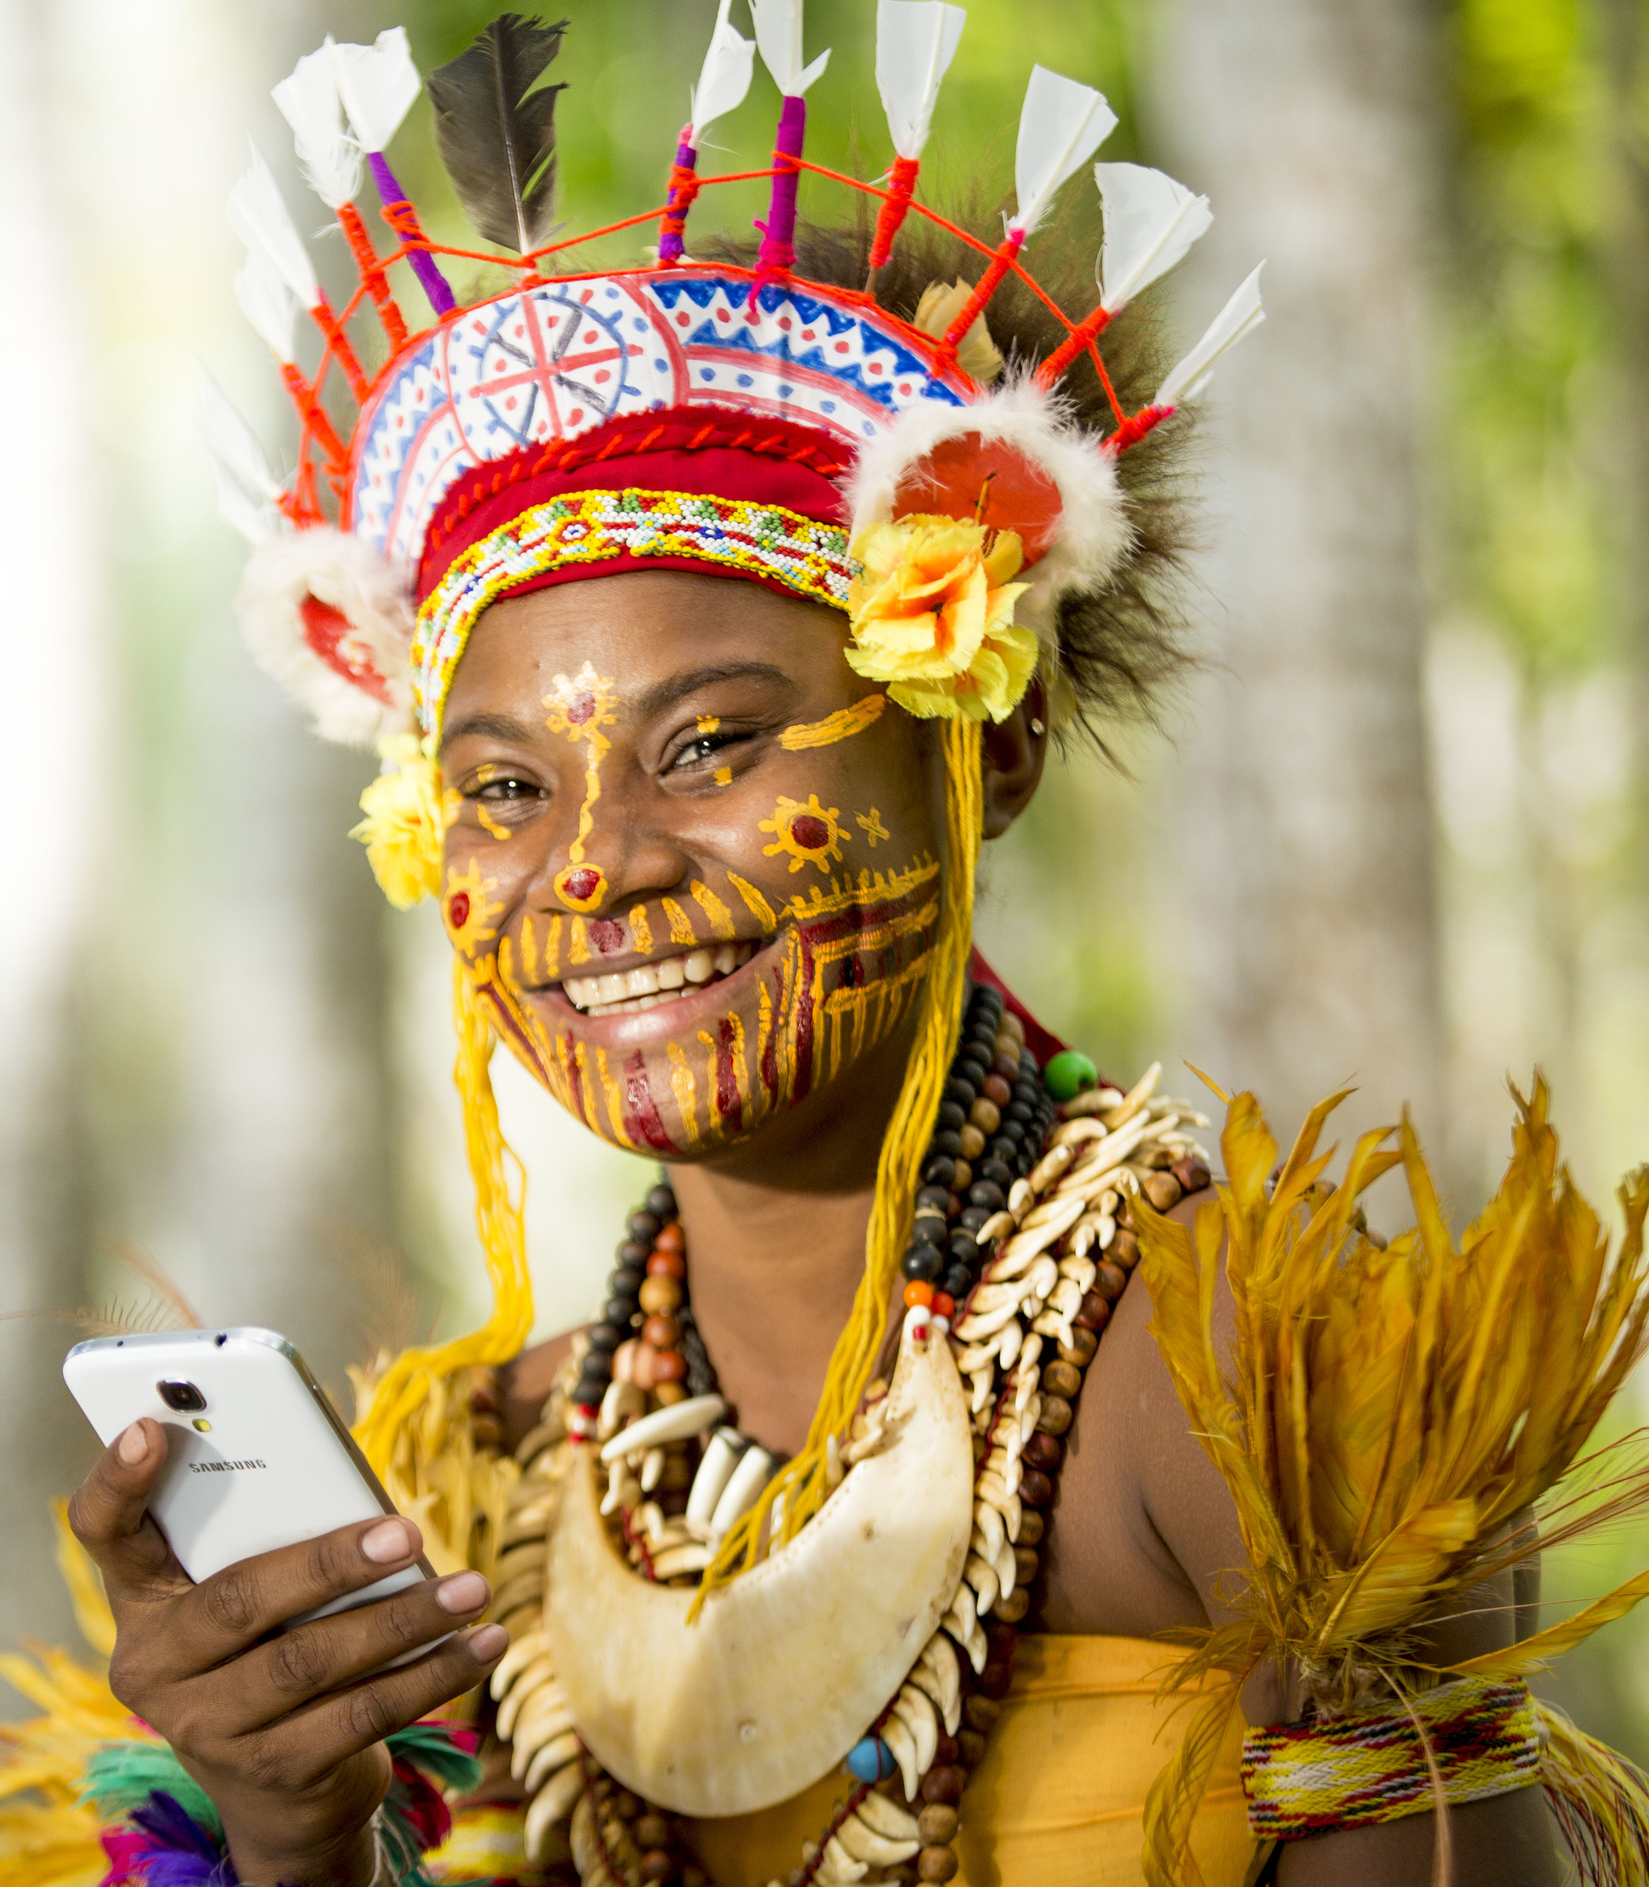
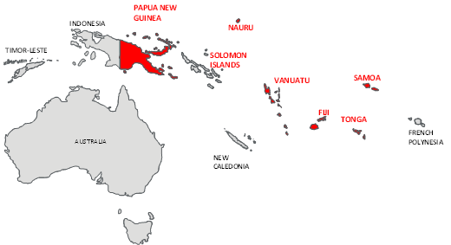
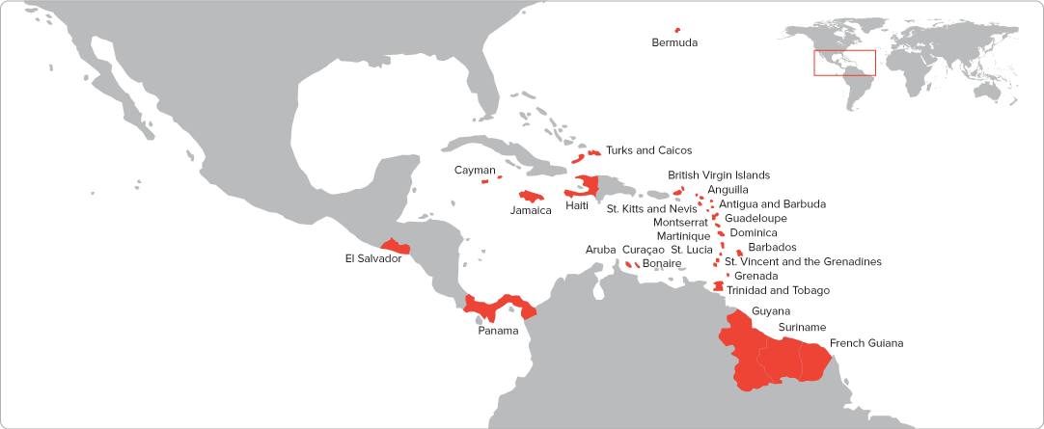
About Us
Caribbean, Central America & South Pacific
14m+ customers in 32 markets
Mobile, Fibre, TV, Content
Many countries are developing: low GDP, low ARPU
Limited fixed broadband penetration
Mobile broadband key to ubiquitous internet access
Shift online gathering pace

Slide 3
Digital Economy
Mobile Operators are the bridge for end users to access the digital world
Three key pillars:
Connectivity large increase in data usage and changes in data usage
costs are going up and revenues are down
deferrals or waivers of spectrum fees have been important part of the solution
Content increased demand for relevant content & local content
prioritisation : zero rating of official websites, Covid related websites and educational material
traffic management has been necessary in some cases
Commerce dramatic shift to online purchasing and home delivery of food & groceries
partnerships in food delivery, ecommerce and telehealth
ingenuity and value - companies that contribute locally
Digital economy is only possible for those who are online

Slide 4
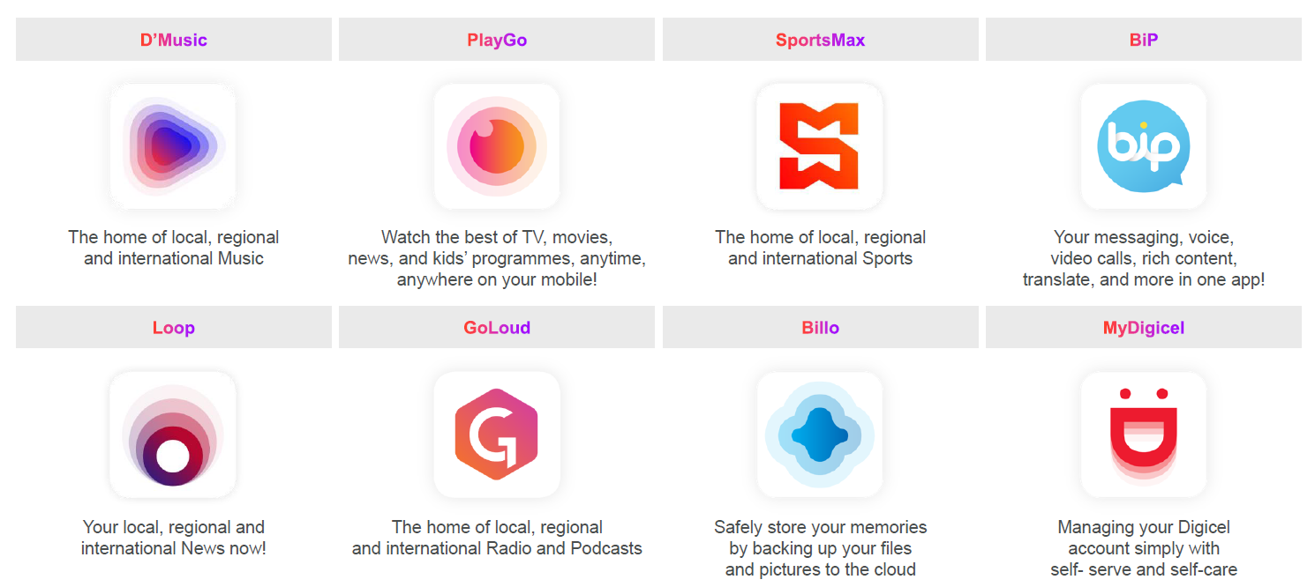
App Ecosystem

Slide 5
https://f.io/K9AOIXNz

Slide 6
Conclusion
A two speed digital world is now a reality
World Economic Forum Global Risks Report 2021:
  Internet usage ranges from more than 87% of the population in high-income countries to less than 17% in low-income countries.
  The digital exclusion of billions of workers worldwide increases the risk of “livelihood crises” and is likely to exacerbate “social cohesion erosion”.
  As other sectors struggle, the big technology players will likely emerge from the pandemic with stronger, more diverse revenue streams and enhanced investment power.
Disaggregation of infrastructure and services: connectivity, content and commerce are provided by different entities - not all services contribute to the cost of infrastructure.
UN Broadband Commission Working Group on 21st century - Report this year will set out proposals and recommendations towards closing the Broadband Gap.

Slide 7
Thank you

