Slide 1


Impact and Innovations
PRESENTED BY
Amber Ledgerwood
DATE
February 2021
SES Proprietary and Confidential

Slide 2



We make a difference
CORRELATED
SES CORE VALUES
We believe in content and connectivity everywhere
We provide cloud-enabled, satellite based intelligent connectivity
We are future proof powered by sustainable growth and innovation
We are passionate about customer experience and customer success
SES is a great place to work
Notes:
We work hard to ensure that impact is built into everything we do- the way we treat our employees, our customers, our partners,

Slide 3





Direct impact of our services
SDG 3: Good Health and Well being
Giving access to connectivity means bridging the information gap and empowering communities with increased access to telemedicine services and information for better health outcomes.
SDG 4: Quality Education
From broadcast education channels to trainings for workers in the field, our connectivity solutions enable people and societies to learn and develop at anytime, anywhere in the world.
SDG 8: Decent Work and Economic Growth
By improving access to education and remote health solutions and investments into regions, countries and businesses while respecting and upholding human rights in our own businesses and our supply chain, we support the implementation of decent work as defined by SDG 8.
SDG 9: Industry Innovation and Infrastructure
Through our innovation in Cloud, automation and virtualisation and the expected benefits for connectivity in poor and remote areas, we demonstrate the long-term potential of digital innovation while addressing the digital divide.
SDG 10: Reduce inequalities
Together with our partners, we bring content and connectivity to people and societies which were previously not connected to the world’s information, so they can contribute to a more equal world with more equal opportunities.
SDG 11: Sustainable cities and communities
Satellite connectivity adds to the resiliency of a community by providing additional connectivity option to rural areas or more resilient connectivity after a disaster.
Notes:
These are the specific SDGs our products and services influence

Slide 4
Innovations and trends
Cloud ​
Increased bandwidth, increased security
Community resiliency
Business models
Sustainability
​Technology Mix
Equipment requirements​
Partnerships
Notes:
Cloud based – We are seeing customers, including aid agencies, rurally located companies, governments going through a digital transformation- moving office applications and aid applications to the cloud- fundamentally changing their traffic patterns and impacting the way that we, as SES support these customers and the satellite technology we offer. They often will require lower latency services or a mix of multiple technologies- flexible, dynamically allocated bandwidth, scalable network requirements- use of SD WAN technologies
Increased bandwidth- similarly, when I started and worked with NGOs a 3Mbps link was sufficient. Now, they need more and demand where they are operating is growing- this is true for almost every project we work on
Community resiliency- COVID has reinforced what we already knew- that connected communities were more resilient to the effects of the pandemic. This goes beyond just a covid environment but connectivity can change the productivity of a community and the outcomes of their citizens. Likewise, even a connected community needs to consider their resiliency to disasters or pandemics and how they can scale or be sure they have continuity options in place.
Business models- something we are reflecting on and seeing change is the way in which customers are asking for services- developing new business models and innovating in this space- again scalable, flexible, dynamic
Sustainability- in all meaning of the word- how can this project be sustained beyond initial funding, how can we partner better to achieve that and sustainability in the impact on the environment sector- another area of work and a trend we see is how we can contribute to a greener internet- how can we contribute to the circular economy of ICT equipment and the sustainability of space.
Technology mix- In most of our deployments- no one technology saved the day- it was a partnership of multiple players. Understanding a few of the other trends- cloud, IoT, resiliency, sustainability and partnerships- this is about bringing the right mix to the table to make the biggest impact.
Equipment – long time coming but satellite technology is becoming smaller, easier to deploy- more innovations to come in this space but definitely a trend in our space.
Partnerships- None of these projects was possible on our own and often a combination of government, private sector players working together. We were especially successful and more capable to execute when we we had full support of the government there to knock down barriers. We have more, non-traditional partnerships than we once did.

Slide 5
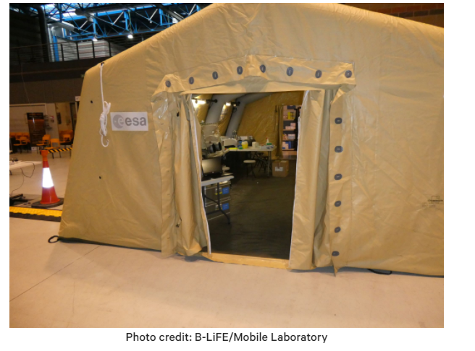
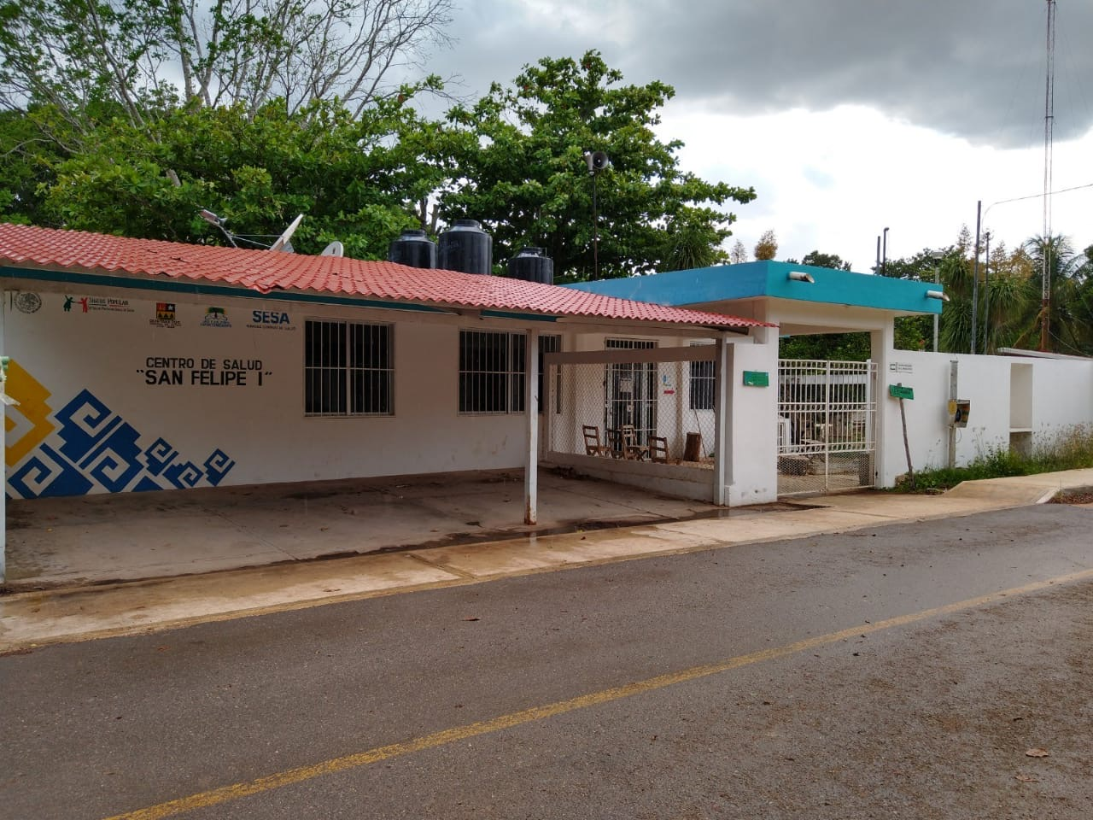
In action
Emergency.lu- An emergency communications platform established in 2012 and has supported emergency response deployments around the world since then. In 2020, SES provided critical communications to WFP (Nigeria, CAR), UNHCR (Niger, Chad Venezuela), and UNICEF (Venezuela, Syria) on the ground. This is a Public-Private-Partnership between the Luxembourg Government and three Luxembourg companies (SES, HITEC Luxembourg and Luxembourg Air Ambulance).
B-Life- Rapid deployment of satellite-enabled mobile Biological Light Fieldable Laboratory for Emergencies (“B-Life”) units to rapidly scale COVID-19 screening operations. Deployed to one of the worst-hit regions in Italy to support frontline medical staff, civil protection volunteers and police forces. In partnership with: ESA Space Solutions, Luxembourg Department of Defence, Universite Catholique de Louvain, Belgium Civil Protection
Mexico- Covid-19 support- Satellite network connecting 35 remote hospitals in Mexico to enable real-time telemedicine, pandemic-related data collection and monitoring of the COVID-19 infection curve. In partnership with: Mexico Secretariat of Health, Mexico Secretariat of Communications, Telecomm de Mexico
Colombian Amazon Covid-19 support- Expanded WiFi services within days to remote health centers in the Amazon to connect residents, as well as provide high-speed dedicated broadband service. Utilizing our O3b MEO service. In partnership with the Colombia Ministry of Telecommunications and SkyNet de Colombia
Notes:
Where are we seeing the trends:
Emergency.lu- equipment trends, partnerships, growing bandwidth, security requirements, new response tactics in disaster response,
B-Life- community resiliency, equipment trends- manpack terminal
Mexico and Colombian COVID 19 support- partnerships, community resiliency, growing bandwidth
rural connectivity- driving community resiliency

Slide 6
Connecting rural areas
https://vimeo.com/363746363

