Slide 1
MTN Group
ITU-D Tech Talks
February 2021

Slide 2
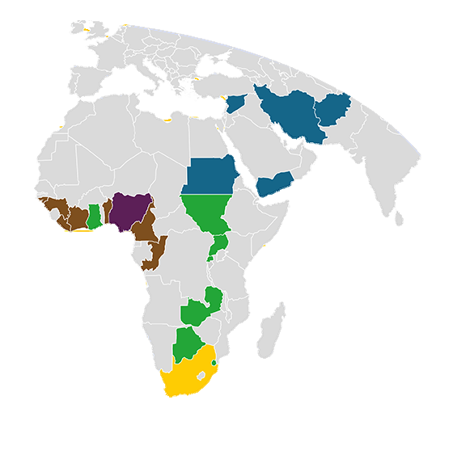
MTN at a glance
Who we are
Our vision
Our belief
Our ambition
To lead the delivery of a bold new digital world
Everyone deserves the benefit of a modern connected life
300m subscribers
200m active data users
100m digital and MoMo users
Annual service revenue of
R142 billion#
261 million subscribers
43,1%
EBITDA margin
102 million
active data users
+ 32,7%
Data revenue
~19k
employees
38 million
active MoMo users
+18,0%
Fintech revenue
Market cap
~R100 billion
#1 or #2 across 21 operations in Africa and the Middle East
Financial numbers at June 2020
# December 2019
Broad range of innovative products and services (Consumer, digital, enterprise, financial services)

Slide 3
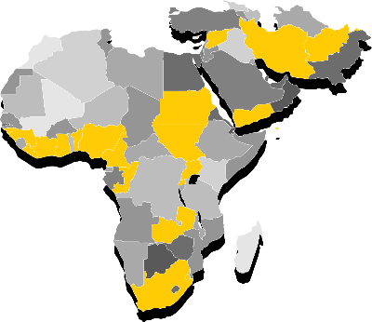
Our telco subsidiaries
Who we are
MTN Group
MTN
South Africa
MTN
Nigeria
SEAGHA
WECA
MENA
MTN
Ghana
MTN
Cameroon
MTN
Syria
MTN
Uganda
MTN
Ivory Coast
MTN
Yemen
MTN
Rwanda
MTN
Benin
MTN
Afghanistan
MTN
Zambia
MTN
Guinea-Conakry
MTN
Sudan
MTN
South Sudan
MTN
Guinea-Bissau
MTN
Congo-Brazzaville
Lonestar Cell
MTN Liberia
Numbers at December 2018

Slide 4







MTN’s ambition | building the Digital Operator
What we do
The evolving telco
The digital player
MTN
The Digital Operator
Voice
Data
Enterprise
Wholesale
Digital
Media, messaging
& mobile advertising
The fintech player
Strong
position in the right markets
Exciting demographic opportunity
Fintech
High growth MEA region
In 3 of 4 largest economies
Top two positions in all markets
Fast growing youthful population
Low data, fintech and digital adoption
Enterprise and wholesale opportunity
Transfers, payments, loans, deposits, insurance, marketplace
Attractive return profile
Well positioned for the long term
Demographics drive revenue
Efficiencies improve margins
Smart capex moderates investment
One network
One distribution
One registration
Portfolio optimisation
Sustainable leverage
Progressive dividend policy

Slide 5




Our BRIGHT strategy
What we do
Best customer experience
Returns and efficiency focus
Ignite commercial performance
Growth through data and digital
Hearts
and minds
Technology excellence
Lead market
in employee NPS
Improve employee engagement
Enhance reputation
Ensure effective risk and compliance practices
Lead market in network NPS
Increase efficiency of customer-facing systems
Increase population coverage
Improve network quality
Lead market in NPS
Reduce monthly churn
Achieve best brand in markets
Grow subscribers to 300 million
Grow market share
Ensure stable voice revenue
Grow enterprise and
wholesale revenue
Achieve
200 million data subscribers
Achieve
100 million digital subscriptions, including
60 million
for MTN Mobile Money
Improve ROIC
Report top- quartile TSR
Increase AFCF yield
Improve EBITDA margin
Voice
Enterprise
Wholesale
Data
Digital
Fintech

Slide 6
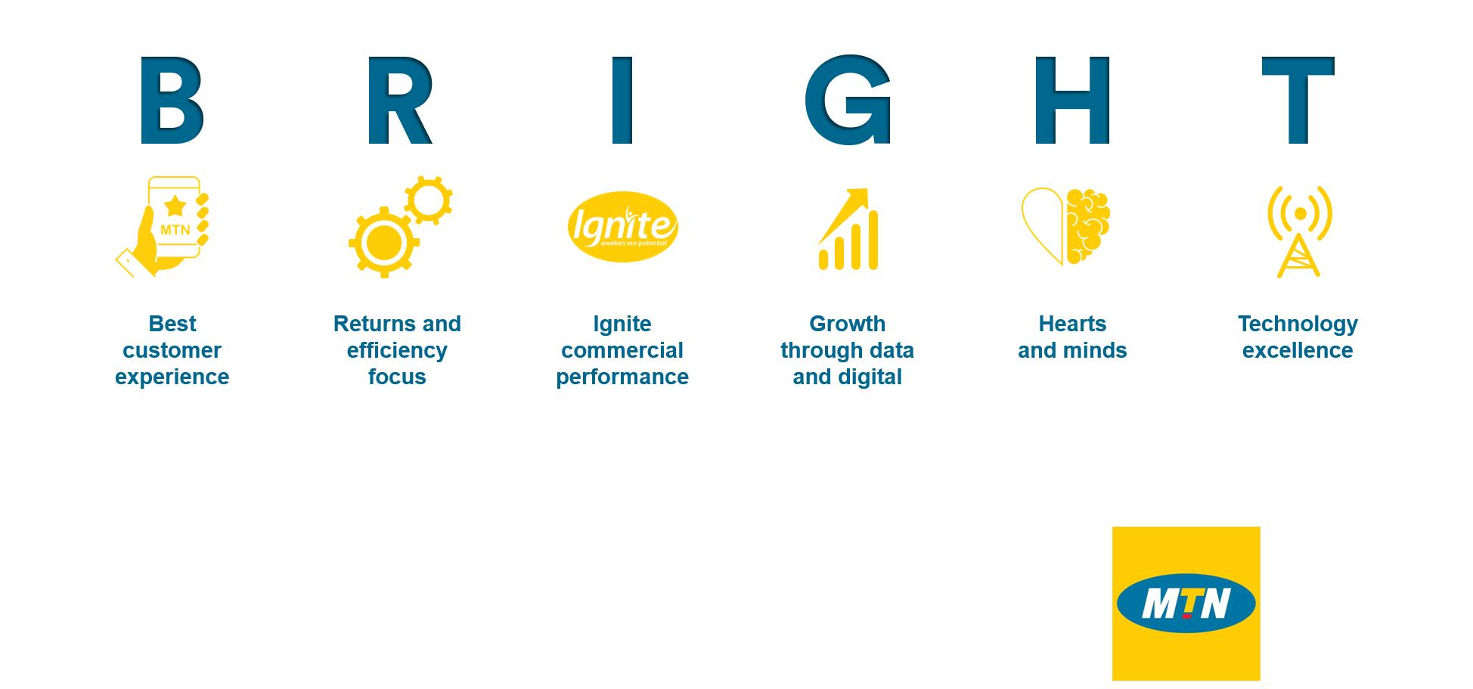
A resilient business model and compelling investment case
Strong
position in the right markets
Exciting
demographic opportunity
High growth MEA region
In 3 of 4 largest economies
Top two positions in all markets
Fast growing youthful population
Low data, fintech and digital adoption
Enterprise and wholesale opportunity
Clear strategy
Attractive
return profile
Well positioned
for the
long term
Demographics drive revenue
Efficiencies improve margins
Smart capex moderates investment
Portfolio optimisation
Sustainable leverage
Progressive dividend policy
Executed by a strong and experienced management team
Enhanced risk and regulatory framework

Slide 7


Focus on Environment, Social and Governance
Environment
Sustainable societies
Sound governance
28 889 tCo₂e
greenhouse
gases
saved/avoided
784 tonnes of
e-waste recycled/ safely disposed
80%
highest score for
sustainable employee engagement
2 m
URLs blocked containing child sexual abuse material
132 calls to
tip-offs anonymous
whistle-blower line
10 998 ethics
e-learning
completion by staff
22 m
GJ energy
consumption
638
renewable
energy sites
37% female employees
in workforce
1,9 million
total Corporate
Social Investment
Beneficiaries
1 857 Vendors
prequalified following due diligence process
74%* of Stakeholders say MTN adheres to good corporate governance
Sustainable economic value
251m, 95m, 35m subscribers, data and MoMo users respectively
517 000
mobile money agents
675 000
affordable low-cost smartphones distributed
39% reduction
in the group effective rate
per megabyte
1 387
rural sites
#GoodTogether
*Based on 2019 Reputation Index Survey
Numbers as at 31 December 2019
7

Slide 8


COVID-19 response
Y’ello Hope – cR1,8bn of value to our stakeholders through Y’ello Hope initiatives | Efforts need to be sustained
Customers
Government relief fund
Information & live updates on COVID-19
Stay in contact with friends & family
27,9m free P2P transactions
6 144TB of free data via Ayoba App
Support procurement of essential goods, unemployment & SMMEs
~ R44m donated
Governments & partners
Health system support
Information dissemination across citizens
Technological solutions for contact tracing
3,2bn Covid-19 government-initiated
SMS Africa Covid Communication & Information Platform
Strengthening health system through critical equipment & supplies
c450k PPE, sanitisers and equipment R40m total value of contribution
Schools & universities
Food security assistance
Enabling continued learning and access to vital learning material
108,6TB of zero-rated traffic to educational and school websites
Food assistance for vulnerable groups
c16k food packages
R7m total value of contribution

Slide 9
Enriching our relationship with the ITU
Sector Membership of MTN Group
Vice Chair of IAGDI-CRO
Participation in invited Fora
Need for overview of ITU activities
ITU Study Groups – ITU-D & ITU-R
Various ITU Conference – WRC-23, WSIS, WTDC, etc
SA and Nigeria scaling
Accelerate USSD to MoMo app
Rollout of advanced services
  Active Membership
  Need to Explore
  Fintech player
Active Participation
Regulating for digital technology
Evolution to digital operations & platforms -IoT, AI, Cloud,
Convergence – Fintech, Insurance
Telephony and digital gaps
Continued need for broadband connectivity
4G & 5G infrastructure
Protecting and Empowering the Emerging Digital Citizen:
  Data Privacy
  Cross border data flows
  Digital transformation
  Focus on Africa
  Digital Citizens
Technology Issues
Demand on network resources e.g. affordable spectrum,
CHASE - Coverage, Handsets, Affordability, Service Bundling, Education
Continued COVID-19 support – communications,
Connectivity
Multiple Taxation and Regulation
Simplify Regulatory processes e.g. Licensing
Functional approach to the digital ecosystem – Telcos//digital SPs
  Access & Affordability
  Focus on Africa
  Key Regulatory Concerns
Pandemic Issues

Slide 10
Evolution of Digital Regulation – Key Focus Areas
Adopt functional regulatory approaches across the whole digital ecosystem rather than just on Telcos and other ancillary licensees
Truly embrace service and technology neutrality in licensing regimes
Simplify and unify/de-fragment licences, permits and authorisations
Introduce interventions in partnership with the private sector that drive accessibility, affordability and digital literacy
Promote digital inclusion by encouraging the deployment of financial infrastructure and services
Positively promote cross border data flows such as the deployment of cloud and pan-African services that often pervade territorial boundaries
Promote healthy competition across multisided markets, platforms and services is key
Regulatory sandbox environments will greatly assist the development of novel digital and fintech services
The adoption of digital identity platforms will greatly facilitate the roll out of digital services compliance as well as promote compliance with mobile money AML and CFT obligations
Operators should be allowed to monetise customer deposits to broaden the service offerings provided to consumer at affordable rates
Need for smart, flexible and pragmatic data privacy and protection frameworks in African countries which blend “local national law, traditions and culture” with “existing international norms and data privacy frameworks”
Need to see the convergence of policy portfolios and regulatory responsibilities or the creation of empowered digital economy/transformation committees
Need for continuing relief from fees and regulatory obligations to enable operators deliver the requisite infrastructure and services for digital transformation
Need broadband policies with sufficient incentives, funding and PPP arrangements to mitigate the rigours of network rollout particularly in unserved and underserved areas

Slide 11



Thank you

