Slide 1

Trends in Networks
Yves Bellégo
February 18th 2021
ITU-D Tech Talk

Slide 2

what is the first service
that our customers value ?

Slide 3

reachability

Slide 4
what is the max user throughput we shall deliver to our customers ?

Slide 5
more

Slide 6
what is the killer app for new technologies (5G, FTTH, …) ?

Slide 7
Will be invented after

Slide 8
lessons learned and trends in networks

Slide 9
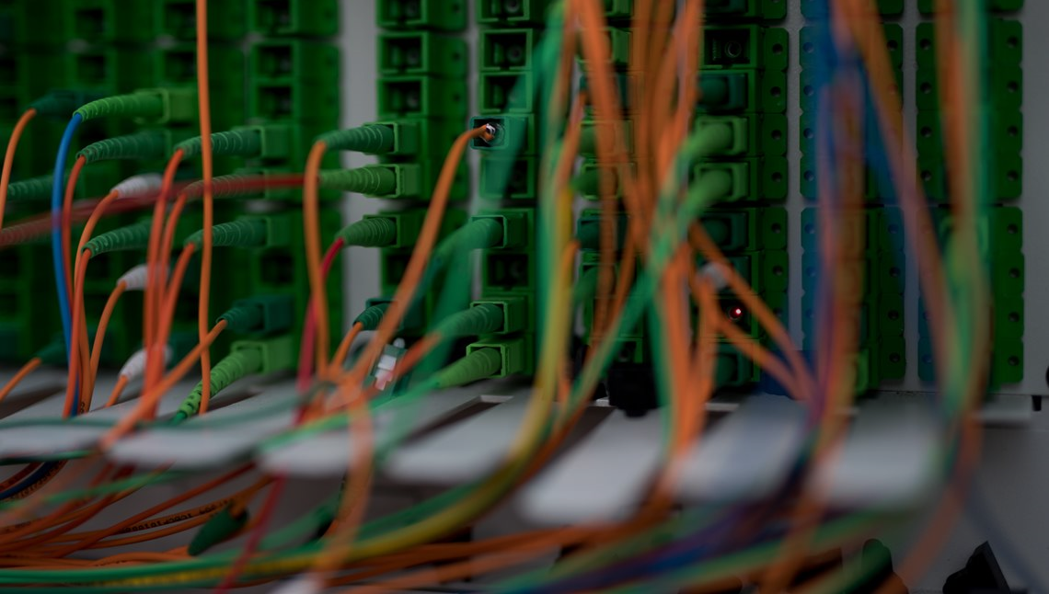
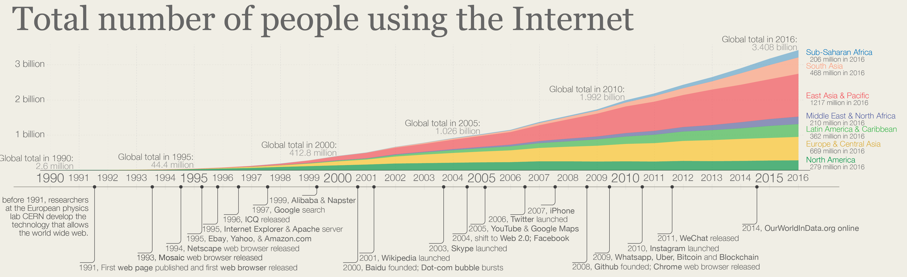

Global solutions
interconnection and interoperability
economies of scale

Slide 10

Technology improvement
Demand for broadband connectivity
Traffic growth
OVUM forecasts
Eastern Europe

Slide 11

moving to software
security concerns
green and responsible

Slide 12
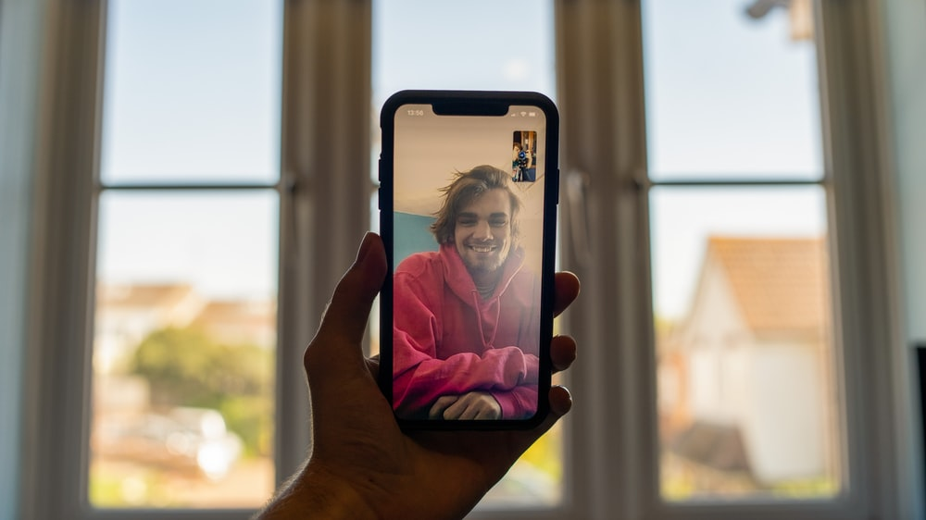
Thank
you !

