Slide 1

TECH TALKS
Interactive Information Session
Rural broadband connectivity with Hughes’ Community Wi-Fi
Fernando Carrillo

Slide 2
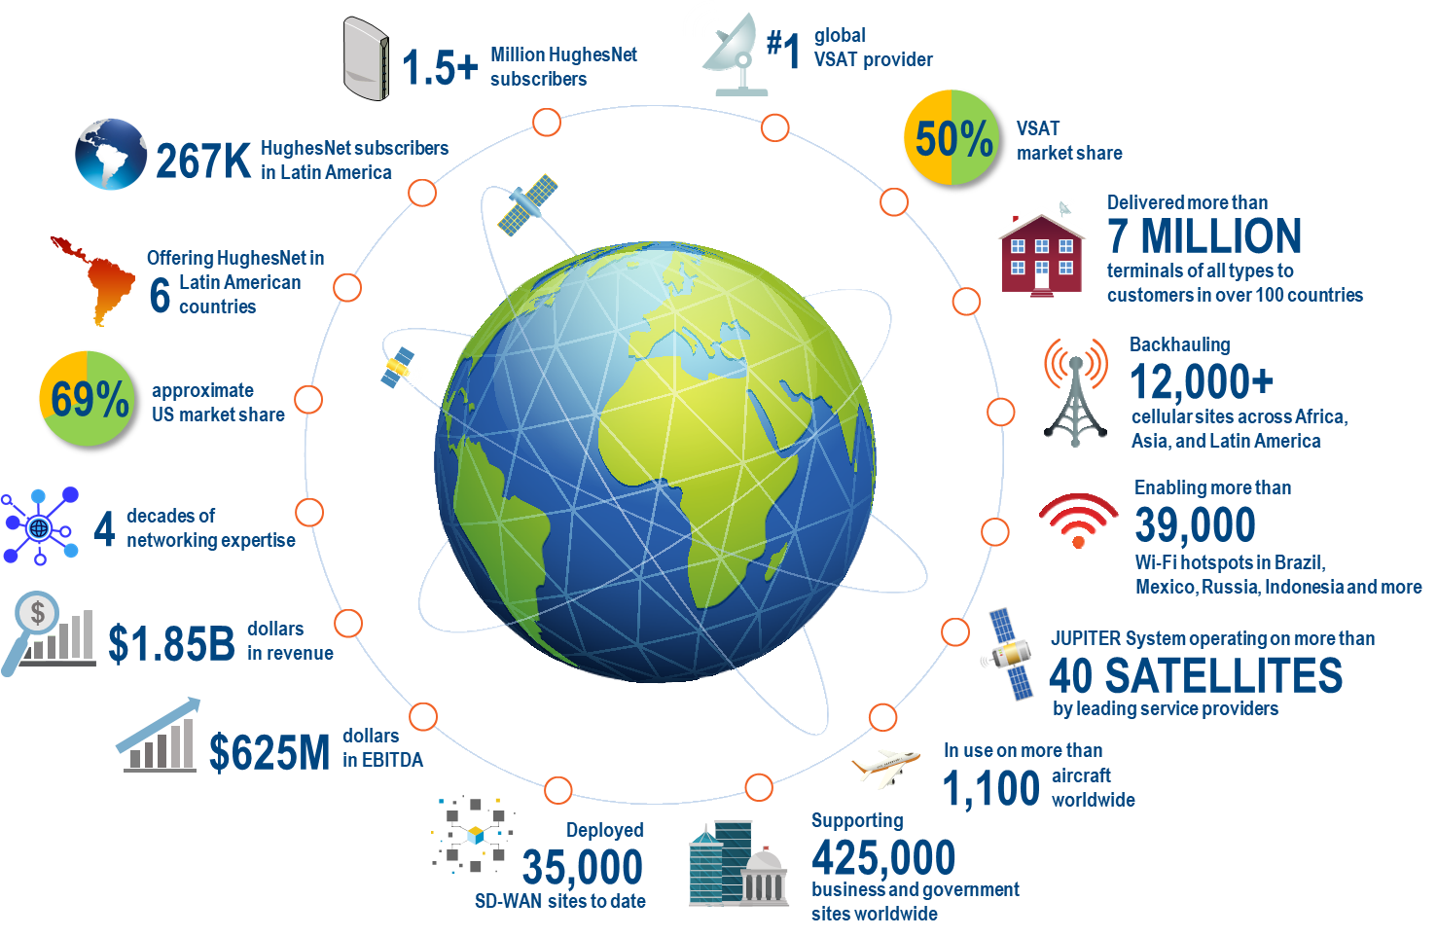
Hughes at a glance
HughesNet®, our flagship high-speed satellite Internet service, is #1 in the marketplace with subscribers in the Americas.
HughesON® managed network solutions are the choice of enterprises and governments on 5 continents.
Hughes enables more than 32k hotspots for Community Wi-Fi in rural areas around the world.

Slide 3


Internet access direct to consumers
, our flagship high-speed satellite Internet service, is the World’s Largest Satellite Internet Service directly to consumers.
1.5 million
  Residential and SMB subscribers
Ranked #1
  By FCC among all ISPs in delivering advertised download speeds 4 years in a row
~69% US market share
  Offering service in Brazil, Chile, Colombia, Ecuador, Mexico, and Peru

Slide 4
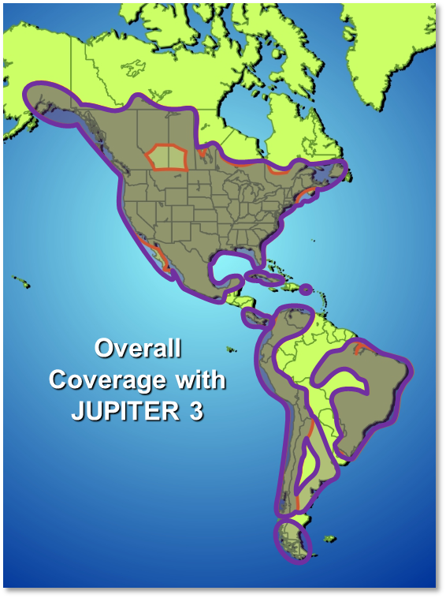
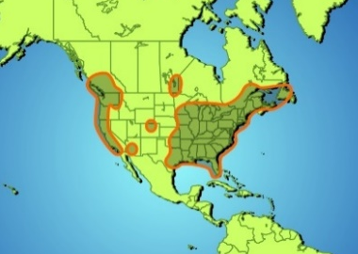
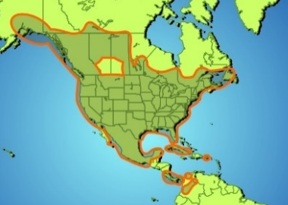
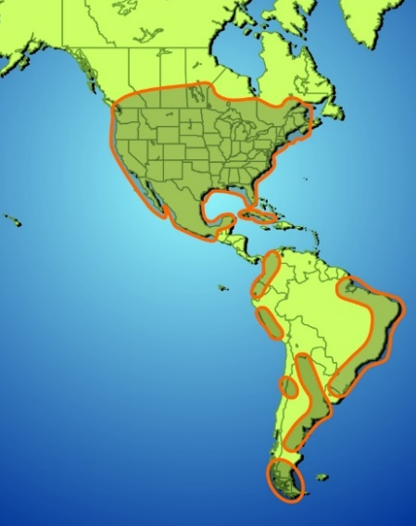
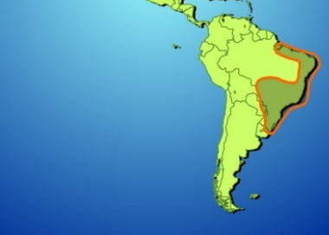

Hughes’ Satellite broadband coverage
With its current fleet of High Throughput Satellites (HTS), Hughes delivers more than 400 Gbps of capacity in the Americas.
Hughes is completing construction of JUPITER 3, a U.S. satellite, which will bring speeds of 100 Mbps across the continental United States, as well as Canada, Mexico, Colombia, Ecuador, Peru, Brazil and Argentina.
With JUPITER 3, the Hughes fleet will reach 80% of the population in the
Americas with 50+ gateways in operation with speeds of 100 Mbps.
JUPITER 1
JUPITER 2
Hughes 65 West
(E65WA)
Hughes 63 West
(T19V)
JUPITER 3

Slide 5
Hughes service presence in LATAM
Costa Rica/Panama
Mexico
Through Partners
HughesNet
Through Partners
Community WiFi
Brazil
Colombia
HughesNet
Community WiFi
HughesNet
Community WiFi
Ecuador
Argentina
HughesNet
Through Partners
Chile
Peru
HughesNet
Community WiFi
HughesNet
Community WiFi

Slide 6
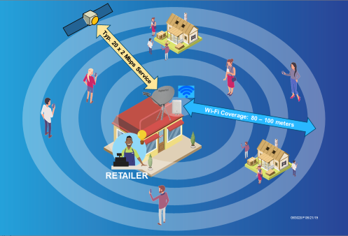
Satellite Enabled Community Wi-Fi
Broadband internet is not available everywhere, and even when available it may not be affordable for many users.
Satellite Enabled Community Wi-Fi offers internet speeds of 10-20+ Mbps anywhere within the satellite coverage.
Users can buy pre-paid data to use through a local Wi-Fi hotspot Access Point in affordable bite size chunks.

Slide 7

Hughes Express Wi-Fi by Facebook Ecosystem
FB XWF Platform
HW + Capacity + Operations
In-Country Partner
Retailer
XWF service is over-the-top of VSAT connectivity
XWF manages APs, Retailers, Users, data packs
Tracks Wi-Fi usage by duration and volume
HW: VSAT, Wi-Fi AP
Satellite connectivity
Operate the Wi-Fi Service platform
Tier-2 VSAT + XWF Support
Can be the VSAT/Wi-Fi Service Provider or another partner
Identifies and signs up Retailers
Installs, maintains Wi-Fi kit
Helps Collect revenue from Retailers and pays Service Provider
Tier-1 Support for VSAT and XWF
Prepays for data packs
Sells data packs to users
Facebook Express Wi-Fi (XWF) Service Platform
AP
Internet
End-Users
Buys data packs
Uses Internet
Wi-Fi Service Mgt. as XPP – XWF Partner Portal
VSAT Service Delivery System

Slide 8
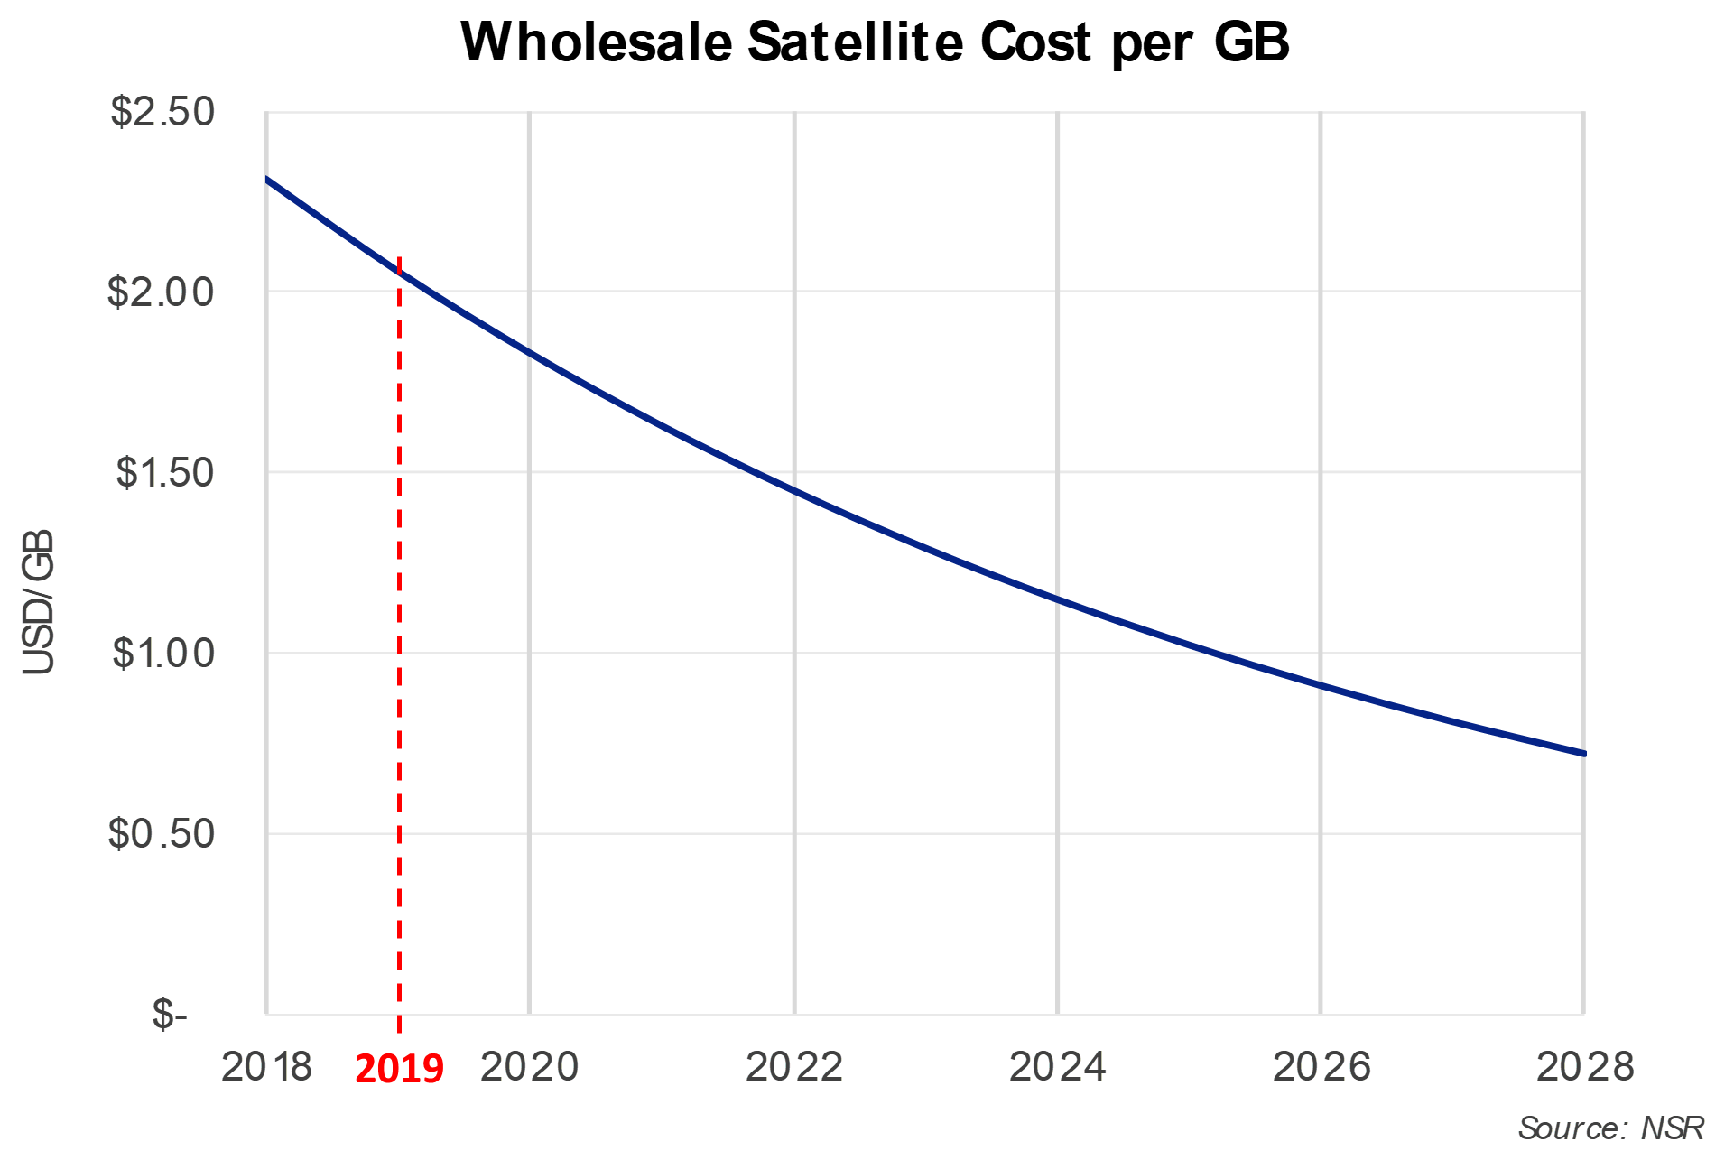
Satellite Enabled Community Wi-Fi
HTS Capacity => Cost Effective Wi-Fi Service
  VSAT consumer internet can cost $50/mo. for 10 GB plans, but the market at this price is limited to higher income households
Satellite Enabled Wi-Fi offers internet speeds of 10-20+ Mbps everywhere through a local Wi-Fi hotspot Access Point
Users buy pre-paid data packs, starting under $1 USD for 200Mbyte of data.
Considering a global average cost per GB for mobile packages of $8.53 USD/GB, retail satellite Wi-Fi service can be price and speed competitive and offered everywhere.
$2.31 USD/GB*
USD/GB
* At current satellite capacity prices and considering a 6-hour busy period.

Slide 9
Example of Data Packs and App Data Usage
Even a 100 MB Data Pack can support multiple WhatsApp or Skype calls!

Slide 10
Study Cases

Slide 11
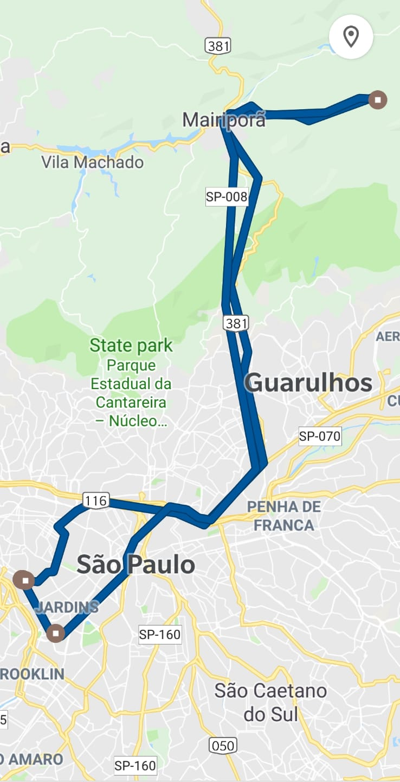
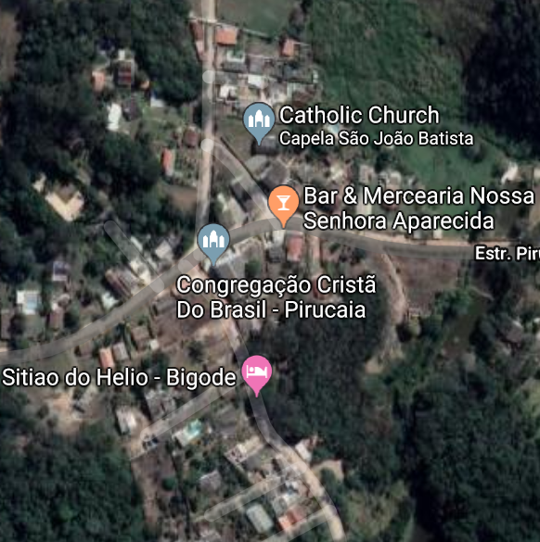
Case Study: Town of Pirucaia, Brasil
62 km from Sao Paulo, 90 min. drive
Approx. WiFi Service Range
Retailer with VSAT/AP
Pirucaia
About 35 homes
120 people
2 HughesNet Consumer Customers
Health Clinic
Two HughesNet Clients
Heavy WiFi user

Slide 12
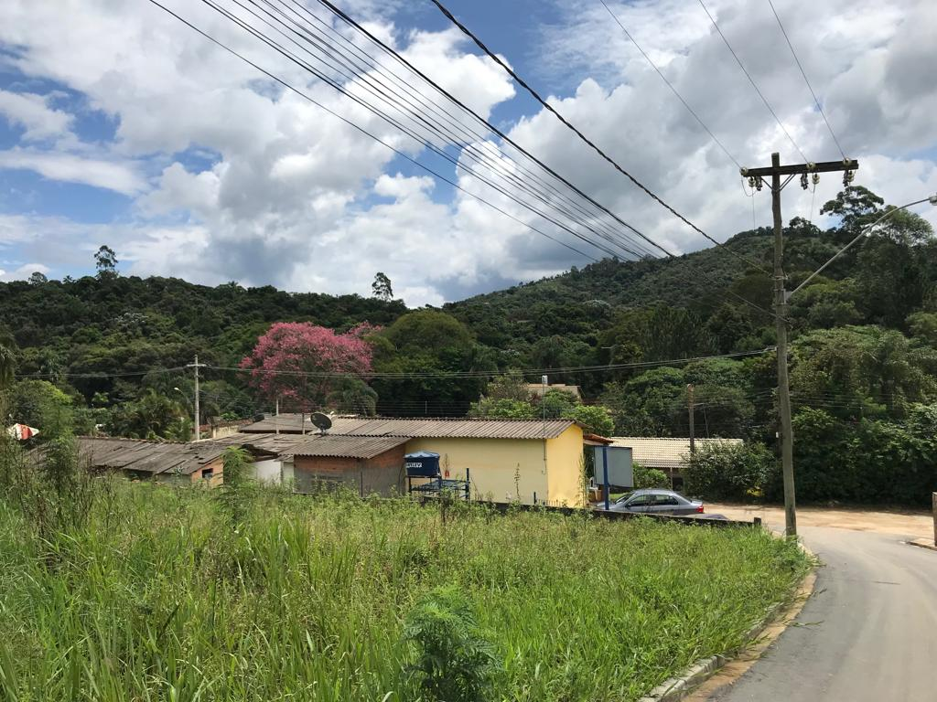
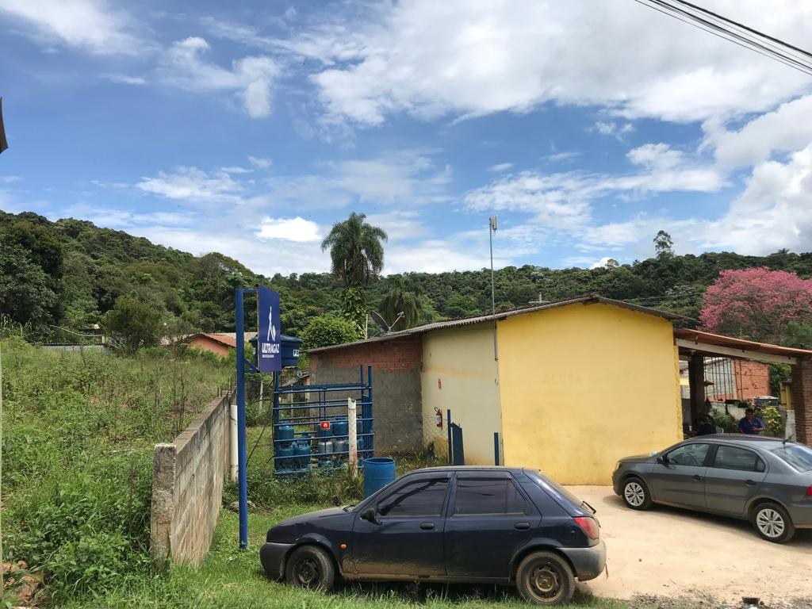
Retailer Site
Cambium Access Point
VSAT

Slide 13
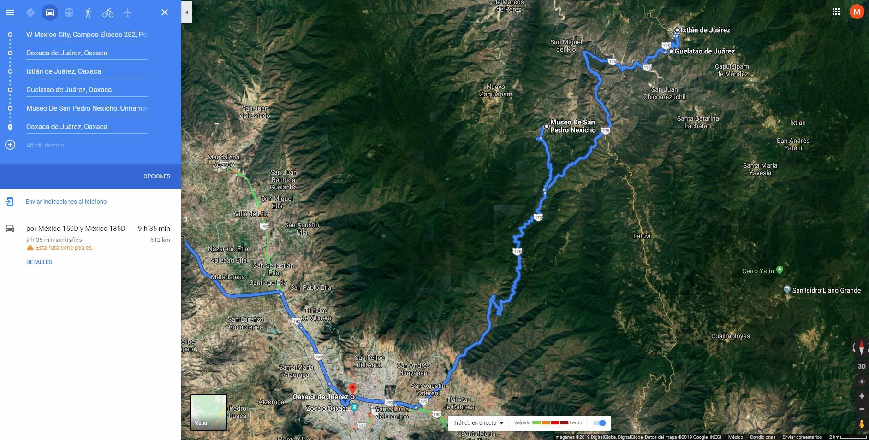
Case Study: Retail Sites in Oaxaca State, Mexico
Site 1
Site 2
Site 3

Slide 14
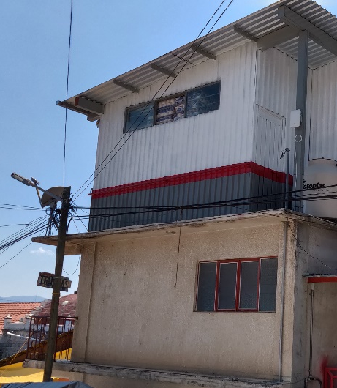
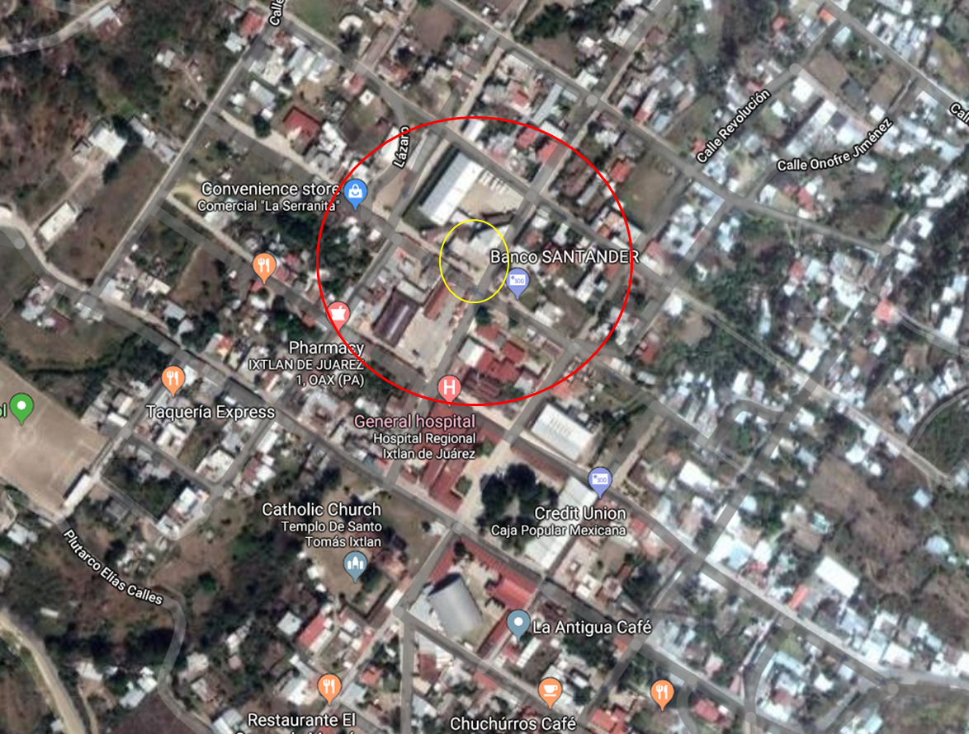
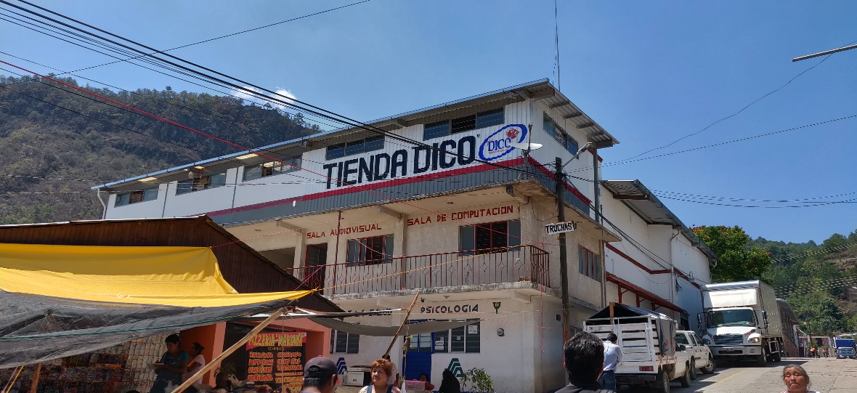
Oaxaca Site #1: Ixtlan de Juarez
There are 9k-10k people in the town
  300 store customers daily / 70,000 MXN in sales per day
  600-700 customers on Mondays
There is 3G in town, no 4G
Good customer experience with download up to 12 Mbps from XWF

Slide 15
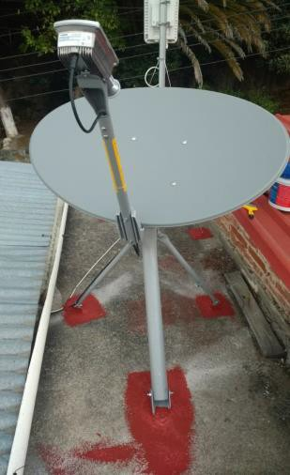
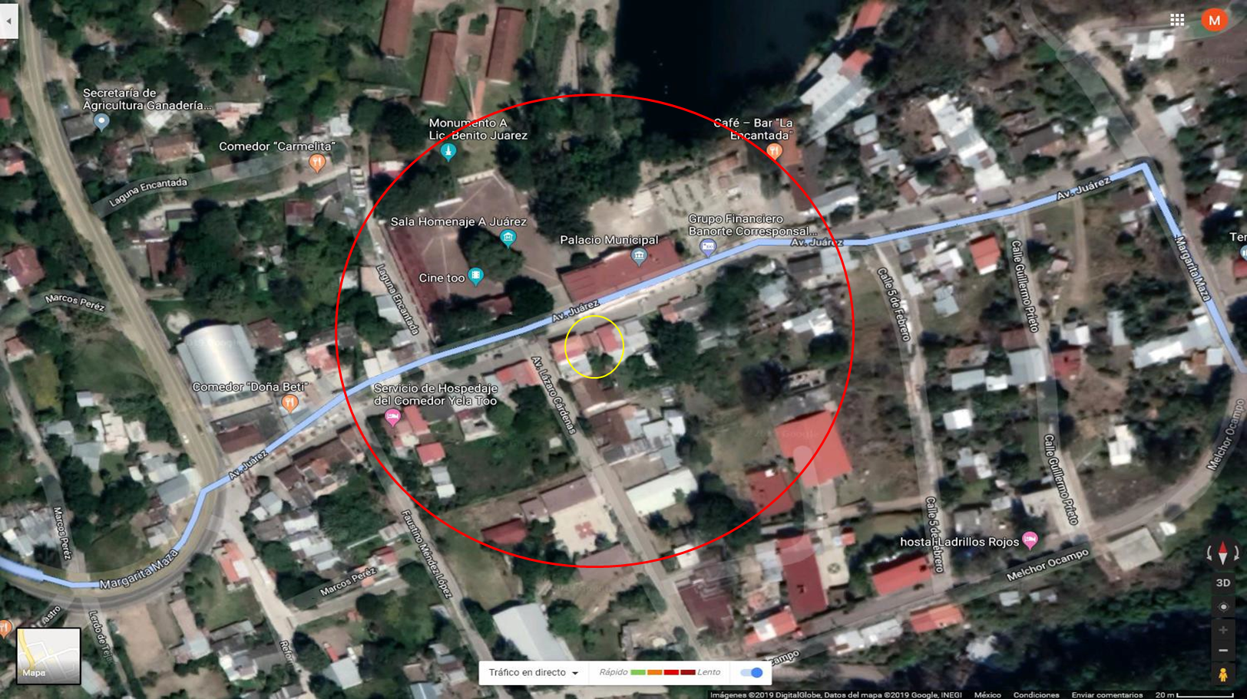
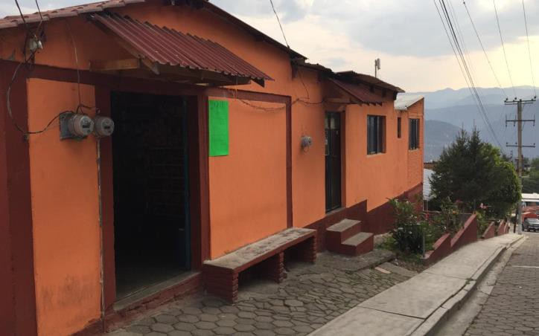
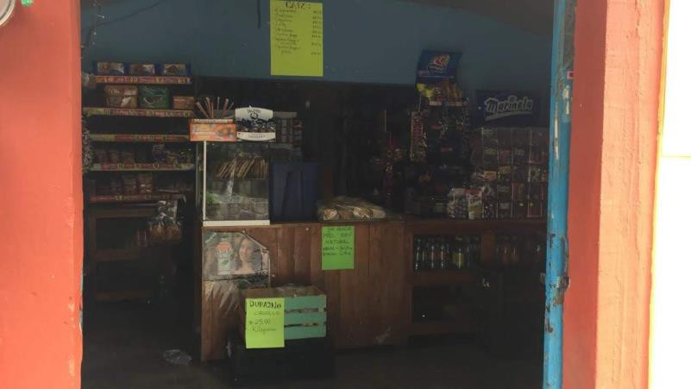
Site #2: Guelatao-de-Juárez
Private store across the street from Benito Juarez Memorial Park
100 customers per day, more during the tourist season
Excellent Wi-Fi throughput speeds on VSAT (>10 Mbps)
16 H00000 5/19/2019

Slide 16
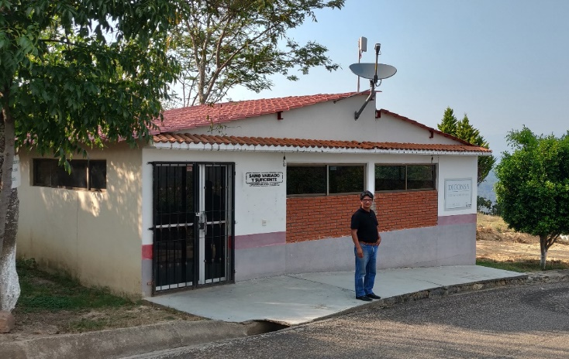
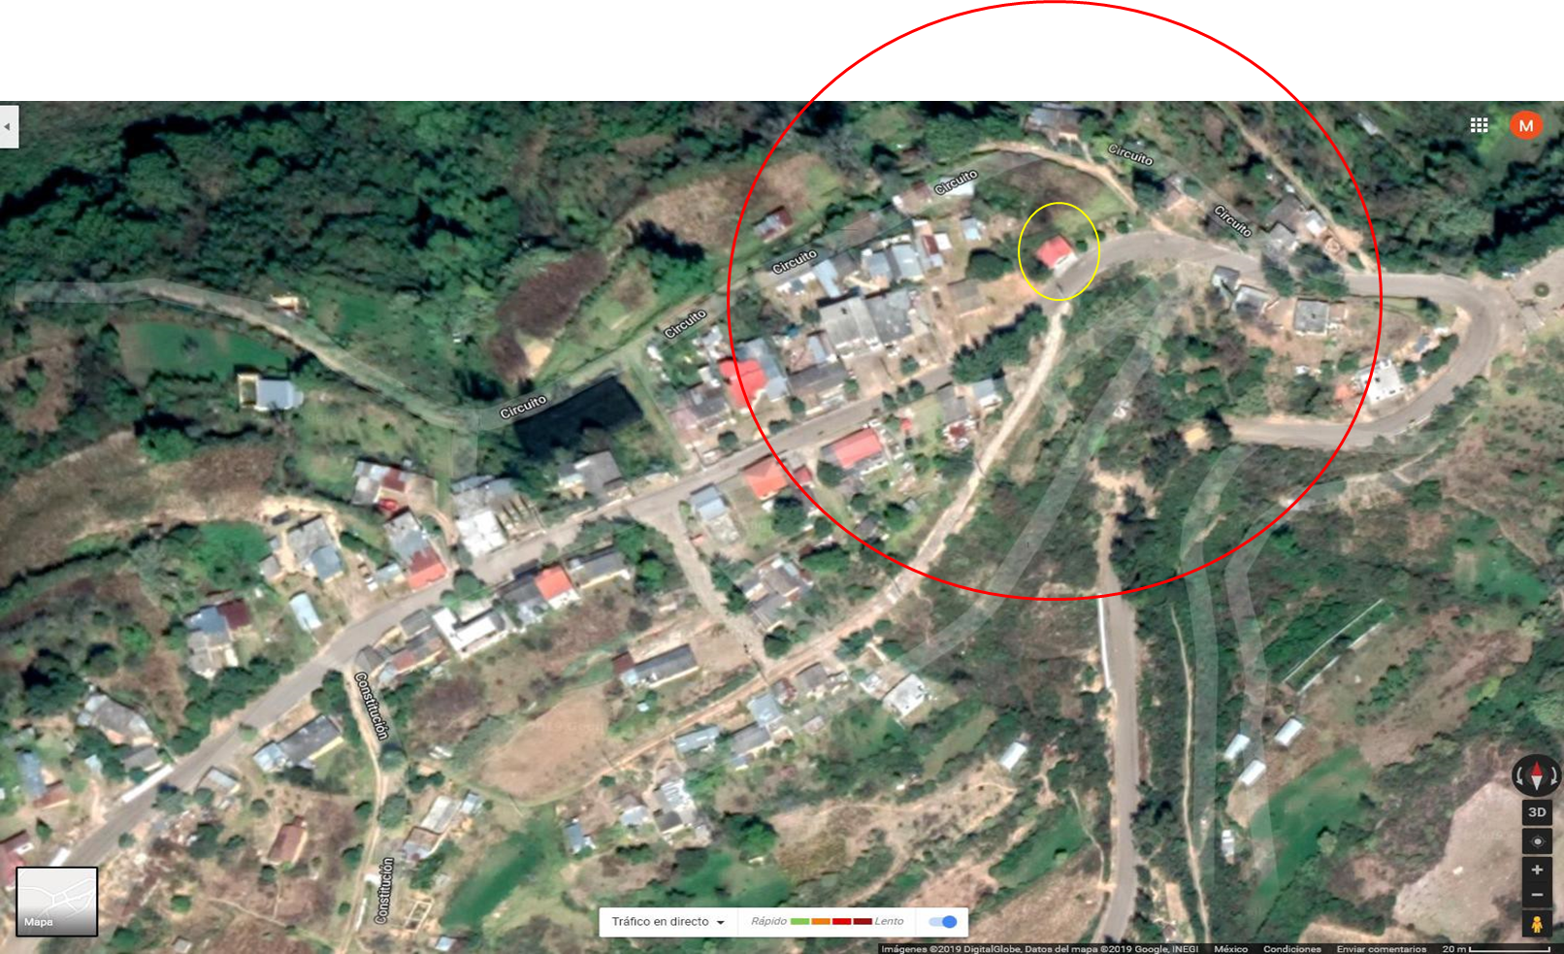
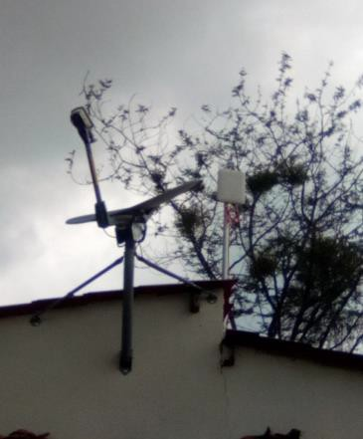
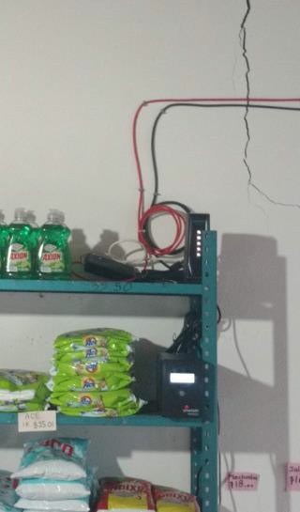
Site #3: San-Pedro-Nexicho
300 people in town; 30-35 people per day come to shop
For banking or purchases, people have to make a round Trip from Nexhicho to Ixtlan for $120 MXP plus + half day spent
Retailer estimates selling 15 data packets each day
Range ~100m

Slide 17
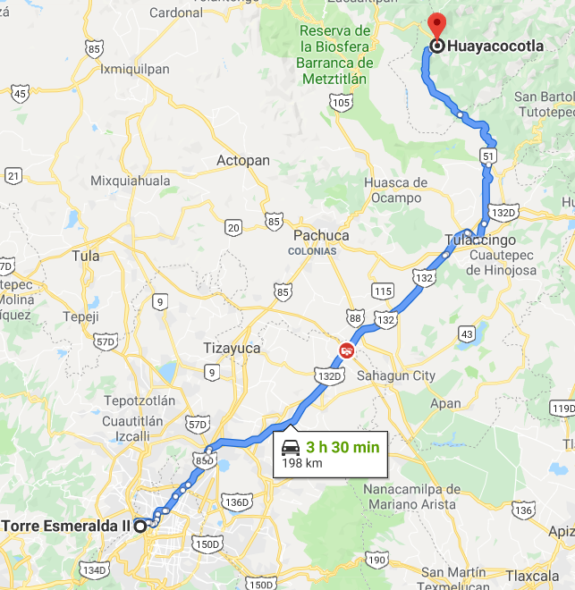
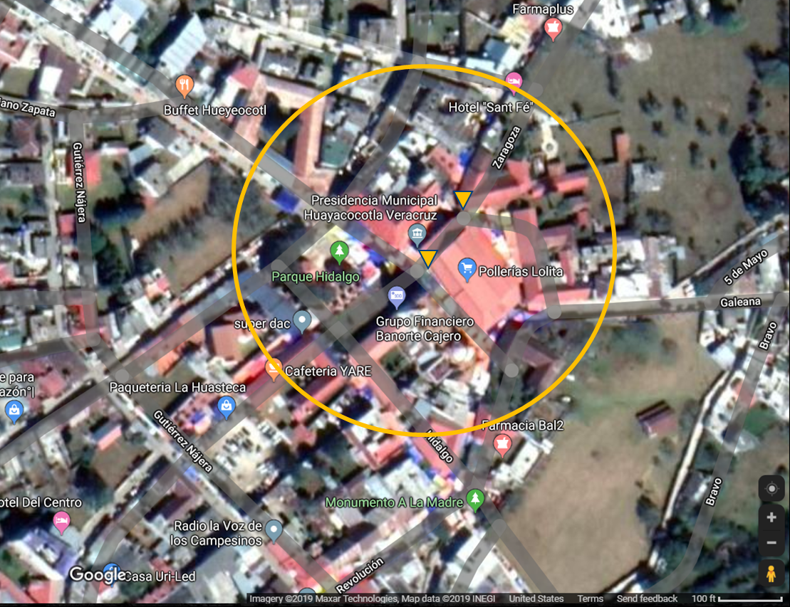
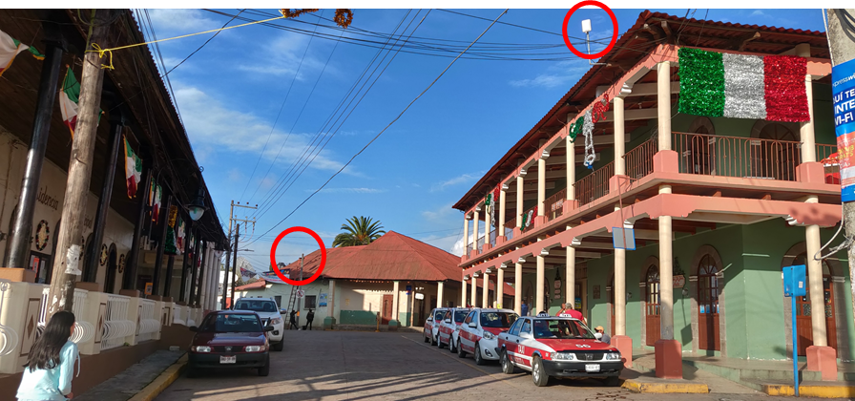

Case Study: Retail Site in Vera Cruz State, Mexico
Retailer Site: local Cable TV company
  Town has ~ 20,000 people
  Installation is in Town Square
  One VSAT with two APs installed

