Slide 1


Smart Village-in-a-Box
Albie Bester | Intelsat
February 2021

Slide 2

Education is the basis for social and economic development. For Africa, a skilled workforce that utilizes ICTs effectively is a key factor in determining its competitiveness in the global digital economy and for harnessing its natural resources for sustainable growth.
Internet Society — Internet for Education in Africa

Slide 3
Connecting Rural Communities
Integrating technologies and concepts to deliver a complete solution
Challenges
Terrestrial network reach
  Centered around densely populated areas
Availability of grid power
  Unreliable or not available
Time to implement
  Construction, trenching, regulatory approval
Connectivity cost
  Dedicated connectivity per site
  Same information downloaded multiple times
Solution
Intelsat network
  Fleet of satellites cover 99% of the earth's populated regions
Renewable power
  Solar, wind powered platforms
  Low power consumption equipment
Time to implement
  Satellite coverage already in place
  Site equipment deployed in 1-2 days
Shared and common connectivity
  Pool of satellite capacity shared among the sites
  Multicasting common data to cashing servers

Slide 4












The satellite capacity allocated to the sites will be presented and managed as a pool of capacity. This allows for the most efficient use since resources will be allocated where it is needed most.
Intelsat Satellite
Satellite multicast systems deliver content to a group of users using a single transmit operation saving network capacity and reducing server requirements
Internet
Solar Power
Hub & Teleport
Solar Power
Site Antenna
Site Antenna
VSAT Modem
VSAT Modem
SupaBRCK Micro Server
SupaBRCK Micro Server
Caching and content Sync
Wi-Fi Access Point/s
Wi-Fi Access Point/s
Syncing content changes made on cloud with the local cashing servers.
The objective is to extract packages of content that capture updates (e.g., new multimedia content for a course on Moodle) and send it to all village servers via multicast
Wi-Fi Enabled Device
Wi-Fi Enabled Device
Wi-Fi Enabled Device
Wi-Fi Enabled Device
Wi-Fi Enabled Device
Wi-Fi Enabled Device
Wi-Fi Hotspot
Wi-Fi Hotspot

Slide 5
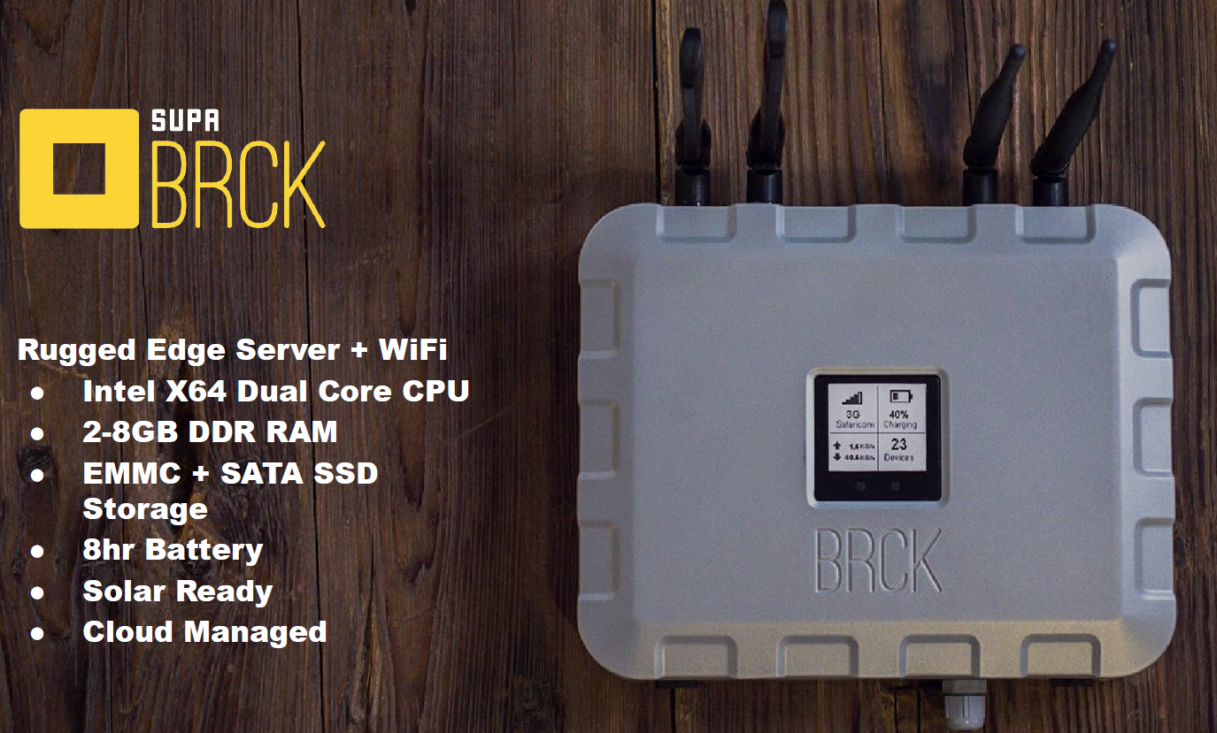
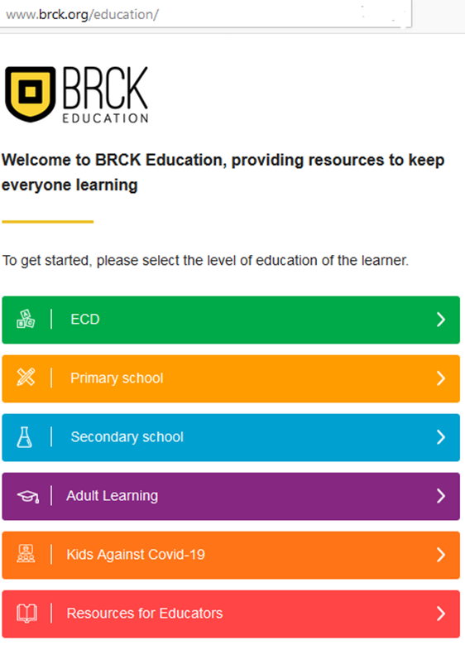


BRCK
Making the internet accessible to everyone and providing the tools to take advantage of the digital economy

Slide 6
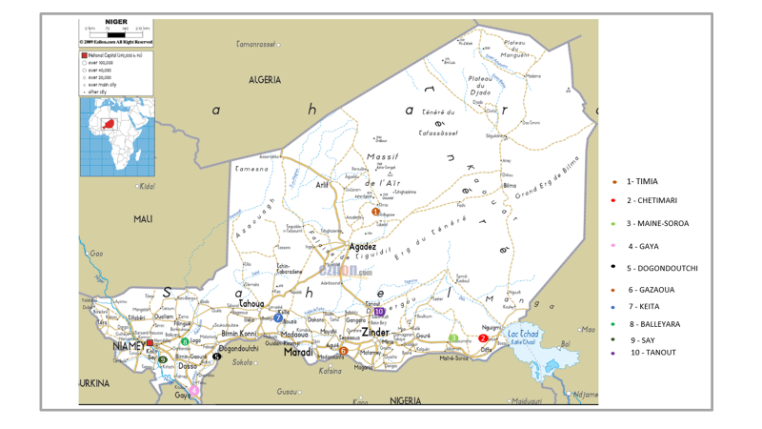
Niger – Smart Villages Pilot Project
ANSI has identified the 10 villages for the broadband pilot.
ITU-D has introduced the Smart Village-in-a-Box concept.
SupaBRCK platform will provide on-site content cashing and other user management services.
Intelsat satellite services will connect the villages

Slide 7
Albie Bester
Albie.Bester@intelsat.com

