Slide 1
WSIS+10 High-Level Event 10-13 June 2014 (9 June – Pre-Events) ITU Headquarters, Geneva
4th Meeting of the Multistakeholder Preparatory Platform
14 April 2014, ITU Headquarters

Slide 3
WSIS Overall Review: Background
The World Summit on the Information Society (WSIS) Outcome Documents and the UN General Assembly Resolution 60/252 resolved to conduct an overall review of the implementation of the Summit outcomes in 2015.
The modalities for the Overall Review were discussed at the 68th Session of the UN General Assembly. Modalities are expected to be finalized by end of March 2014.
Following the guidance of its Membership (PP-10 Resolution 172 and ITU Council Resolution 1334 (Mod. 2013)), ITU has initiated the preparatory process leading towards the WSIS+10 High-Level Event to be held in 2014.

Slide 4
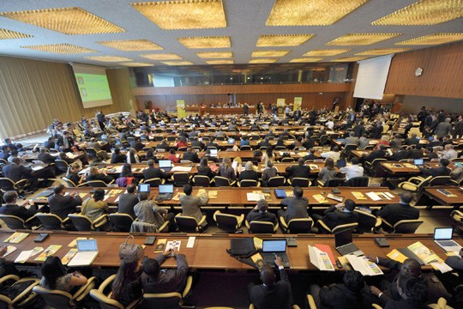
WSIS Overall Review: Background
WSIS Forum 2012 and 2013, and the WSIS+10 Vision Challenge led towards elaboration of the work plan on the WSIS+10 process endorsed by the WSIS stakeholders as well as 32 UN Agencies, members of the UN Group on the Information Society.
Moreover templates for the 10 years implementation reports of Action Lines and Member States have been endorsed through a multistakeholder consensus.

Slide 5
Council Resolution 1334 (MOD. 2013) WSIS+10 High Level Event
The WSIS+10 High-Level Event will be an extended version of the WSIS Forum to:
WSIS+10 High Level Track
address the progress made in the implementation of the WSIS outcomes related to the WSIS Action Lines under mandates of the participating agencies
WSIS Forum Track
provide a platform for multi-stakeholder coordination of the implementation of the WSIS outcomes, with involvement and participation of all WSIS action line facilitators, other UN agencies and all WSIS stakeholders.

Slide 6
Objectives
The WSIS+10 High-Level Event will review the WSIS Outcomes (2003 and 2005), in particular, related to the Action Lines with a view to developing proposals on a new vision beyond 2015, potentially also exploring new targets.
The meeting will be organized taking into account decisions of the 68th Session of the UN General Assembly (negotiations on modalities started on 23 October 20013)

Slide 7
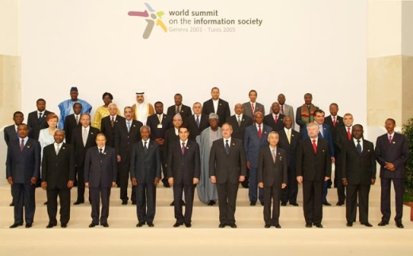
WSIS+10 High-Level Event: Expected Outcomes
1) WSIS+10 Statement on Implementation of WSIS Outcomes
2) WSIS+10 Vision for WSIS Beyond 2015 under mandates of the participating agencies

Slide 8
Preparatory Process for WSIS+10 High-Level Event as an extended version of WSIS Forum
Coordination Mechanism of Co-Organizers and WSIS Action Line Facilitators ITU, UNESCO, UNCTAD, UNDP, WHO, WIPO, DESA, ILO, ITC, UPU, UN Women, UN Regional Commissions, CSTD Secretariat
WSIS+10-MPP to Elaborate Outcome Documents
Open Consultation on Format and Thematic Focus

Slide 9
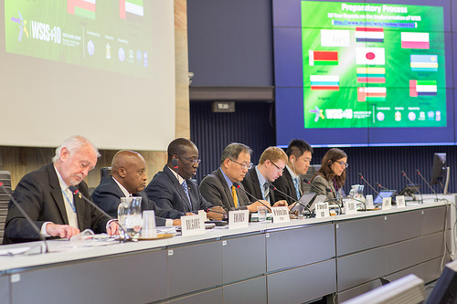
Preparatory Process (Multistakeholder Preparatory Platform)
Phase One: July 2013 - Initiation of the Open Consultation Process
Phase Two: 7-8 October 2013 - First Physical Meeting
Phase Three: 16-18 December 2013 – Second Physical Meeting
Phase Four: 17-18 February 2014 - Third Physical Meeting: 1st reading of all Action lines completed.
Phase Five: 14-17 April 2014 - Fourth Physical Meeting, ITU Headquarters, Geneva
Phase Six: 28-31 May 2014 - Fifth Physical Meeting (pending decision of the Fourth Physical Meeting
Briefing: 19 May 2014 – Geneva

Slide 10
Update on the WSIS+10 High-level Event: Statement and Vision
Progress of Drafts: Zero Draft, 1st Draft, 1st Reading
Three Physical meetings held till date attended by more than 160 participants per meeting.
More than ~450 contributions processed
The commitment of Governments, Private Sector, Civil Society and UN Agencies is immense
All UN Agencies that have a mandate in WSIS (ITU, UNESCO, UNCTAD, UNDP, WHO, ILO, UNDESA, ITC, UPU, WMO, UNEP, WIPO, UN Women and Regional Commissions) are contributing to the development of the Outcome Documents.
UNWOMEN has proposed a new Action line on Gender Empowerment.

Slide 11
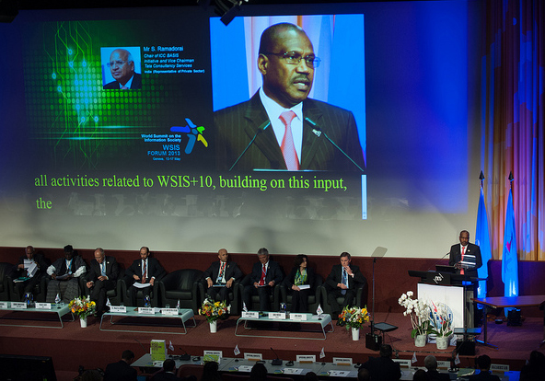
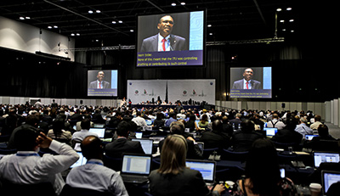
HL Event: Expected Participation
High-Level Guests:
Heads of States (TBD)
Ministers
International Organizations
CEOs
Civil Society Leaders
~2000 Onsite Participants
Multistakeholder Participation
Remote Participation

Slide 12
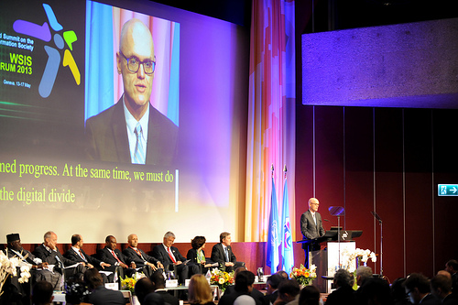
Format of Event
9 June: Pre-Events
Up to 4 Tracks in Parallel
10-11 June: High-Level Track (CICG)
12 June: High-Level Dialogues (CICG)
Pillars for Post 2015 Development Agenda with focus on Action Lines
11 June (PM) - 13 June (AM) June: Forum Track (ITU)
AL Facilitators Meetings, Country Workshops, Ministerial Round Table, Partnership on Measuring ICT for Development (10 year anniversary) , Thematic Workshops, Knowledge Exchanges and Cafe
13 June (PM): AL Facilitators Meeting (Tunis, Para 109)

Slide 13
Preliminary Agenda
Monday | Tuesday | Wednesday | Thursday | Friday
 | HL Networking Breakfast | HL Networking Breakfast | HL Networking Breakfast
Pre-Events | HL Opening Segment | Policy Statements Forum Track | HL Dialogue Forum Track | Forum Track
Pre-Events | Endorsement of Outcome Documents WSIS Project Prizes | Policy Statements Forum Track | HL Dialogue Forum Track | Forum Track
 | HL Lunch / Inauguration of Exhibition | Ministerial/HL Lunch
Pre-events | Policy Statements | Policy Statements Forum Track | HL Dialogue Forum Track | AL Facilitators Meeting
Pre-events | Policy Statements | Policy Statements Ministerial Round Table / Forum Track | HL Dialogue Forum Track | AL Facilitators Meeting Closing Ceremony
Donors Dinner | Reception | Gala Dinner

Slide 14
High-Level Policy Statements 10-11 June 2014
High Level Representatives of Government, Private Sector, Civil Society and International Organization are invited to register for a speaking slot in the High-Level Track (10-11 June 2014); Because of time constraints, speakers will be limited to maximum three minutes. However, the longer version of the statement can be posted on the conference website.
Online registration form www.wsis.org/forum
Deadline: 10 May 2014
For further details, please contact WSIS Secretariat at wsis-info@itu.int.
www.wsis.org/forum

Slide 15
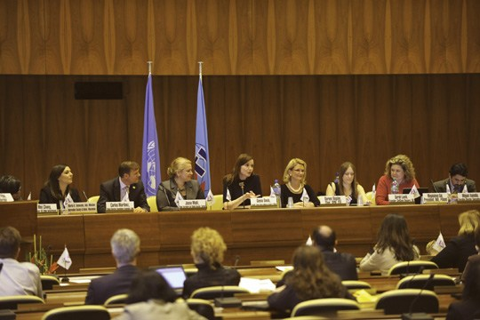
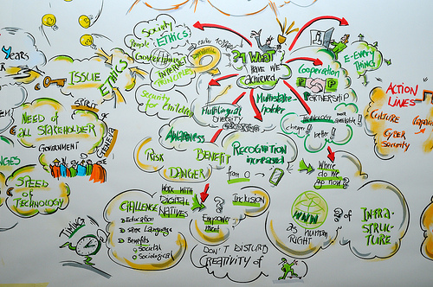
High Level Dialogues
WSIS+10 and Post 2015 Development Agenda
Measuring the Information Society beyond 2015
Cyberspace beyond 2015
From Information to Knowledge Society
Implementation of WSIS beyond 2015
World Café

Slide 16
Country Workshops
10-Year Country Reports: Argentina, Belarus, Bulgaria, Japan, Lithuania, Oman, Poland, Rwanda, Uruguay. Under preparation: UAE, India, Bangladesh and others
Last chance to request for country workshop to celebrate 10 years achievements in implementation
More information at itu-wsis@itu.int

Slide 17
Update on the WSIS+10 High-level Event: 10 Year Reports
10-Year Country Reports: Argentina, Belarus, Bulgaria, Japan, Lithuania, Oman, Poland, Rwanda, Uruguay. Under preparation: UAE, India, Bangladesh and others
10-Year Action Line Facilitators reports: C2, C5 and C6 from ITU, C3, C7 e learning, C7 e science, C8, C9 and C10 from UNESCO and C7 e business from UNCTAD, ITC, UPU
A comprehensive Civil Society Report has been submitted by the Association for Progressive Communication
Final quantitative assessment report (Partnership on Measuring ICTs)
10 Years Regional Assessment Reports by Regional Commissions
WSIS Stocktaking Report 2014
WSIS Success Stories Report 2014
WSIS+10: ITUs role in the Implementation of WSIS Outcomes (10 Year Report)

Slide 18
Preparatory Process Accountability of WSIS beyond 2015
Towards Accountability
Consensus on set of targets to ensure accountability of the WSIS process beyond 2015
Towards Final Assessment
A metadata questionnaire: Measuring the WSIS Targets - A statistical framework publication.
A full data collection of the actual data for each of the WSIS Target indicators is being conducted.
Final quantitative Assessment Report on the Achievements of the WSIS Targets, to be
Measuring the Information Society Report 2013 (official launch on 7 October 2013)

Slide 19
10 Year Anniversary of Partnership for Measuring ICT for Development
Partnership on Measuring ICT for Development developed a set of indicators to measure the WSIS targets
Final assessment of progress made towards each of the ten WSIS targets
Major report coordinated by ITU and involving many contributors
The only quantitative global assessment of WSIS outcomes
Based on data collection carried out in 2013 with all member states (WSIS targets questionnaire)
Launch of final report: WSIS+10 High-level Event, 10-13 June 2014, Geneva

Slide 20
10 Year Anniversary of the WSIS Stocktaking Process
WSIS Stocktaking Process
Publicly available database and networking platform
More than 30.000 Active Users
More than 10.000 Entries
Regular reporting through
WSIS Stocktaking Reports
WSIS Success Stories
Regional Reports

Slide 21
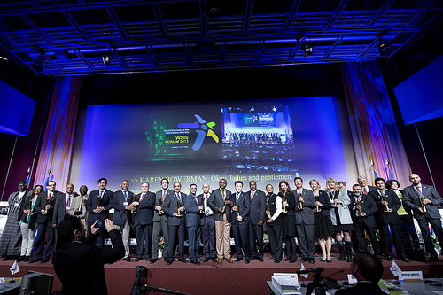
10 Year Anniversary of the WSIS Stocktaking Process
WSIS Project Prizes Track
More than 140 projects nominated in 17 categories following the WSIS Action Lines
Appreciation process is underway: 18 April 2014
Ceremony at the WSIS+10 High Level Event
WSIS Project Prizes recognize excellence in the implementation of projects and initiatives which further the goals of WSIS in improving connectivity to information and communication technologies (ICTs) in line with the 11 Action Lines laid out in the WSIS outcome documents

Slide 22
Format and Thematic Focus Open Consultation Completed
Recommendation of Speakers
Expression of interest for organization of thematic and country
Knowledge exchange and exhibition
Key thematic aspects for HLE
Innovative suggestions on the format
19 May 2014 / Briefing Session / ITU HQ (Popov)

Slide 23
Communications
Paperless approach
Web Presence and Social Media
iwrite4WSIS
imeetYou@WSIS
Facebook and Twitter: #WSIS
Presence on the ITU website
www.wsis.org/forum
www.wsis.org/review

Slide 24
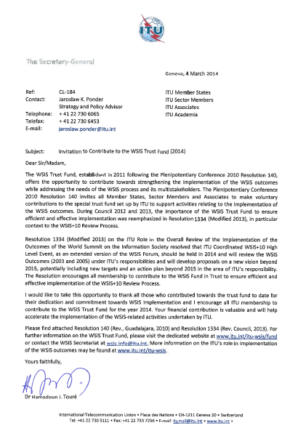
WSIS Fund in Trust of ITU: Categories for WSIS+10 High-Level Event Partnership
Partnerships
Strategic Partner: Platinum
Strategic Partner (Government): Gold
Strategic Partner (Private Sector): Gold
Partner for Specific Activities
Special Thanks:
Japan, Kuwait, Oman, Poland, Rwanda, Switzerland, UAE and Intel

Slide 25
Call for Actions
Request for Workshops (Country Workshops) and Thematic Aspects
Registration: Opening of the registration, link is available at www.wsis.org/forum
Call for Policy Statements: Deadline for requests: 10 May
Availability of High-level Representatives
Government : Minister, Head of State
Private Sector: CEOs
International Organizations: Head of Agency
Civil Society Leaders
Call for Contributions to the WSIS Fund in Trust

Slide 26
Thank You
www.wsis.org/review
www.wsis.org/forum
www.wsis.org/stocktaking
wsis-info@itu.int

