Slide 1
Open Consultation for WSIS+10 HLE 7 October 2013
ITU Headquarters

Slide 2
WSIS Overall Review: Background
The World Summit on the Information Society (WSIS) Outcome Documents and the UN General Assembly Resolution 60/252 resolved to conduct an overall review of the implementation of the Summit outcomes in 2015.
The modalities for the Overall Review are expected to be developed in the 68th Session of the UN General Assembly.
Following the guidance of its Membership (PP-10 Resolution 172 and ITU Council Resolution 1334 (Mod. 2013), ITU has initiated the preparatory process leading towards the WSIS+10 High-Level Event to be held in April 2014.

Slide 3
WSIS+10 High Level Event
The WSIS+10 High-Level Event will be an extended version of the WSIS Forum to:
address the progress made in the implementation of the WSIS outcomes related to the WSIS Action Lines under mandates of the participating agencies
provide a platform for multi-stakeholder coordination of the implementation of the WSIS outcomes, with involvement and participation of all WSIS action line facilitators, other UN agencies and all WSIS stakeholders.

Slide 4
Objectives
The WSIS+10 High-Level Event will review the WSIS Outcomes (2003 and 2005), in particular, related to the Action Lines with a view to developing proposals on a new vision beyond 2015, potentially also exploring new targets.
The meeting will be organized taking into account decisions of the 68th Session of the UN General Assembly.

Slide 5
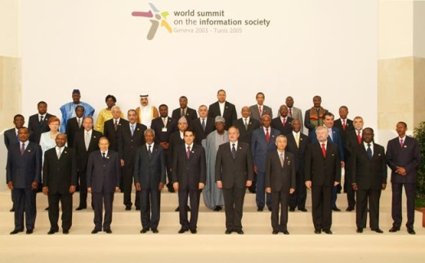
WSIS+10 High-Level Event: Expected Outcomes
1) WSIS+10 Statement on Implementation of WSIS Outcomes
2) WSIS+10 Vision for WSIS Beyond 2015 under mandates of the participating agencies

Slide 6
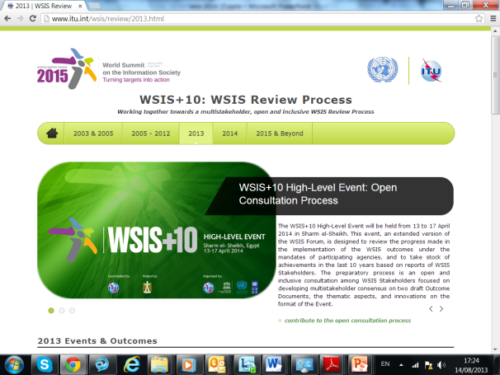
Preparatory Process Multistakeholder Preparatory Platform www.wsis.org/review
Open and inclusive, multistakeholder
consultation process in six phases
with engagement of all UN Agencies
mandated to facilitate implementation
of the WSIS Outcomes
Three physical meetings with remote participation
Ongoing online consultations based on formal submissions and online discussions
Background and input documents for reference

Slide 7
Preparatory Process Background Documents www.wsis.org/review
WSIS+10 Visioning Challenge
WSIS Forum 2013 Outcome Document
2012 & 2013 Identifying Emerging Trends and a vision beyond 2015
WSIS+10 Event:
Towards Knowledge Societies for Peace and Sustainable Development: Final Statement
Measuring the Information Society Report 2013 (official launch on 7 October 2013)

Slide 8
WSIS+10: Preparatory Process Multistakeholder Preparatory Platform (www.wsis.org/review)
Phase One: July2013 | Initiation of the Open Consultation Process: Official Submissions (www.wsis.org/review)
Phase Two: 7-8 October 2013 | First Physical Meeting, Room C, ITU Headquarters, (with remote participation facilities) ,9:00-18:00
Phase Three: 16-17 December 2013 | Second Physical Meeting, ITU Headquarters (with remote participation facilities)
Phase Four: 17-18 February 2014 | Third Physical Meeting, ITU Headquarters (with remote participation facilities)
Phase Five: 1st March 2014 | Outcomes of the open consultation published on the website
Phase Six: 12 March 2014 | Final Brief on the WSIS+10 High Level Event, ITU Headquarters (with remote participation facilities)

Slide 9
Preparatory Process Call for Action: Open Consultation Process
Invitation letter in 6 UN Languages:
Invitation to Contribute to the Open Consultation Process
[ar] - [zh] - [en] - [fr] - [es] - [ru]
Input on Form#1: Inputs towards
Draft WSIS+10 Statement on the Implementation of WSIS Outcomes
Draft WSIS+10 Vision for WSIS Beyond 2015 under mandates of participating agencies
Input on Form#2: Inputs towards Format and Thematic Aspects
Form One
Form Two

Slide 10
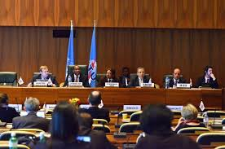
Form One: Around 50 Contributions
Governments (19): Argentina, Bulgaria, Egypt, El Salvador, Iran, Japan, Morocco, Oman, Lithuania, Nigeria, Poland, Rwanda, Saudi Arabia, Sweden, United Kingdom, UAE, Uruguay, USA
Civil Society (11) and Academia (1): Belgium, Brazil, India, Netherlands, Sudan, South Africa, Switzerland, USA
Private Sector (5): China, France, USA
International Organizations (12): All Facilitators of the Action Lines

Slide 11
Form Two: Around 50 Contributions
Recommendation of Speakers
Expression of interest for organization of thematic and country
Knowledge exchange and exhibition
Key thematic aspects for HLE
Innovative suggestions on the format

Slide 12
Skeleton of the WSIS+10 HLE
 | Sunday | Monday | Tuesday | Wednesday | Thursday
AM |  | Opening of HL Track | HL Plenary / HL Round Tables AL FM / Workshops | HL Plenary / HL Round Tables AL FM / Workshops | AL Facilitators Meeting
AM |  | HL Plenary / HL Round Tables AL FM / Workshops | HL Plenary / HL Round Tables AL FM / Workshops | HL Plenary / HL Round Tables AL FM / Workshops | Closing
PM | Opening Ceremony | HL Plenary / HL Round Tables AL FM / Workshops | HL Plenary / HL Round Tables AL FM / Workshops | HL Plenary / HL Round Tables AL FM / Workshops
PM | WSIS Project Prizes | HL Plenary Adoption of the Outcomes | HL Plenary / HL Round Tables AL FM / Workshops | HL Plenary / HL Round Tables AL FM / Workshops

Slide 13
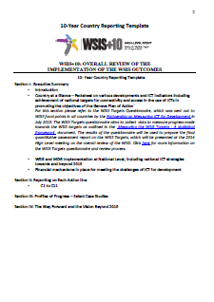
Preparatory Process Call for Action: 10 Year’s Country Reports
10 Year’s Country Reports
Invitation letter in 6 UN Languages:
[ar] - [zh] - [en] - [fr] - [es] - [ru]
Objective of Country Reports
Self-evaluation of 10 year achievements
Reference in the WSIS+10 Statement
Background Document at Country Workshops at the WSIS+10 High-Level Event
Integral part of the WSIS Stocktaking Process
Deadlines
a draft version of the report to the First Physical Preparatory Meeting of the WSIS+10 High–Level Event (7-8 October 2013);
Received submissions from: Rwanda and Poland
a final version of the report to the Second Physical Meeting of the WSIS+10 High–Level Event (16-17 December 2013).
TEMPLATE Agreed by multistakeholder consensus during WSIS Forum 2012

Slide 14
Preparatory Process Call for Action: Quantitative Assessment
The ITUs ICT Data and Statistics Division continues to play a leading facilitation role in the Partnership on the Measuring the ICTs for Development.
A metadata questionnaire was coordinated by the Partnership on Measuring ICT for Development, and was sent in October 2012 to countries by the Regional Commissions. This questionnaire aims at collecting information on data availability for the WSIS Target indicators as outlined in the Measuring the WSIS Targets - A statistical framework publication.
A full data collection of the actual data for each of the WSIS Target indicators is being conducted.
The data collected in 2013 will be used to prepare the final quantitative Assessment Report on the Achievements of the WSIS Targets, to be launched on the occasion of the WSIS+10 High-Level Event in 2014 (http://www.itu.int/en/ITU-D/Statistics/Pages/intlcoop/ partnership/followup.asp)

Slide 15
Preparatory Process Call for Action
WSIS Stocktaking Process
www.wsis.org/stocktaking
(1st December 2013)
Call for update and new entries 2013-2014. Contribution to the WSIS Stocktaking Report 2014! Deadline: 1st December 2013
The sixth edition of the WSIS Stocktaking Report is the continuation of the WSIS Stocktaking Report series and will be prepared for WSIS+10 High-Level Event and Forum 2014.
The WSIS Stocktaking Report 2014 will also be shared with ITU-D study Groups in the elaboration of Output Reports and will be submitted as the contribution to the 17th session of the Commission on Science and Technology for Development (CSTD).
WSIS Stocktaking: Regional Reports. Deadline: 1st December 2013
The propose of regional reports is to serve as the information document for ITU-D Regional Development Forums (RDF) and Regional Preparatory Meeting in order to provide the examples of activities related to the implementation of WSIS outcomes in the region and to enrich discussions related to the overall review on the implementation of the WSIS outcomes and upcoming WSIS+10 High Level Event.

Slide 16
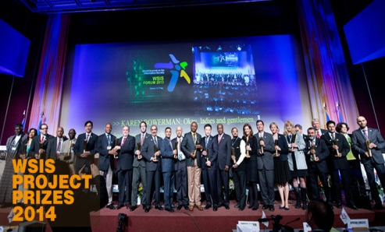
Preparatory Process Call for Action
WSIS Project Prizes 2014: ww.wsis.org/prizes
WSIS Project Prizes is a unique recognition for excellence in the implementation of WSIS outcomes.
The WSIS Project Prizes 2014 contest (www.wsis.org/prizes2014) provides a platform to identify and showcase success stories and models that could be easily replicated; empower communities at the local level; give a chance to all stakeholders working on WSIS to participate in the contest, and particularly recognize the efforts of stakeholders for their added value to the society and commitment towards achieving WSIS goals.
Launch on 5th September 2013 / Deadline: 1st November 2013

Slide 17
Preparatory Process Call for Action: Regional Level
Within the framework of the Regional Preparatory Process towards the World Telecommunication Development Conference 2014 (WTDC-14), ITU is in the process of collecting regional views on the implementation of the WSIS outcomes and WSIS+10. Series of Regional Development Forums (RDF) held back to back with six WTDC Regional Preparatory Meetings will reinforce this exercise.
Submitted Reports: Asia-Pacific, Africa, Americas, CIS
Inputs to come: Arab States and Europe
Importance of regional activities, relevant to the WSIS+10 process
ECLAC: IV Ministerial Conference (April 2013, Uruguay)
UNECA: Workshop on WSIS process (February, Ethiopia)
ESCWA: WSIS+10 Regional Meeting for Arab States (November, Tunisia)
ECA: WSIS+10 Regional Meeting for Africa (November, Tunisia)
Tunisia: ICT4All Forum and Exhibition (November, Tunisia)
Others
The outcomes of all regional meetings are submitted to the preparatory process and documented in the WSIS+10 Visioning Challenge.

Slide 18
Preparatory Process Link between WSIS and Post 2015 Development Agenda
Taking into account ongoing dialogue on the Post-2015 Development Agenda (MDG Review Process) and WSIS+10 review process it is important to note the possible interaction between both processes to ensure that efforts across the UN System are coherent, connected and coordinated to achieve maximum, sustainable impact.
ICTs are key enablers of development, and are critical components of innovative development solutions.
The recent joint statement of the UN Group on the Information Society on the Post 2015 Development Agenda draws attention to the above and is available at www.ungis.org.

Slide 19
Preparatory Process Call for Action
All WSIS Stakeholders are encouraged to engage in the preparatory process
submitting written inputs to the open consultations on the WSIS+10 High-Level Event using the online questionnaires (www.wsis.org/review) ➔ DEADLINE: 30 SEPTEMBER
participating actively in all physical meetings onsite or in a remote manner; ➔ 1st MEETING: 7-8 OCT
responding to the WSIS Stocktaking questionnaire on the on-going activities related to WSIS implementation (www.wsis.org/stocktaking) ➔ DEADLINE: 1st DECEMBER
and nominating the projects for the international contest of WSIS Project Prizes 2014 (www.wsis.org/stocktaking and www.wsis.org/prizes) ➔ DEADLINE: 1st NOVEMBER
The Member States are in addition invited to
provide 10 Years country reports based on the templates agreed by multistakeholder consensus, to the first physical preparatory meeting of the WSIS+10 open consultations in a draft form and the final versions to the second at the latest (www.wsis.org/review) : ➔ DEADLINES: 4 OCT and 12 DEC
respond to the WSIS Targets survey that will be conducted between July and September 2013 by the Partnership on Measuring ICT for Development (http://www.itu.int/en/ITU-D/Statistics/Pages/intlcoop/partnership/followup.aspx) : ➔ DEADLINES: SEPTEMBER
The Facilitators of the WSIS Action Lines were invited to
provide 10 Years Action Line reports based on the templates agreed by multistakeholder consensus (www.wsis.org/review); ➔ ➔ DEADLINES: 4 OCT and 12 DEC

Slide 20
WSIS+10: Preparatory Process First Physical Meeting
7-8 October 2013, Geneva
Chair and Vice-Chairs: Russia, Egypt, Switzerland, Saudi Arabia
Remote Participation Facilities
All WSIS Action Line Facilitators
Background Documents
Draft Agenda
10 Year Implementation Country Reports
10 Year Implementation Reports by Action Lines
Launch of the Report on Measuring the Information Society
First Reading of the Zero Draft of the Outcome Documents

Slide 21
Preparatory Process: Starting Point
ZERO DRAFT of STATEMENT and WSIS+10 VISION
Official Sumbmissions 30 September 2013
www.wsis.org/review/mpp
Regional Outcomes
10 Year Reports (Countries / Action Lines)
WSIS+10 Visioning Challenge
WSIS Forum 2013 Outcome Document
2012 & 2013 Identifying Emerging Trends and a vision beyond 2015
Towards Knowledge Societies for Peace and Sustainable Development: Final Statement

Slide 22
Principles for development of inputs to the Zero Drafts of Outcomes
Focus on the WSIS Action Lines and measurement of their implementation.
We develop a vision upon existing framework of Action Lines, identifying emerging trends, challenges and priorities for new decade, without making existing framework of Action Lines obsolete.
Geneva Declaration and Geneva Plan of Action still remain valid until further decisions by General Assembly.
No proposals related to the change of implementation mechanism, responsibilities, internet governance, including IGF, enhanced cooperation, CSTD etc.
No prejudging the outcomes of the 68th Session of the GA on modalities of the Overall Review. Respect towards mandates given by Tunis and respect for the multistakeholderism.

Slide 23
Outcomes: Inputs to Zero Drafts www.wsis.org/review/mpp
A. THE MAIN ACHIEVEMENTS
The main achievements in the area of the information society, in particular, in the implementation of the WSIS Action Lines, in the past ten years
B. THE KEY IDENTIFIED CHALLENGES
The key identified challenges that would need to be addressed in the next 10 years
C. TOWARDS DIGITAL INCLUSION
Our vision for an information/knowledge society ensuring the digital inclusion of youth, women, poor, persons with disabilities and indigenous peoples for their social and economic empowerment
INPUTS
Inputs extracted from the Submissions received during the Open Consultation Process for the Draft WSIS+10 Statement on the Implementation of WSIS Outcomes
A. PREAMBLE
Preamble
B. PRIORITY AREAS TO BE ADDRESSED IN THE IMPLEMENTATION OF WSIS BEYOND 2015.
Priority areas to be addressed in the implementation of WSIS Beyond 2015.
C. ACTION LINES
C1. The role of public governance authorities and all stakeholders in the promotion of ICTs for development
C2. Information and communication infrastructure
C3. Access to information and knowledge
C4. Capacity building
C5. Building confidence and security in the use of ICTs
C6. Enabling environment
C7. ICT applications: benefits in all aspects of life
E-government
E-business
E-learning
E-health
E-employment
E-environment
E-agriculture
E-science
C8. Cultural diversity and identity, linguistic diversity and local content
C9. Media
C10. Ethical dimensions of the Information Society
C11. International and regional cooperation
D. ACCOUNTABILITY, MONITORING AND EVALUATION
Accountability of the WSIS Action Lines beyond 2015 (Targets and Indicators for an open and inclusive information/knowledge society for all beyond 2015)
Statement
Vision

Slide 24
Thank you for your attention!
For more information do not hesitate to
- Consult www.wsis.org/review
- Contact wsis-info@itu.int

