Slide 1
Azerbaijan:
Digital Skills Assessment
2023-2024

Slide 2
Azerbaijan: Digital Skills Assessment
In 2023, the Ministry of Digital Development and Transport of Azerbaijan initiated a collaborative effort under the supervision of the ITU Regional Office for CIS and the ICT Data Statistics Division to assess digital skills and identify the country's current level of digital literacy and persisting digital skills gaps.
The work on assessment was discussed, organized and coordinated on the basis of the ITU’s Digital Skills Assessment Guidebook (ITU, 2020).

Slide 3
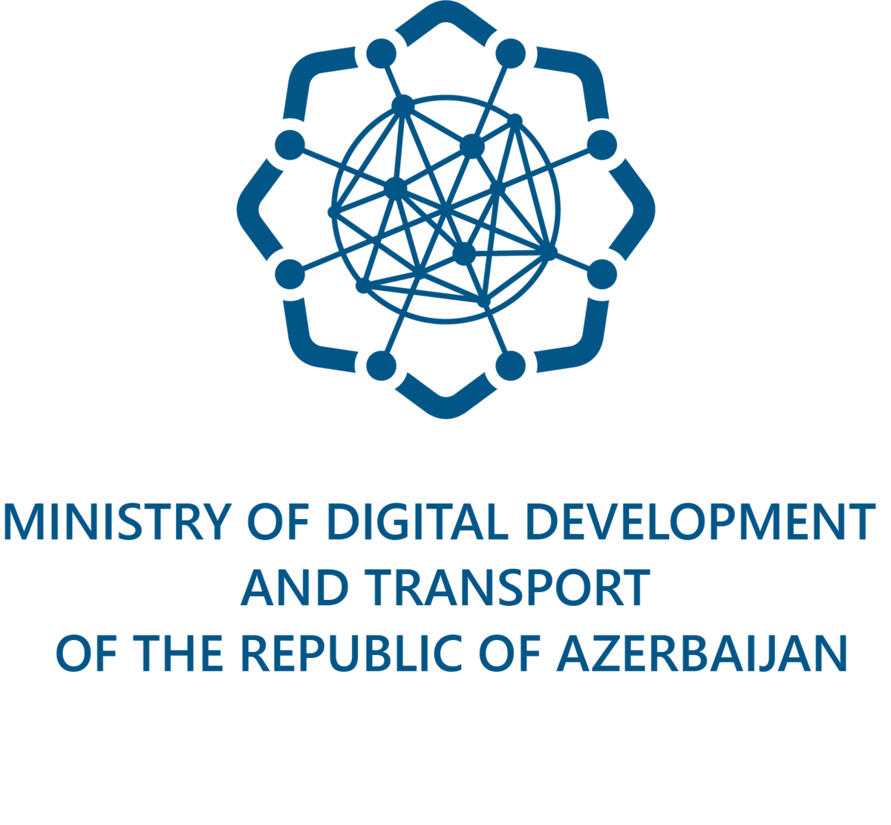
Key Stakeholders
Ministry of Digital Development and Transport
Responsible for overall coordination and implementation.
Worked with the State Statistical Committee to develop survey questionnaires, conduct the surveys, and validate the data.
Engaged at all stages, including target group identification, questionnaire validation, and final report approval.
State StatisticAL Committee
Played an important role in executing the surveys.
In collaboration with the ministry, designed questionnaires and conducted comprehensive surveys across diverse regions and sectors.
Responsible for data compilation, initial assessment, and micro-editing of survey data.
ITU (International Telecommunication Union)
Provided guidance and support for the survey design.
Assisted in developing questionnaires and contracting consultants for in-depth analysis.
Involved in data review, preparing recommendations, and final report validation.

Slide 4
National Digital Skills Roadmap & Transformation Strategy
“Azerbaijan 2030: National Priorities for Socio-Economic Development”
Strategic Policy Document: Approved in February 2021.
Priorities: Competitive human capital and innovations.
Focus: Lifelong learning through harmonious development of competencies, social skills, and abilities.
Key Objective: Instilling digital competencies in new generations from school age onward.
In today’s Azerbaijan, connectivity of households with mobile-cellular network is high.
Households with mobile-cellular network
91.5%
Focus on Lifelong Learning and Digital Competencies
Lifelong Learning:
Promoting continuous development of competencies.
Digital Competencies:
Emphasis on preparing new generations for the digital era.
From school age onwards, integration of digital skills in education.
87.8%
Household internet penetration
The groundwork for these achievements was laid a decade ago with the inception of Azerbaijan’s ICT Roadmap 2016-2020.

Slide 5
Azerbaijan’s ICT Roadmap (2016-2020) – Strategic Plan
Focused on improving governance, increasing productivity, and digitizing services, paving the way for digital skills growth in the country.
Strategic target | Policy priority
Improve governance structures, and strengthen ICT | Establish an independent regulatory body Liberalise the telecommunication market Increase mobile infrastructure investments
Increase productivity and operational efficiency of the business environment | Extend digital payments and apply ICT in education system Extend technology-based operations in business environment Upgrade technology education with the involvement of businesses Improve the electronic systems of government institutions Increase knowledge and skills in the ICT sector
Digitise government and social environment | Improve the information systems of government institutions Create an end-to-end integrated e-health infrastructure

Slide 6
Digital Skills Classification
5 skill areas
Information and data literacy
Communication and collaboration
Digital content creation
Problem-solving
Safety
Basic digital skills
Individuals must have at least 1 activity in all 5 skill areas.
Above basic digital skills
Individuals must have 2 or more activities in all 5 skill areas.
Below basic digital skills
Individuals with no activity in at least one skill area. The indication is given detailing how many skill areas are covered:
4 out of 5 skill areas
3 out of 5 skill areas
2 out of 5 skill areas
0-1 out of 5 skill areas

Slide 7
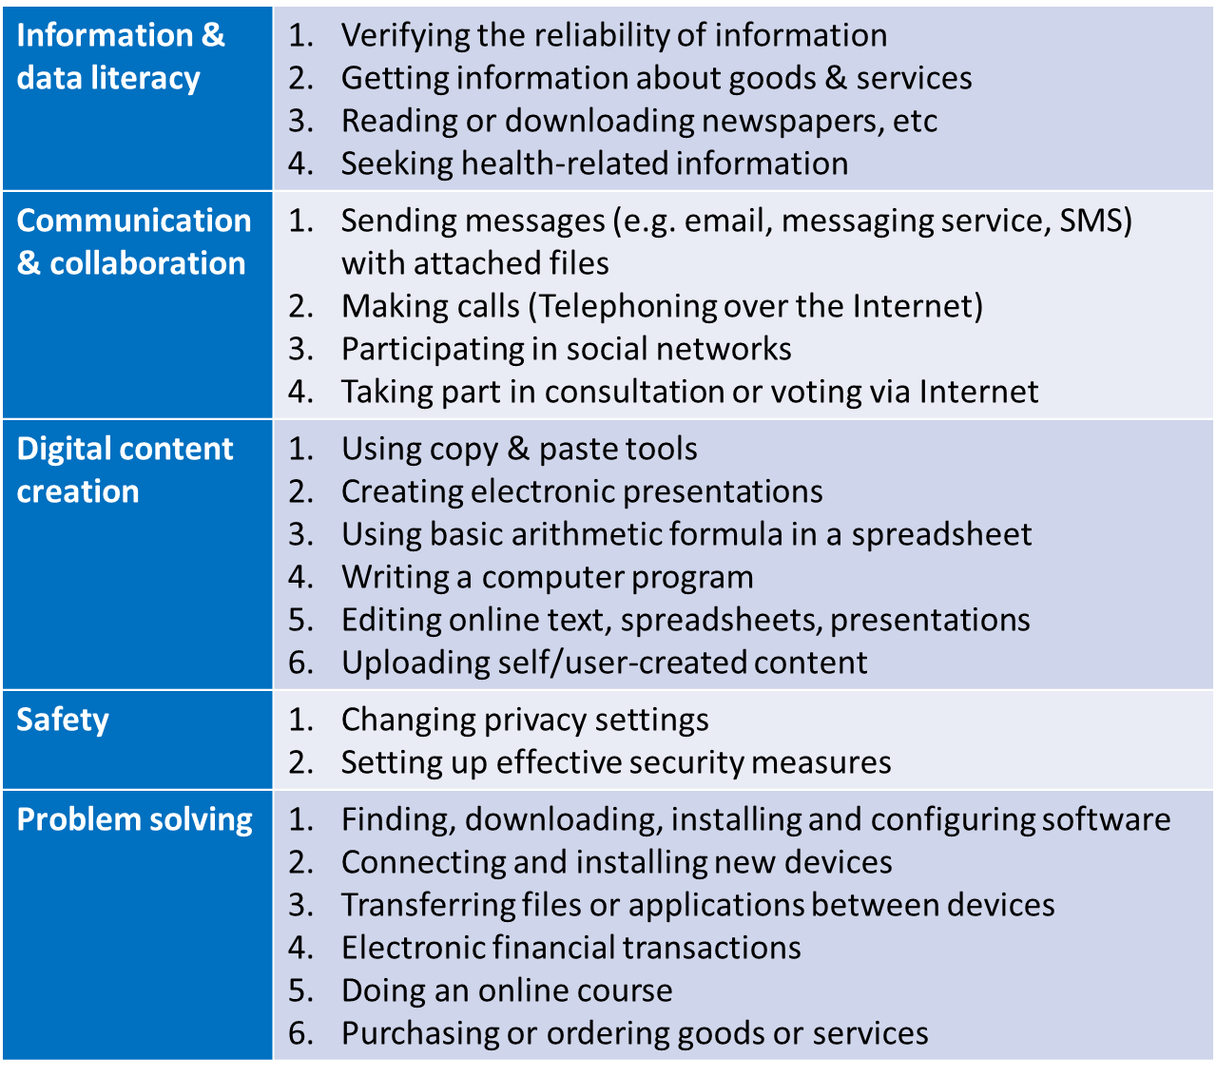
Methodology
The work on assessment was discussed, organized and coordinated on the basis of the ITU’s Digital Skills Assessment Guidebook (ITU, 2020).
A person reports whether they performed activities within the last 3 months by giving a binary answer (yes or no). Having carried out digital activities is considered a proxy for digital skills.
Then raw binary scores are converted to levels for each skill area:
If no activity, 0 is assigned.
If only one activity, 1 is assigned.
If more than one activity, 2 is assigned.
Finally, the individuals are classified into 3 digital skill levels.
Above basic
Basic
Below basic
A criterion-based approach is used to calculate the level of ICT skills.
Below basic digital skills - individuals have performed activities in less than 5 out of the 5 skills areas
Basic digital skills - individuals should have at least one activity in all 5 skills areas
Above basic digital skills - individuals should have 2 or more activities in all 5 skills areas.

Slide 8
Survey Data
Survey gathered information about age, gender, average monthly income, education level, health, internet usage and activities done on the internet in the last 3 months.
A representative survey of nearly 35 000 individuals using a randomized sample of households aged 7 and older in 13 economic regions of Azerbaijan.
The data gathering was conducted in different phases by the State Statistical Committee of Azerbaijan.
Online surveys target groups:
Students - 6372
Staff of private enterprises – 1116
Teaching staff from higher education institutions – 886
Public agencies – 679

Slide 9
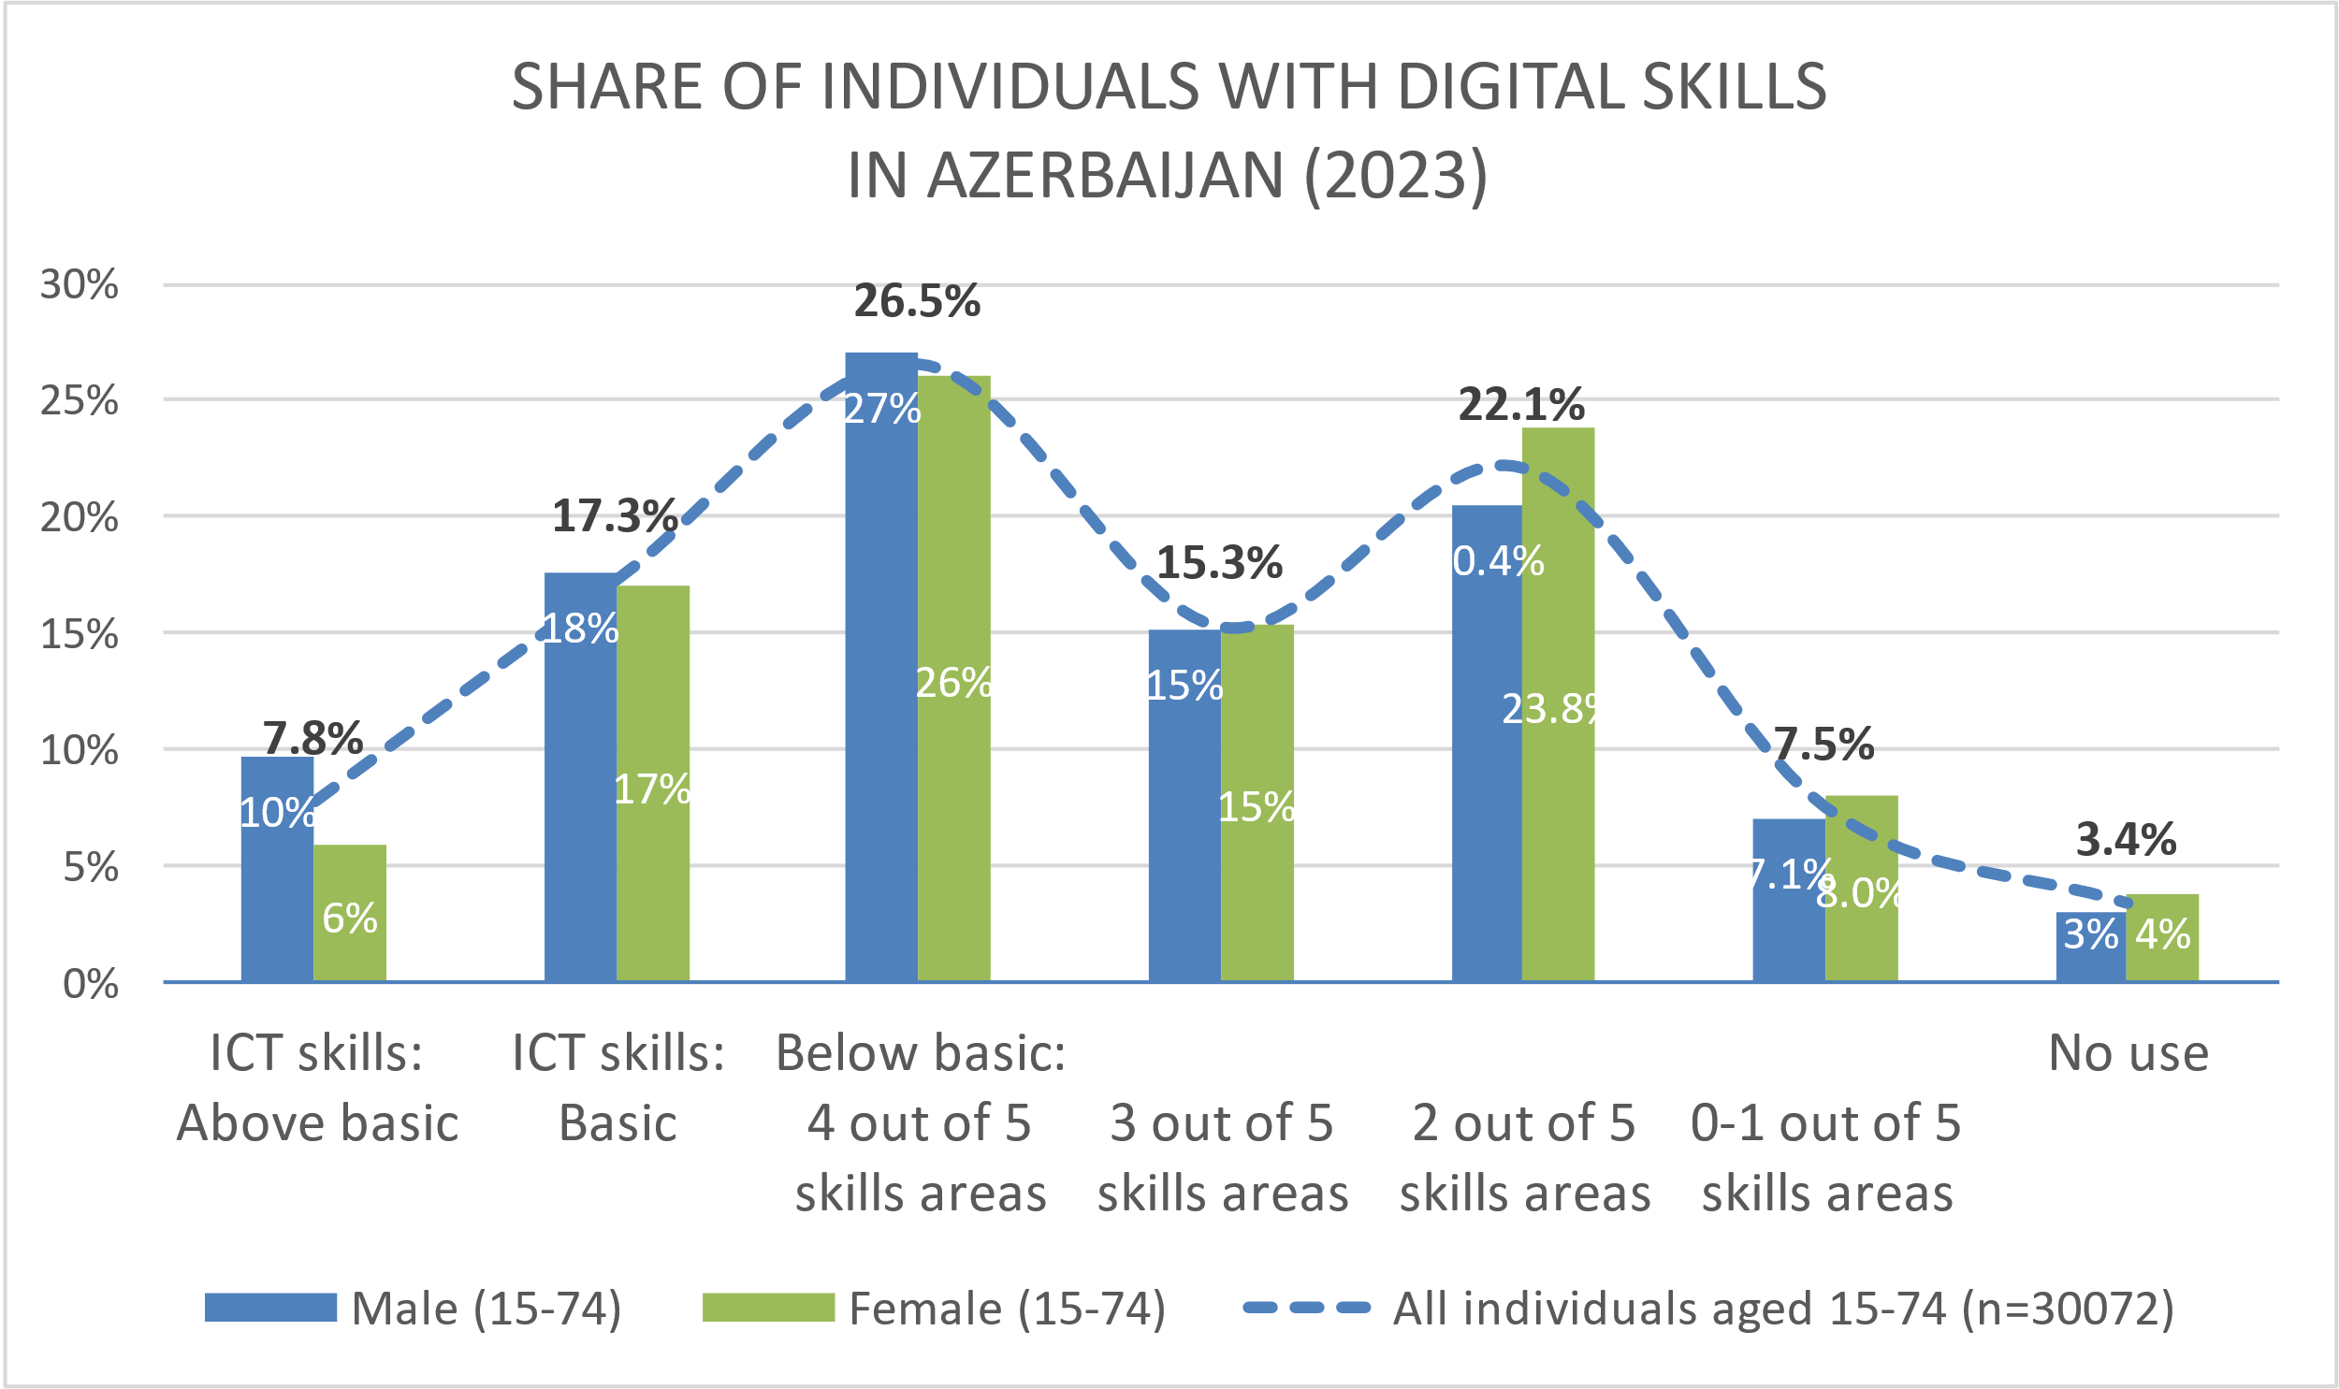
Digital Skills Distribution in Azerbaijan (2023)
The analysis presented and described data per each target group, with disaggregation by gender, age, locality, income, social status, etc.
25% of Azerbaijanis aged 15-74 have at least basic digital skills.
More precisely, 7.8% have above basic digital skills and 17.3% have basic digital skills.
More men have above basic digital skills (10%) compared to women (6%).
At a basic level, the difference is smaller; 18% of men have basic digital skills compared to 17% of women
Basic digital skills
Above basic digital skills
Above basic digital skills

Slide 10
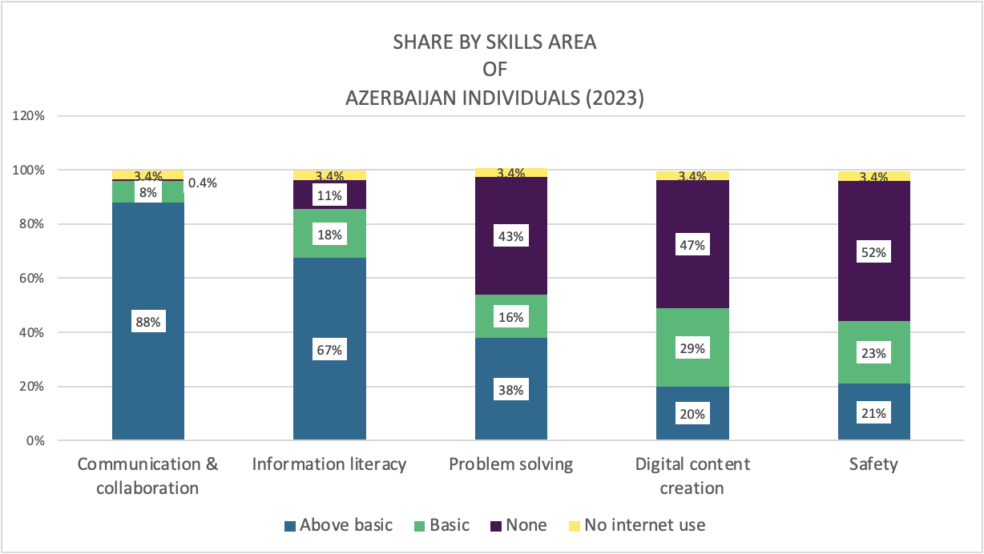
Distribution of Individuals by Digital Skill Areas
Basic digital skills
Key Skill Areas: Communication and Collaboration
Most popular area: 96.2% of internet users in Azerbaijan engaged in activities here.87% of females and 89% of males have above basic skills in this area. Basic digital skills training not required here.
Information Literacy
18% of population currently at a basic level.
For Azerbaijanis aged 15-74, the most important skills areas lagging were:
Safety
Digital content creation
Problem-solving
Above basic digital skills

Slide 11
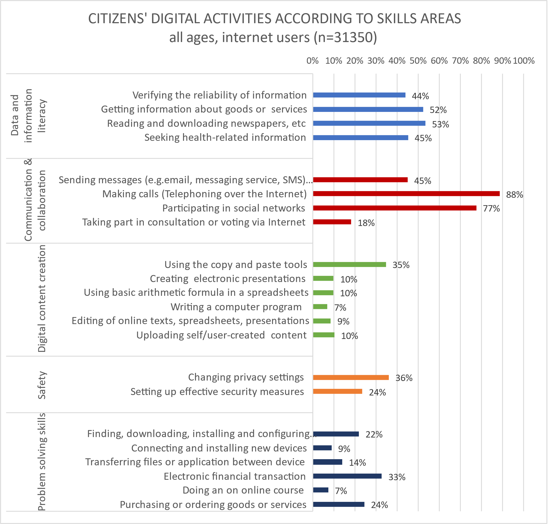
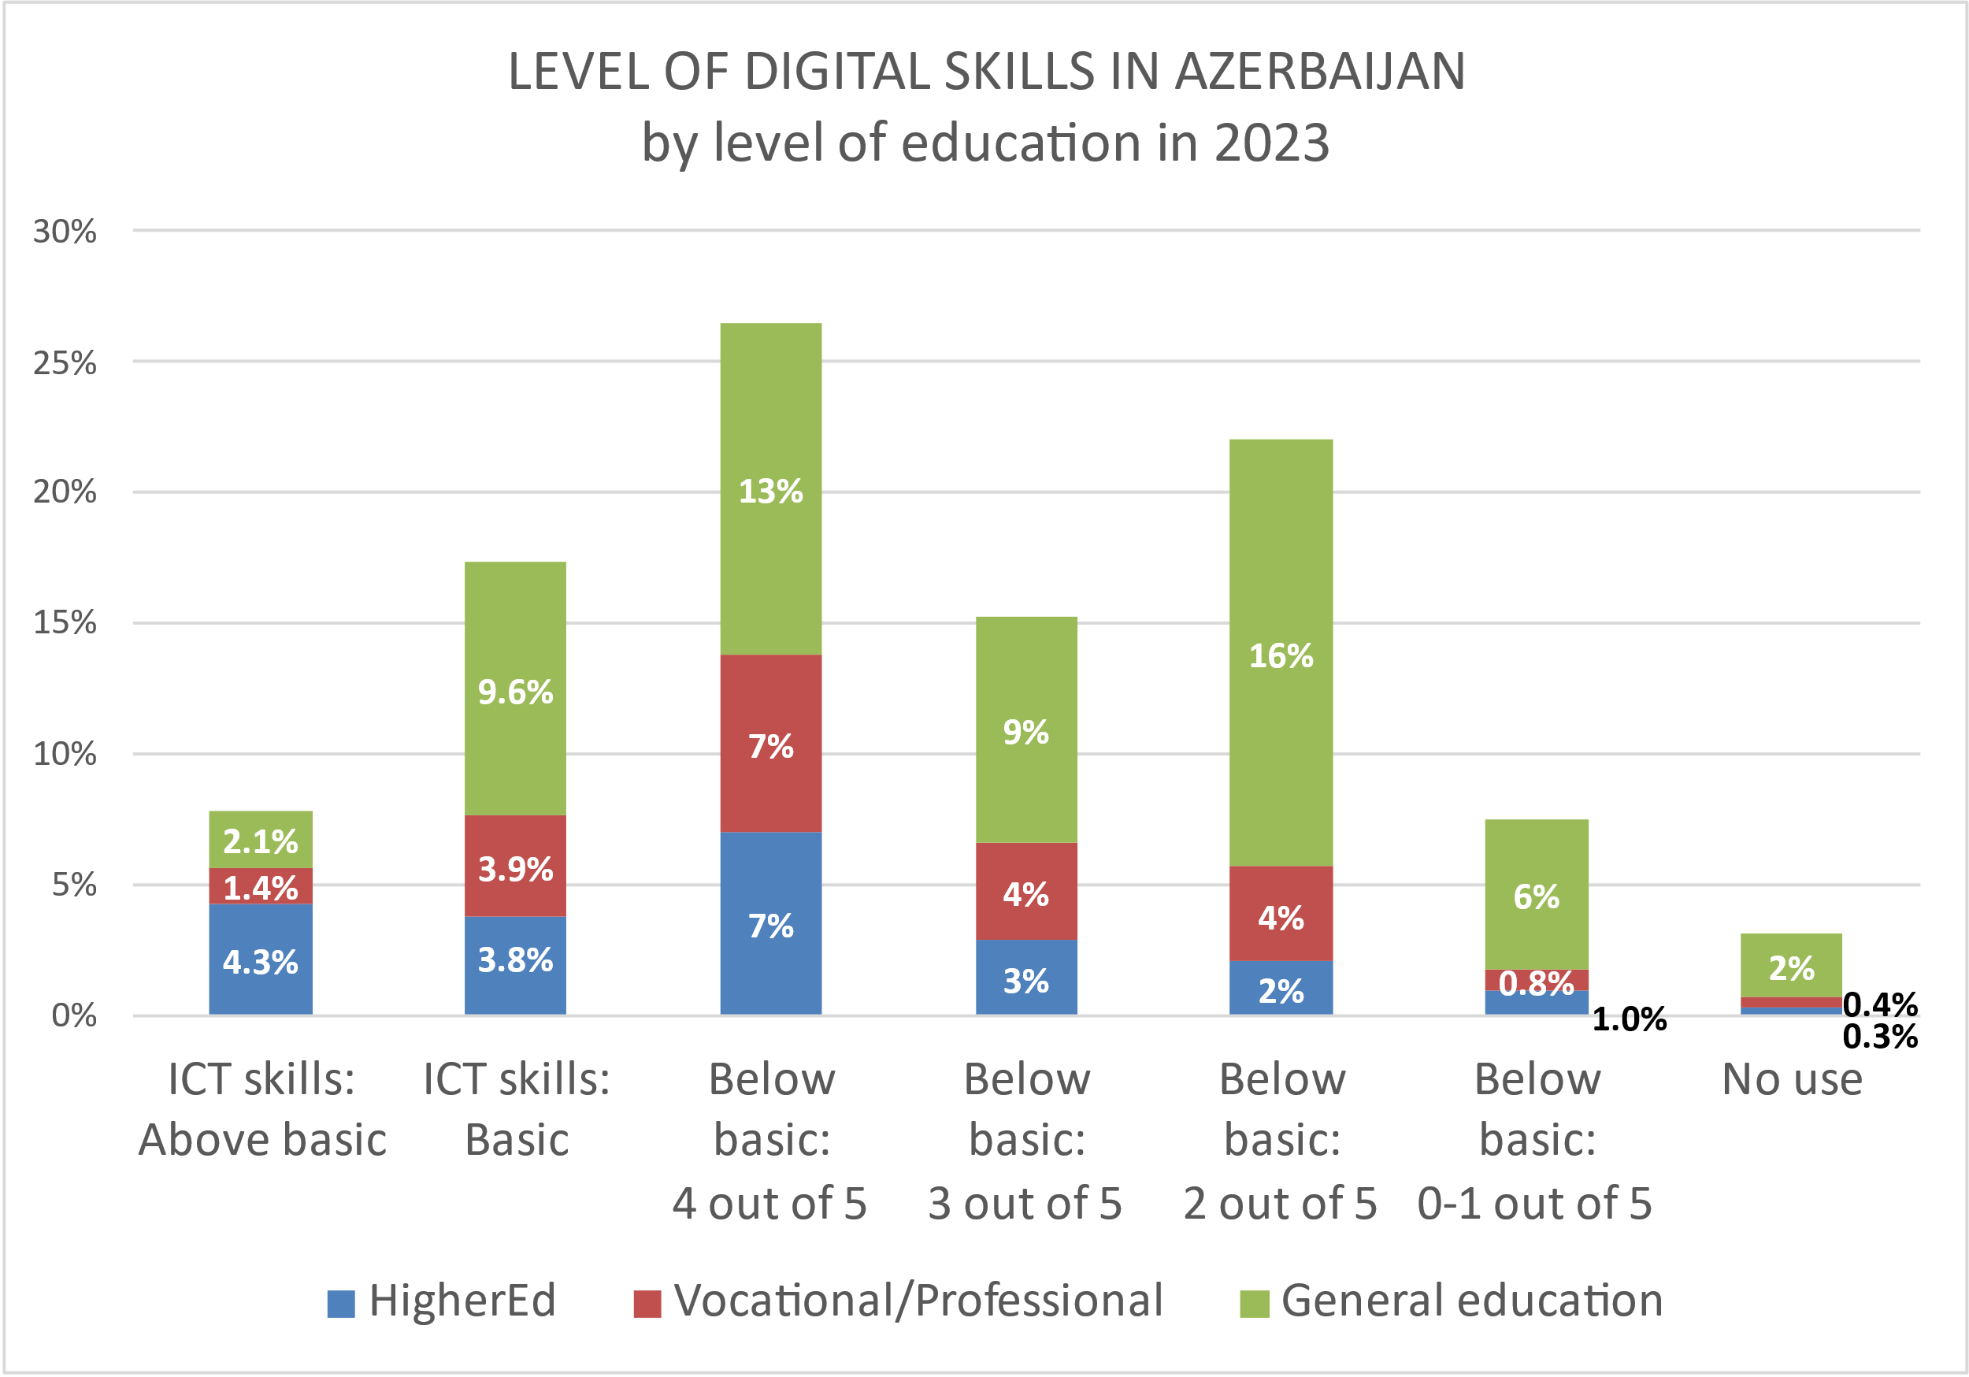
Digital Skills Levels by Education and Digital Activities Among Citizens in Azerbaijan (2023)
Level of digital skills in Azerbaijan by level of education in 2023
Citizen’s digital activities according to skills areas all ages, internet users (n=31350)

Slide 12
Challenges in Digital Skills Assessment
Challenges in Data Collection
Uneven Regional Participation
The participation across regions, with higher representation from Baku and Absheron, could create challenges in accurately reflecting the national situation, especially in more rural areas.
Challenges in Measuring Skill Levels
Subjective Self-Reporting
The digital skills assessment primarily relied on self-reporting, which could lead to inaccuracies due to over- or underestimation of individual competencies.
Challenges in Targeting Vulnerable Groups
Exclusion of Older and Younger Populations
The document notes that certain age groups, particularly the very young and elderly, were either under-assessed or not represented adequately, leading to an incomplete understanding of digital literacy across the entire population.
Above basic digital skills
Challenges in Cross-Sector Comparisons
Lack of Consistency Across Sectors
The document mentions the difficulty in comparing digital skills across different sectors such as public and private enterprises, as each sector has varying levels of digitalization and skill requirements.

Slide 13
Key Lessons Learned from Digital Skills Assessment
Lesson 1: The Need for Representative Sampling
Key Point: The use of convenience sampling for some groups, like students and teaching staff, could limit the representativeness of findings.
For reliable and generalizable results, it is essential to employ structured and representative sampling techniques across all target groups.
Lesson 2: Self-Reported Data Limitations
Key Point: Reliance on self-reported surveys can lead to over- or underestimation of digital skills.
Self-reports introduce bias; integrating observational or performance-based assessments could offer more accurate results.
Lesson 3: Need for Advanced Skills Assessment
Key Point: There was less emphasis on advanced skills such as coding or using specialized software.
Focusing primarily on basic skills leaves gaps in understanding the population’s readiness for more specialized, technical digital tasks.
Lesson 4: Addressing Skills Gaps in Vulnerable Groups
Key Point: Disparities in digital skills based on gender, income, and education persist.
Tailored digital training programs should be implemented to address these disparities, ensuring inclusive digital skill development for all groups.

Slide 14
Recommendations for Other Countries
Include a Variety of Skills Levels
The assessment should cover both basic and advanced digital skills.
This ensures that countries can understand not only the general population’s basic digital abilities but also the more specialized and technical skills that may be necessary for future workforce demands.​
Target Vulnerable Groups
The assessment should pay special attention to vulnerable populations, such as those in rural areas, older adults, and individuals with lower incomes.
Tailored questions and focused sampling for these groups will help identify specific gaps that need targeted interventions.​
Combine Self-Reported Data with Performance-Based Assessments
While self-reported surveys are useful, they can sometimes lead to over- or under-estimation of skills.
Countries should consider combining these surveys with performance-based assessments to get a clearer and more accurate picture of actual digital abilities​.
Involve multiple stakeholders
A collaborative approach involving various stakeholders, such as educational institutions, public and private sectors, and policy-makers, is necessary to regularly assess and monitor digital skills development.
Regular assessments and coordinated efforts can help create effective strategies for upskilling and fostering digital literacy across the population.

Slide 15
Thank You

