Slide 1
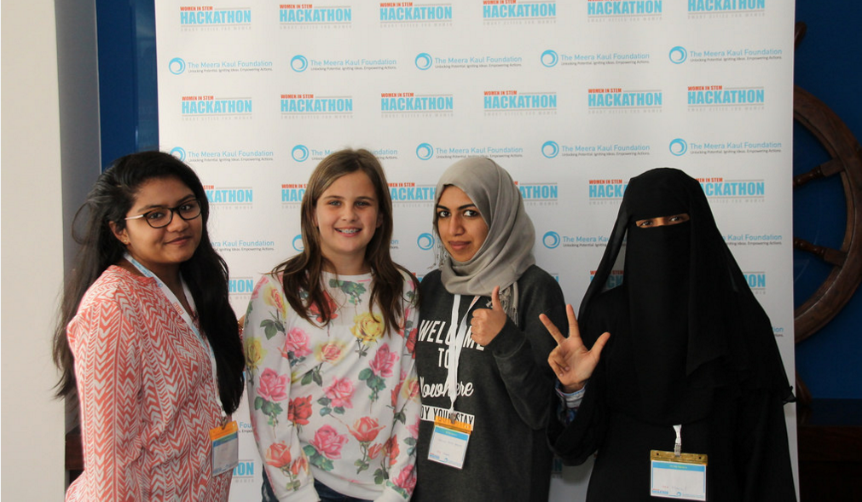
“A journey fuelled by innovation & curiosity”
  Early curiosity
  Self-Taught Coder
  Disillusionment in School
  Postgraduate Hackathon Win
  Inspiration from Dubai
  First-hand Ecosystem Insight
“We need real-world digital skills, not just textbook tech”

Slide 2

“Turning crisis into opportunity - the power of action”
  Pandemic Impact
  Open Letter to Industry
  Learner-Led, Industry-Supported Classroom
  Global Hackathon Leadership
  Beirut Port Blast Response
  Al-Wasl.Connect
Lacie Slezak (@nbb_photos), 2016, Unsplash

Slide 3
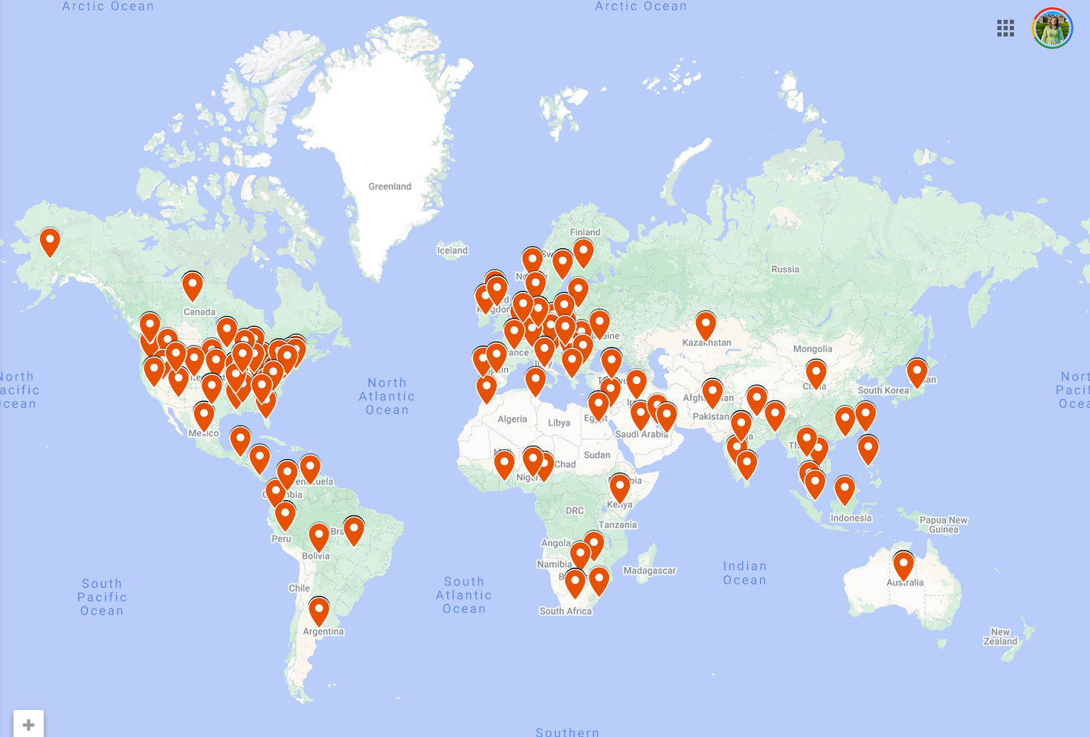
“Building a Global Skills Ecosystem: from uncertainty to impact”
“Digital skills transcend boundaries, students are changemakers”

Slide 4





“Building a global digital skills blueprint”
Inspire
Connect
Grow
“Enabling every learner to become a Digital Changemaker”

Slide 5
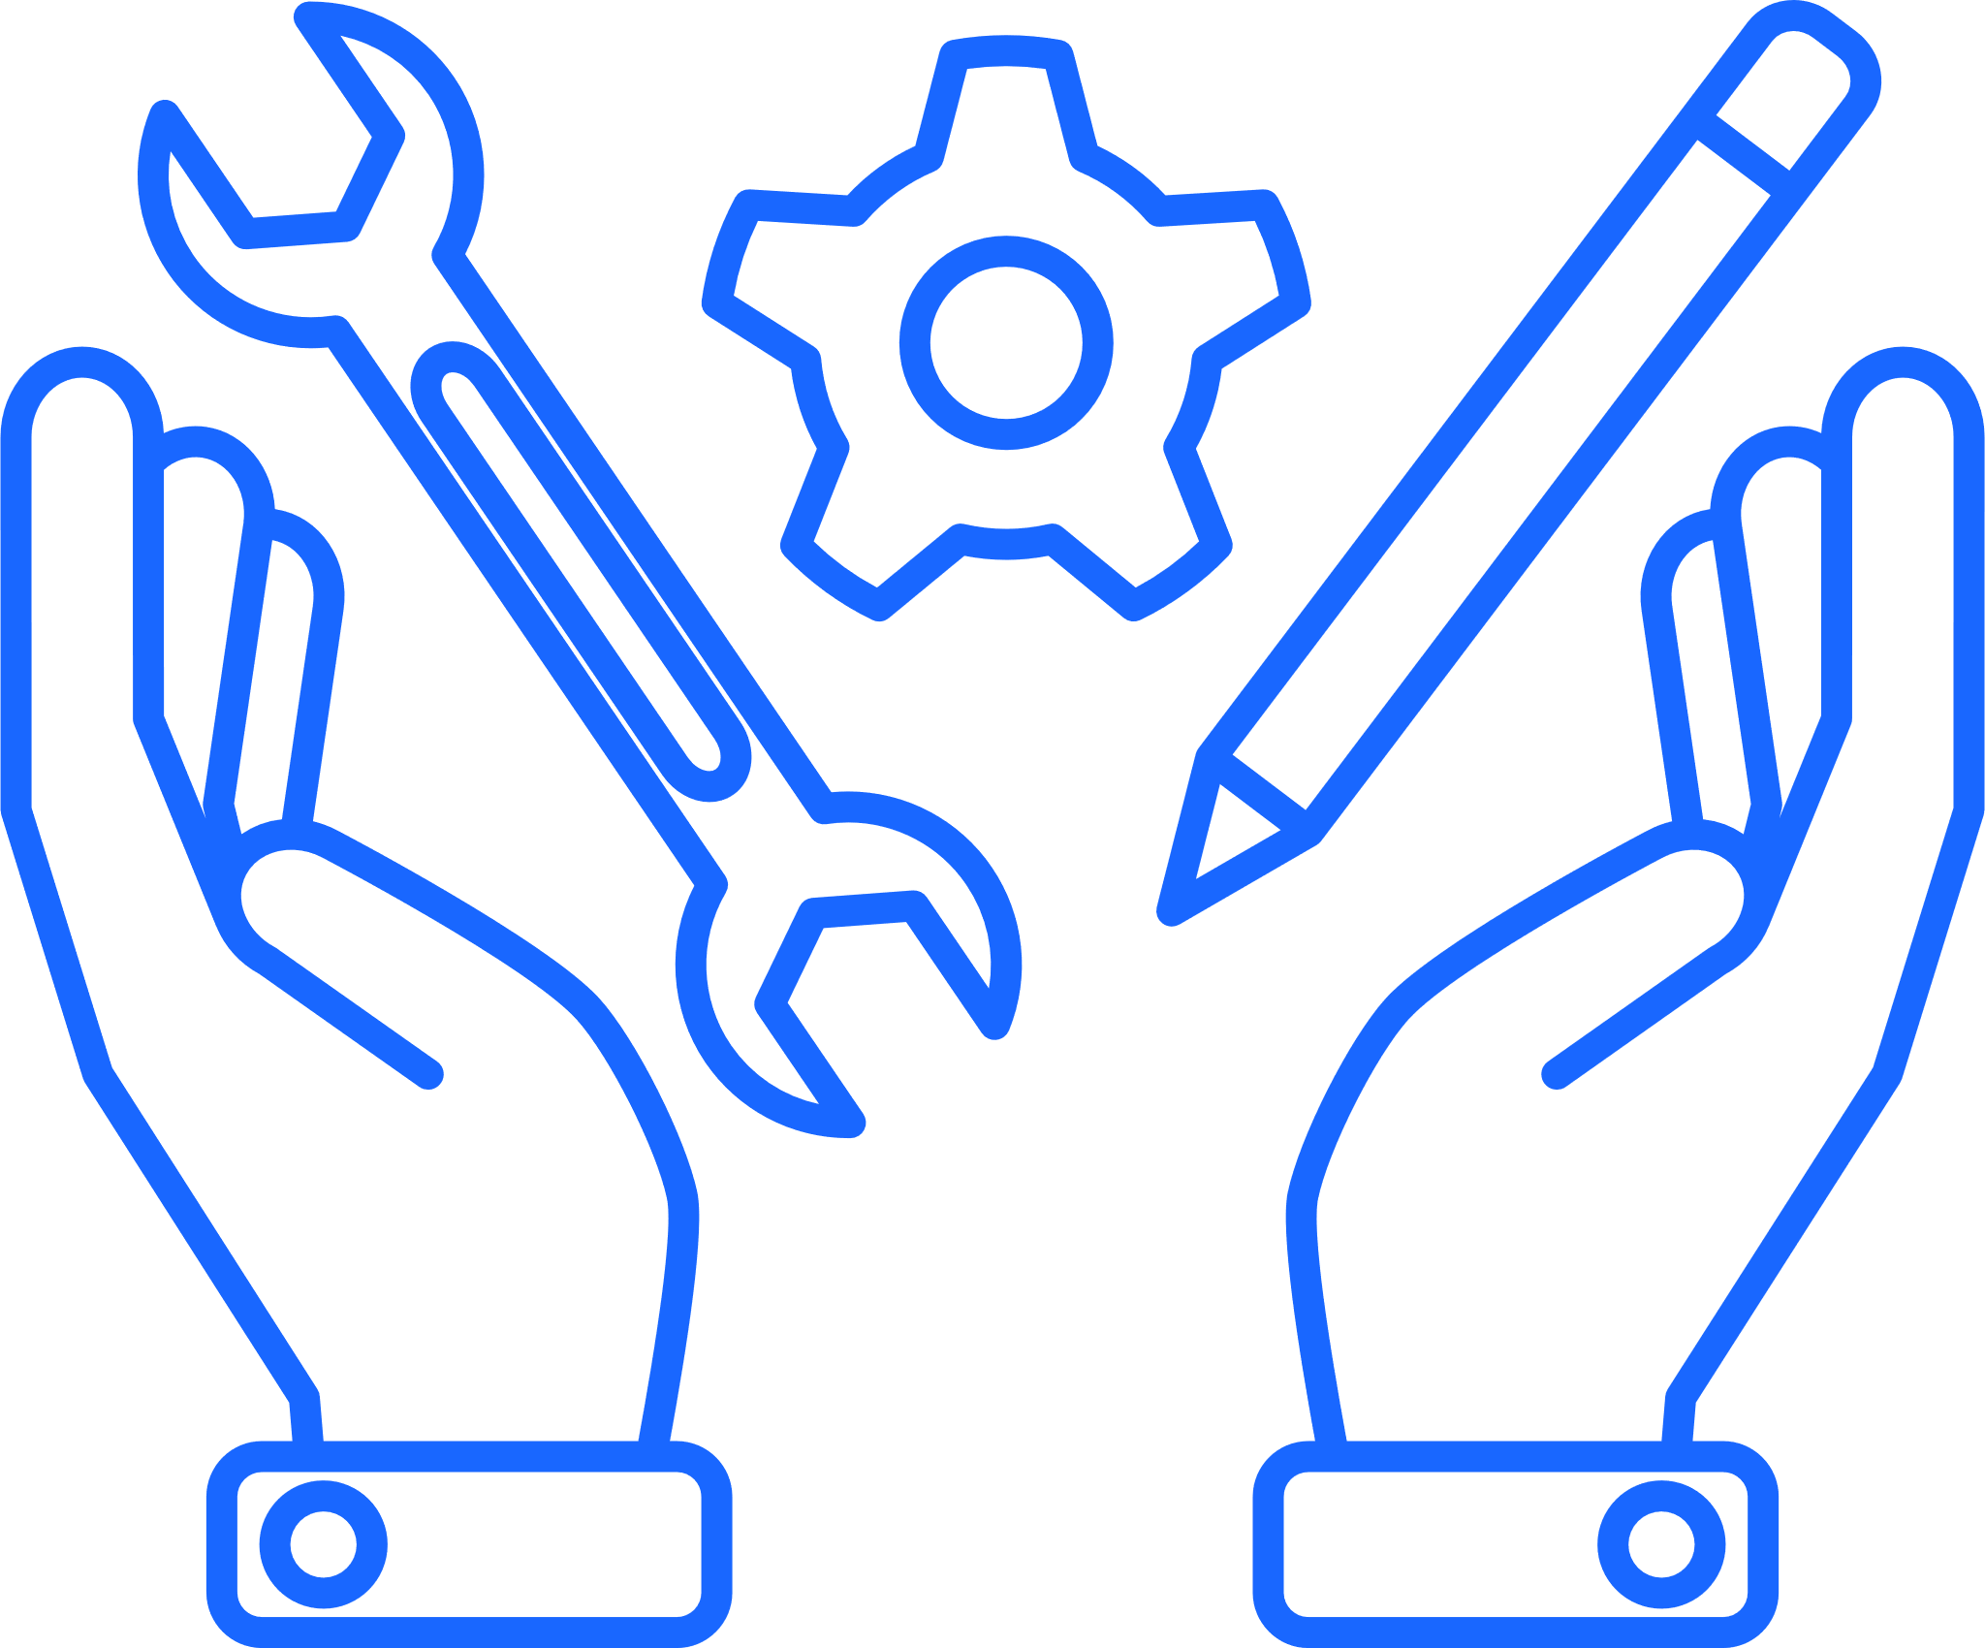
“Build ecosystems that blend essential qualities”
Critical thinking
Perseverence
Empathy
Growth
Grit
Lived experience
Flexibility
Open-mindedness
Resilience
Curiousity
Blue sky thinking
Impact
Innovation
Listener
Entrepreneurial
Co-creation
Self motivated
Creative
Bold
Strategic
Initiative
Lead
Self motivated
Activist

Slide 6
What will you do?

Slide 7
What will you do?

