Slide 1
Future skills requirements in the age of emerging technologies
Digital Skills Forum
19 September 2024
Manama, Bahrain
Stijn Broecke
Senior Economist

Slide 2
The risk of automation is high
Share of employment in occupations at the highest risk of automation by country, 2019

Slide 3
But in many countries, employment is at a record high
Employment to population ratio, ages 15 to 64

Slide 4
AI creates new jobs: workers with AI skills are increasingly demanded in the labour market
% of vacancies demanding AI skills

Slide 5
AI also creates jobs indirectly: AI exposure is associated with higher employment growth

Slide 6
High-skilled workers possess more skills that cannot be automated yet (“bottleneck skills”)
Shares of bottleneck and highly automatable skills and abilities, by occupation

Slide 7
There are fewer and fewer jobs for the low-educated

Slide 8
But is the demand for some high-level skills also beginning to fall?
Occupations highly exposed to AI demand management and business skills
But in workplaces most exposed to AI, there are signs of declining demand for these skills

Slide 9
Many firms provide training to workers
Percentage of employers that address changes in skill needs by retraining or upskilling workers and other strategies
Source: OECD employer survey on the impact of AI on the workplace (2022)

Slide 10
Workers who have received training are more positive about the impact of AI

Slide 11
But perhaps more needs to be done?
Share of employers saying lack of skills is a barrier to adopting AI
% of employers

Slide 12
Public policies should encourage more training for AI
Close monitoring of the impact of AI on the labour market
Sound skills assessment and anticipation programs
Skills development programmes at all levels of education and for various groups of workers
Employment support measures, including targeted training programmes and career guidance
Targeted grants or subsidies for SMEs to facilitate their adoption of trustworthy AI

Slide 13
Changing skill needs necessitate new and targeted training
What type of training?
For specialised AI skills, initial education is important but lifelong learning is crucial
Elementary knowledge of AI should be taught at all levels of education
Who to target?
Vulnerable workers, to support equity
High-skilled workers, to support productivity

Slide 14
THANK YOU

Slide 15
More AI-related training opportunities will be needed
Share of AI-related formal and non-formal training programmes
%
Source: Forthcoming OECD work on “Training provision for the green transition and adoption of AI ”

Slide 16
The AI workforce is growing rapidly
Share of employment with skills for developing AI, 2011 & 2019
Source: Green, A. and L. Lamby (2023), “The supply, demand and characteristics of the AI workforce across OECD countries”

Slide 17
More and more jobs are exposed to AI
Share of vacancies with high exposure to artificial intelligence, 2021-2022
Source: Green, A. (2024), “Artificial intelligence and the changing demand for skills in the labour market”

Slide 18
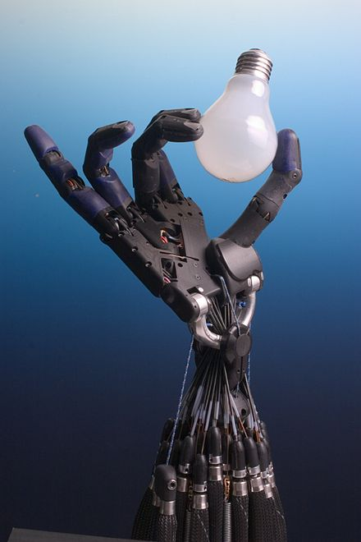
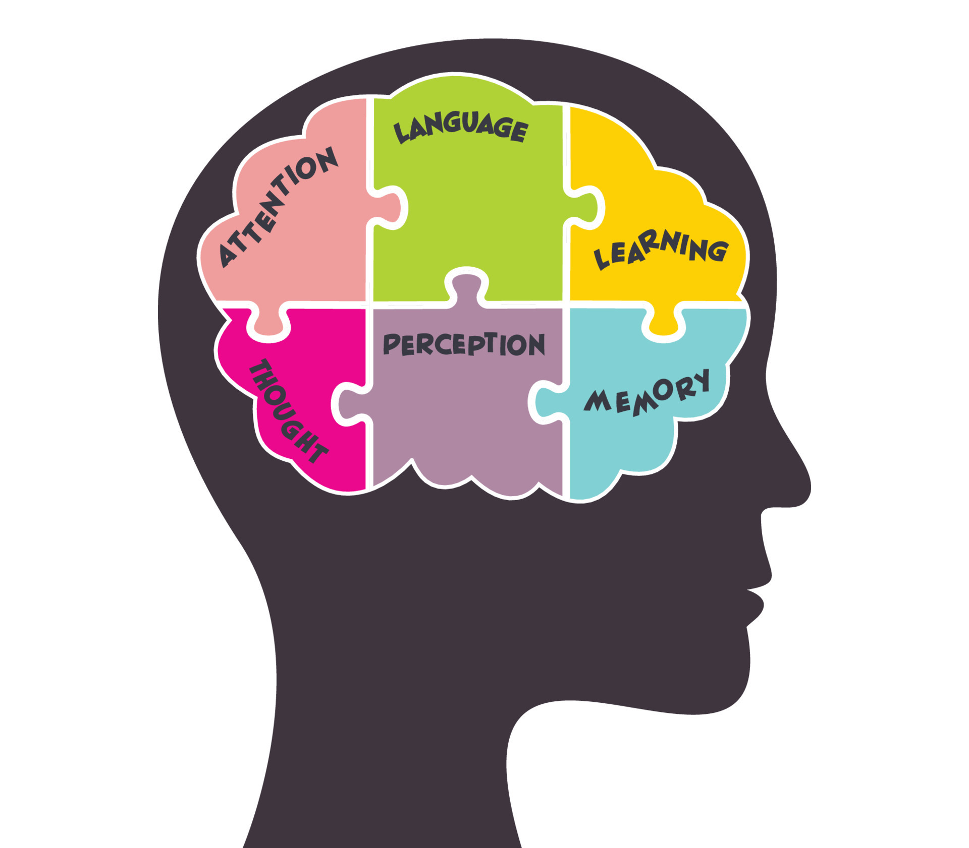
AI is also making important progress in “bottleneck” areas
Théâtre D'opéra Spatial, Jason M. Allens
First place, emerging artists, digital arts,
Colorado State Fair Fine Arts Competition
Arts, creativity
Cognitive skills, literacy
Fine psychomotor abilities

Slide 19
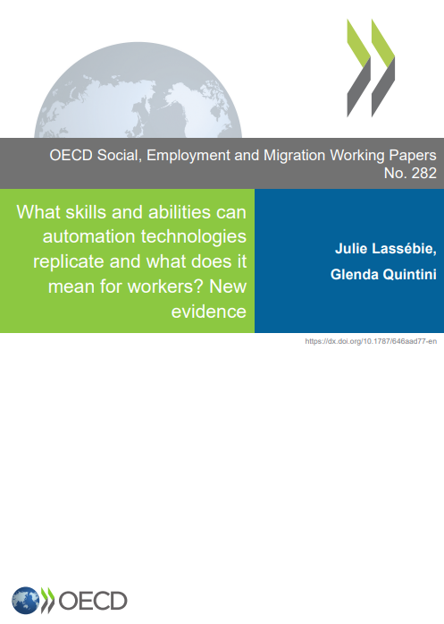
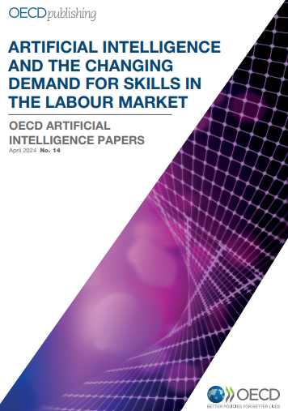
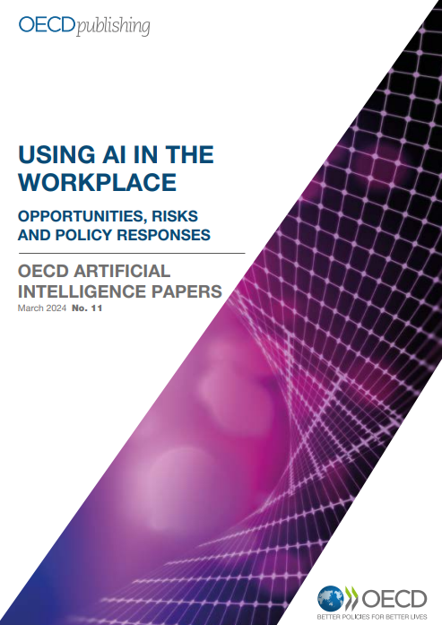
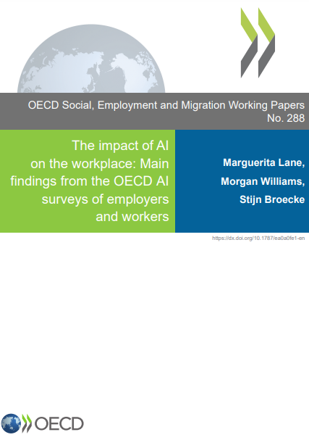
Numerous OECD works on the topic

