Slide 1
FUTURE SKILLS REQUIREMENTS MAIN POINTS
Significant Impact of Emerging AI Technologies
Role of Higher Education in Workforce Preparation
Knowledge Transfer to Developing Countries
Future Trends in Online Education for AI Skills
Fostering Inclusive and Adaptive Learning

Slide 2
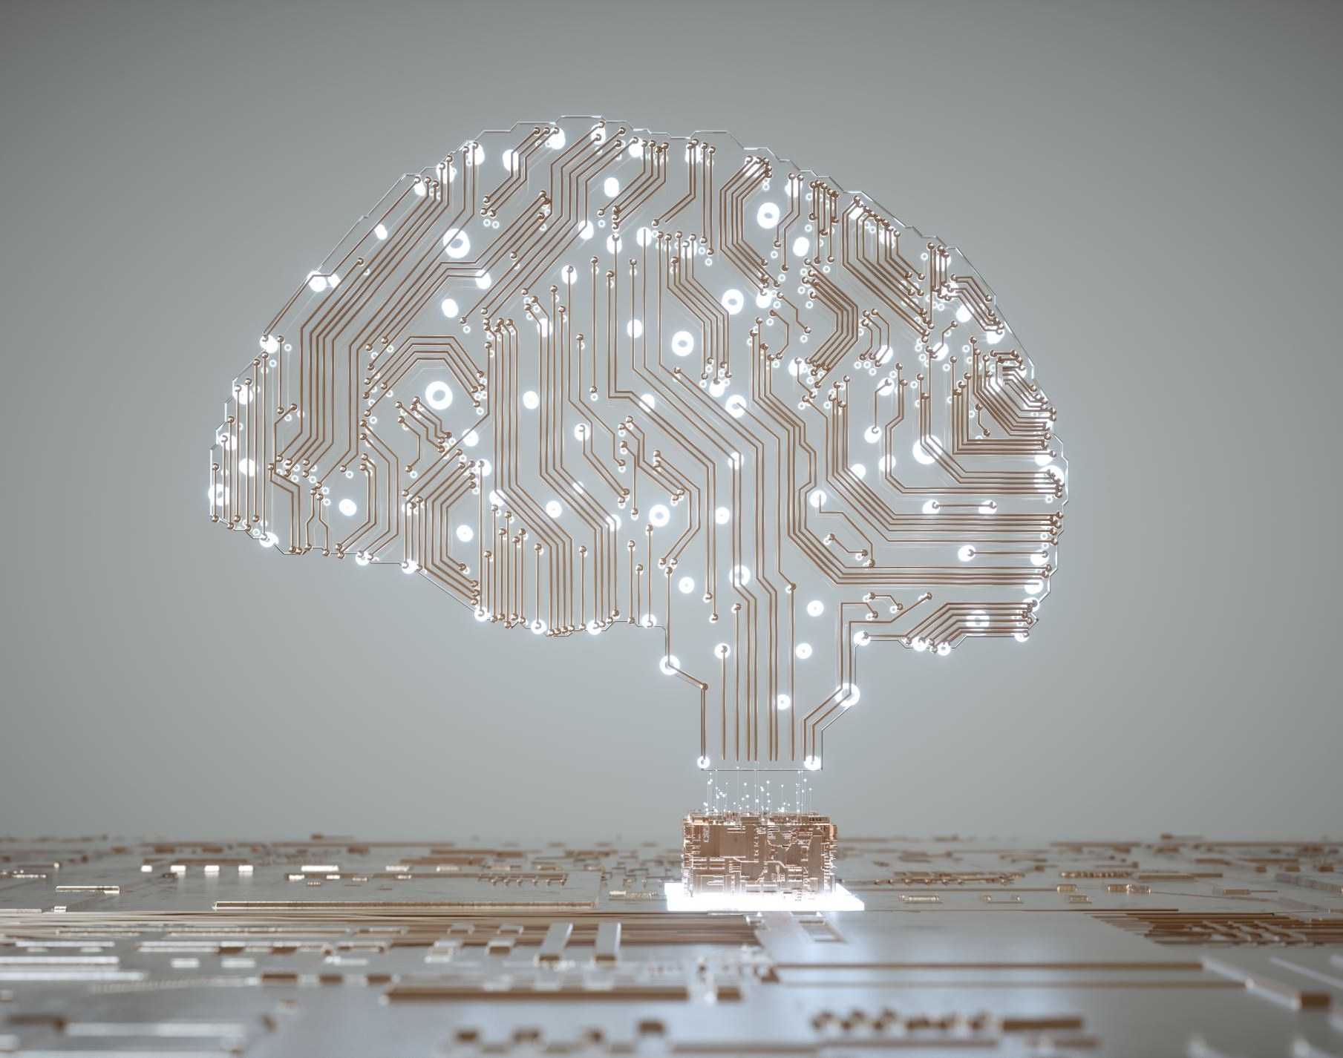
SIGNIFICANT IMPACT OF EMERGING AI TECHNOLOGIES ON FUTURE TASKS AND SKILLS
Generative AI
Natural Language Processing
Computer Vision
Reinforcement Learning
Predictive Analytics
AI in Healthcare

Slide 3
ROLE OF HIGHER EDUCATION INSTITUTIONS IN PREPARING THE WORKFORCE FOR AUTOMATION ESPECIALLY IN DEVELOPING COUNTRIES
Curriculum Development Focused on Digital Skills
Promoting Lifelong Learning and Flexibility
Industry Partnerships for Practical Training
Fostering Innovation and Entrepreneurship
Building Soft Skills for Human-AI Collaboration
Advocating for Inclusive Education

Slide 4
KNOWLEDGE TRANSFER ESPECIALLY WITH DEVELOPING COUNTRIES
Joint Degree Programs and Exchange Initiatives
Online Learning Platforms and Open Courseware
Research Collaborations and Knowledge Sharing
Faculty Training & Development Programs
Technology and Infrastructure Support
Scholarships and Financial Aid

Slide 5
FUTURE TRENDS IN ONLINE AND EXTENDED EDUCATION PLATFORMS FOR MEETING AI SKILLS NEEDS IN DEVELOPING COUNTRIES
Personalized Learning Experiences
Increased Access to High-Quality Content
Micro-credentials and Modular Learning
Collaboration with Local Industries
Low-bandwidth and Offline Solutions
Community-Based Learning and Peer Support

Slide 6
KEY TAKEAWAY POINTS
Enhancing learning through developing dynamic capabilities
Facilitating sense making in AI Education
Building intellectual capital through collaborative cross-disciplinary research
Promoting knowledge sharing among universities
Developing dynamic learning AI communities
Discipline knowledge is essential

Slide 7
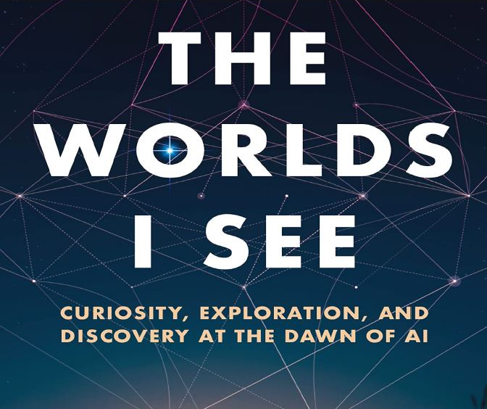
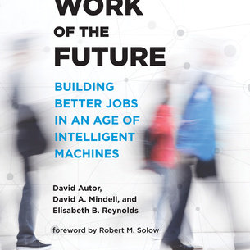
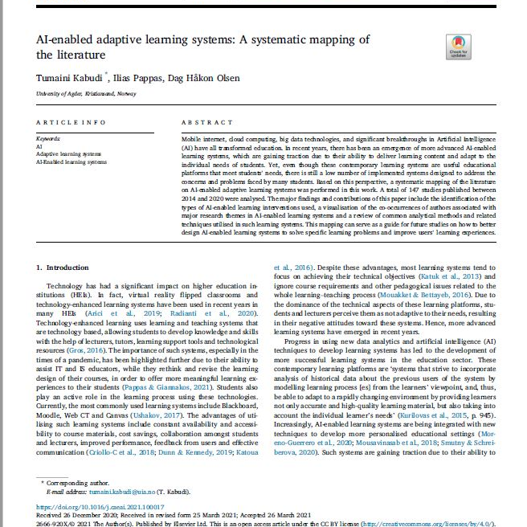
BIBLIOGRAPHY
Havard Business Review, (2019), Artificial Intelligence (Erik Brynjolfsson, Thomas Davenport, Andrew Ng)
Autor, David, Mindell, David,and Reynolds, Elisabeth, (2021), The Work of the Future: Building Better Jobs in an Ae of Intelligent Machines, Cambridge, MA: MIT Press.
Mazzucato, Mariana (2021), Mission Economy, London: Penguin.
Li, Fei-Fei, (2023), The World I See: Curiosity, Exploration, and Discovery at the Dawn of AI, New York: Flatiron Books
Kabudi, Tamaini, Pappas, Illas, and Olsen, Hakon, (2021), AI-enabled adaptive learning systems: A systematic mapping of the literature, Computers and Education: Artificial Intelligence.

