Slide 1


Skills for the Twin Green and Digital Transition
Green Skills
Generic Skills
Digital Skills

Slide 2
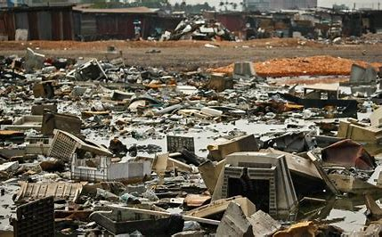

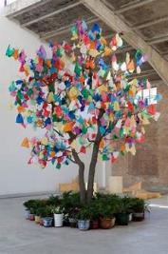
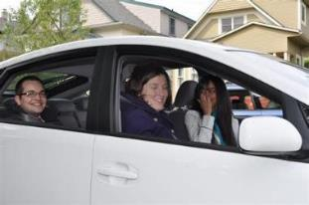
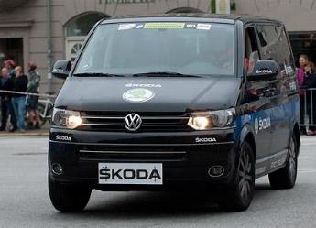
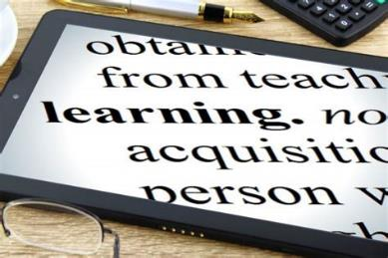
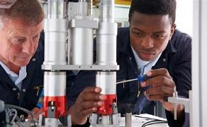
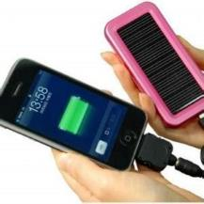
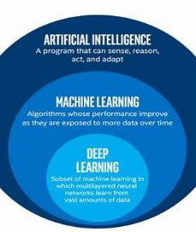
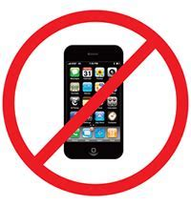
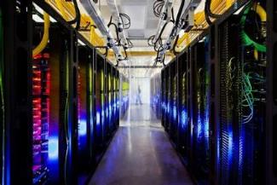
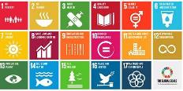
Combine “Green” and “Digital” skills to become “Green & Digital”
Skills to use platforms and applications, such as Ride share / Use of house (airBNB) / Selling second hand products
Skills to commercially recycle/sell e-waste
E-commerce options, but also environmental damage from transporting e-commerce products
E-learning tools and skills, with paper saving and less travel
Understanding when to upgrade versus buy
Skills to safely recycle e-waste
E-Waste use and management
E-Commerce and Services
Energy use and reduction
Policy Design and Evaluation
Hard skills to design more environmentally
/ energy-use efficient devices
Hard skills to Design Smart home applications (e.g. Smart Heating use)
User skills irt use Smart home applications
Data collection and analytical skills
to analyse data and understand trends related
to sustainability.
Design and use solar power chargers for electricity and electronics
Basic awareness to switch off devices and save energy
Awareness that the use of AI requires data centers to use water and energy
Policy design and evaluation skills to understand impact irt borader SDG (e.g. Digital divide, equality, sustainability)

Slide 3




Green and Digital Transition Requires Educational Responses
Global transition, yet local context differs a lot.
Societal change precedes formal educational responses – non-formal, on the job and community based training for basic skills in combination with advanced knowledge and skills and capacity development
Fast moving field, that requires continous responses
Both technical (hard) skills as well as policy analytical skills and generic skills are needed to guide the transition
Higher Educational Growth in programmes evident, but mainly in global north.
Degree education to fit labour market needs
Digital Transformation Programmes
Data Science education
Sustainable Development Programmes
Lifelong Learning in Higher Education
Demographic changes require people to work longer
Digital Divide i.r.t. Age
Technical and Hard skills need retraining
Leadership / soft skills take time to develop

Slide 4
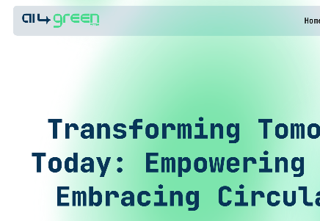
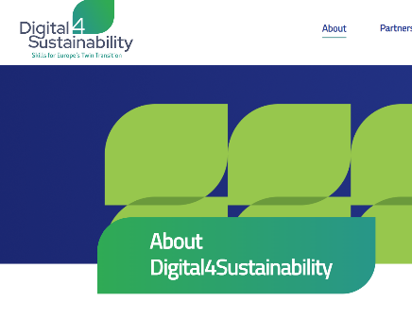
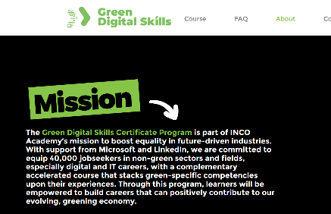
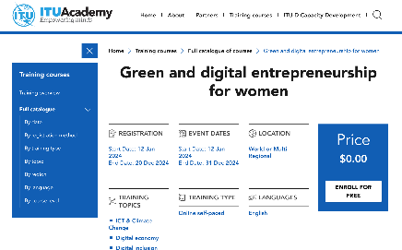
Twin Transition is new – early mover examples
AI4GreenSME: (ai4greensme.eu).
Erasmus+ funded Malta, Cyprus, Spain and Bulgaria. Help SME to use digital to become more sustainable.
Erasmus+: Digital4Sustainability
24 European countries (digital4sustainability.eu), upskilling workforce to make ICT more sustainable.
Inco Academy for Green Digital Skills
INCO Academy | Green Digital Skills Certificate Program (inco-group.co)
ITU Academy
Summer School on Digital Transformation for Sustainability
ITU Academy
Green and digital entrepreneurship for women | ITU Academy

Slide 5
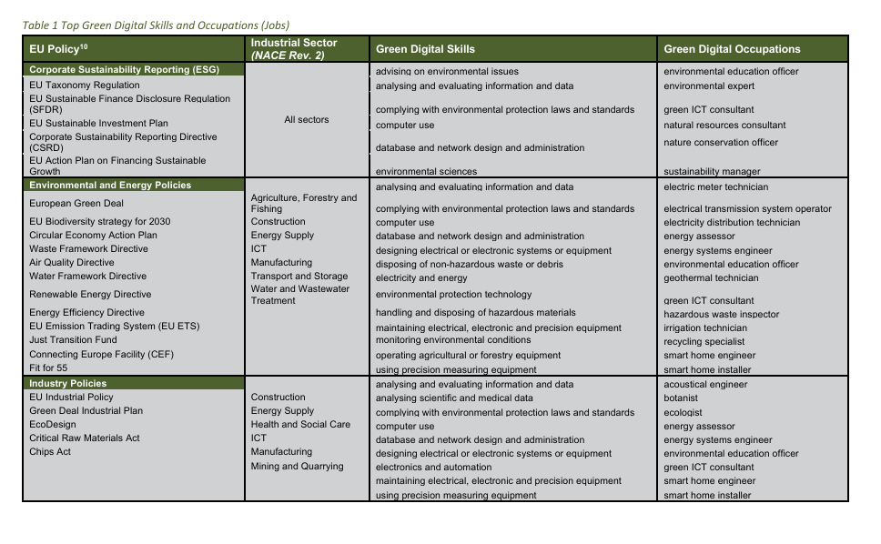
HUAWEI Study on defining green digital skills and jobs
Higher education
Advice on green or digital issues
Analyse and evaluate data
Legal compliance
Designing systems / equipment
Technical / Vocational level
Computer skills
Dealing with waste
Dealing with / maintaining equipment
HUA-White Paper-Twin Skills for the Twin Transition.indd (huawei.com)

Slide 6
Role of Higher Education Institutions in the Twin Transition
DEGREE
Design education based on real examples, case studies, and policy issues
Build cross-cutting skills in programmes
LIFELONG LEARNING
Train Policy Makers and professionals, to design and evaluate policy for (green) development
Train Higher Educated Staff of companies and institutions, to keep up with developments
Train the trainers and other HE institutions
Funding or scholarships for global south participants
HE DIGITAL AND SOCIO-ECONOMIC DIVIDE
Beware of digital divide within Higher Education, at enrollment level
But also within HE systems, at national, institutional and staff/student level, there is an divide with respect to access and use of hardware and software, that impacts educational results
INNOVATION AND RESEARCH
Cooperate with governments, NGO, Industry to complement skills
Communicate findings beyond academia - Share best practices and challenges

Slide 7
ITU Digital Skills Forum Role of Higher Education in Green and Digital Transition
United Nations University
Maastricht Economic and Social Research Institute on Innovation and Technology
THANK YOU
Dr. Mindel van de Laar
Head Capacity Development Office, UNU-MERIT (Maastricht University)
cdo@merit.unu.edu
Mindel.vandelaar@maastrichtuniversity.nl

