Slide 1
Skills for the green and digital transitions
Olga Strietska-llina
Team Lead Skills for the Future of Work
International Labour Organization

Slide 2
Some immediate technology-induced job losses may be partially compensated by decarbonisation measures
Greening of economy can create new space for application of technologies and drive new innovation
Interconnected digital and green transitions
Digital
Green
Development and application of green technologies can speed up the green transformation process
Digitalization can facilitate more equitable access to skills development opportunities, supporting the skills base for green and digital economies.
Teleworking and digitalisation of learning decrease carbon footprint
Notes:
These transformations are not isolated trends but rather occurring simultaneously and interacting with one another. The digital and green transitions including other drivers of change form a complex web of dynamic and interconnected factors that transform the way we work and learn.
Example: increasing consumer demand for clean energy (e.g. in the United States), energy-efficient homes (e.g. in Australia) and more water-efficient technology to respond to rising consumption (e.g. in the United Arab Emirates) are driving skills for green jobs through training, development of technology and policy incentives (2019 Skills for Greener future report)

Slide 3
Technological change and digitalization: Opportunities & Challenges
Opportunities
Challenges
Digital divide & Digital gender divide within countries & across countries
Efficiency and productivity gains
Algorithmic management affects job quality and may lead to the de-skilling of the workforce
Innovation
Empowerment and augmentation of the workforce's capabilities
Displacement risk for manual routine-based jobs and beyond
Potential employment creation and opportunities
Skills gaps
Sources: ILO (2021), Changing demand for skills in digital economies and societies
Notes:
Digital divide between countries
In 2019, 87% of people were using the Internet in developed countries, compared with 44% in developing countries.
The COVID-19 pandemic sparked a surge in Internet use and in 2020 and by mid 2022, over 63 per cent of the world population were internet users. Yet that means that just over a third of the world’s population does not use the Internet. Many of them live in least developed countries and the majority are women and girls.
The digital gender gap continues expanding in many developing countries, creating a specific need to support digital gender equality in terms of access to digital infrastructure. Disparities in access than translate into disparities in access to digital skills and jobs. In LDCs, only 19 per cent of women used the Internet in 2020, compared to 86 per cent in developed countries in 2019.
According to the ILO Statistics, in almost every country, regardless of income level or development stage, women are under-represented in the information and communication sector. Based on data available for 116 countries, women’s median share of employment in those positions is less than one third. When women do get a digital job, they face a median gender pay gap of 21%.
Algorithmic management
The changes that algorithmic management introduces in work organisation may have detrimental effects on several aspects of job quality. Often workers have little possibility to override or even discuss these instructions with supervisors, because the data and the algorithms have already defined these instructions and tasks distribution in the (supposed) optimal way. In addition, a prolonged loss of autonomy, due to the continuous repetition of discrete tasks under strict instructions, can prevent workers to use, practice and develop competences and knowledge in their job, which leads to the de-skilling of the workforce. (ILO June 2022).

Slide 4
ENVIRONMENTAL IMPACTS OF ICT AND AI
Sources: ILO (2021), Changing demand for skills in digital economies and societies
Notes:
Teleworking and digitalisation of learning may decrease carbon footprint. Teleworking arrangements and the digitalization of learning can contribute significantly to reducing the carbon footprint.
Digital learning reduces the need for physical infrastructure and transportation, leading to lower energy consumption and carbon emissions. For instance, the Open University in the UK found that online courses consumed 90% less energy and produced 85% fewer CO2 emissions per student than traditional face-to-face courses.
Digital technologies also contribute to e-waste.
Gen AI offers a transformational potential but, with their heavy reliance on data centres and high energy use, they also leave carbon footprint. Exponential growth of energy consumption in recent years and it is still forecast to triple this year.
One AI query requires ten times more electricity than a Google query.
The economist Maria Mazzucato recently reported that “about 700,000 litres of water could have been used to cool the machines that trained ChatGPT-3 at Microsoft’s data facilities”.
Learning and innovating how AI and digital technologies can develop sustainably and how energy can be clean, affordable and abundant, are key challenges for the twin green and digital transition

Slide 5
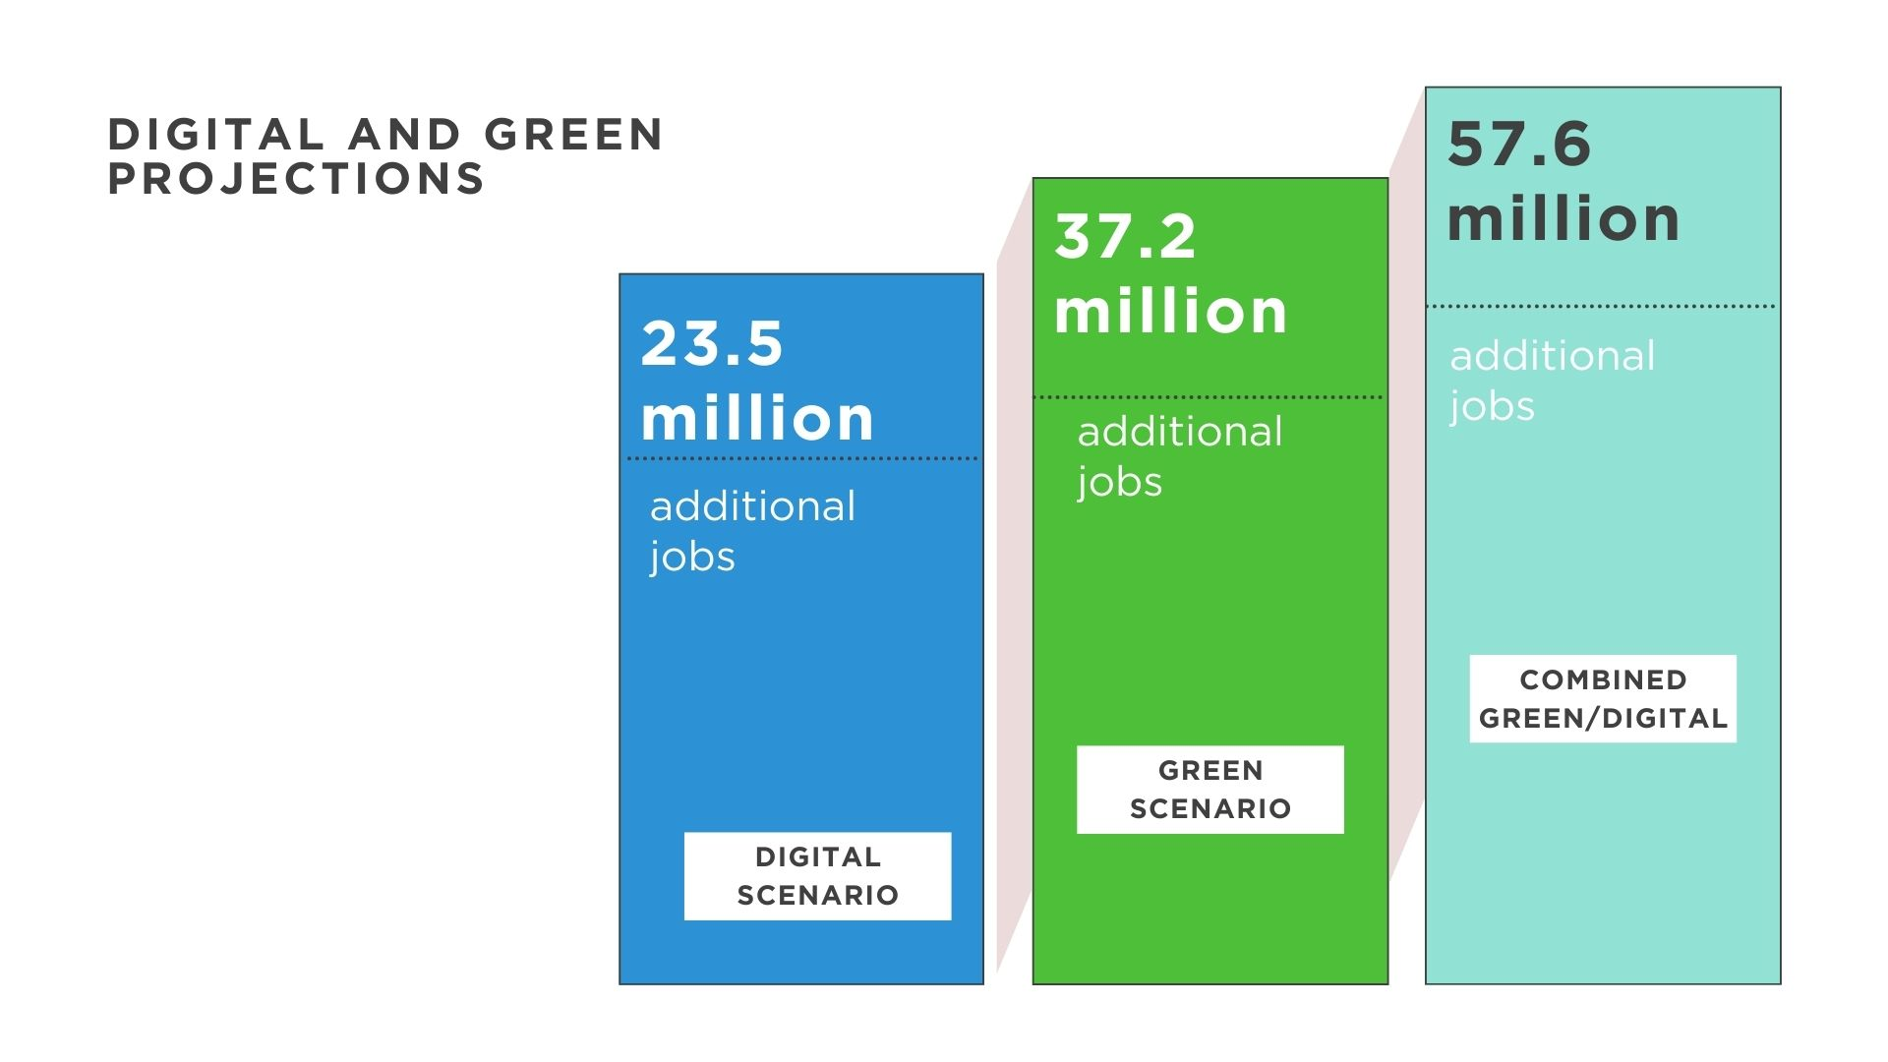
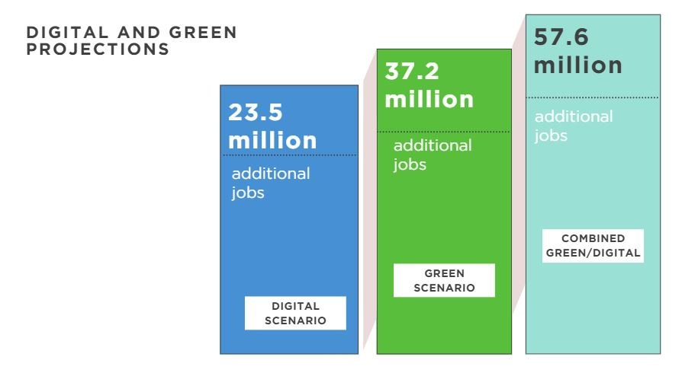
Total Employment Gains by 2030 compared to business-as- usual scenario
on top of that…
When efforts are combined
Policies and investment to achieve 1.5 °C goal
By 2030, BAU scenario will push the global employment up to…
Investment to achieve 90% broadband coverage
3.5
billion
Source: ILO(2024), based on the E3ME model of Cambridge Econometrics
Notes:
Employment projection by 2030
By 2030, the business-as-usual scenario will push the global employment up to 3.5 billion by 2030. On top of this growth prospect, there are opportunities for additional job creation that can arise from the investments to achieve the universal broadband coverage and the energy transitions:
The investments to achieve universal broadband coverage can create around 23.5 million additional jobs.
The implementation of climate and energy policies and the investments in renewable energy and energy efficiency to achieve the 1.5-degree target can create around 37.2 million additional jobs.
When these efforts are combined, the additional jobs that can be created by these investments and policies can be as much as 57.6 million jobs.

Slide 6
Top 10 occupations with Largest Gains in the Digital Scenario (jobs in million)
Top 10 occupations accounting for 11 million jobs, or 46 per cent of total gain under digital scenario
Source: ILO(Forthcoming), based on the E3ME model of Cambridge Econometrics
Notes:
Digital Scenario (top 10 occupations accounting for 11 million jobs, or 46.3 per cent of total gain under digital scenario)
The investment to achieve universal broadband coverage will not only create demand for workers who are essential for the digital infrastructure development and maintenance, but also for workers who support the expansion of e-commerce and online services and meet the demand for enhanced customer engagement and personalization, which often require human interaction and not easily automatable tasks.
Except for “Building & Related Trades Workers” and “Labourers in Mining, Construction, Manufacturing & Transport”, which will see sizable gains already in the short run, most of the occupations will experience employment creation over the medium term time horizon. This is because the most of additional jobs created under the digital scenario will be due to the cascading effect of the proliferation of e-commerce and overall increase in income and resultant spending on goods and services, which will take time to manifest its impact.

Slide 7
Top 10 occupations with Largest Gains in the Green Scenario (jobs in million)
Top 10 occupations accounting for 22.4 million jobs, or 60 per cent of total gain under green scenario
Source: ILO(Forthcoming), based on the E3ME model of Cambridge Econometrics
Notes:
Green Scenario (top 10 occupations accounting for 22.4 million jobs, or 60 per cent of total gain under green scenario)
The climate policies and investment to achieve the 1.5 degree goal will create employment opportunities in a variety of occupations that are required to shift towards a low-carbon and mode sustainable economy. The demand will be particularly strong for workers who support building renewable energy infrastructure, retrofitting building for energy efficiency, developing green technology products, manufacturing necessary components, adopting business management and operation to align with environmental sustainability requirement, and handicraft production that prioritizes environmental sustainability.
In contrast to digital scenario, most occupations will see employment gain in a relatively short time period.

Slide 8
Top 10 occupations with Largest Gains in the Combined Scenario (jobs in million)
Top 10 occupations accounting for 30 million jobs, or 52 per cent of total gain under combined scenario
Source: ILO(Forthcoming), based on the E3ME model of Cambridge Econometrics
Notes:
Combined Scenario (top 10 occupations accounting for 30 million jobs, or 52 per cent of total gain under combined scenario)
When combined the investment to achieve the universal broadband coverage and the energy transitions will boost the demand for both labourers associate professionals and professionals. The employment opportunities will be created for a wide range of occupations related to construction, manufacturing, energy systems, sales, services and business administration.
In the combined scenario, not only the size of employment creation is augmented, but also the employment creation will be much more balanced with a mix of short-term and medium-term gains.

Slide 9
Employment Gains by Gender
Scenario | Gender | Net employment gain (Persons) | Gender gap (Persons)
Digital | Female | 8,231,100 | -7,086,200
 | Male | 15,317,300
 | Total | 23,548,400
Green | Female | 9,985,400 | -17,278,100
 | Male | 27,263,500
 | Total | 37,248,900
Combined | Female | 17,096,800 | - 23,451,200
 | Male | 40,548,000
 | Total | 57,644,800
Digital Scenario: Women gain around 7 million LESS jobs than men.
Green Scenario: Women gain around 17 million LESS jobs than men.
Combined Scenario: Women gain around 23 million LESS jobs than men.
Source: ILO(2024), based on the E3ME model of Cambridge Econometrics
Notes:
Gains by Gender:
Across digital, green and combined scenarios, women are significantly less likely to benefit from the newly created employment opportunities. Unless targeted actions are taken the investment in internet connectivity and energy transitions will likely further exacerbate the existing gender inequality in employment opportunity even to a greater extent than the baseline trajectory.
The realization of universal broadband coverage would enable more women to work remotely and in a more flexible manner, while creating higher demand for service-oriented occupations, such as sales workers and personal service workers, where women are relatively well represented. And yet, the projections suggest that the employment opportunities will still not be shared in an equitable manner between women and men. This suggests the need to further promote higher female labour force participation and skills development in basic digital skills and STEM fields among women.
More alarmingly, the energy transitions will create more jobs in historically male-dominated occupations, in areas such as mining, construction, manufacturing, transport, metal, machinery, electrical & electronics trades, which will lead to a much wider gender gaps than the digital scenario. The gender gap in employment opportunities in green economy coming out of our projection is in line with a number of other research findings. (e.g. OECD, 2024. Lost in the green transitions: measurement and stylized facts https://www.oecd-ilibrary.org/economics/lost-in-the-green-transition-measurement-and-stylized-facts_dce1d5fe-en). To achieve a just energy transition, there is a need for measures to address male-dominated workplace culture and practices as well as enhanced skills development in the energy and its supporting sectors. .

Slide 10
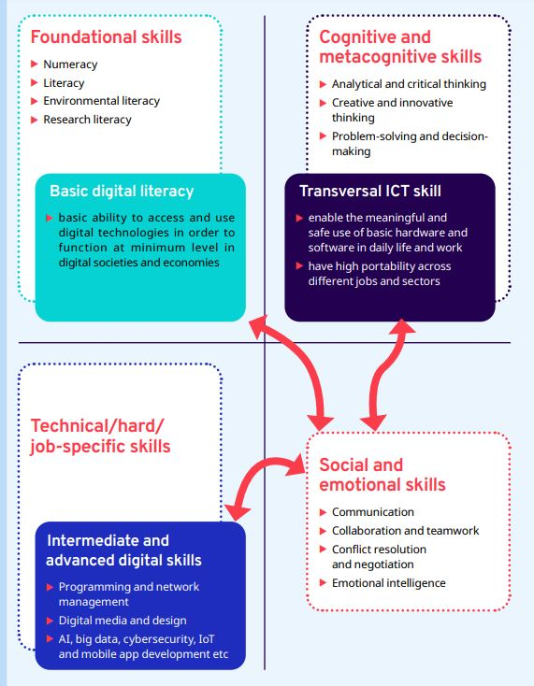
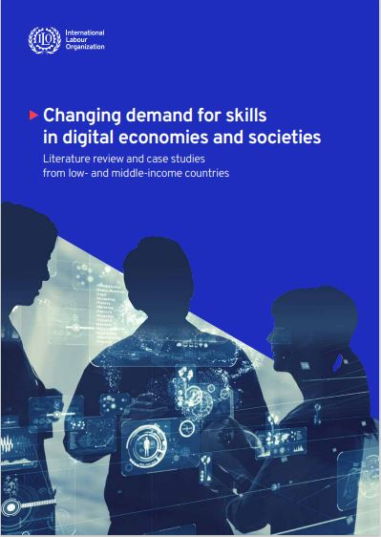
What are digital skills?
Sources: ILO (2021), Changing demand for skills in digital economies and societies
Notes:
Digital skills as a subset of skills for digital economies. There are overlaps and linkages with other types of skills and their components

Slide 11
Core employability skills for green transition
Environmental awareness
Marketing skills to promote greener products & services
Strategic & leadership skills to enable policy-makers and businesses to set the right incentives for cleaner production and transportation
Teamwork & communication skills
Coordination,& management skills
Entrepreneurial skills
Occupational Safety and health (OSH)
Innovation & digital skills

Slide 12
Policy coherence and coordination
Comprehensive and coordinated approaches
Anticipation
of skills needs
Adapting curricula and competency standards
Social dialogue and institutional development
Skills development measures enable green and digital transitions
Adapting apprenticeship training, vocational education programmes and tertiary education
Active
labour market policies
Intended
inclusive
policies
Source: ILO(2019), Skills for a Greener Future. Infographic
Notes:
It is hard to overstate the importance of enhanced policy coherence between skills/sectoral/environmental/digital policies and better-built institutional coordination among line ministries and agencies with the active involvement of social partners who have high stakes in the greening agenda. This is key for the effective design, planning, implementation and evaluation of policies on skills development for green jobs and climate action.
Effective mechanisms to anticipate and monitor skills needs for green jobs should also be put in place so that with better information and data on skills needs, we can make much more informed policy decisions and adapt curricula, competency standards, apprenticeship training and vocational education programmes to current and future demand more effectively.
We also need a complex set of policy measures, including active labour market policies, career guidance and counselling initiatives.

Slide 13
Investment in reskilling and upskilling is a condition for the green and digital transition
Skills development are
buffer
engine
Notes:
The creation of over 57 million additional jobs jobs in both scenarios cumulatively, as well as the potential loss of jobs, is entirely dependent on investment in reskilling and upskilling to equip workers with the required technical and core skills.
Therefore, investment in reskilling and upskilling is key to enable just green and digital transition which is just, productive and in the interest of economies and socieities.
Skills are buffer and enabler.

Slide 14
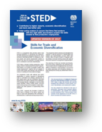
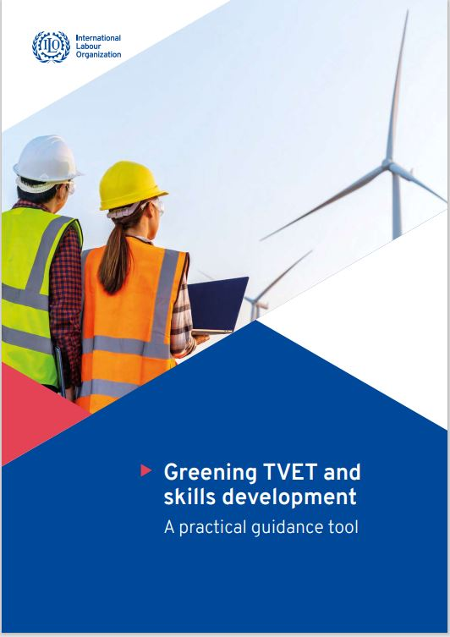
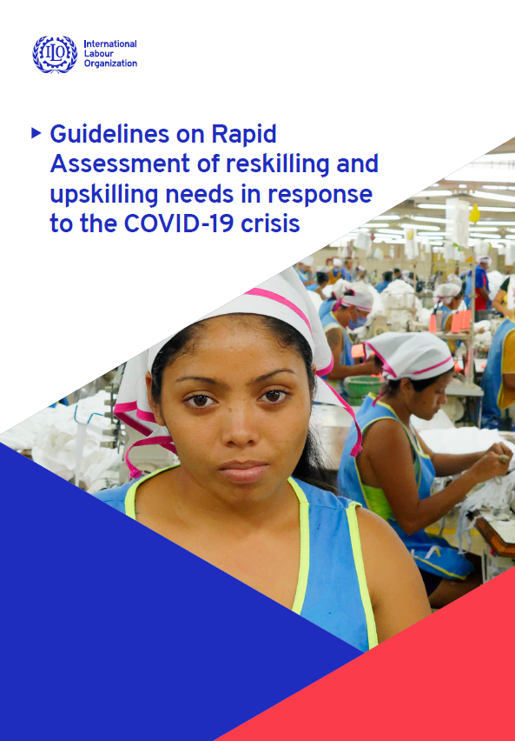
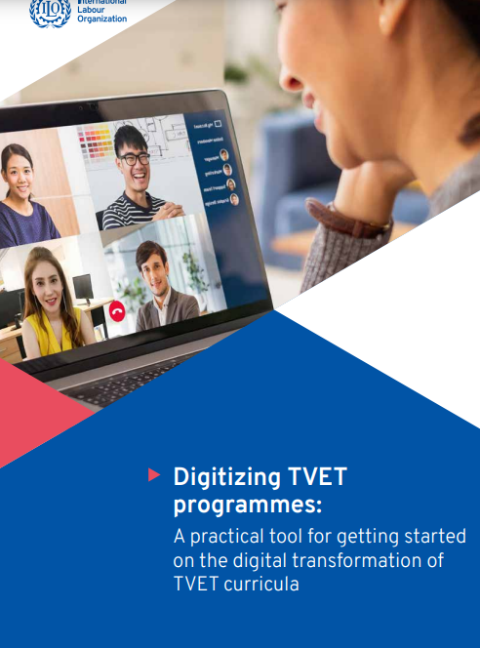
Thank you for your attention!
More resources at: ilo/skills

