Slide 1
Digital Skills for the Future: Perspectives from Stanford and the Silicon Valley
Mei Zhao
Chief Education Solutions Officer
Stanford Global and Online Education
Stanford University
September 18, 2024
The ITU Digital Skills Forum
Notes:
Introducing myself and CGOE

Slide 2
AGENDA
Three Questions:
What’s AI’s Impact on Jobs?
What do we humans do in the age of AI?
What are the essential digital mindsets and skills for the future?

Slide 3
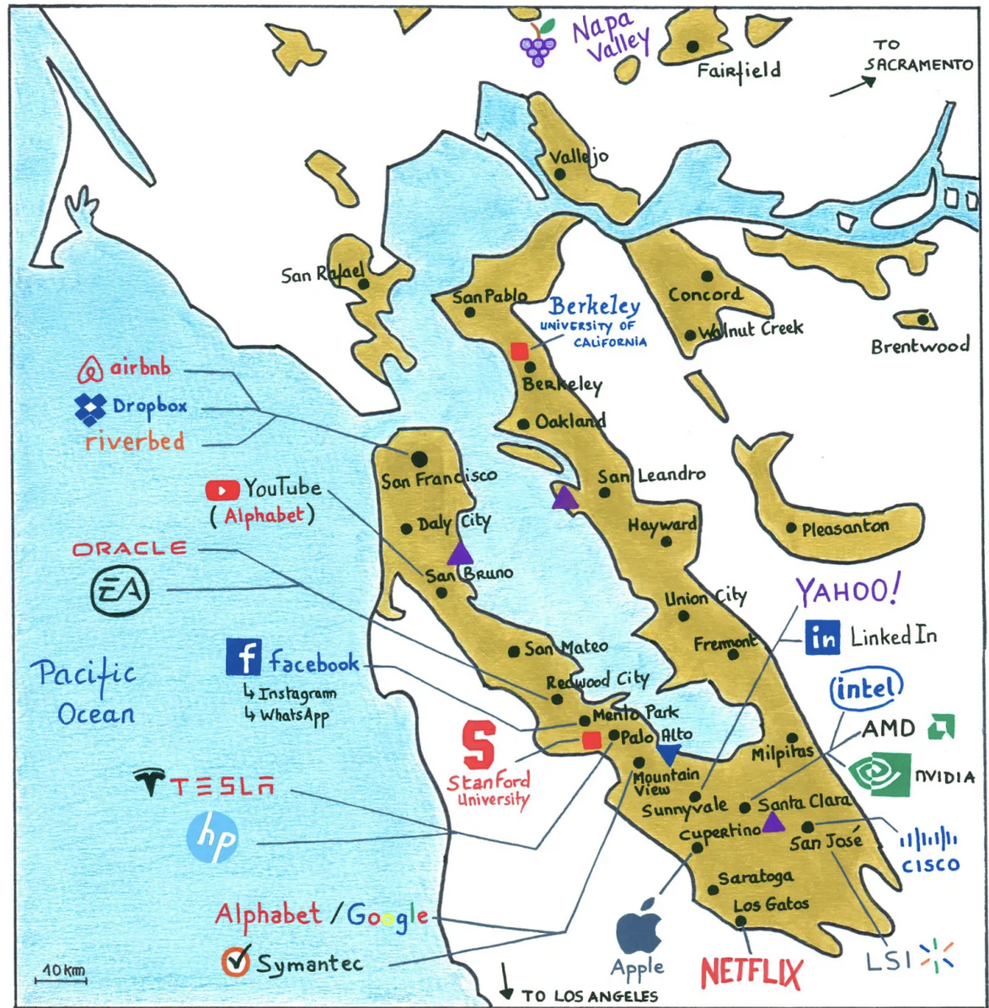
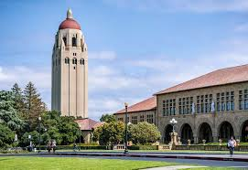
Stanford University and the Silicon Valley
Stanford University
HP Garage: Birthplace of the Silicon Valley
Photo credit: Mind the Map. https://mindthemap.fr/silicon-valley/
Notes:
For more than a century, Stanford has discovered and fostered breakthrough technologies that have been instrumental in the rise and constant regeneration of Silicon Valley, and at the same time, contributed to the broader global economy. Stanford graduates have founded, built or led thousands of businesses, including some of the world’s most recognized companies.
The presence of Stanford University was a key factor in the development of the technology enterprise now known as Silicon Valley. More than anything, it was Terman, his students, and the encouragements and opportunities that he gave them that enabled this great enterprise to flourish.

Slide 4
1. What’s AI’s Impact on Jobs?
Jobs and Tasks are Different. A Job Includes many tasks.
AI is good at: Routine tasks in highly predictable and structured environments
AI is not good at: Building human relations, understanding subtle cues of human interactions, contextual knowledge and domain expertise.
Bad news:
AI is a highly disruptive force. Already displacing certain jobs. Ethical and societal concerns.
Good news:
AI boosts productivity, replacing mundane tasks, enabling humans to focus on their roles' complex, strategic, and creative aspects, and creating new jobs.
Credit to: istock photos

Slide 5
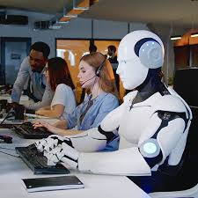
2. What Do We Humans Do in the Age of AI?
We humans have the agency to shape AI.
We need to develop skills not to compete with AI but focusing on what’s uniquely human.
We can guide and safeguard AI development to instill ethical and uniquely human values.
We use AI to augment human intelligence, rather than operating independently of, or replacing it.
“In a work team of the future, half may be people and half algorithms.”
Erik Brynjolfsson and Andrew McAfee,
The Second Machine Age.
Photo Credit to
Columbia Business School

Slide 6
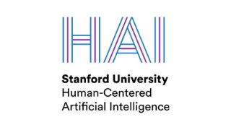
Stanford Human-centered AI
Stanford Institute for Human-Centered AI
Founded in 2019 to guide and build the future of AI.
HAI advances AI research, education, policy and practice to improve the human condition.
Interdisciplinary - led by faculty from multiple departments across Stanford.
Research focuses on:
Developing AI technologies inspired by human intelligence;
Studying, forecasting and guiding the human and societal impact of AI;
Designing and creating AI applications that augment human capabilities.
The 2024 AI Index Report
AI beats humans on some tasks, but not on all.
The data is in: AI makes workers more productive and leads to higher quality work.

Slide 7
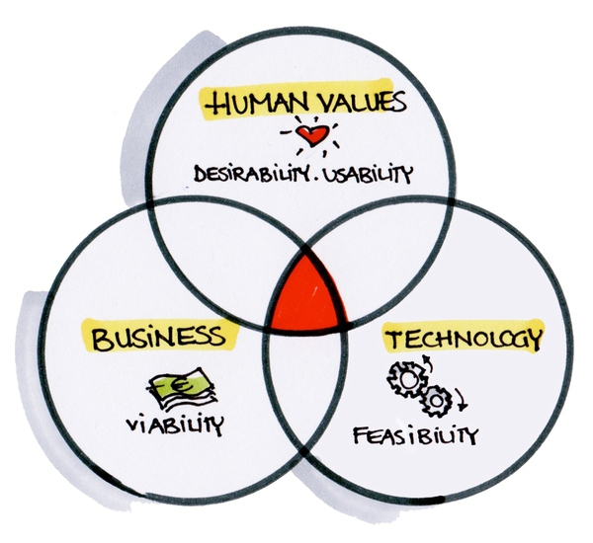
3. What are the essential digital mindsets and skills for future?
Not to competing with AI, but focusing on cultivating uniquely human skills:
Creativity and Innovation:
Problem Seeking/Defining (not just solving a given problem) – “path finders”
Curiosity & Agility
Experiment and embracing ”failure”
Critical thinking
System Thinking:
Understanding broader context and interdependencies (not just focusing local solutions)
Data Literacy:
Understanding the critical role of data as foundations for AI. Uncover biases and pitfalls. Understand data-driven decision making.
Human Skills:
Empathy, social intelligence, effective collaboration, and communication
Entrepreneurial Mindsets:
Can do spirit – even though I do know how to do it yet
“The only way to do it!” – Bias towards action
Life-long learning
Ethical Reasoning and Actions
Doing the right thing
Professor David Kelly, Co-founder of the design firm IDEO and Stanford d.School.

Slide 8
Conclusion & Call to Action
Individuals:
Cultivating uniquely human skills: creativity, empathy, social intelligence, and ethical reasoning
Embarking on life-long learning
Higher education institutions:
Embracing future digital mindsets and skills education in curricula
Promoting experiential learning and action learning
Strengthening academia and Industry partnership for real-world learning and application
Employers:
Demystifying AI
Cultivating a culture of innovation
Becoming a learning organizations
Leading Change
Notes:
Fostering a culture of collaboration between academia and industry.

Slide 9
Thank You!
Mei Zhao
Chief Education Solutions Officer
Stanford Engineering Global and Online Education
Stanford University

