Slide 1
Digital Skills
Forum
ITU Digital Skills Toolkit 2024
Presentation
September 2024

Slide 2
Background
Digital Skills Toolkit 2018, first edition
Reflect evolution of technology and economic/workforce trends
Requests from ITU membership to update Toolkit
ITU Group on Capacity Building Initiatives (GCBI)

Slide 3
Objectives
Practical tool for policy makers to develop a national digital skills strategy.
Clear steps and worksheets
Examples from around the world
Audience
Policy makers
Countries with and without existing digital skills strategy

Slide 4
“
There is a global digital skills shortage that could mean 85 million jobs are unfilled by 2030
World Economic Forum, 2023
Notes:
One indicator of the importance of digital skills is the number of jobs that will go unfilled due to a digital skills shortage – 85 million

Slide 5
Digital Skills: Cross-cutting strategy for digital transformation
Economic Growth
Employment
Social Inclusion
Reducing inequalities
Civic Engagement
E-Government
Technological Change
AI
Lifelong learning
Digital harms
Future advances
Entrepreneurship & Innovation
Notes:
Digital skills a critical and cross-cutting strategy to achieve digital transformation
Economic growth – digital skills needed in all areas of work – farming and merchants to entrepreneurship to advanced business applications
Social inclusion – digital skills needed to ensure all population groups enjoy benefits. Especially underserved. Requires lifelong learning opportunities.
Civic engagement – Citizens equipped with digital skills can participate in civic life and e-government. Importantly, learn to avoid scams and misinformation which can harm social frabic
Tech change – Strategy essential for monitoring and adapting to changes in the tech landscape. Toolkit recommends frequent strategy refresh

Slide 6
Artificial Intelligence
Generative AI becoming standard in many workplaces
Digital skills for AI
AI for digital skills
Informed, ethical & responsible use
Image: Wikimedia Commons
Notes:
AI to illustrate importance
Will have transformative impact of all sectors of society
Strategy enables country to better seize opportunities and mitigate against harms

Slide 7
Value of Framework
Standardization
Guidance
Development
Assessment
European Digital Competence Framework for Citizens
(DigComp 2.2)

Slide 8
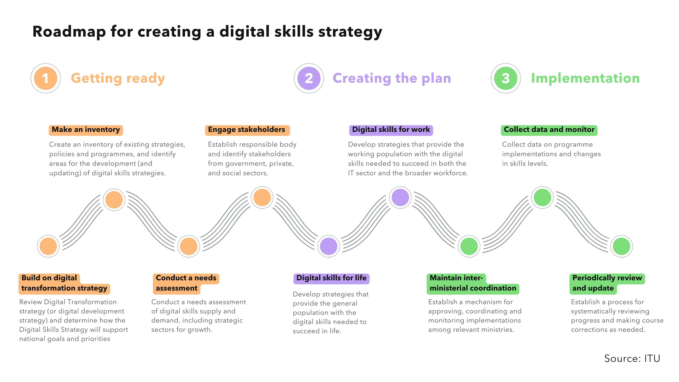
Notes:
Toolkit provides practical guidance and worksheets that cover all phases of the strategy process
Getting ready -- focuses on gathering the data and identifying the stakeholders needed to develop a comprehensive strategy
Building on a country’s Digital transformation strategy (or similar)
Creating an inventory of existing strategies, policies and programs
Conducting a needs assessment
Constituting a group of government and outside stakeholders to guide strategy development
Toolkit simplifies digital skills into 2 categories
Digital skills for life: Skills that every citizen needs to enjoy full participation in digital life
Digital skills for work: Skills at different levels needed to succeed in the workforce
Examples from around the world for inspiring own strategy
Worksheets to guide plan development
Toolkit provides overview of implementation considerations that are especially important for a topic like digital skills, such as
Collecting data and monitoring performance
Refreshing the strategy every few years

Slide 9
Digital transformation: Building on existing strategies
Create an inventory of digital transformation and skills strategies
Identify digital skills strategies within specific ministries
Conduct an assessment of digital skills strategy and programme implementations
What is the state of a country’s existing digital skills strategies?
National level - digital transformation
Ministerial level - digital skills strategies and programmes

Slide 10
Digital skills assessments: Identifying needs and evaluating progress
Identify existing data
Conduct a digital skills assessment of the general population
Conduct targeted studies
What is the importance of digital skills assessments?
Establish baseline and benchmarks
Identify underserved groups
Assess physical and human infrastructure
Perform skills gap analysis based on workforce needs

Slide 11
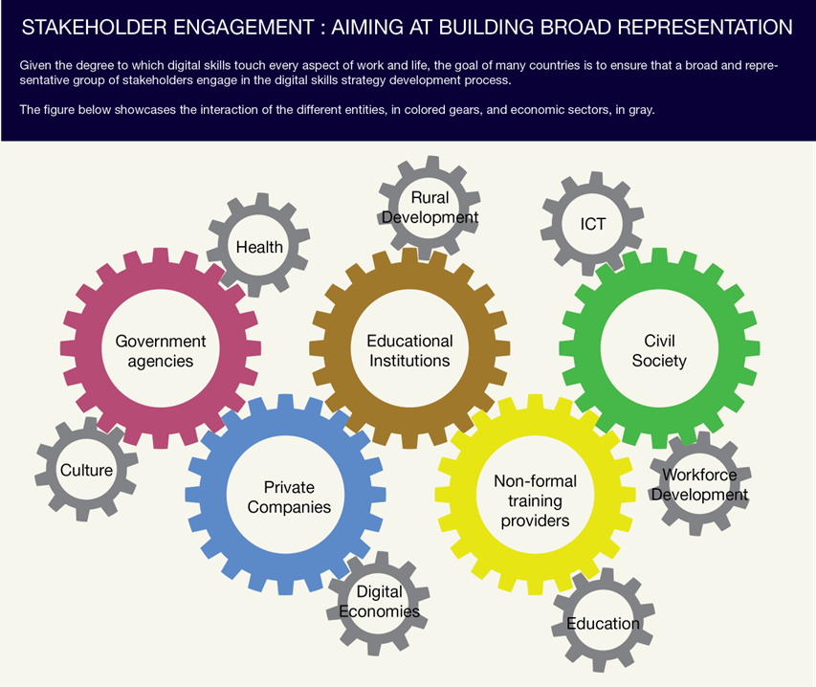

Slide 12
Digital skills for life: Developing strategies for all citizens
Develop strategy for primary and secondary education
Develop strategy for lifelong learning
Ensure inclusion of underrepresented populations
Everyone needs digital skills to be a full participant in the digital society and digital
Access news and information
Communicate with friends and family
Use government, health, other services
Entertainment and leisure

Slide 13
Digital skills for work: Developing strategies for professional development
Develop strategy for higher education and TVET
Engage IT industry
Identify partners for community-based training
More advanced skills improve opportunities for success in work
General work-related digital skills
Domain specific skills
Advanced IT skills

Slide 14
Implementation
Establish implementation oversight
Measure impact
Update national strategy
Active participation in forums, coalitions & conferences
The rapid pace of change around digital technologies requires continuous attention
Image: Joe Haupt

Slide 15
Thank you

