Slide 1
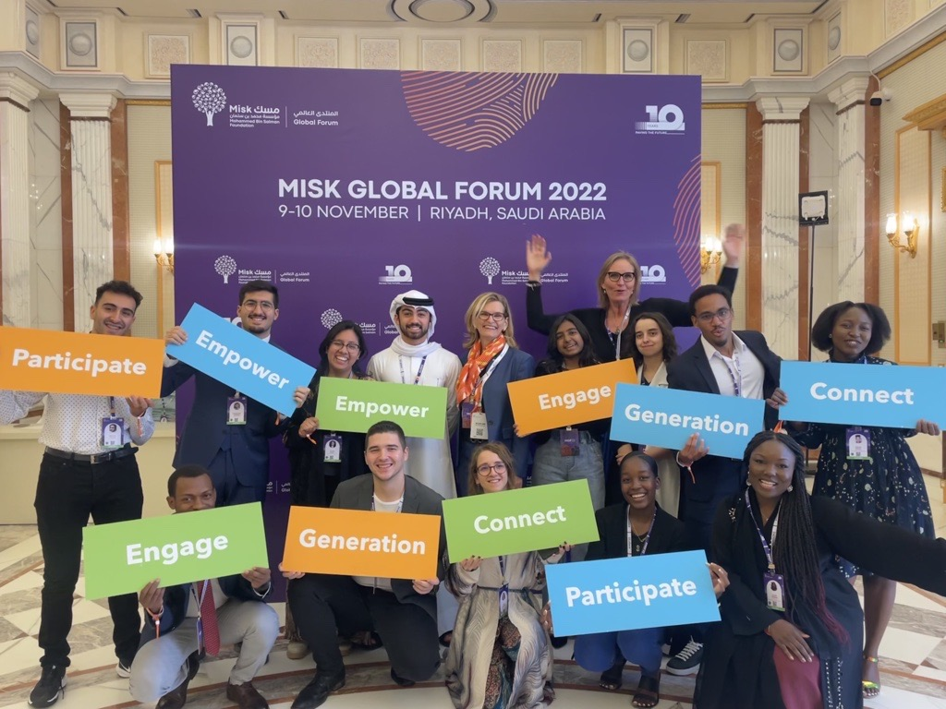
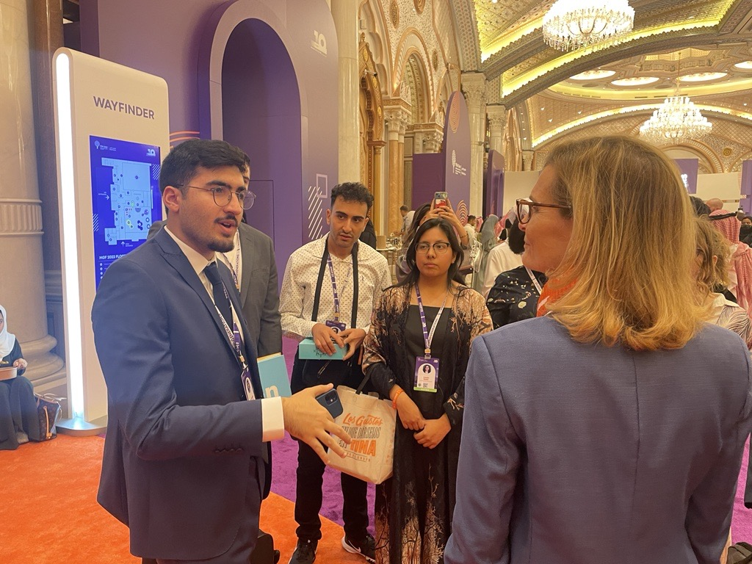
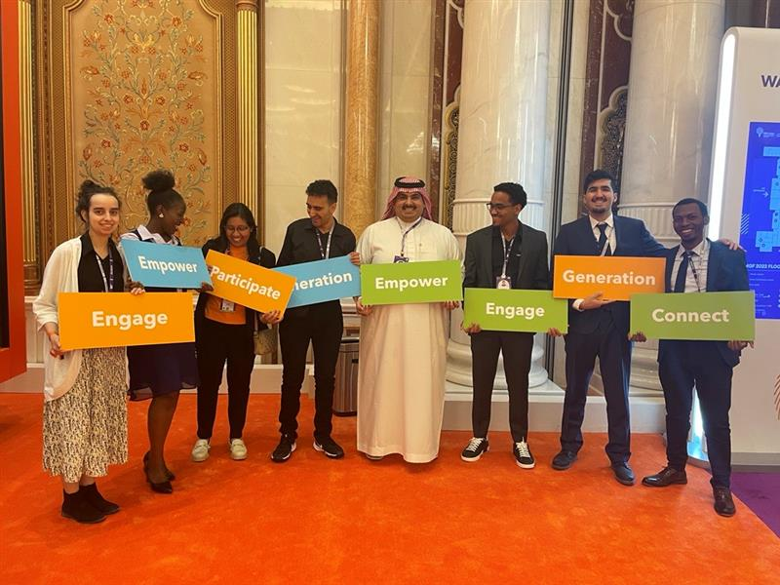
Generation Connect participation in the MGF 2022

Slide 2
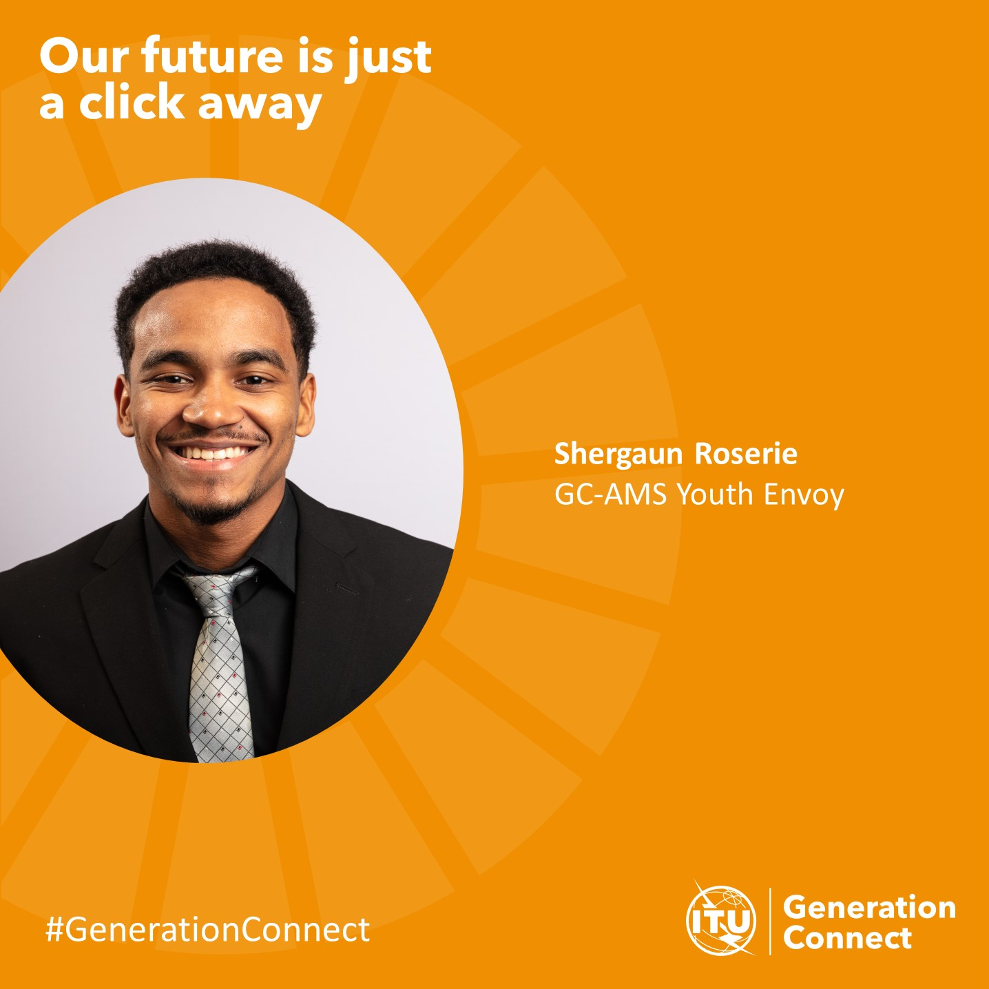
The Misk Global Forum was a highly engaging opportunity, whereby which I was given the environment to network with and learn from a diverse cast of leaders from across the world. The overall organization of the event allowed participants to not only engage speakers in an intimate environment (through the various sections apart from the stage) but also the opportunity to gain practical skills from the event through the skills lab. I believe that this was a key aspect of the event which I would love to see be integrated into more global events.
As an entrepreneur, I spent much of my time engaged in the Founders’ Café. The speakers gave deep and insightful knowledge into their own growth and were keen to engage listeners for several moments even after their speech had ended. I was able to capitalize on this opportunity to network with both the cofounder of Enhance Ventures and the cofounder of Foodics who both shared their thoughts on how I could tackle challenges that I was facing with my own start-up. This opportunity has inspired me to continue to strive towards my goals and has reinforced in me that I can one day be just as successful as these global business titans.

Slide 3
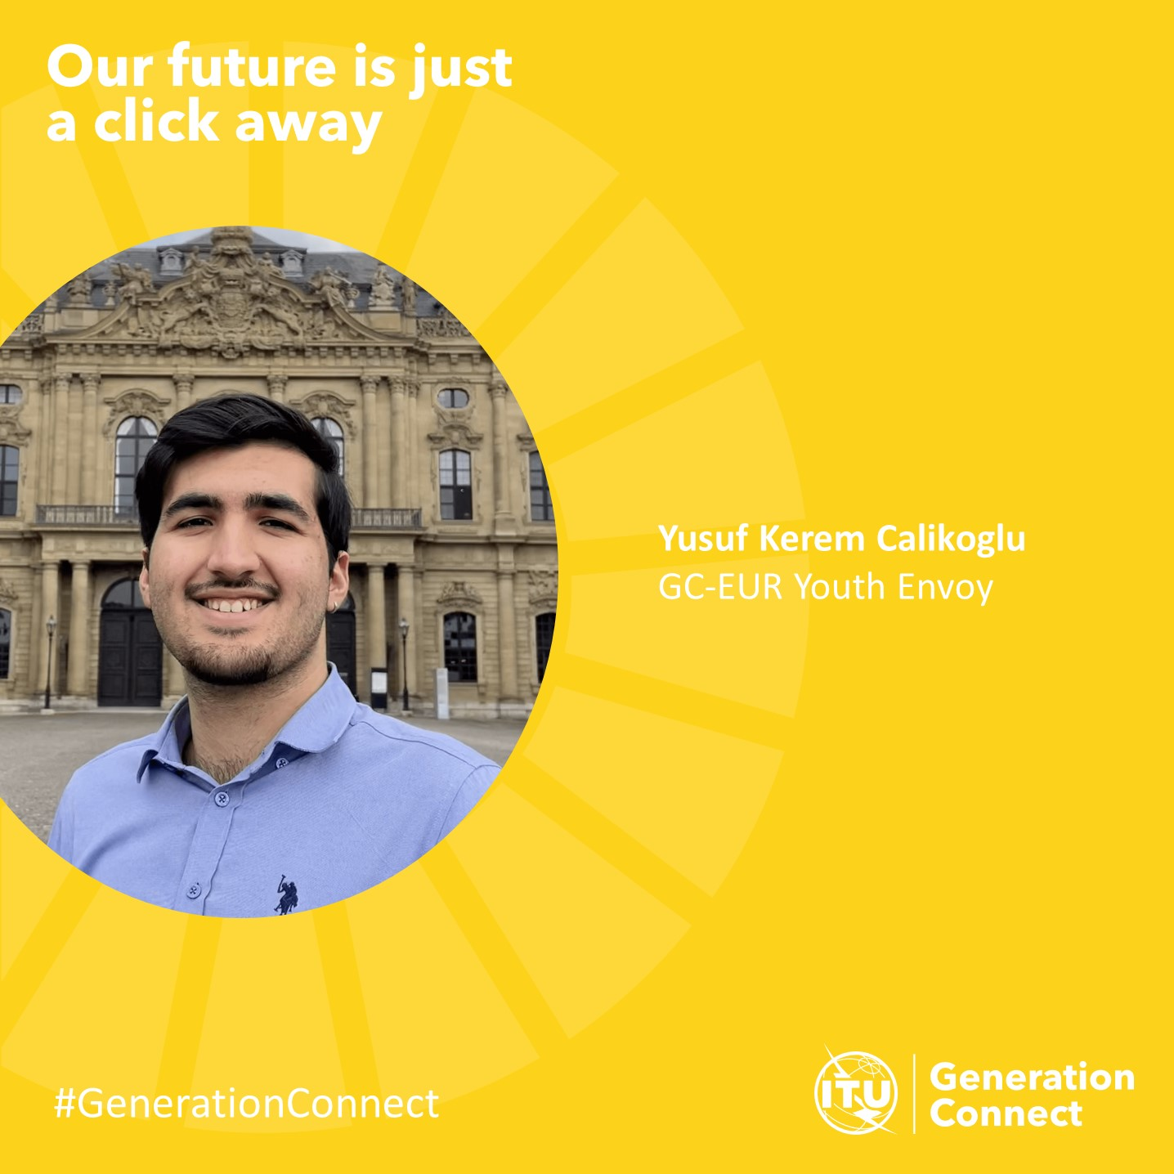
First of all, even just experiencing the culture was amazing. This was my first visit to Saudi Arabia. So seeing its deep and rich culture and getting to know the locals was a huge learning experience.
The opportunity to hear visionary and successful people from all around the world talk about various topics at a multigenerational event was eye-opening. The topics varied from entrepreneurship to mental health. Having attended one session to hear about people's entrepreneurial experiences and attending another session to learn about taking care of one's mental health in just one single event felt really unique. My favorite sessions were at the Founders Cafe where I met with like-minded entrepreneurs and had the pleasure to exchange information with them.

Slide 4
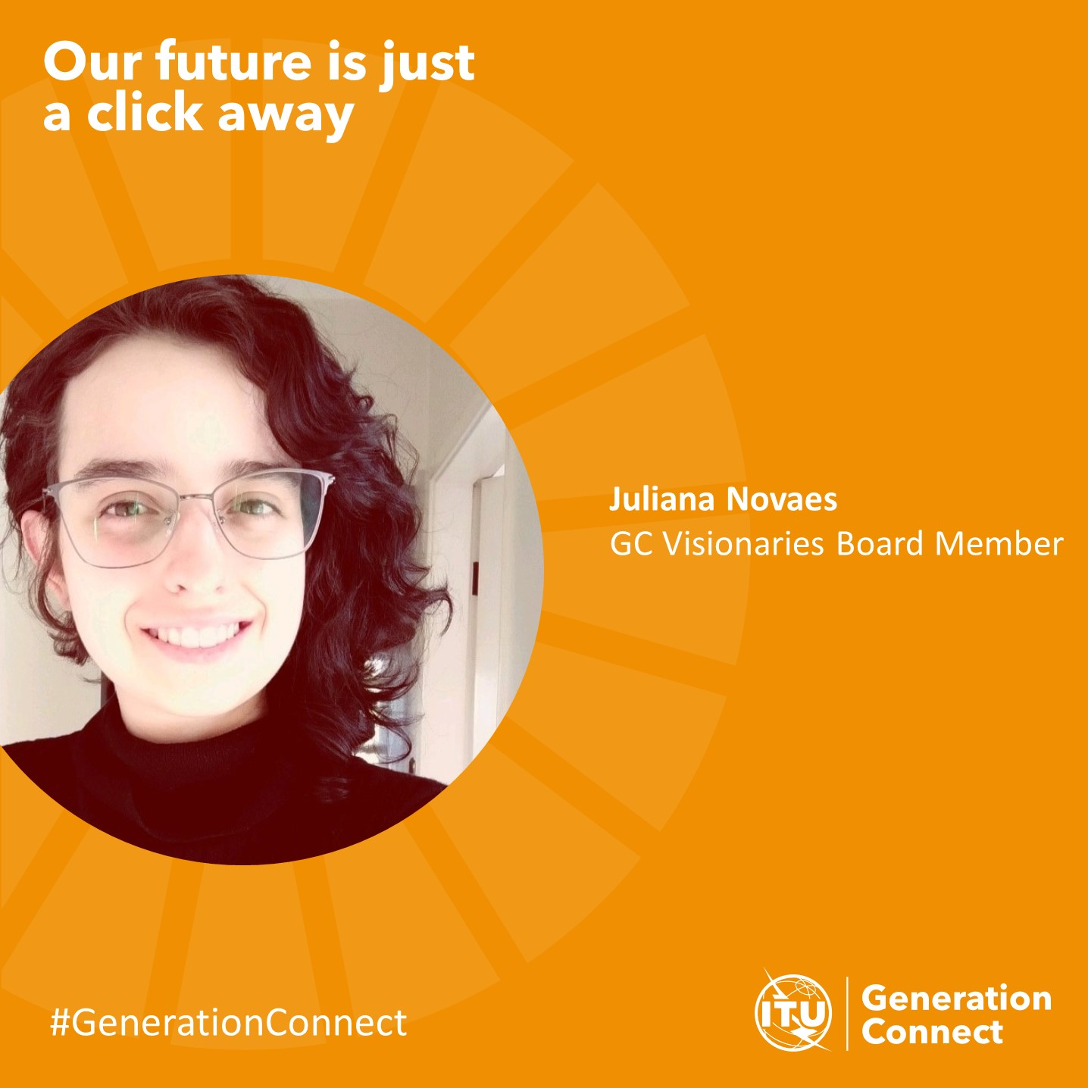
MISK impressed me not only for the quality of its program and the impeccable organization, but also for its holistic approach to youth development and innovation.
During the panels, skills and mentoring sessions, we are introduced to content that goes way beyond the typical talks on how to build our hard skills or become more competitive in the investment and job markets.
Contrary to many other events I have attended in the past, the focus of MGF sessions was much more on how to become stronger, empathic and resilient to overcome the difficulties we will face as young people starting our career amid a global crisis. In this forum, I learned from highly qualified panelists the importance of meditation, therapy, saving money, investing, communicating with people from different cultures and overcoming my cultural biases. These, in my opinion, are skills we have little contact with in our formal education and that I personally believe are very valuable.
We cannot become good leaders and innovators if we are not resilient and have a people-centered attitude, being able to overcome our personal difficulties and learning to communicate and respect our differences. MISK is an example to be followed on how to build an event for youth and I am extremely grateful for having joined this year's edition.

Slide 5
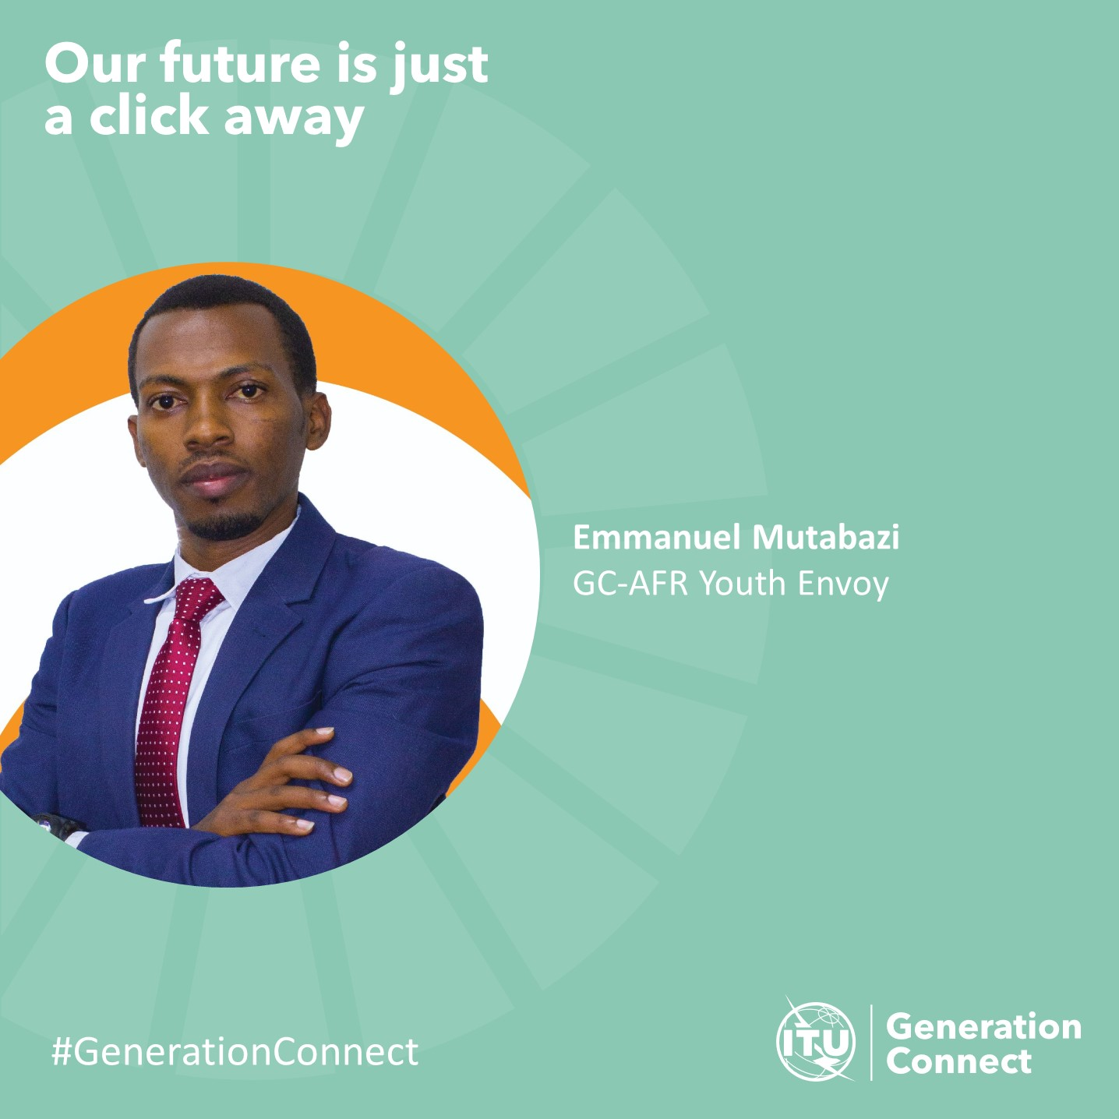
The experience was memorable and mind blowing. People from all walks across the world under one roof to challenge themselves on how to create positive change, that was super interesting.
Moreover, I would like to take this opportunity to thank Misk foundation and ITU as well as partners who made it possible for us to attend the forum and youth representation in particular. I am thankful for that!
We look forward to keep the momentum to strive for change and bridge generations to come.

Slide 6
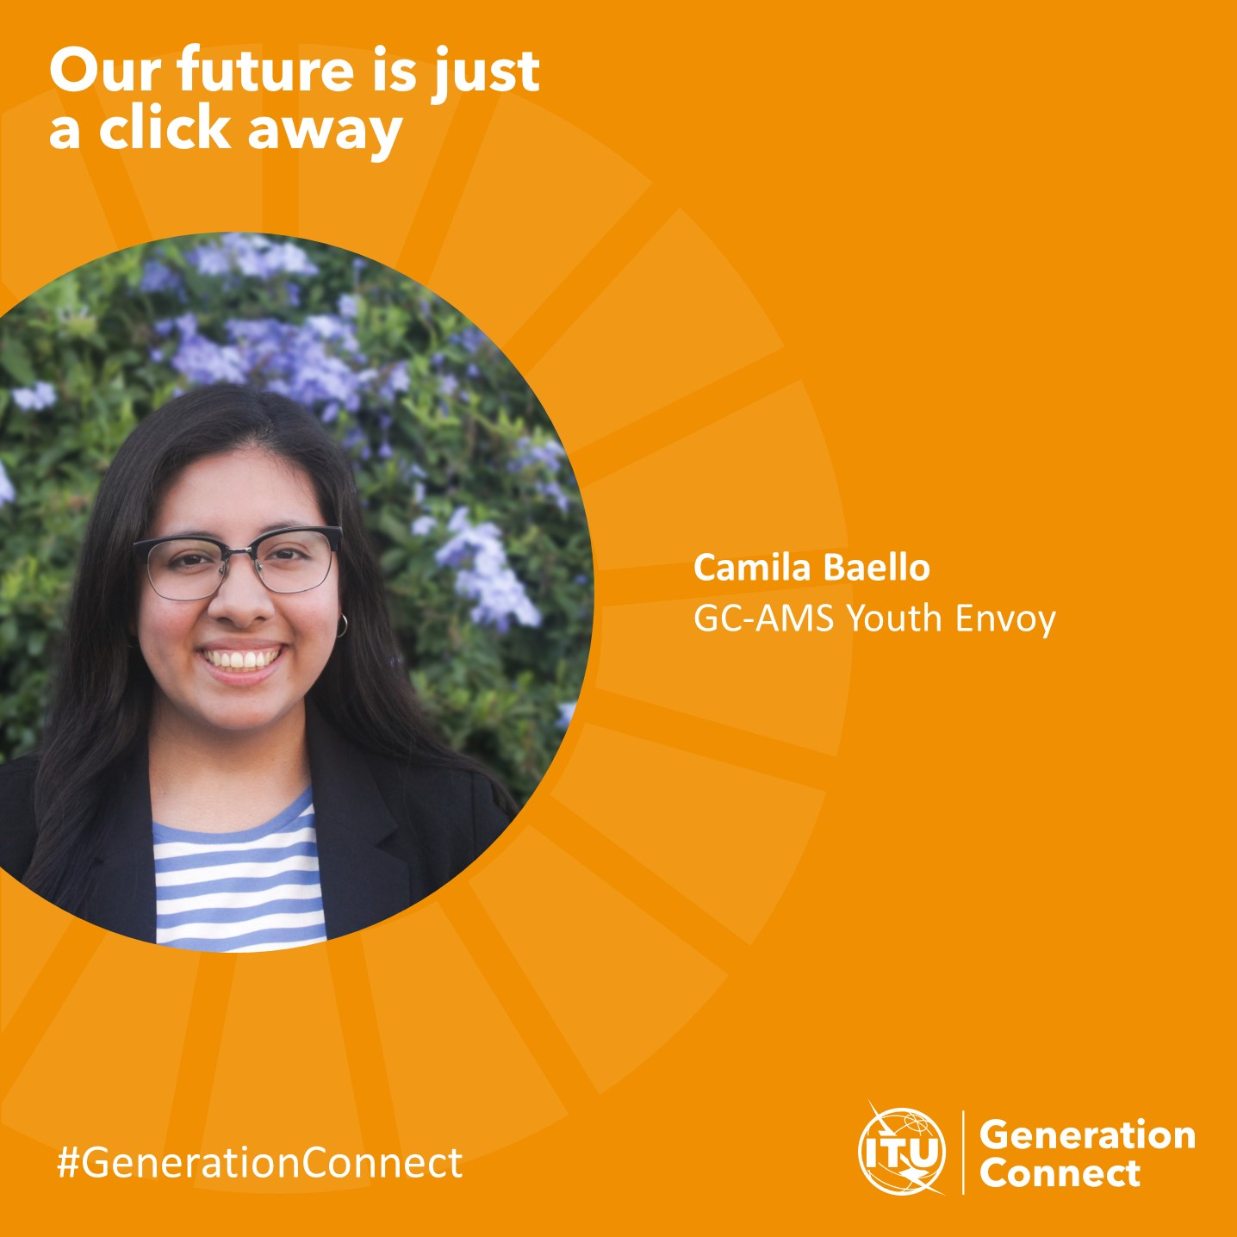
Please find below some reflections and main ideas that I want to highlight regarding my experience participating in MGF 2022:
1) The importance of fostering and promoting the development of accessible and innovative digital tools to empower people around the world, especially for those who might not have an ICT's related background.
2) The agenda and setup of the conference accentuated the relevance of technology for youth in our present and future. It was inspiring to connect with more people working from different arenas on the importance of engaging youth in global discussions.
3) Connecting with people from different parts of the world to exchange ideas and experiences can boost innovative and inclusive outlooks that could lead to more complex joint technological solutions.

