Slide 1
Transmission of regional contents in a national DAB multiplex
WRD15
Geneve 13 February 2015

Slide 2
Transmission of regional contents in a national DAB multiplex
The DAB system is designed to carry in its multiplex several multimedia contents having the same intended coverage area
The spectrum allocated in band III and L-band to the DAB service is subdivided in blocks
Each block is referred by two alphanumeric charcarcters: the first one indicates the frequency channel, the second one the position in the channel (e.g. 12B).
In band III, GE06 reserved channel 12 exclusively for DAB service. The other channels of the band can also be utilised for DVB-T

Slide 3
Transmission of regional content in a national DAB multiplex
The L-Band has been identified for IMT under agenda item 1.1 of the next WRC15.
In some countries, where band III is intensively utilised for DVB-T, the number of blocks available for DAB are very limited.
International coordination: in order to avoid interferences to the neighbouring countries no more than half of the available blocks can be utilised.
Conversely, the number of programmes to be transmitted could be very high

Slide 4
Transmission of regional contents in a national DAB multiplex
In some countries public broadcasters need to transmit both national and regional/local contents
The regional content can be time limited (few hours a day)
Different solutions can be chosen in order to broadcast national and regional/local contents

Slide 5
Transmission of regional contents in a national DAB multiplex
k x SFN Planning
12B
12B
12A
12A
12B
12C
12C
12A
12D
12D
12C
12B
12B
12D
12A
12A
12B
12C
12C
Each Block cover one Region. No neightboring Regions have assigned the same Block
12A
12D
12D
Cluster that will be repeated
12C
12B
12B
12D
12A
12A
12B
12C
12C
12A
12D
12D
12C
12D

Slide 6
Transmission of regional contents in a national DAB multiplex
1 x SFN for National contents (DAB+)
K x SFN for Regional contents (DRM+)
F 2
F 1
F 2
F 3
F 1
F 4
F2
F 3
F 1
F 4
12A
F 3
F 4
F 2
F 1
F 3
F 4

Slide 7
Transmission of regional contents in a national DAB multiplex
t1
t2
t1
12A
t1
t1
t2
t2
When can the dynamic reconfiguration be useful?
When Regional programmes are short compared to the National programme (t1 >> t2).

Slide 8
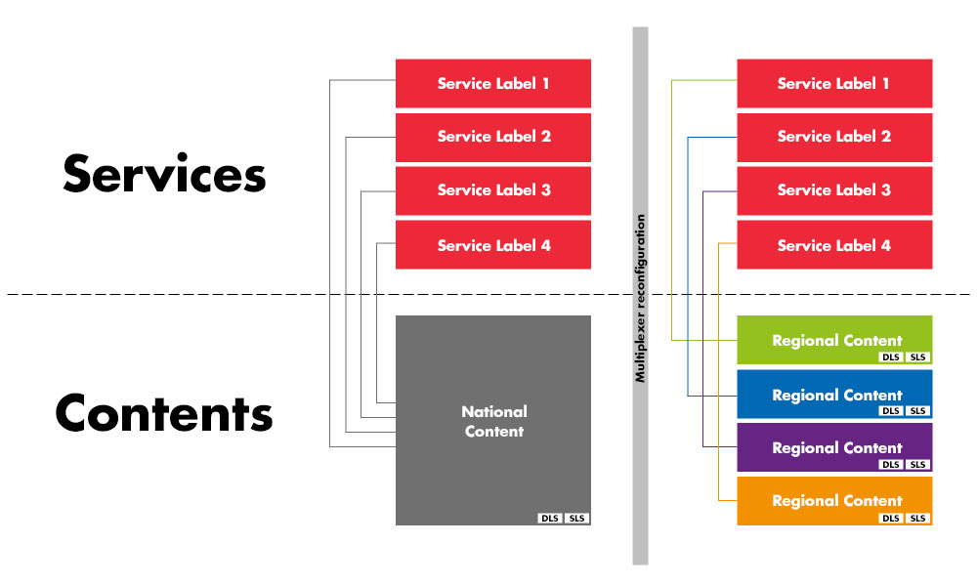
Transmission of regional contents in a national DAB multiplex

Slide 9
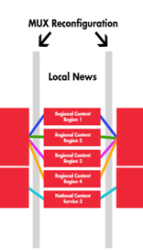
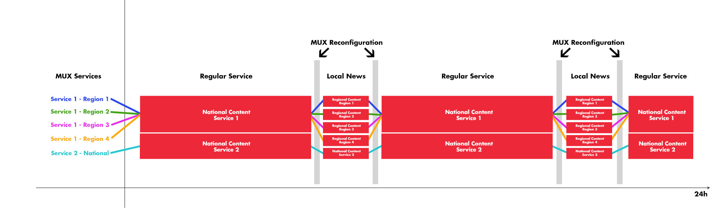
Transmission of regional contents in a national DAB multiplex

Slide 10
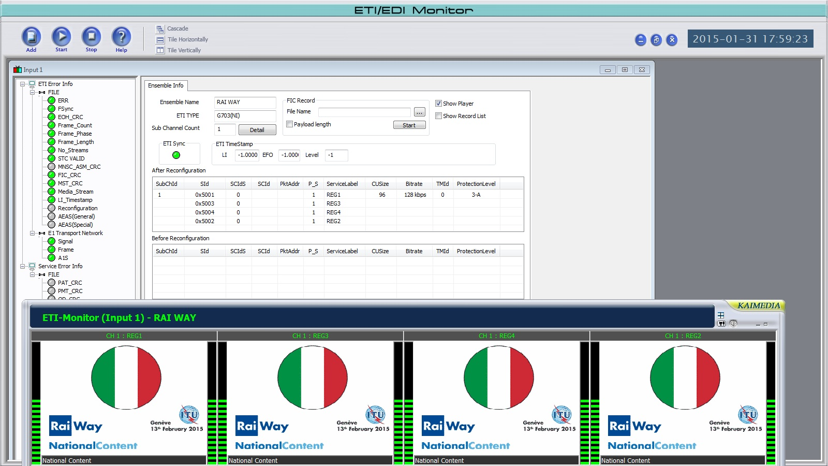
Transmission of regional contents in a national DAB multiplex

Slide 11
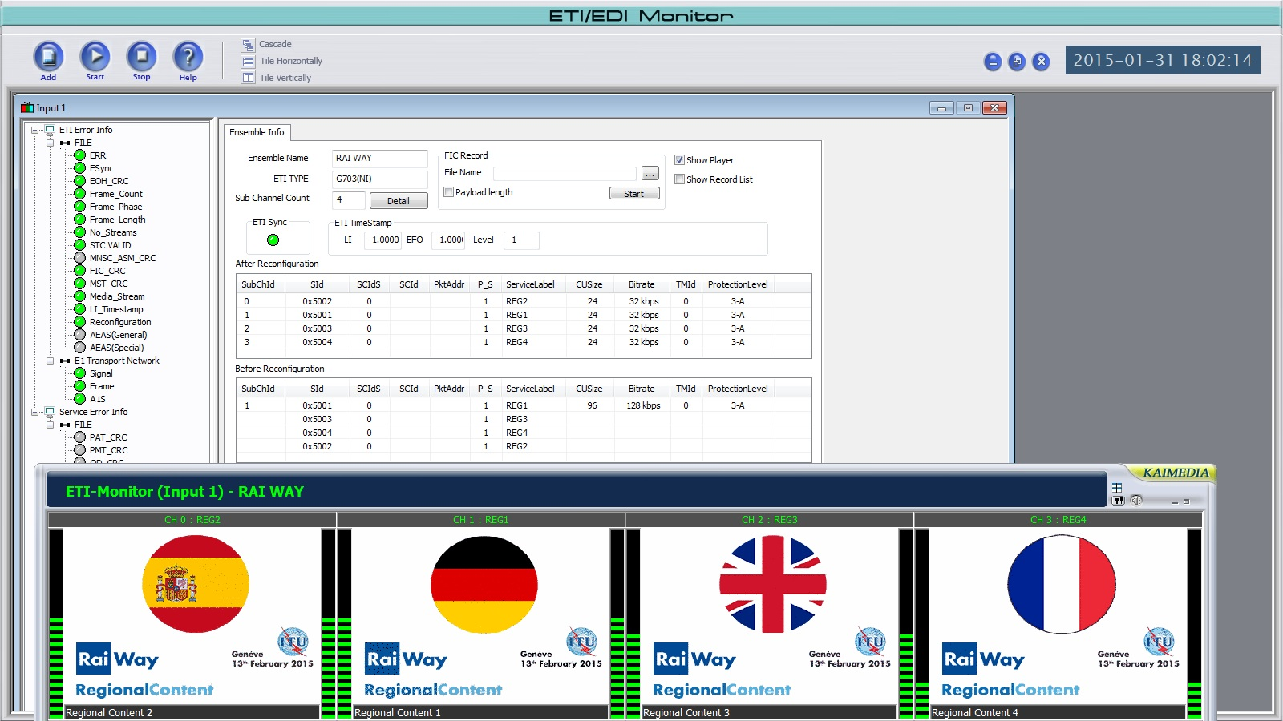
Transmission of regional contents in a national DAB multiplex

Slide 12
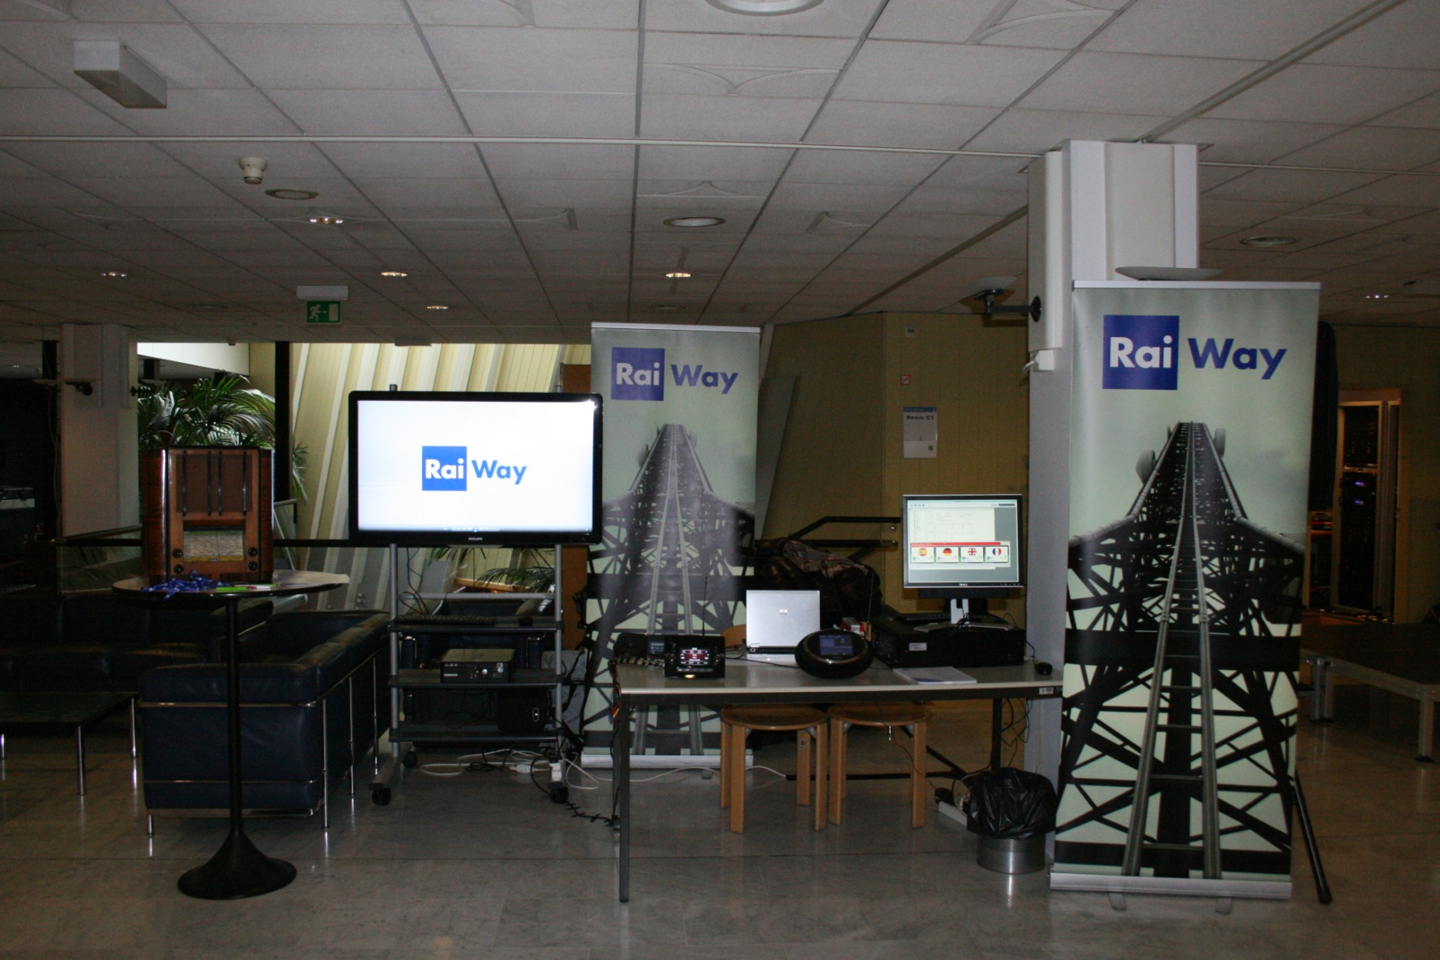
Transmission of regional content in a national DAB multiplex

