Slide 1

EWF –
Emergency Warning & Alert Functionality
Dipl.-Inf. Olaf Korte
Head of Broadcast Applications Group
Multimedia Applications Departement
Fraunhofer IIS
olaf.korte@iis.fraunhofer.de
phone: +49-(0) 9131-776-6085
fax: +49-(0) 9131-776-6099

Slide 2

Emergency Warning & Alert
Stages of a Disaster Operation
Detection of
pending
disaster
Disaster
hits
Preparatory
General
Education
Instant
Warning
Dissemination
Crisis /
Rescue
Support
Post-
Disaster
Services
Digital Radio provides essential services
in all these stages, as it:
reaches the affected people reliably
detailed multi-lingual infos
as text and slides (if available)

Slide 3
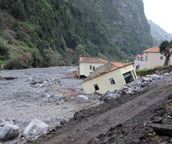
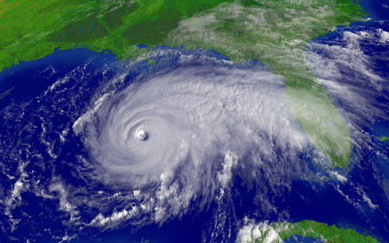
Emergency Warning & Alert
Tools for Information Dissemination
What is your country‘s approach
today on information dissemination
in case of disasters?
  Analog AM/FM Radio
  Mobile phones, SMS
  Internet / Social Media
  TV (satellite, terrestrial)
  Special Devices, Alarm Systems
Now also: Digital Radio!

Slide 4
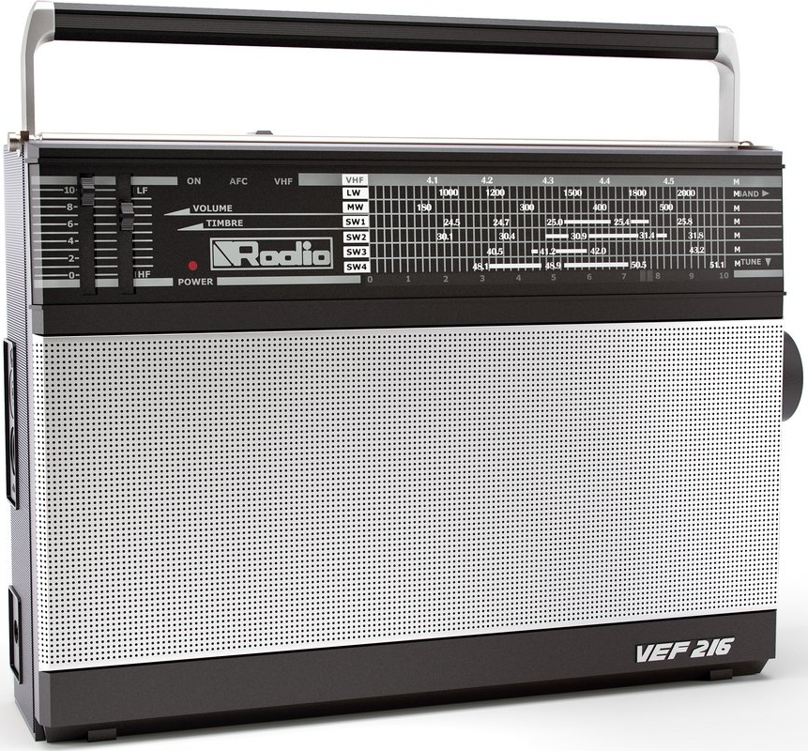
Emergency Warning & Alert
Unique Benefits for Information Dissemination
Radio is ubiquitously available:
  at home
  at work
  in the car
  as portables & in mobile phones
  outdoors & indoors
Radio is a companion
with an everyday purpose
→ unintrusive and always present

Slide 5
Emergency Warning & Alert
Unique Benefits for Information Dissemination
Radio is independent
from local infrastructure:
  Battery powered / wind-up
  No satellite dishes / settop boxes
  Transmitter coverage from outside disaster area:
  E.g. high power, high tower
  Secured transmitter sites
  (backup power etc.)
  Well-controlled infrastructure

Slide 6
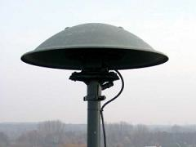
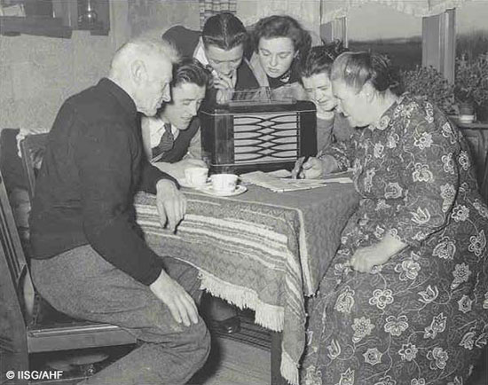
Emergency Warning & Alert in Digital Radio
EWF vs. EWS
EWS – Emergency Warning System
„The EWS feature is intended to provide for the coding of warning messages […] and will only be evaluated by special receivers.“
→ E.g. Siren activation
EWF – Emergency Warning Functionality
Emergency Broadcast to the public giving all relevant information on Digital Radios (DAB and DRM).

Slide 7
Emergency Warning & Alert in Digital Radio
Announcements
Announcements:
Signal special on-air content to receivers
Types: Alarm, Warning/Service, Road Traffic, News Flash, etc.
Automatic receiver switching and emergency wake up
  tune to Warning Service
  Visual signalling + volume increase

Slide 8
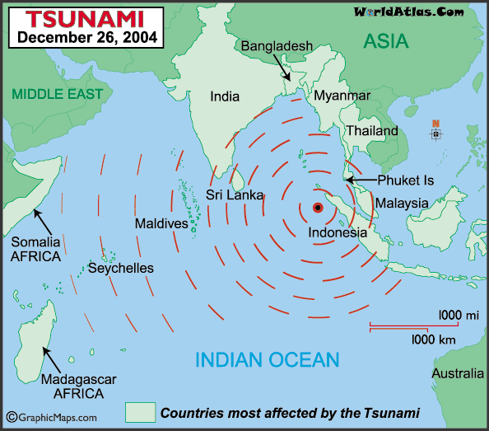

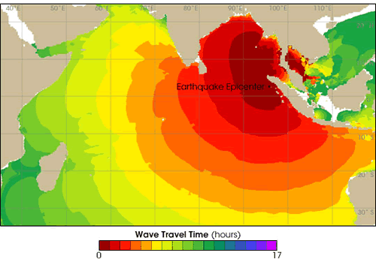
Emergency Warning & Alert in Digital Radio
Relevant standardized data applications
DAB Dynamic Label
scrolling text sequence
Journaline
advanced
on-demand text
Slideshow
image sequence
Tsunami pending in
Shanghai at 16:00
Max. 128 characters,
typ. every 20 sec.
Automatic sequence:
no user-interaction
Full news articles with
topic structure (menus)
On-demand look-up
Multilingual (Unicode)
Images, typ. 320x240
Automatic sequence:
no user-interaction
(optional categories)
All Receiver Classes
(text-only screen)
Multimedia Rx
(colour graphics screen)

Slide 9
Emergency Warning & Alert in Digital Radio
Functional Overview
Supporting EWF coverage
from outside disaster area; E.g. high power, high tower
Information in English
What is going on?
What area is affected?
► What do I need to do?
Where can I get help?

Slide 10
Emergency Warning & Alert in Digital Radio
Listener Experience
!
!
When the alarm signal is triggered by authorities:
All running digital receivers pick up alarm signal
from currently received service, and switch to emergency broadcast (if required)
Turned-off receivers may switch on automatically
(requirement to be communicated to rx mfcts)
→ Receivers present the audio content
of the emergency programme
Receivers with appropriate screen in addition present
  detailed information and
  instructions (Journaline),
  text-headlines (Dynamic Labels) and
  Images (Slideshow, if available)

Slide 11
EWF –
Emergency Warning & Alert Functionality
Thank you!
Dipl.-Inf. Olaf Korte
Head of Broadcast Applications Group
Multimedia Applications Departement
Fraunhofer IIS
olaf.korte@iis.fraunhofer.de
phone: +49-(0) 9131-776-6085
fax: +49-(0) 9131-776-6099

