Slide 1

Speech Rate Control for Radio
World Radio Day 2015
The ITU-R Study Group 6 Session
“The future of Radio: Old Roots, New Routes”
13th February 2015
Satoshi Oode
Advanced Television Research Department
Science and Technology Research Laboratories
NHK, Japan
Japan Broadcasting Corporation
Notes:
Hello everyone.
I’m Satoshi OODE, from NHK, Japan.
Today, I’d like to introduce Speech Rate Control Technology.

Slide 2
Radio Broadcasting in Japan
Radio service in Japan started in 1925.
NHK has been providing radio service using two AM channels and an FM channel since then.
Until now, radio is one of the important media to get information, knowledge, fun and so on.
Especially, radio made a vital contribution to survive in the disaster, for instance, the big earthquakes in 1995 (Kobe), 2011 (Tohoku).
Broadcasters have a responsibility for transmitting their programs to listeners independently not only from “regional difference” but also from “individual difference”.
However, TV and Radio Programs exclusively for the hearing or visually impaired people and the elderly are not so many.
Notes:
Japan’s Radio service started in 1925.
NHK has been providing radio service using two AM channels and an FM channel since then.
Until now, radio is one of the important media to get information, knowledge, fun and so on.
Especially, radio made a vital contribution to survive in the disaster, for instance, the big earthquakes in 1995 (Kobe) and 2011 (Tohoku).
Broadcasters have a responsibility that everyone can listen to programmes any where, any time.
However, TV and Radio Programs exclusively for the hearing or visually impaired people and the elderly are not so many.

Slide 3
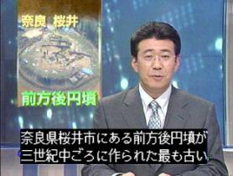
Accessibility to Broadcasting in NHK
For hearing impaired people
  NHK started off-line closed-captioning services in the 1980s, and on-line live closed-captioning services for News proguramme from 2000.
  Digital TV system has standard slots which are
  applicable to closed-captioning and audio description.
  Japan aims “100% of closed-caption including live
  programmes by the end of 2017”,
  excluding technically impossible programmes.
  On-line live closed-captions are automatically
  made using speech recognition technology.
For the elderly and visually impaired people
  Speech rate control and speech synthesis technologies are being studied.
On-line live
closed-captions
Speech Rate Control Technology is focused on
not only by the elderly but also the foreign language leaner.
Notes:
For hearing impaired people,
NHK provide off-line closed-captioning services in the 1980s, and on-line live closed-captioning services for News proguramme from 2000 in television services.
For the elderly and visually impaired people,
NHK developed speech rate control and speech synthesis technologies.

Slide 4
Motivation and Outline of Speech Rate Control Technology
What did
he say?
“Aging society” is progressing rapidly in Japan.
  26 % of the population was elder than 65 in 2014.
  Their audibility gradually and certainly degrade
  due to aging.
  The elderly say;
    “Newscaster speaks too fast
    and it’s hard to understand”.
    “Dialogue of actor is hard to catch
    because of BGN or sound effects”.
Conventional hearing aid device
  It compensates for only elder’s audible degradation related to the dynamics of loudness and frequency range.
Speech rate control technology
  It was developed to make speech easier to listen to.
  It can maintain vocal pitch and quality.
  The length for a programme does not change, only the speech rate changes.
too fast..
Notes:
Aging society is progressing rapidly in Japan.
Over 26 % of the population was elder than 65 in 2014.
Their audibility gradually and certainly degrade due to aging.
And They crimes to the broadcasters. “I can not understand what actors mentioned”.
Actually, they have 2 problems.
One is hearing problem related to the ratio of dialogue and BGM.
Conventional hearing aid devices can match with this problem.
The other is brain processing problems related to speech rate.
Conventional hearing aid devices can not cope with this problem.
Thus, NHK developed Speech rate control technology.
Our speech rate control technology can maintain vocal pitch and quality.
The length for a programme does not change, only the speech rate changes.

Slide 5
Principal of speech rate control (I)
To keep the fundamental period,
the speech rate control technology is based on expansion and contraction of waveform by insertion and deletion of fundamental periods.
Fundamental period is not changed and vocal pitch and quality are maintained .
①
②
②
③
④
④
⑤
⑥
Proposed method
①
②
③
④
⑤
⑥
Original
time
Conventional method
Fundamental period is enlarged or shorted and pitch becomes lower or higher.
Notes:
In this slide, I explain principal of speech rate control technology.
If the fundamental period is enlarged or shorted, vocal pitch becomes lower or higher.
To keep the fundamental period,
The speech rate control technology separate waveform into each fundamental period.
And insertion and deletion of fundamental periods makes changes of speech length.

Slide 6
Principal of speech rate control (II)
Speech rate control was performed by two operational modes as follows:
(i) Uniform extension of the utterance time.
(ii) Adaptive mode giving slower feeling without accumulating time delay.
It expands the beginning of the speech sufficiently and contracts the pauses between words or sentences as much as possible. This method minimizes the time delay of the slowed speech, without producing perceptual incongruities.
Original
Good morning everyone!
Here in NHK.
pause
Uniformly
extended
Delay is accumulated
Good morning everyone!
Here in NHK.
Pause is shorted with maintaining the naturalness
Adaptive
mode
Good
morning
every
one!
Here
in NHK.
Slowed at first and
gradually restored
time
Controlled speech is
synchronized with original
Notes:
Speech rate control was performed by two operational modes.
One is uniform extension mode. And Second is adaptive mode.
Adaptive mode expands the beginning of the speech sufficiently and contracts the pauses between words or sentences as much as possible.
This method minimizes the time delay of the slowed speech, without producing perceptual incongruities.

Slide 7
Evaluation by the elderly
Materials : 3 broadcast news sentences, about 10 seconds respectively
Evaluation : Method of paired comparison; Which do you hear slower, “original” or “Adaptive mode converted speech” ?
Result : 80% of 60s and 70s, and more than 50% of 80s+ heard
“Adaptive mode” is slower than “original”.
Aged 60 to 69 (N=92)
Aged 70 to 79 (N=137)
Aged 80 or more (N=50)
Evaluation ratio
Adaptive mode
News Sentences Number
Same
Original
7
Notes:
The elderly assessed our technology.
80% of 60s and 70s, and more than 50% of 80s assessed that the speech rate of “Adaptive mode” is slower than that of “original”, although actual speech length was same duration.

Slide 8
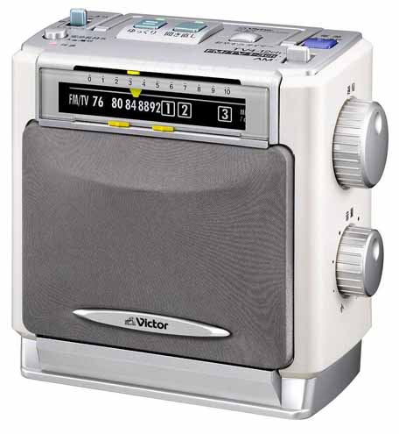
Radio with Speech Rate Control function
Radio receiver with Speech Rate Control function was manufactured by JVC in 2002.
Its user-friendly interface was designed for the elderly.
It has not only speech rate control function but also repeat play back and vocal enhancement function.
After that, TV equipped with the speech rate control function was manufactured.
Radio with Speech Rate control function
manufactured by JVC in 2002.
Notes:
Radio receiver with Speech Rate Control function was manufactured by JVC in 2002.
It is displayed outside, but it was broken down in this morning.
Its user-friendly interface was designed for the elderly.
It has not only speech rate control function but also repeat play back and vocal enhancement function.
After that, TV equipped with the speech rate control function was manufactured.

Slide 9
Principal of speech rate control (III)
Recorded programs can be played back faster.
- Programs stacked in recorder can be watched
in shorter time for business person.
- Foreign languages
can be made fast for experts to train.
You’ve got a Pile of recorded programmes.
Let’s skim through the programmes!
①
③
⑤
⑥
The deletion of pitch periods can make total speech time shorter and maintain vocal pitch.
The adaptive mode*1 of speech rate controller will make speech still be comprehensible.
*1 It expands the beginning of the speech sufficiently and removes the pauses.
Faster
①
②
③
④
⑤
⑥
time
Original
①
②
②
③
④
④
⑤
⑥
Slower
Proposed method
Faster
time
Original
Slower
Conventional method
Notes:
In the case of Recorded programmes, speech rate control technology can play back it faster.
Busy business person can watch broadcasting programmes stacked in the HDD recorder in shorter time.
Experts of foreign languages can train their skill to listen to very fast speech.
The deletion of pitch periods can make total speech duration shorter and maintain vocal pitch.
The adaptive mode of speech rate controller will make speech still be comprehensible.

Slide 10
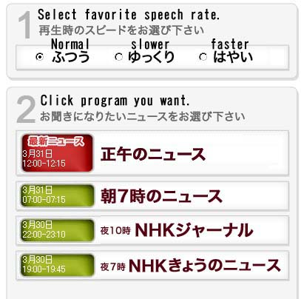
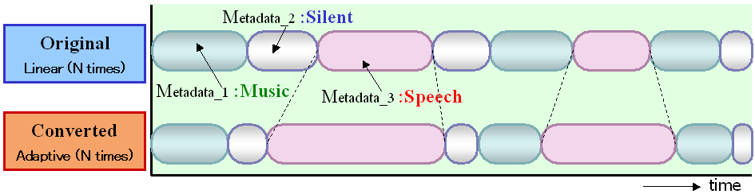
Applications of
Speech Rate Control Technology
For leaner of foreign language
Applicable to multiple languages
  We executed the adjustment to Japanese, English, German, and Korean of this technology in consideration of a acoustical feature of the utterance.
Available on NHK’s www
  NHK now offers an on-demand service to listen to the radio news that had been broadcast within 24 hours at the 3 speeds (slow -normal -fast) .
http://www.nhk.or.jp/r-news/
For visually impaired people
Upgrading the Speech Rate Control Technology by using the Metadata
  It identify places in recorded sound to adjust the listening experience, and it clues to catch the amazing fast speech. (e.g. 3 times normal speed)
Notes:
Applications of Speech Rate Control Technology are spreading now.
For leaner of foreign language, the speech rate control technology adapts for multiple languages.
And NHK provides an on-demand service to listen to the radio news that had been broadcast within 24 hours at the 3 speeds, slow, normal and fast.
For visually impaired people, the speech rate control technology was updated by using the Metadata.
You can listen to broadcast programme with 3 times of normal speech rate.

Slide 11
“Stock Market” on NHK’s Radio 2
-Speech synthesis technology is used-
“Stock Market” and “Weather News” are broadcasting using the speech synthesis technology on NHK’s Radio 2.
The technology can generate speech of any stock price to combine small vocal units of speech.
In the “Stock Market” programe, closing prices of about 830 items are read out in 45 minutes. It is hard for announce to be exactly and to keep even temp.
This task is matched for speech synthesis technology.
Now, speech rate control technology is used to finish to read all items in just 45 minutes.
The stock value is fifty four.
Database
fifty-f
ty-five
… is
fifteen-f
ty-four
is-fi
en-four
fifty-f
Vocal units are combined
ty-four
Notes:
Speech rate control technology is used in Stock Market prorgamme on NHK’s Radio 2.
“Stock Market” are broadcasting using the speech synthesis technology.
The technology can generate speech of any stock prices to combine small vocal units.
In the “Stock Market” programe, closing prices of about 830 items are read out in 45 minutes.
It is hard for announce to be exactly and to keep even tempo.
This task is matched for speech synthesis technology.
Now, speech rate control technology is used to finish to read all items in just 45 minutes.

Slide 12
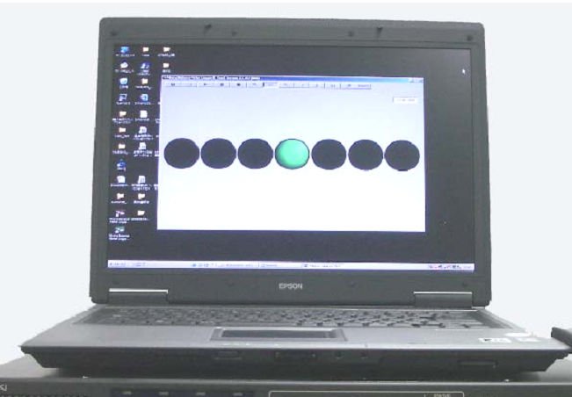
Conclusion
Technology is spreading now.
Further research and development are necessary to improve accessibility especially for the elderly.
Future Works
  News readout service in data broadcasting.
  The speech synthesis read out News flash
  through data broadcasting.
  Audio balance measurement algorithm.
  The device to indicate the suited balance
  between dialogue and background sound
  for the elderly are being developed
  considering the age-related hearing loss.
  Dialogue enhancement in 8K SHV broadcasting.
  The 8K Super Hi-Vision broadcasting plans to support to control the level of dialogue channels by the listeners.
Proto type of
Audio balance meter
Notes:
NHK studies further technologies to improve accessibility especially for the elderly.
Such as Audio balance measurement algorithm and Dialogue enhancement functino in 8K SHV broadcasting.

Slide 13
Thank you for your attention.
Japan Broadcasting Corporation
Notes:
Thank you for your attentsion.

