Slide 1
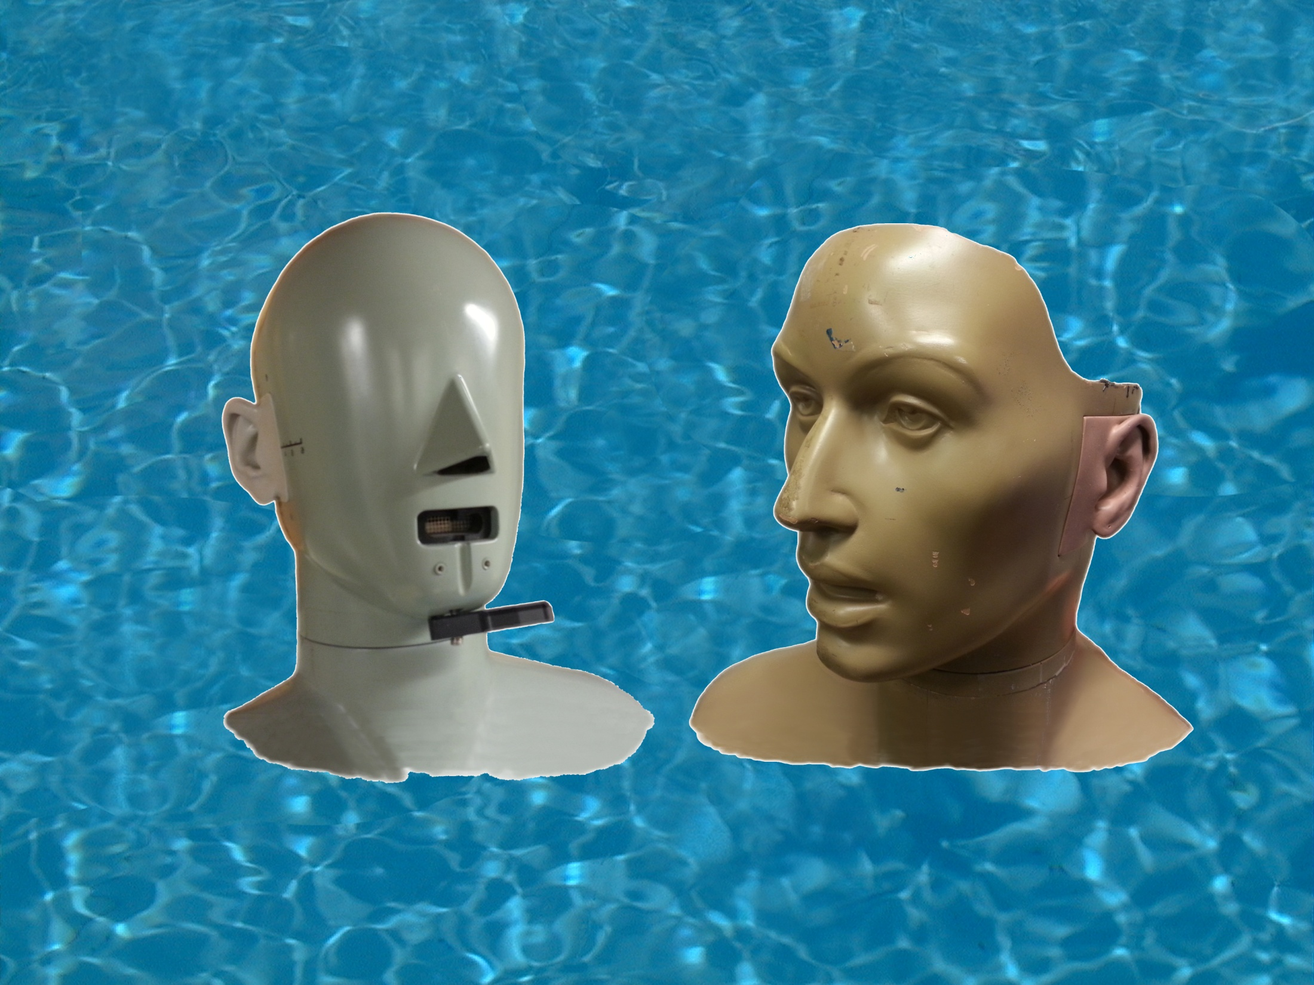
You won’t believe your ears !
Binaural Audio

Slide 2
Two eyes …
… and we see stereoscopically

Slide 3
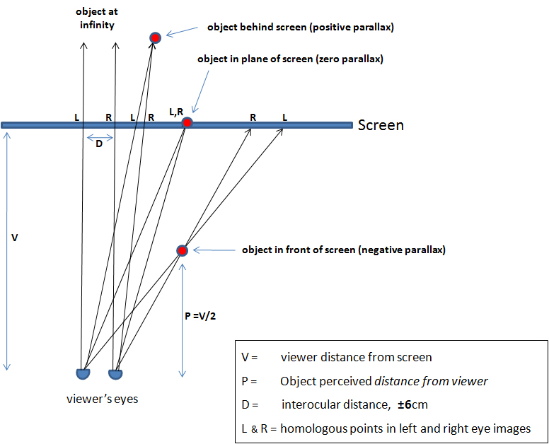

Slide 4
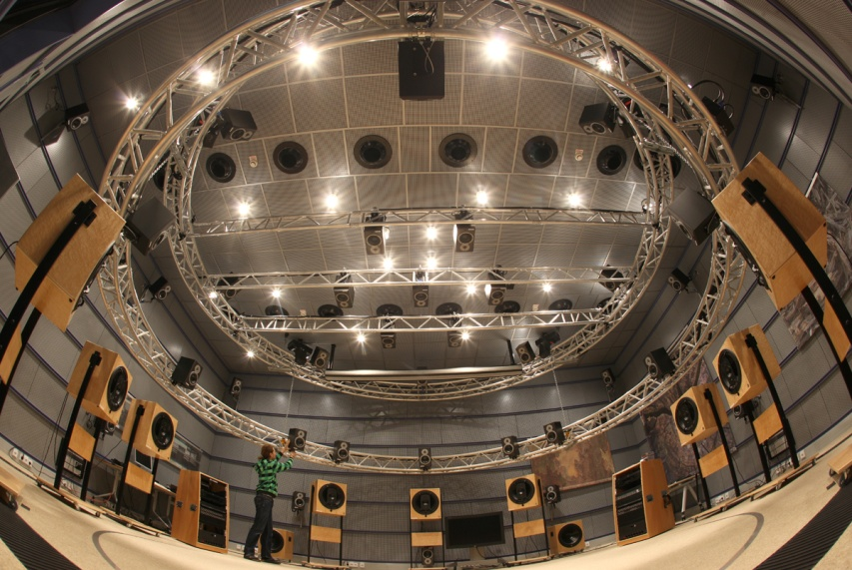
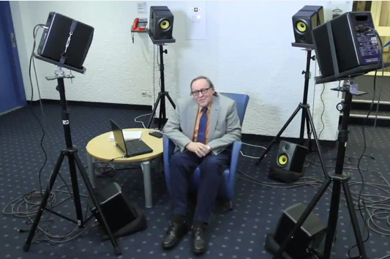
Two ears …
… and we hear immersively

Slide 5
But if you make the recording ‘right’
All you need is …

Slide 6
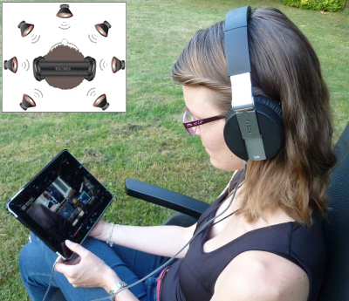
It is a hugely complex subject …
… but extremely simple to enjoy

Slide 7
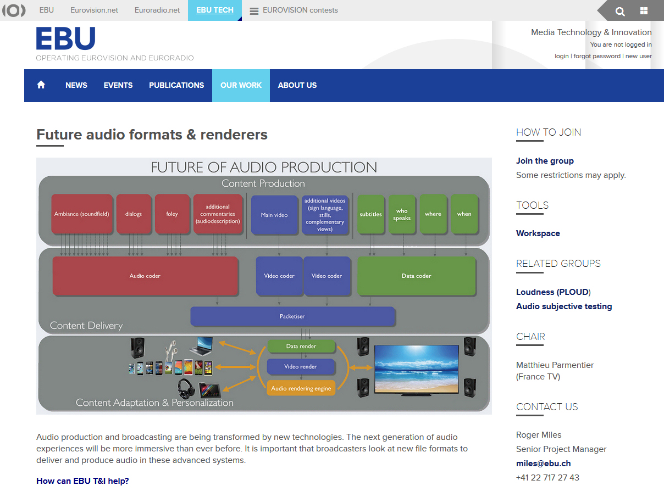

Slide 8
Links you might like …
http://nouvoson.radiofrance.fr/
http://www.binaural.fr/binaural/
http://www.bbc.co.uk/rd/projects/binaural-broadcasting
http://en.wikipedia.org/wiki/Binaural_recording
https://tech.ebu.ch/groups/far
Come and be submerged!

