Slide 1
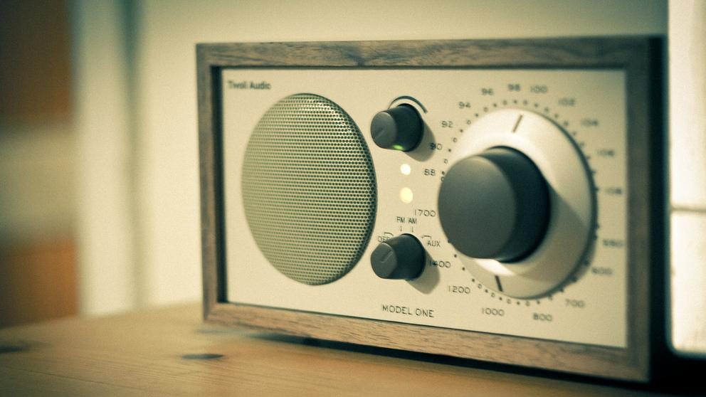
Personalised Radio
Matthew Shotton
BBC R&D
Matthew.Shotton@bbc.co.uk
Image: Johan Larsson
https://www.flickr.com/photos/johanl/6125230384

Slide 2
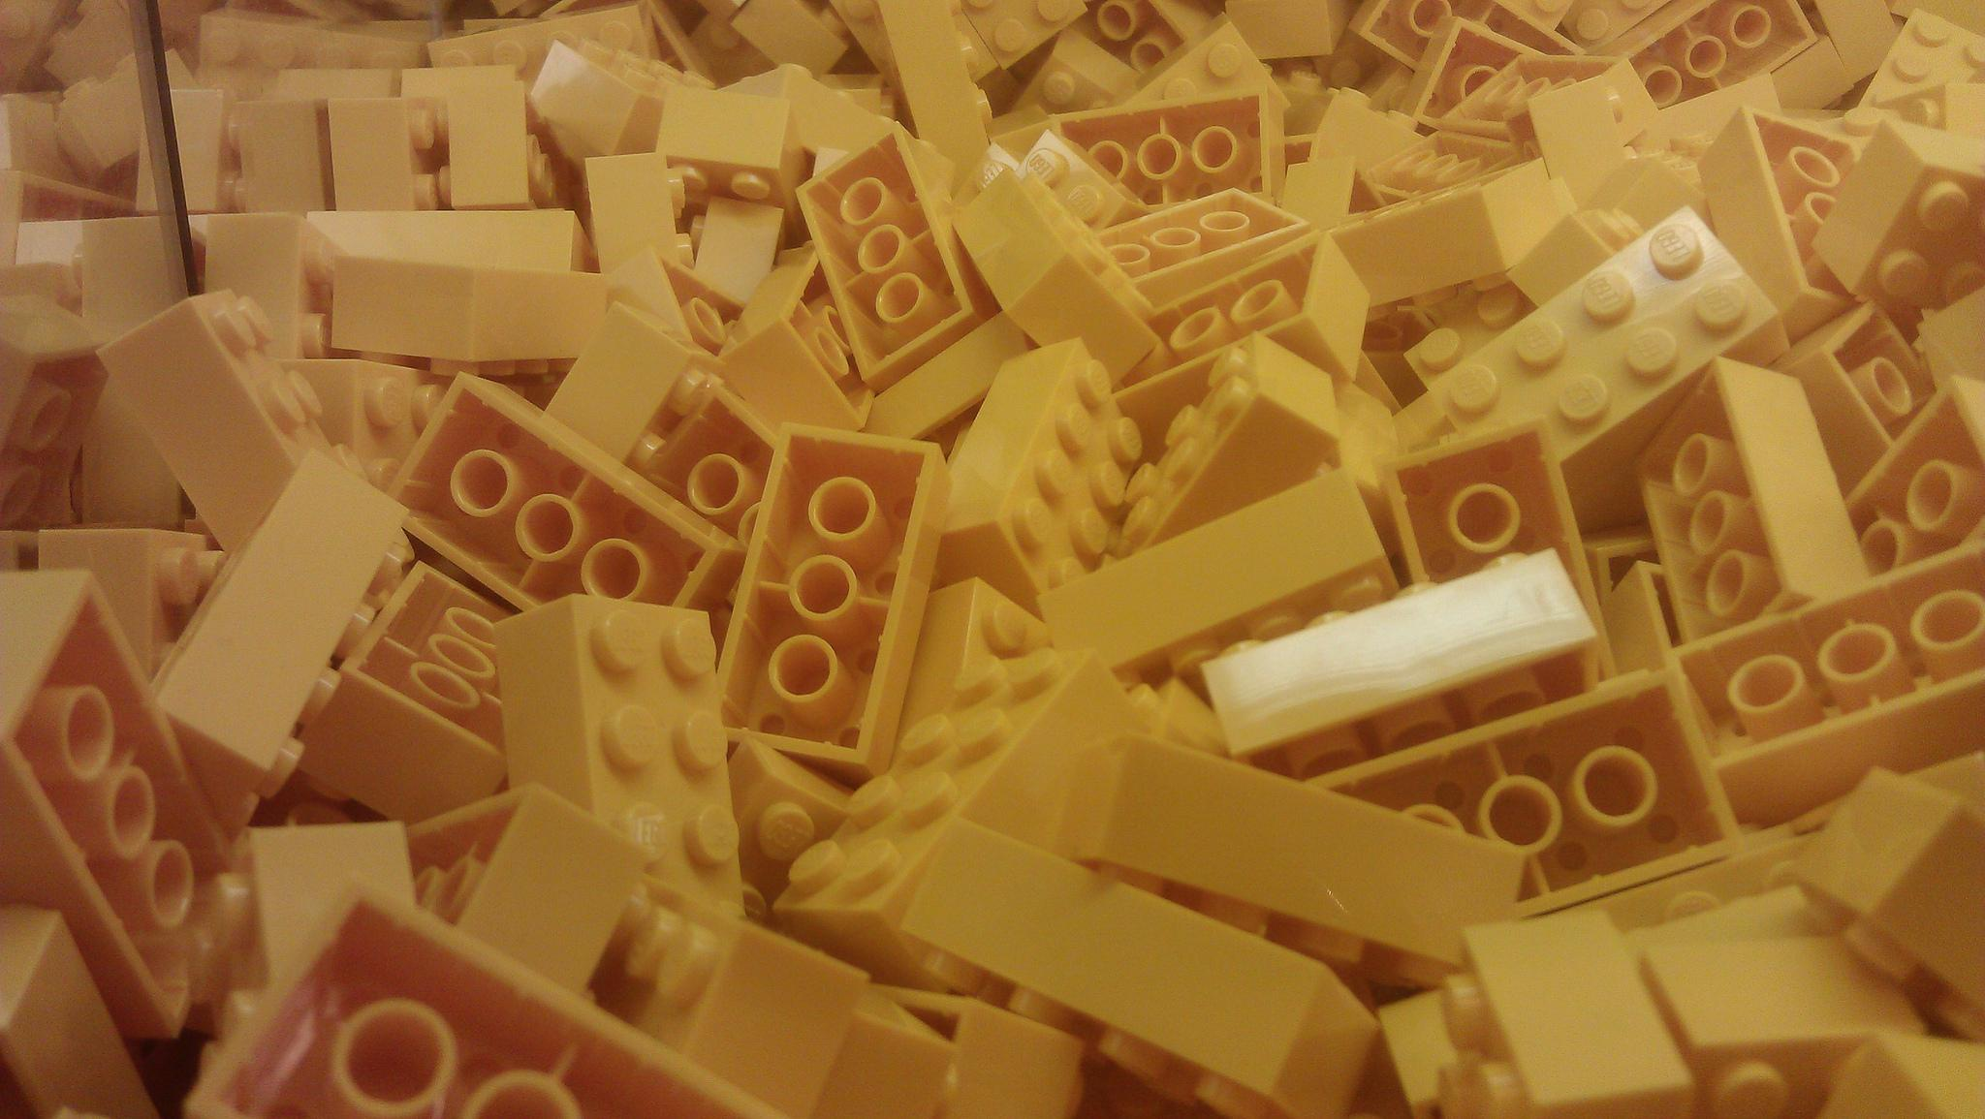
Object Based Broadcasting
Image: Paul Wilkinson
https://www.flickr.com/photos/eepaul/7396791752/in/photostream/

Slide 3
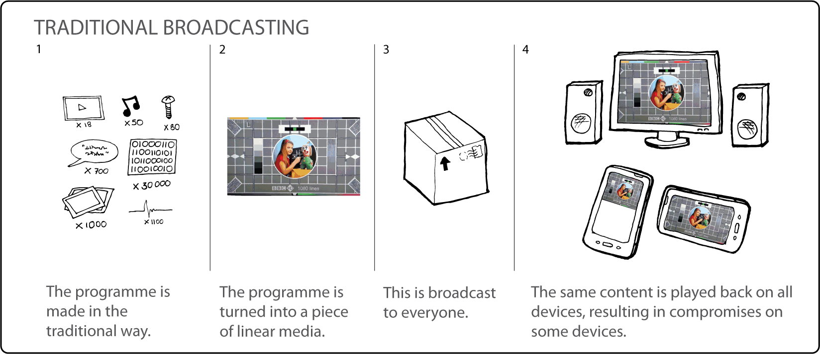

Slide 4
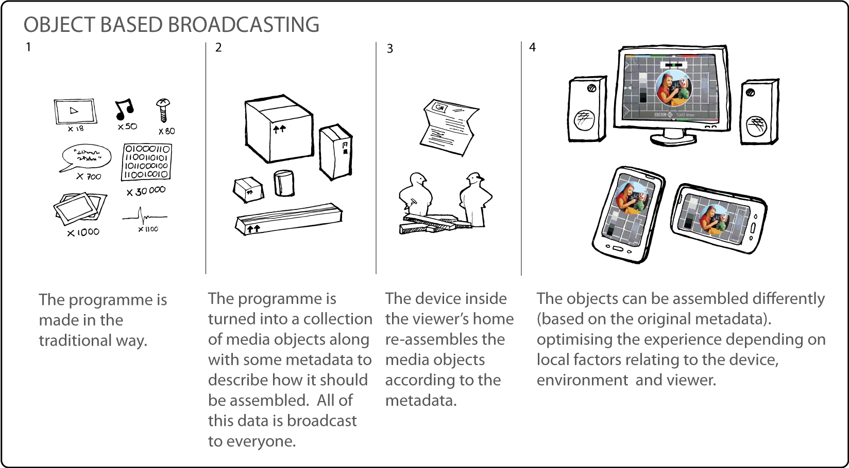

Slide 5
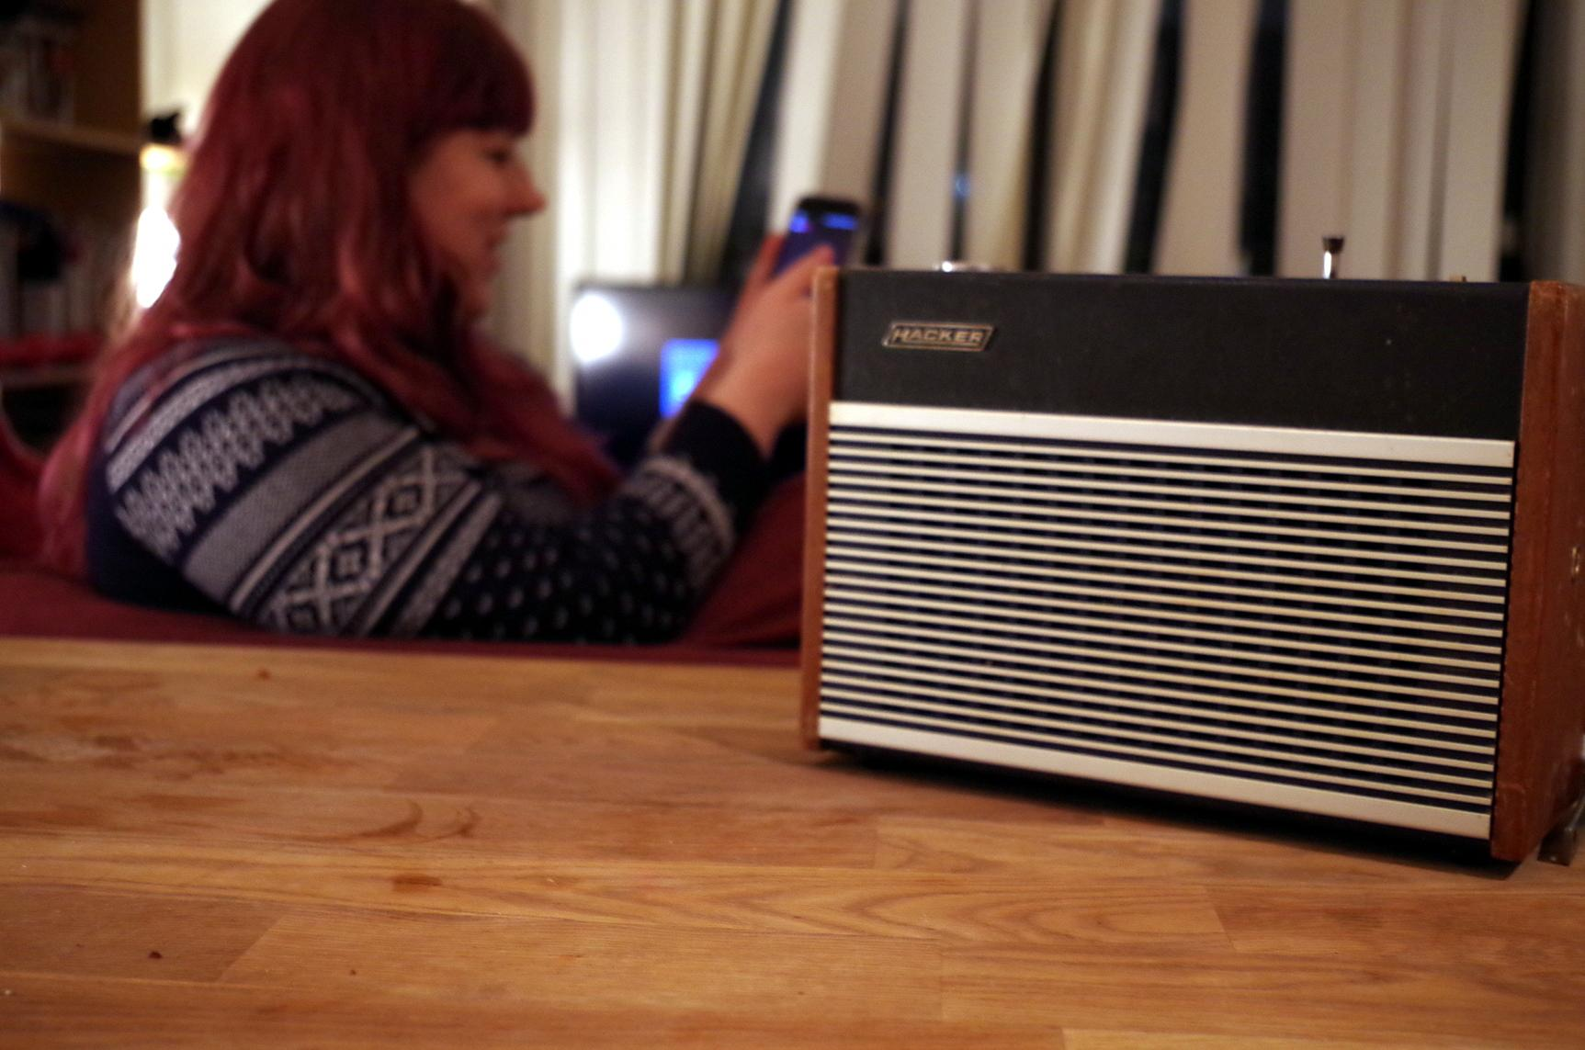
What this enables
Content that adapts to…..
the device or system
the environment
the person

Slide 6
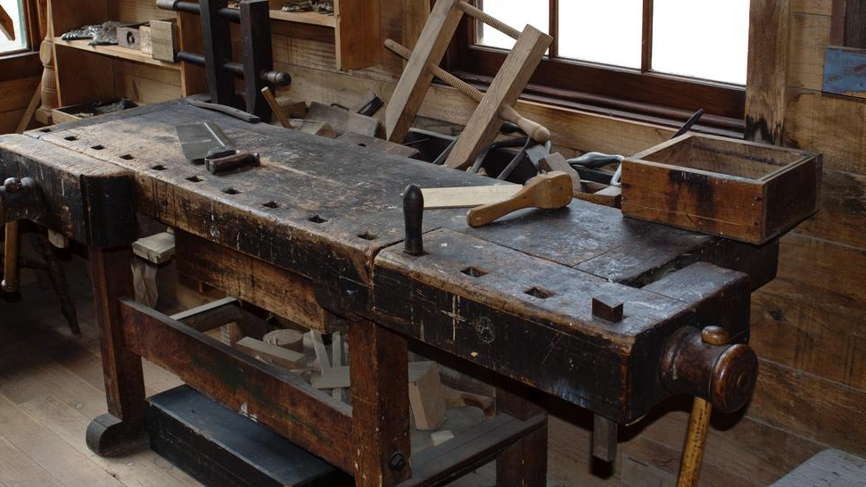
What we have made
Image: John McClumpha
https://www.flickr.com/photos/john_mcclumpha/4485039687

Slide 7
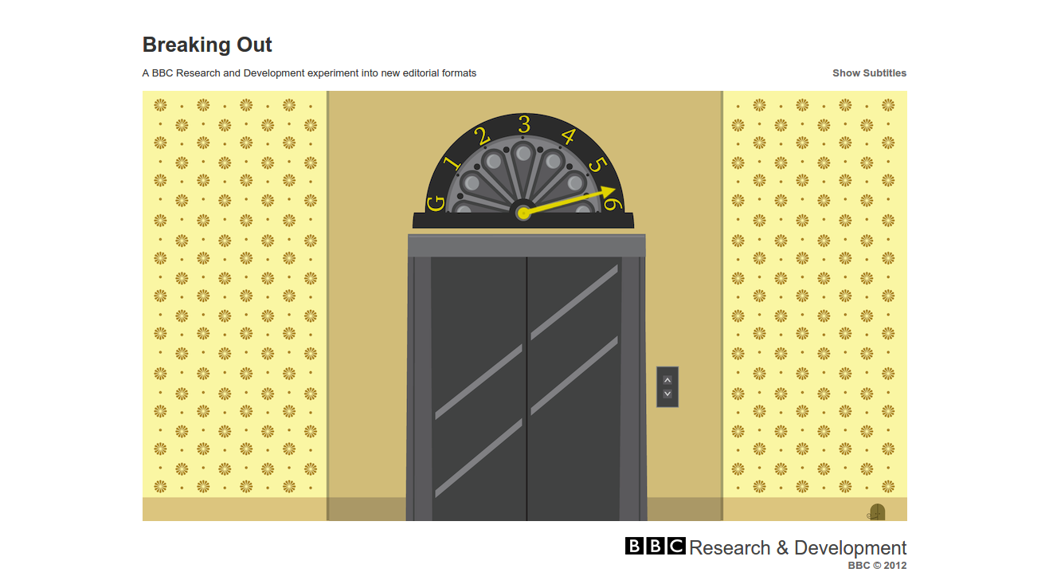
Breaking Out
http://www.futurebroadcasts.com/

Slide 8
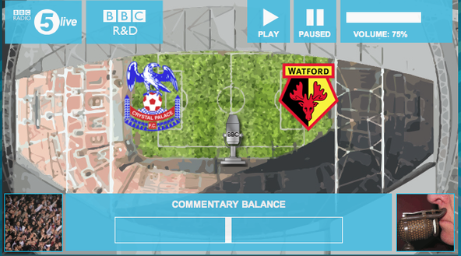
5 Live Football

Slide 9
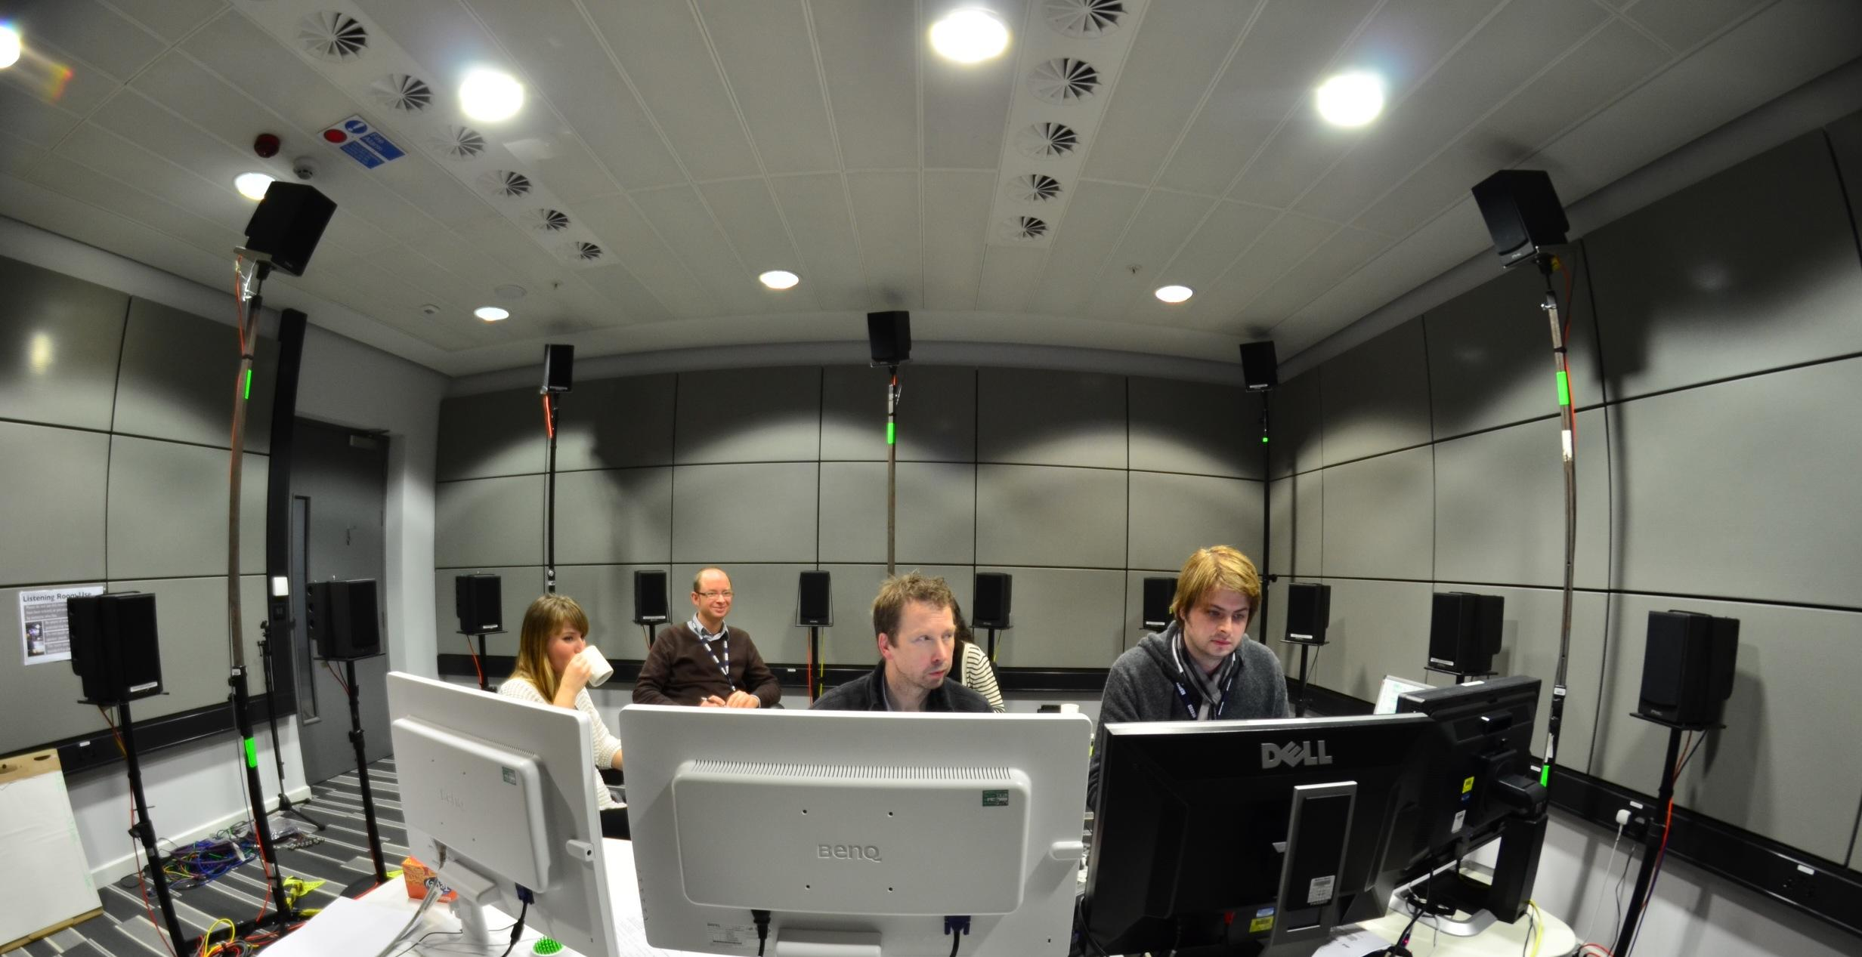
Pinocchio Production

Slide 10
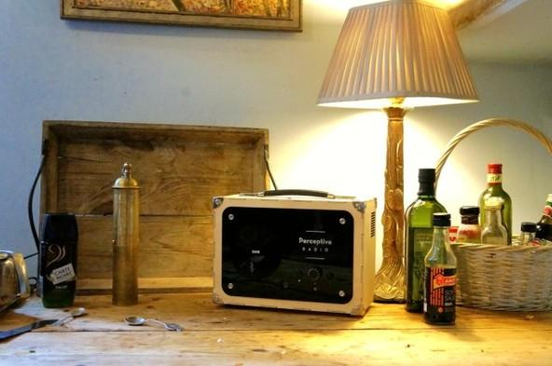
Perceptive Radio

Slide 11
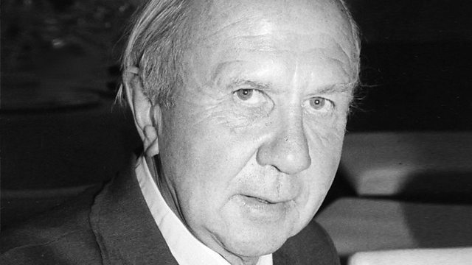
Variable Length Radio Documentary
Derek Tangye - The Cornish Gardner

Slide 12
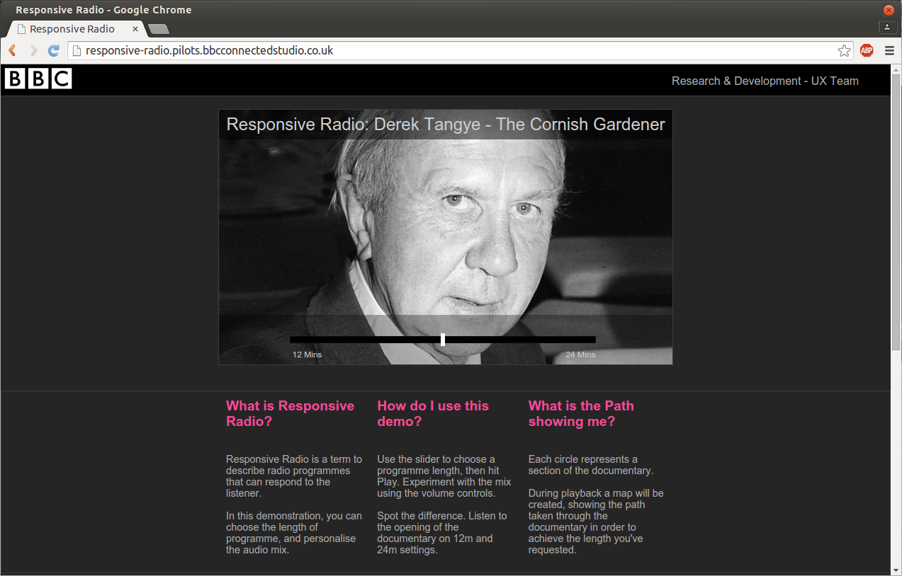
http://responsive-radio.pilots.bbcconnectedstudio.co.uk/

Slide 13
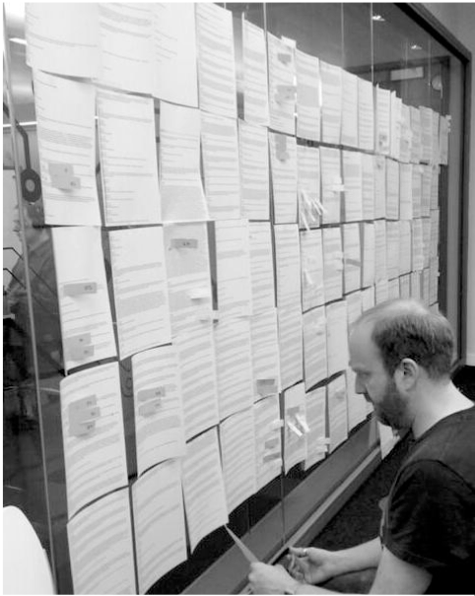
Deconstructing the narrative
Work with producers
Analyze story arc
Identify core themes
Split audio into objects
Identify edits
Create narrative graph

Slide 14
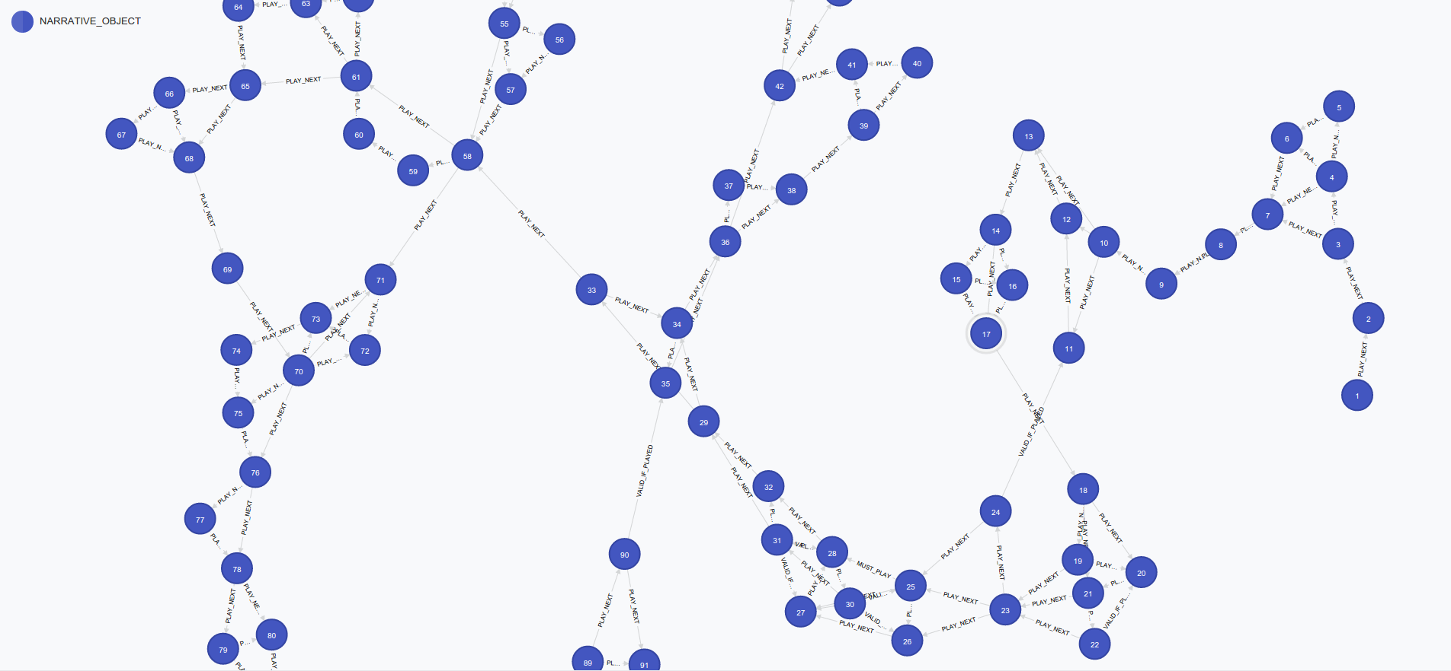

Slide 15
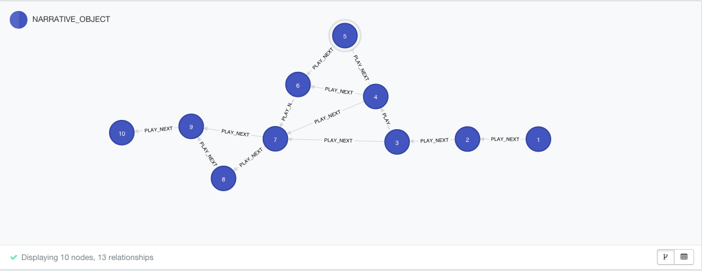

Slide 16
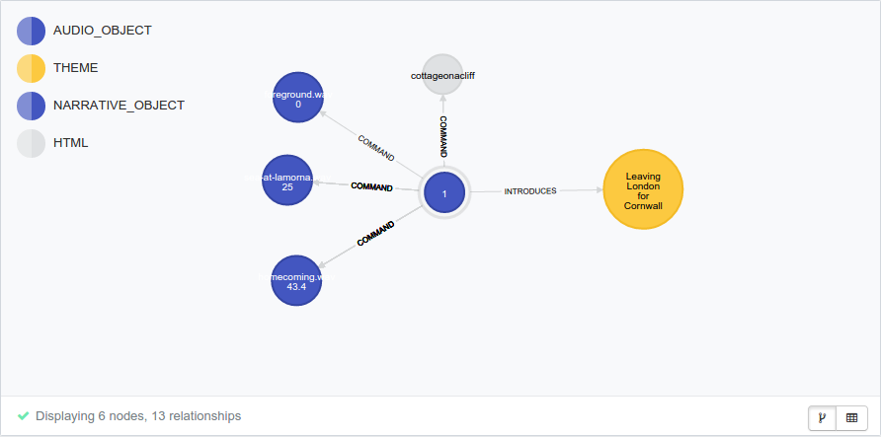

Slide 17
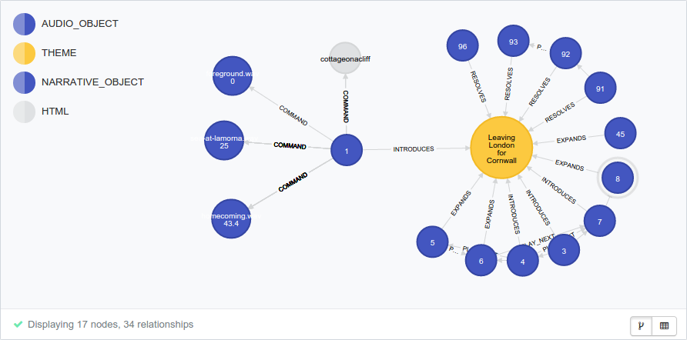

Slide 18
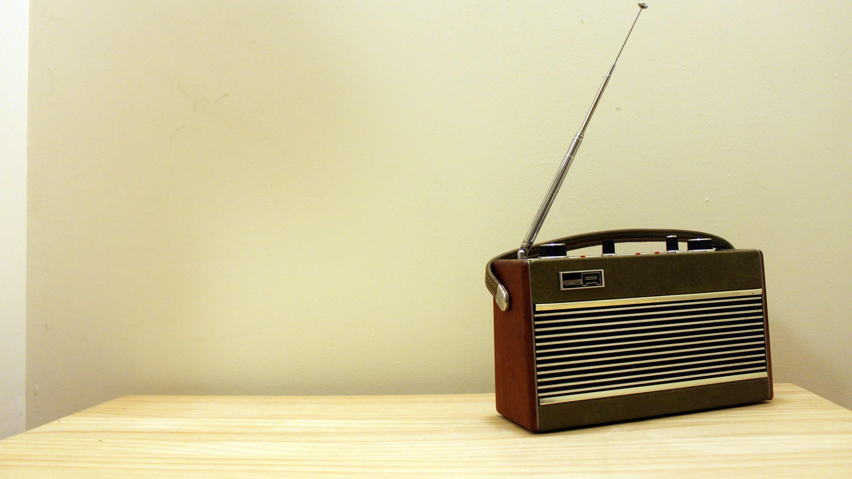
Thank You
Matthew Shotton
BBC R&D
Matthew.Shotton@bbc.co.uk
Image: Jasmine Cox

