Slide 1

Conclusions and proposals for standardization
UNESCO World Radio Day 2015
ITU
13 February 2015

Slide 2
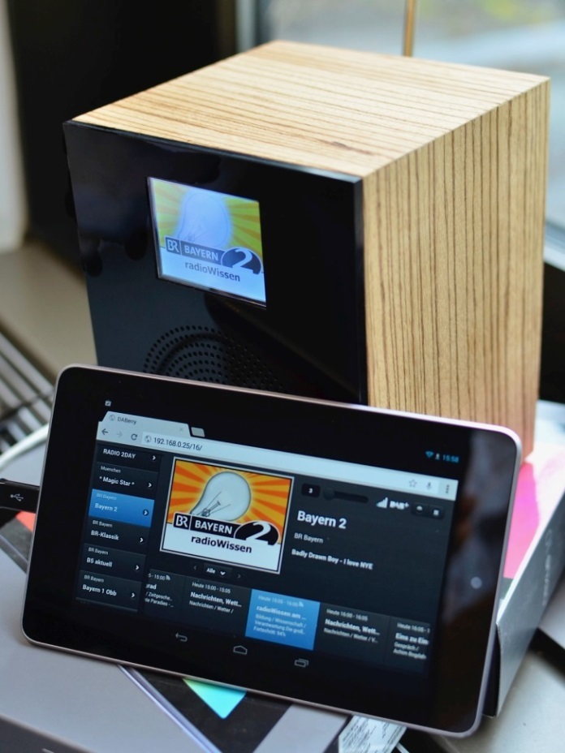
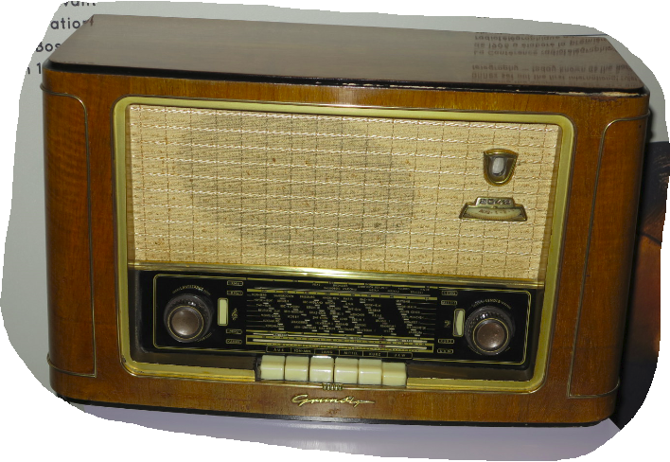
From Analog to Digital Radio
From AM and FM
to
Interactive DAB+
Prototype 2014
Series 1953

Slide 3
Standards
Ensure a horizontal market and are thus beneficial
  To the content providers
  To the service providers
  To the end-user
In short: to the whole value chain
ITU has been and will continue to work on broadcasting standards (so-called Recommendations) and, of course, on the use of the spectrum
Future areas of standardization could be (inter alia)
  Loudness control in both FM and in digital sound radio (like in Television, Rec. ITU-R BS.1770)
  Hybrid Radio (“Radio DNS”)

