Slide 1
RadioHack 2015
Mathias coinchon
13.2.2015

Slide 3
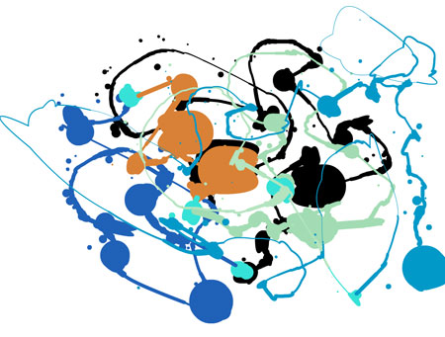
Radiohack organisation
Developers
Experts
Wifi
Pizza
Coffee, beer
Ideas
Code
Projects
Innovations
Collaborations

Slide 4
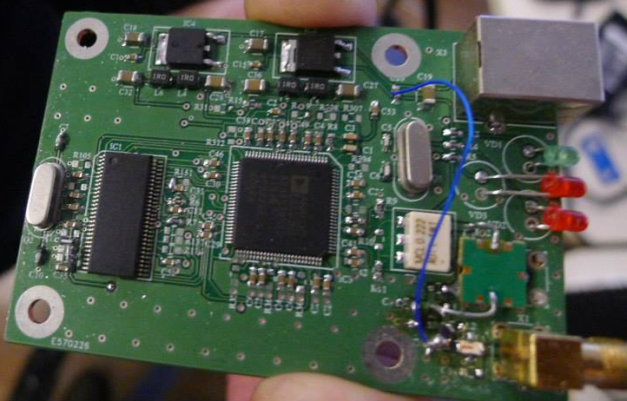
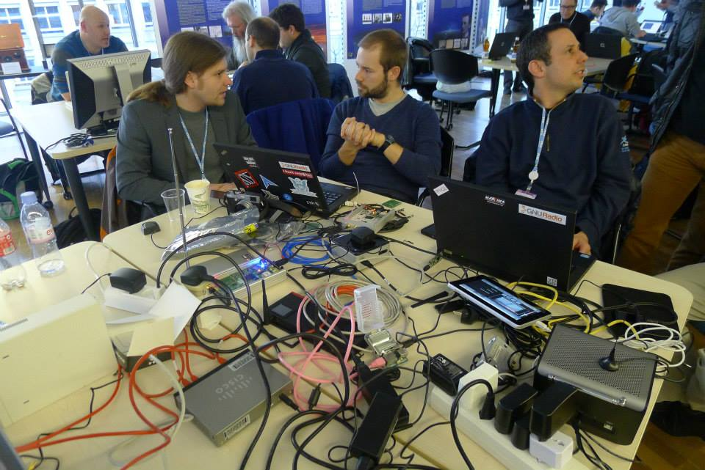
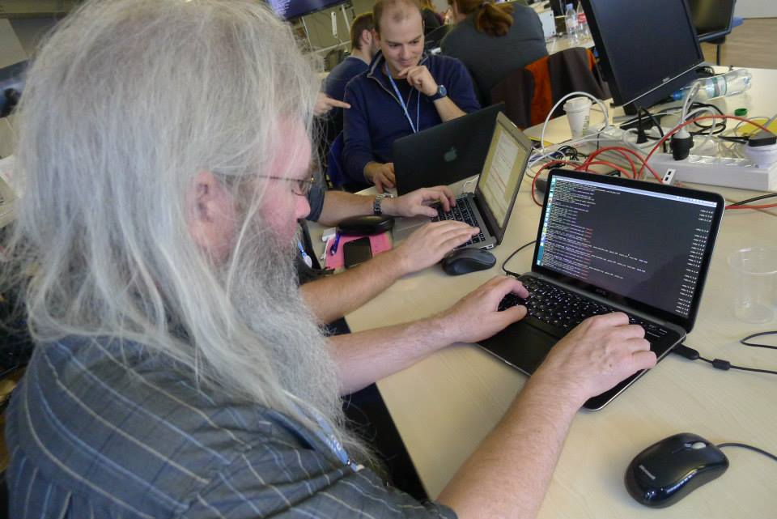
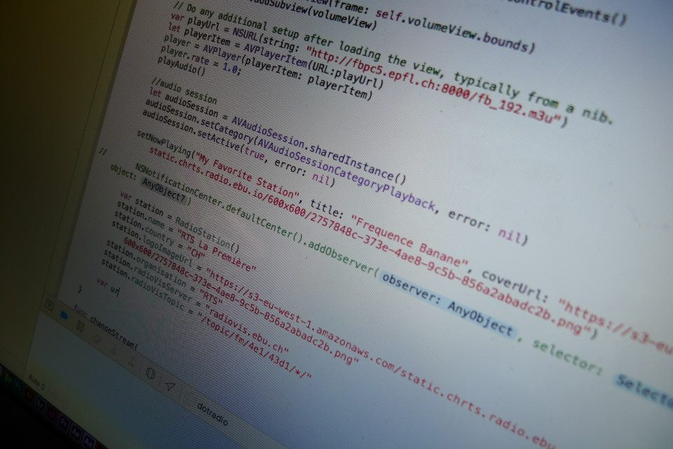

Slide 5
projects

Slide 6
projects
New EPG/SPI for RadioDNS and DAB (Ben Poor - Global Radio)
Cross platform authentication and tagging (Sean O’Halpin - BBC)
RadioWeb, DABberry receiver (Fabian Sattler - IRT)
Chaptering Radio Programs (Floris Daelemans - VRT)
Hybrid content radio (Paolo Casagranda - RAI)
Universal smartphone radio project, API (Byrion Smith - Global Radio)
Visual radio production (Matthieu Habegger - EBU (SMP))
Odr-mmbtools for DAB+ TX (Matthias Brändli - Opendigitalradio.org)
DAB transmission with ARM devices (Rashid Mustapha - UK OFCOM)
Service following (Peter Redhead - Global Radio)
Ebu.io and opensource (Michael Barroco - EBU)
Tonio app (Florian Novak - Tonio)

Slide 7
Some highlights

Slide 8
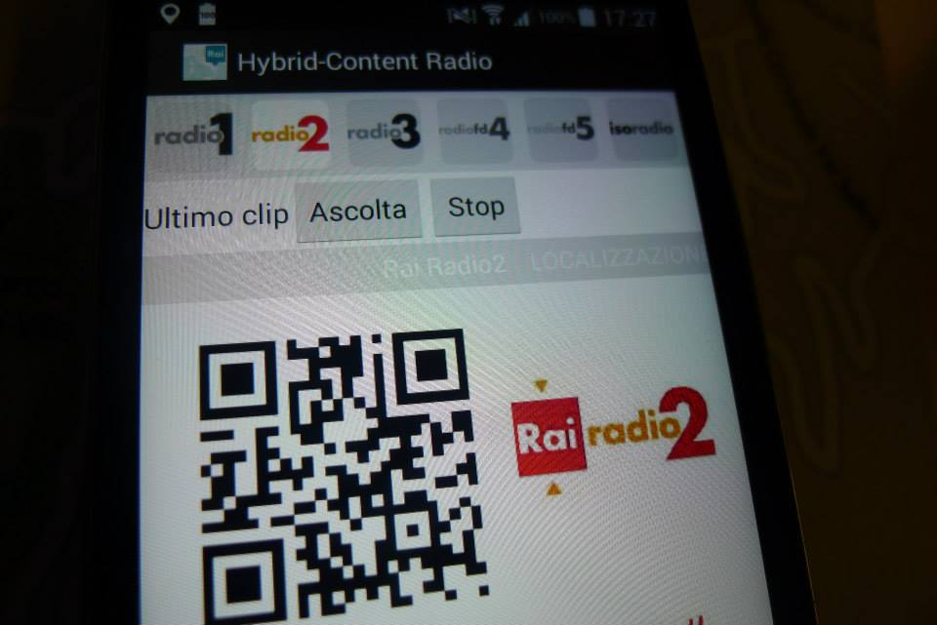
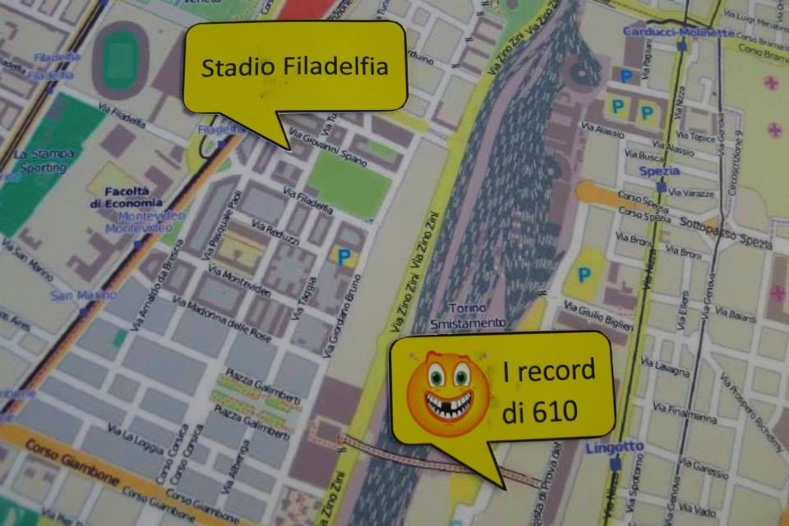
Hybrid content radio – research from RAI
Mixing linear radio and on-demand content, program based on geolocalisation
Personalised radio
Discussion in EBU DRP group. Contact: paolo.casagranda@rai.it

Slide 10
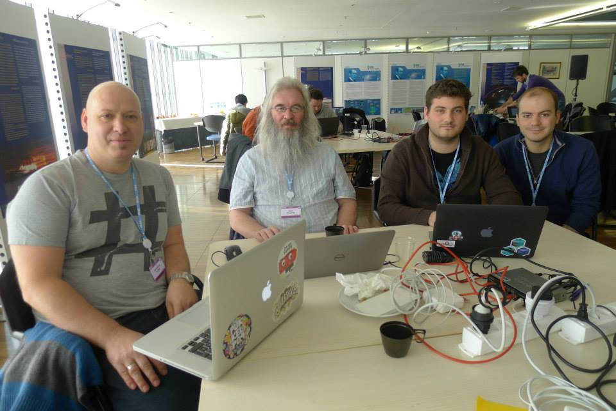
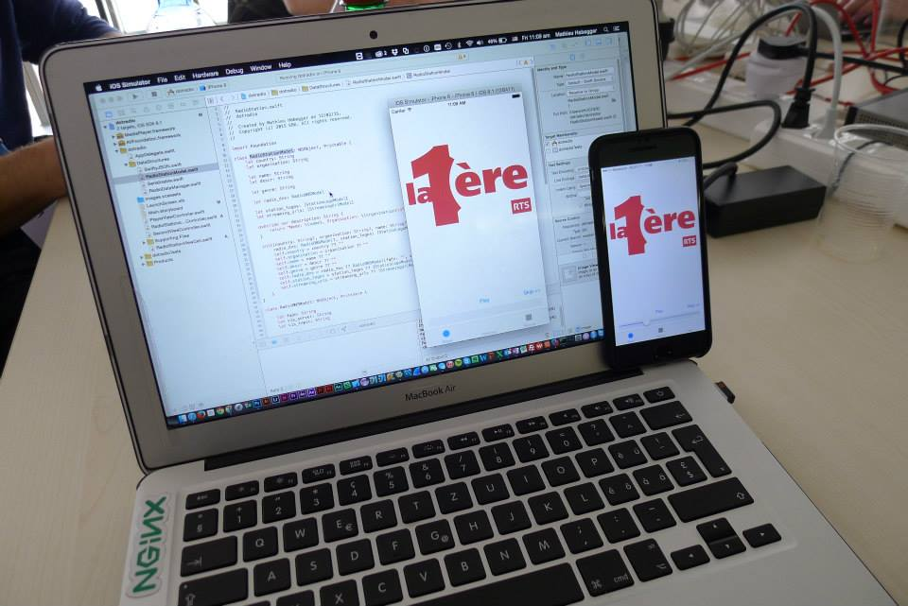
« tune-out » app, radio app based on radiodns distributed, metadata, controlled by broadcasters
Idea, prototype made at Radiohack by VRT, BBC, SMP, EBU
Source code in EBU gitlab, Contact: barroco@ebu.ch

Slide 11
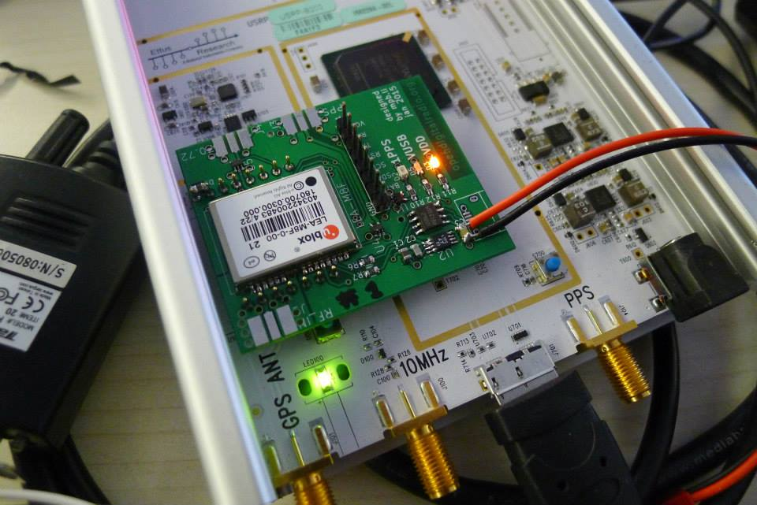
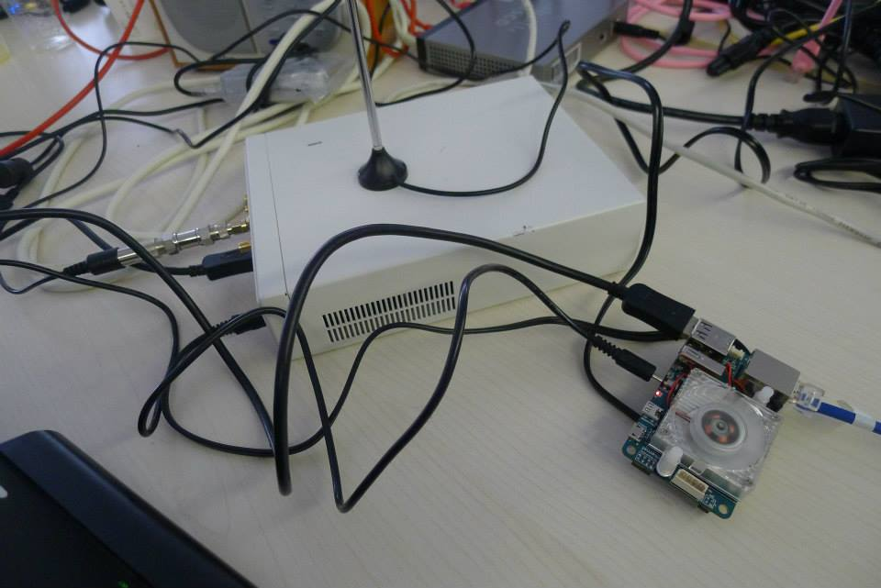
Low cost DAB Single Frequency network transmission DAB/DAB+ transmission using a 65$ computer
All based on Free Open Source Software (odr-mmbtools)
GPS disciplined oscillator board prototype
Odroid U3 + USRP B100 SDR peripheral (600€)
More information: www.opendigitalradio.org

Slide 12
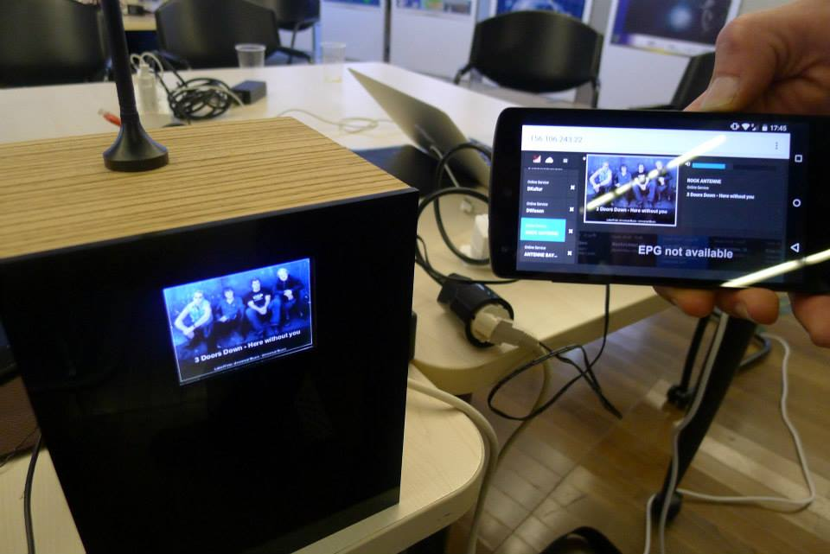
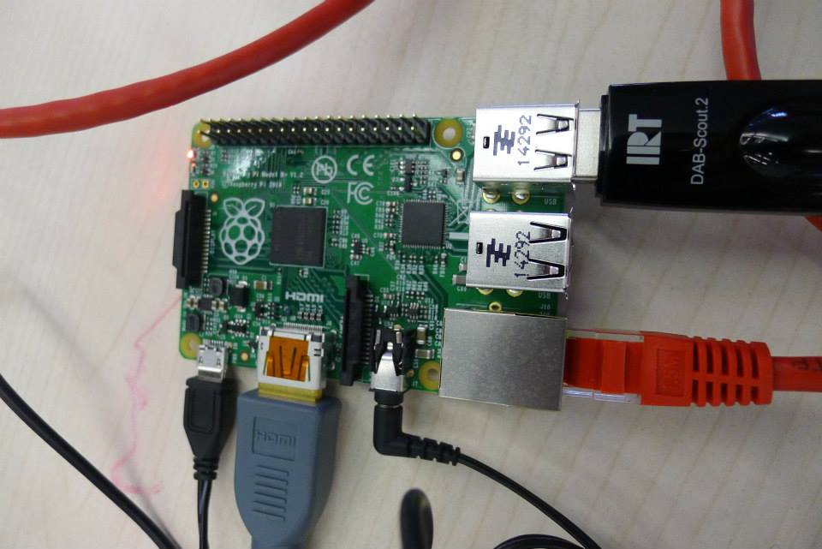
DabBerry, hybrid DAB+ receiver on raspberry PI
IRT Project (see next presentation)
35$ Raspberry Pi computer + DAB USB RX

Slide 13
Join the radiohack community: http://tech.ebu.ch/radiohack
Questions: coinchon@ebu.ch

