Slide 1
INCENTIVES FOR BROADBAND DEPLOYMENT AND COORDINATION OF PUBLIC AND PRIVATE SECTORS TO PROMOTE SUSTAINABLE DEVELOPMENT
João Batista de Rezende President, Anatel Brazil
Rio de Janeiro, June 2012

Slide 2
Summary
Brazil: a favorable moment
National market figures
Regulatory agenda

Slide 3
Brazil: a favorable moment
Sustainable development
Reduction of poverty
Reduction of deforestation and increase in the use of green technologies
Sustained economic growth
Dynamic internal market, resilient to the economic crisis
Important international player for foreign investments
Public and private sectors investment
From the Ministry of Planning, Budget and Management

Slide 4
Social Development
Due to sound public policies, Brazil has been able to reduce social and regional inequalities, expand consumer market and support investment and innovation
Brand new consumers!

Slide 5
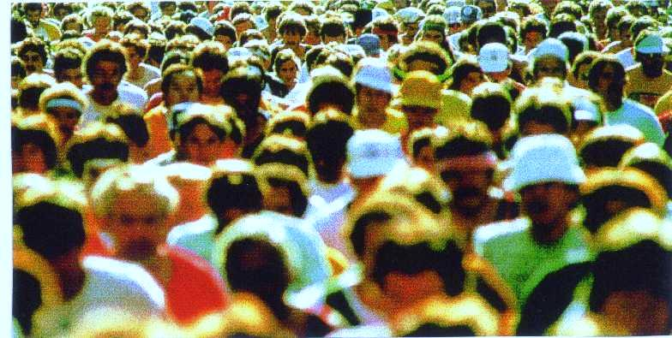
Social Development
From 2003 to 2009, about 29 million people joined middle class (C class).
7 million people climbed to the upper class. A and B classes will rise 40% till 2014 reaching more 11 million people.
13
20
31
Classes A&B
Class C
66
94,9
113
Classes D&E
96
73,3
59
2003
2009
2014
Source: exame magazine, FGV Rio, Cognatis Geomarketing, IPC editor

Slide 6
Anatel
Created by the General Telecommunications Law 1997
Recent initiatives on transparency and accountability
New means of public interaction through social media
Board’s open meetings
Restructuring of the Agency

Slide 7
Telecom Users
The restructuring of the sector (1996) and the privatization of the state-owned Telebrás (1998) system brought competition and a set of universal service targets increasing telecom access to every municipality in the country, reaching all the corners of the immense Brazilian territory.
242
43
16,5
28,7
37,4
12,8
3,6
0,4
2001
2011
2001
2011
2001
2011
2001
2011
Fixed
Mobile
Pay-TV
Broadband
Source: Anatel. Million users

Slide 8
Internet service providers MARKET SHARE
In a growing broadband market, companies are moving fast in order to offer bundle of services. The importance of this movement is easily observed in the chart below. The level of competition is likely to increase adding value and bringing benefits such as lower prices, improve the quality of services and better consumer relation.
29,7%
25,8%
22%
9,1%
1,7%
2011
Source: Teleco

Slide 9
Internet speed and household access in Brazil
Numerous issues are contributing for the growth of Internet users in Brazil with faster speeds, such as middle class consumption, lower prices of devices and services, easier retail financing, better perception of the Internet connection as an important tool for education, access to information, leisure, communication.
2008
2009
2010
> 2Mbps
≤ 2Mbps
18%
24%
27%
Households connected

Slide 10
National Broadband Program (PNBL)
The National Broadband Program was created by Decree Nº. 7175 of May 12, 2010.
The objective of this program is to expand the infrastructure and telecommunications services, promoting access by the public and seeking the best possible price, coverage and quality. The goal is to provide broadband access to 40 million Brazilian households by 2014 at a speed of at least 1 Mbps.
The Ministry of Communications, Anatel and fixed phone companies (CTBC, Oi, Sercomtel and Telefonica) have signed terms of engagement to offer connections of 1Mbps for R$ 35.00 per month.
Furthermore, prices and conditions were established to offer wholesale capacity to small providers and municipalities.
By the end of the year, the PNBL service plan will be available in 1,200 cities. At the end of 2013 there will be 3,300 cities served. Finally, in December 2014, connections of 1Mbps for R$ 35.00 will be available in 4,668 cities.

Slide 11
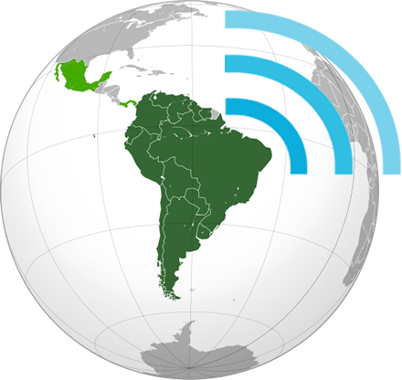
Amazon Region
Unasur project to build a fiber optic ring to connect the South American countries. The Ministry of Communications is leading the project.
The estimate costs for the first connections between the countries is US$ 100 million for 2000 km of fiber optic networks

Slide 12
Services to rural areas
Ensuring telecom services in rural areas of Brazil, where 16% of population reside (30 million inhabitants), is a challenge
In June 2011 we will auction the frequency of 450 MHz to carry voice and data services for rural areas
Jointly auctioned with 4G (2,5 GHz).
Possibility of use for green applications

Slide 13
4G
In 12 of June Anatel sold the 2.5 GHz spectrum band for 4G services and the 450 MHz for rural services
Companies VIVO, TIM, CLARO and OI will have to offer the 4G services acoording to the schedule below:
Date | Coverage
April 2013 | ALL cities of the Confederation sCup 2013
December 2013 | ALL cities of the World Cup 2014
May 2014 | ALL the cities with more than 500k inhabitants
December 2015 | ALL the cities with more than 200k inhabitants
December 2016 | ALL the cities with more than 100k inhabitants
December 2017 | At least one operator in ALL the cities with more than 30K inhabitants

Slide 14
4G
Also, the 3G coverage should be expanded according to the following schedule:
Date | Cobertura
December 2017 | At least 30% of cities below 30k inhabitants.
December 2018 | At least 60% of cities below 30k inhabitants.
December 2019 | 100% of cities below 30k inhabitants.

Slide 15
A proposed green agenda for Anatel
Action in course:
Batteries disposal – following national regulation definied by Ministry of Environment;
Coming:
Draft new regulation on “Power supply and battery charger standard”;
Considering, among other aspects, the energic efficiency.
Opportunities:
Installation of meteorological instruments on the websites of providers to monitor and mitigate environmental disasters;
Encourage telecommunications providers to use the Corporate Sustainability Index (ISE);
To include a research line “green ICT” for FUNTTEL financing projects;
To foster academic researches connected to industry needs.
To enhance participation at ITU-T SG-5;
To stablish a “Green label”, which should consider different procedures related to environmental aspects over a product (life cycle, use of metals...)

Slide 16
Thank you
JOÃO BATISTA DE REZENDE
President
Agência Nacional de Telecomunicações – Anatel
Brazil
joao.rezende@anatel.gov.br
ain@anatel.gov.br
+55 61 2312-2063

