Slide 1
Linking ICT with climate action for a low-carbon economy
Johan Wibergh
Executive Vice President, Networks
Ericsson

Slide 2
Leveraging investments in broadband to address climate change.
Recommendations for policy makers and global leaders to accelerate global progress towards a low-carbon economy.

Slide 3
The Broadband Bridge - Report highlights
Transformative potential of Broadband and ICTs as a solution to mitigate and adapt to climate change.
Pioneering projects and innovation from private sector and international organizations.
Government best practices
10 recommendations for global leaders and policy makers to turn vision into action for a low carbon, sustainable future.
Notes:
About the case studies:
The report highlights several cases from the public and private sectors of administrations and digital pioneers that are maximizing the potential of broadband to align ICT and environmental policy.
It’s very important to look at countries which are taking the message onboard, so it’s interesting to note that while more than 100 countries now have a national strategy to promote broadband, only a third of them have incorporated low-carbon planning into their national strategies, integrating ICT and environmental policies.
This is really a missed opportunity – and I’m sure Dr Touré would agree that we should be inviting all governments to review their national broadband strategies to incorporate the recommendations of this report.

Slide 4
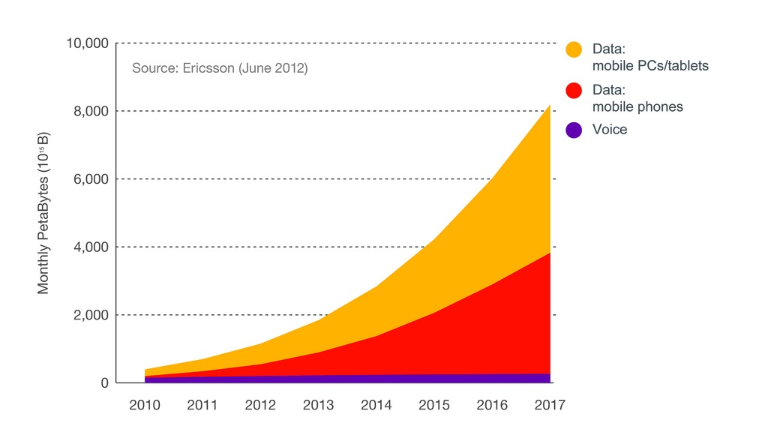
Ericsson’s Traffic and Market Report
Mobile subs 6.2 billion in 2012, and by 2017:
85 % of the world's population will have 3G coverage; 50 % will be covered by 4G
Smartphone subscriptions: 3 billion expected
Global data traffic to grow 15 times by the end of 2017. For many, the mobile phone will be the only means of accessing the internet.
Source: Ericsson

Slide 5
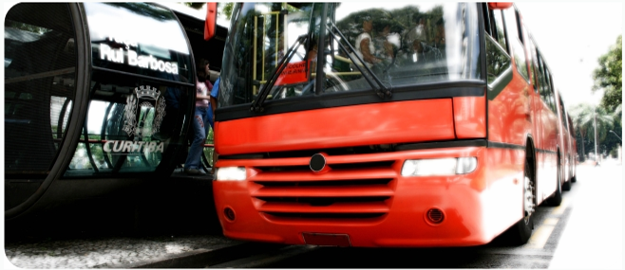
Infrastructure for a low carbon economy
ICT can reduce 15% of global CO₂ emissions by 2020, a German study predicts 25%
Our smart work study with Telia Sonera shows 40% of employee CO₂ emissions can be avoided, which corresponds to 2-4% of Sweden’s total CO₂ emissions
Our just published study with Verizon, DT, BT, GeSI and the Yankee Group shows CO₂ savings from telecommuting in the US are the same as the total primary energy consumed by Switzerland in a year
Digital delivery of music can reduce CO₂ emissions by up to 90%, compared to CDs. The same thinking can be applied to many other digitally consumed services
Better fleet management cuts fuel costs and travel time and reduces emissions
Source: Ericsson

Slide 6
Broadband and Rio+20
The Broadband Commission Call to Action addresses Rio+20 and urges the conference to include broadband in future the Sustainable Development Goals.
Investments in broadband facilitate sustainable development and economic productivity
Failure to invest sufficiently in broadband will expose developing countries to risks of exclusion from the economic and social benefits
To deliver transformational emission reductions, more engagement of private sector is critical, as is supporting government planning and policies.

