Slide 1

Increasing International Capacity
Malcolm Johnson
Deputy Secretary-General, ITU
CTO Forum 2015, Nairobi, Kenya
14 September 2015
Notes:
Thank you very much, it is a great pleasure to be invited to give this presentation on “Increasing International Capacity”. First of all, I shall give a brief overview of some of the overall trends we are seeing, before describing ITU’s recent effort underway to map the evolution of international capacity between countries and between continents.

Slide 2
Total bandwidth growing rapidly and has more than doubled over 3 years, but most growth is in developed countries; developing countries being left behind.
Source: ITU data.
Notes:
The good news is that international bandwidth is increasing, and growing strongly, especially recently – total connectivity more than doubled between 2011 and 2014, increasing from a total of 78,205 Gbit/s in 2011 to 177,824 Gbit/s in 2014, according to ITU’s most recent annual survey. However, most of this growth is in developed countries, which had a total of 123,303 Gbit/s in 2014; total connectivity in developing countries is failing to match this growth
(Note: Hong Kong (China) alone accounted for a third of the connectivity of developing countries in 2014, this curve would be much reduced stripping out Hong Kong).

Slide 3
The regional breakdown shows half of total connectivity in Europe in 2014; strong growth in Asia-Pacific region from 2011-2014.
Source: ITU data.
Notes:
In terms of the regional breakdown of the same total international capacity, half of all international connectivity was in European connectivity for 2014, although there was strong growth in Asia-Pacific connectivity from 2011-2014.

Slide 4
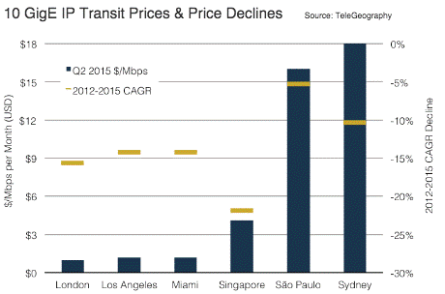
Notes:
The prices for international connectivity are falling – IP transit service prices continue to decline throughout the world. According to new data from TeleGeography’s IP Transit Pricing Service, median 10Gbps Ethernet (10 GigE) port prices across key global transit markets fell by an average of 14% annually between 2012 and 2015, and 22% over the past year. Despite widespread declines, significant price disparities persist between primary Internet traffic hubs and more remote markets.
The median 10 GigE port price in London, which serves as a critical international traffic hub for Europe, Africa, and parts of Asia, fell by 16% compound average annually over the past four years to reach US$ 1 per Mbps per month in mid-2015, among the lowest in the world. Similarly, median prices in both Los Angeles and Miami, which serve as traffic hubs for Asia and Latin America respectively, fell 14% per year to US$ 1.20 per Mbps per month.
Prices have fallen much more slowly and transit is more expensive in regions that remain largely dependent on long-haul links to Europe or the US to gain access to international connectivity. Here, service providers incur the cost of transport and price local transit accordingly, yielding far higher prices in Sao Paulo and Sydney.

Slide 5
Strong reductions in price of consumer fixed broadband packages
Source: ITU data.
Notes:
And the good news is that at least some of these reductions in international transit costs are being passed onto consumers, as measured by reductions in the cost of consumer fixed broadband packages, which have fallen by 41% over the four years 2010-2013.

Slide 6
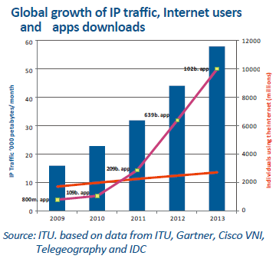
Notes:
Partly as a result of, partly driven by, this growth in international capacity, global Internet traffic has continued to grow. According to Cisco’s Visual Networking Index, Internet traffic grew by 20% CAGR in 2013. While this still represents double-digit growth, the growth rate has reduced compared to 2012 (39%). ITU recorded 2.7 billion Internet users globally for the end of 2013, 2.9 billion at the end of last year, and 3.19 billion projected for the end of this year. However, growth in Internet users is slowing, suggesting that Internet adoption may be approaching saturation in areas where people have affordable access to networks, as over two thirds of the population in many OECD countries now use the Internet. Network growth may also be slowing, as network deployment moves out of densely populated urban areas.

Slide 7
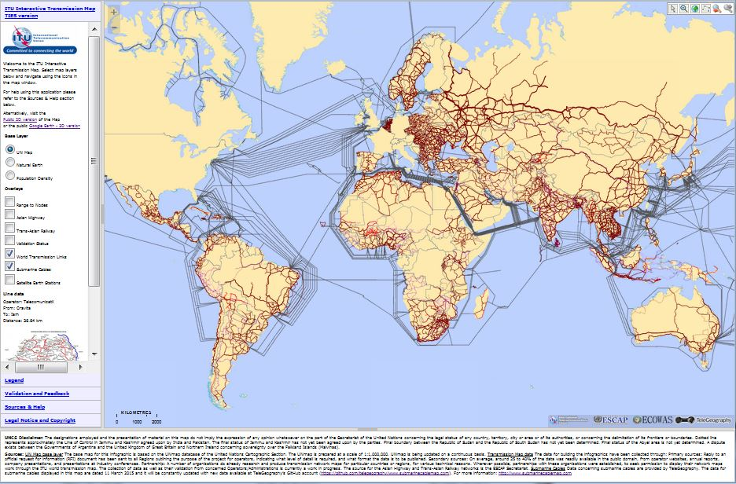
http://www.itu.int/itu-d/tnd-map-public/
Notes:
And now I should like to introduce a very interesting tool we are developing at ITU, which we are very excited about. The ITU Interactive Transmission Maps interactive database is designed to map major existing links, including submarine and terrestrial cables in relation to geography and population distribution, at the international, regional and national (domestic) levels, so when we talk about the digital divide and connecting the unconnected, we know where they are and where networks are needed.

Slide 8
http://www.itu.int/itu-d/tnd-map-public/
Notes:
The map contains details of the major international submarine cables.

Slide 9
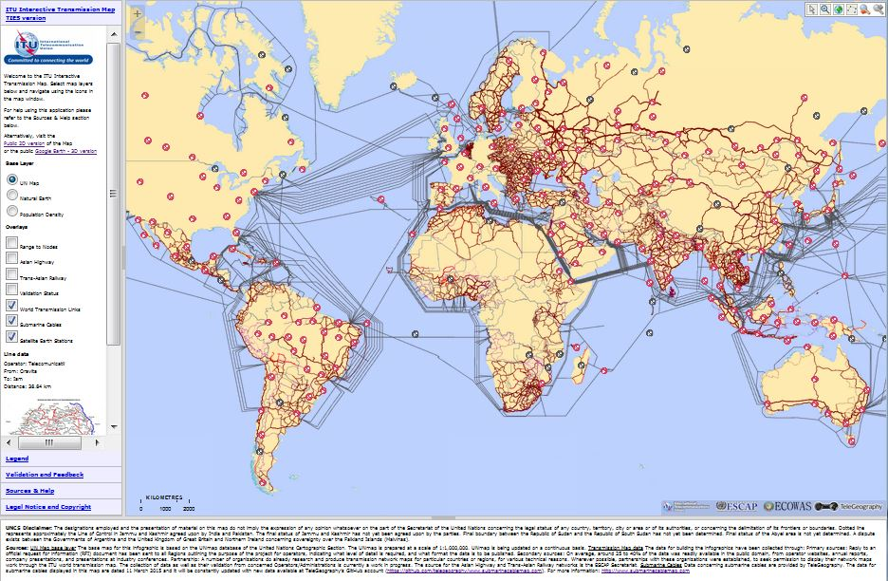
http://www.itu.int/itu-d/tnd-map-public/
Notes:
And this is the same map, overlaid with the major network nodes.

Slide 10
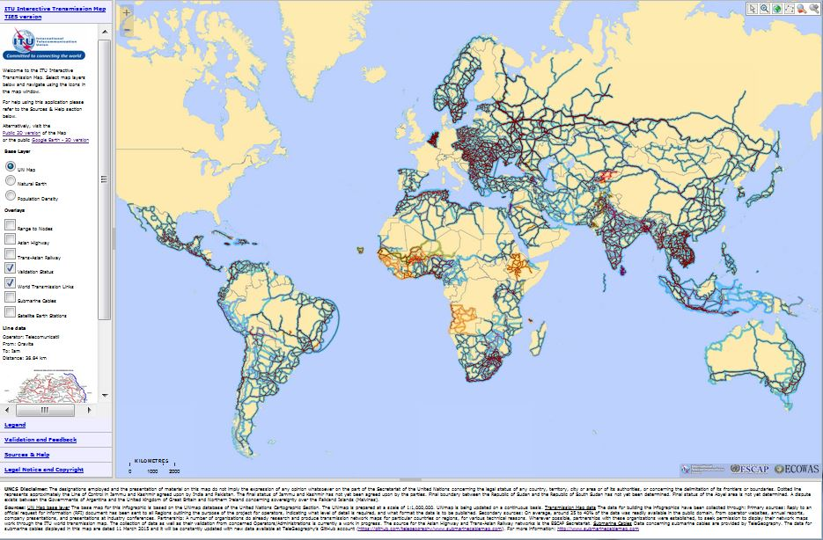
http://www.itu.int/itu-d/tnd-map-public/
Notes:
As well as the terrestrial cables.

Slide 11
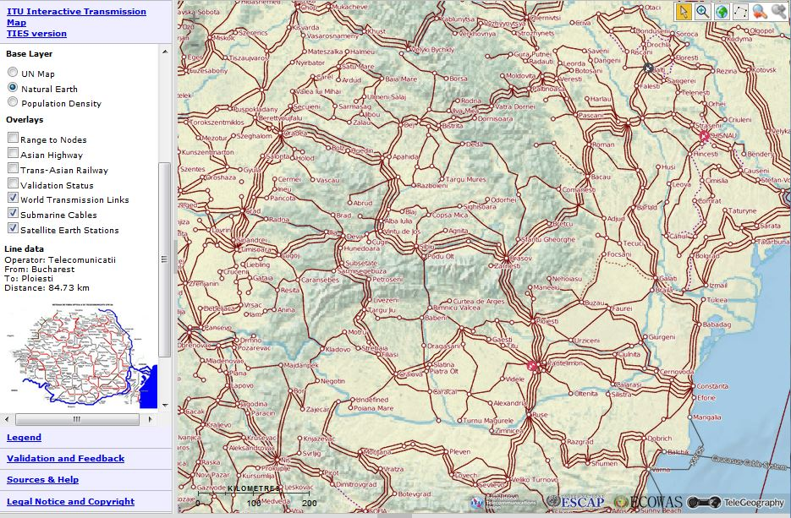
Natural Earth map layer, shows physical terrain. Explanations for natural barriers and the physical pattern of networks.
http://www.itu.int/itu-d/tnd-map-public/
Notes:
We are also mapping connectivity domestically within countries, as well major physical features (including topography, river courses, lakes and mountain ranges).

Slide 12
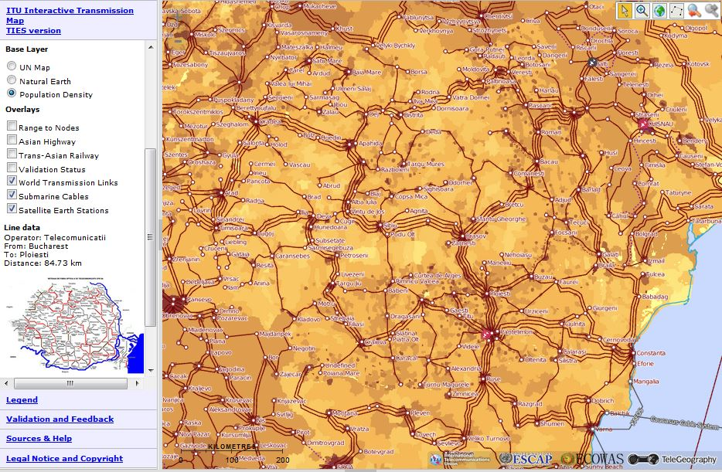
Population density map layer, showing concentrations of population in towns, cities and urban vs rural areas.
http://www.itu.int/itu-d/tnd-map-public/
Notes:
We are also mapping network nodes in relation to population density to give a much more detailed and finely nuanced high-resolution picture of the digital divide as to where it really exists.

Slide 13
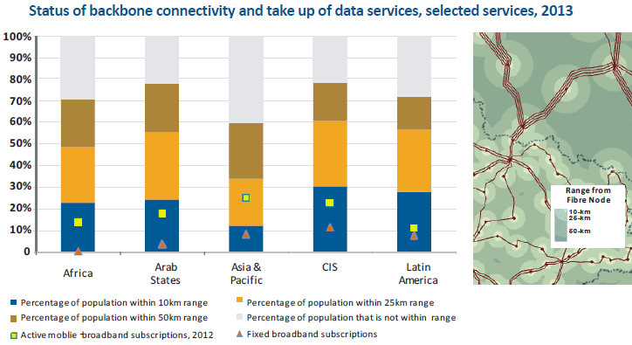
Source: ITU data.
Notes:
And these are some of the results of that fine ‘high resolution’ mapping of the digital divide. Here we can compare the distribution of the population within range (10 km, 25 km, 50 km) of a network node (which is assumed to ultimately give access to higher speeds and better options for Internet connectivity). Here, we can see that the Commonwealth of Independent States has the lowest proportion of population out of range or within 50 km of a network node, compared to Asia-Pacific, which has the greatest proportion out of range (and lowest proportion within 10 km range of a network node).

Slide 14
Major conclusions based on this work
Huge efforts underway to increase international connectivity, but many countries still face challenges in deploying and expanding NGN to meet ongoing growth in data traffic.
Strong growth in international submarine cables along African coastline and parts of Asia-Pacific, increasing the options for international high-speed connectivity.
This competition is helping reduce costs of international bandwidth.
The challenge now is to ensure that cable landing stations are connected to/integrated with domestic broadband networks in a competitive manner.
Notes:
So far, the mapping results indicate that:
while huge efforts have been made to increase international connectivity, many countries still face challenges in deploying and expanding NGN to support the ongoing growth in data traffic.
On the upside, additional international submarine cables have been deployed, especially along the eastern and western coasts of Africa and parts of Asia-Pacific, increasing the options for international high-speed connectivity between that continent and the rest of the world.
This competition will help reduce the costs of international bandwidth.
But the challenge now is to ensure that cable landing stations are further connected to domestic broadband networks in a competitive manner.

Slide 15

A Note of Caution
Strong growth in usage, traffic
volumes and connectivity capacity,
BUT Internet growth rates are slowing.
Some parts of the industry are almost
‘too’ competitive facing competition from
new technologies/players, eroding revenues & profit margins, and raising doubts over long-term future investment.
In some regions, operators face declining revenues, but increasing capex demands.
This needs to be monitored carefully – ITU is working closely with all its Members to track industry evolution.
Notes:
However, despite the positive picture painted here of strong growth in international capacity, traffic and Internet usage, I should just like to sound a note of caution, based on ITU’s most recent major report, “The State of Broadband 2015”:
This report finds that Internet growth rates are slowing.
And we are used to seeing competition as a positive thing, but one can have too much of a good thing – Some parts of the industry are almost
‘too’ competitive or facing competition from new technologies/players, eroding revenues and profit margins, and creating doubts over the long-term future sustainability of investment.
In some regions, operators face declining revenues, but increasing capex demands.
All of this needs to be monitored and reviewed carefully, and ITU is working closely with all its Members to do just this.

Slide 16
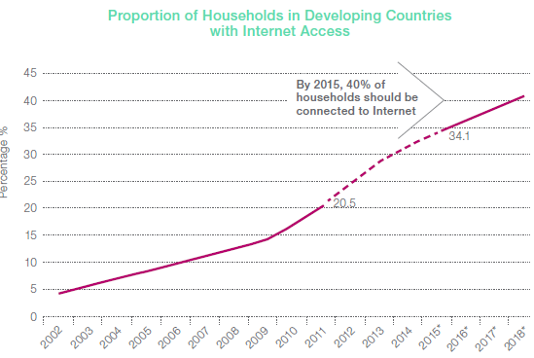
Notes:
As one example of this, it is interesting to note that the Broadband Commission’s target for household connectivity for 2015 has not been achieved, and does not look likely to be achieved until 2018, as rates of connecting households with Internet access are slowing. As you can see from this graph, the rate at which households are being connected up with access to the telecommunication networks you saw earlier is slowing.

Slide 17
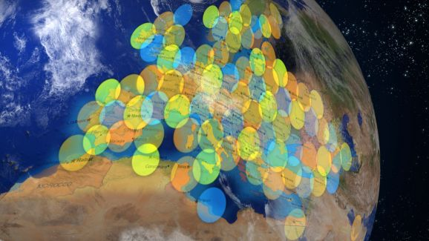
Notes:
And now, as a segway to the panel discussion coming up shortly, I should like to mention the very important role of satellite, which has too often been seen as a gap-filler technology by some. ITU has a strong and active satellite community. And let’s remember that when the European Commission announced in mid-October 2013 that every EU household was now able to have a basic broadband connection, Ms Neelie Kroes (Vice-President of the European Commission and then European Commissioner for the Digital Agenda) specifically referred to the use of satellite and the pan-European availability of satellite broadband as one of the reasons. The latest generation of satellite broadband technologies are now capable of delivering comparable speeds and quality of service, at near-comparable cost, in many countries, so in my view, satellite can now be seen as a serious alternative for connecting regions or areas where other types of connectivity are difficult to implement and achieve.

Slide 18
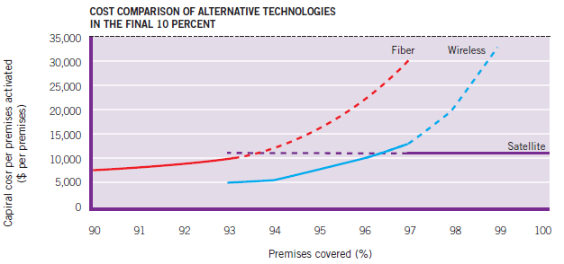
Marginal costs of different technologies
Notes:
Of course, the major advantage of satellite connectivity in terms of deployment is that although satellite may have higher overall costs per subscriber for connecting subscribers initially, the marginal costs of connecting additional subscribers are relatively low, and connectivity can be provided to entire regions in one fell swoop.

Slide 19
Introducing the Satellite Industry
Satellite-based services are an essential component of the Telecom Infrastructure to support the Information Society and bridge the digital divide
Satellite systems are the only technology that can provide worldwide coverage in a single link
Satellite services costs are not affected by distance
Appealing (and sometime the unique) option to bridging the digital divide
Three main applications:
  Communications
  Navigation
  Earth Observation and Monitoring

Slide 20
Satellite for Telecom
Currently near 500 Geostationary (GEO) and non Geostationary (Non-GEO) satellites in service
Global capacity is > 6,000 Transponders (channels of 36 MHz per TRPs); very ambitious projects are planned or designed, increasing this capacity up to 7,000 TRPs in year 2020
up to 200 Gbps (Reception/transmission); newest technologies would rise it up to 700 Gpbs in year 2020
Although the amount of satellite-based broadband subscribers is currently low (>2 millions), new non-GSO projects will significantly increase it by 2020
More than 230 millions of Satellite TV receivers worldwide
Increased use for cellular backhaul (interconnection between base stations and Nodes)
SATCOM revenues: 2015: US$20 billion , 2020 ~US$ 23 billion

Slide 21
Satellite for Navigation
Currently 2 operational platforms for Global Navigation Satellite Systems (GNSS): GPS, GLONASS, and several in planning/deployment: GALILEO, BEIDOU, etc.
More than 100 satellites devoted to operational GNSS and near 300 for those planned
Over 1 billion of user terminals equipped with GNSS receivers: smartphones, watches, navigation gadgets, etc.
GNSS encompass almost all activities: security & defense, transportation (air, land, sea), emergency care, medical, educational, sports, infrastructure projects (railways, highways, bridges, buildings, networks, etc.) leisure, research,
GNSS receivers &services revenues: 2014: US$74 billion

Slide 22
Satellite for Earth Observation
Currently near 200 Satellites devoted to Earth Observation and Monitoring
Applications include: remote sensors (visible, infrared, ultraviolet), radars, thermography, meteorology, etc.
They have become essential for rapid attention of natural disasters and to prevent them through early warning
They have also become a unique tool for territory planning: water supply, agricultural, road planning, etc.
The market for these products is growing steadily: about US$1 billion in 2014

Slide 23
Satellites: The Role for ITU
The ITU was delegated by Member States to manage the Orbit-Spectrum Resource (OSR)
The ITU Radio Regulations define the key principles to plan and manage the OSR exploitation worldwide driven by the key principles of: efficiency, rationality, economic, and equitable access
This management allows the operation of the thousands of satellites currently in service, avoiding harmful interference-and in an interference-free environment
Sustainable and clear regulations are essential to guarantee the long-term huge investments in space systems.

Slide 24

Malcolm Johnson, Deputy Secretary-General, ITU
Notes:
Thank you very much.

