Slide 1
AMBASSADORS’MEETING
17 SEPTEMBER 2015

Slide 2
AGENDA
Cybersecurity @ ITU
ITU Telecom World 2015
WRC-2015
WTIS-2015
Other important events

Slide 3

CYBERSECURITY
ITU’s Role
2003 – 2005
World Summit on the Information Society entrusted ITU with a role of the sole facilitator for WSIS Action Line C5 on Building confidence and security in the use of ICTs

Slide 4
CYBERSECURITY
Importance of Cybersecurity
Internet users - 40% of the World’s population
Estimated annual cost of cybercrime – $455 billion
Developing countries most at risk as they lead the growth in the use of ICTs
Trust is crucial for the adoption of new technologies enhancing socio-economic wellbeing of every country

Slide 5

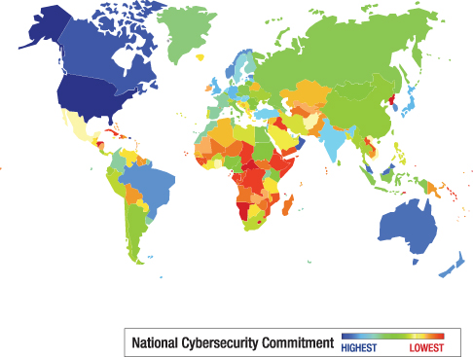
CYBERSECURITY

Slide 6
CYBERSECURITY
Leading Cybersecurity Actors – Over the Years
Ministry of Finance
Ministry of Foreign Affairs
Ministry of Interior
Ministry of Telecommunications/ICTs
Ministry of Telecommunications/ICTs
Ministry of Education
Ministry of Health
Ministry of Defense

Slide 7
Multitude of “Global” processes/forums: Sample Snapshot
CYBERSECURITY
IAEA forums
OASIS
ITU Study Groups and forums
Global Forum On Cyber Expertise
Internet Governance Forum
ISO/IEC
UN Governmental Group of Experts
OHCHR forums
HRC forums
The London process
Annual Garmish Forum
UNESCO forums
Wuzhen Summit
UNODC forums
World Economic Forum processes
UNODC forums
UN Governmental Group of Experts
UNGA Discussions in various committees
East West Institute Annual Summits
?

Slide 8
CYBERSECURITY
ITU - Holistic Approach
(Five areas of action)
Technical/Procedural Measures
Over 300 standards
Legal Measures
Organizational Structures
Capacity Building
International Cooperation

Slide 9

ITU- Building Trust in Networks

Slide 10
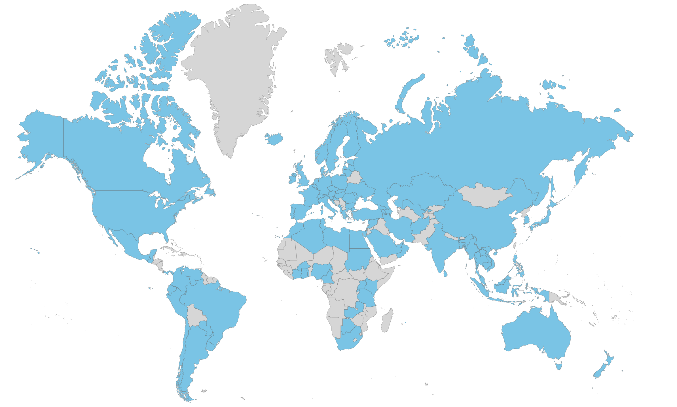
CYBERSECURITY
ITU National Computer Incident Response Team (CIRT) Programme: enabling the first line of cyber-response
CIRT assessments for 65 countries
Supported operational CIRTs in 11 countries
CIRT projects under execution in 4 countries
11 cyber drills with participation of over 100 countries
92 Countries with no CIRTs

Slide 11

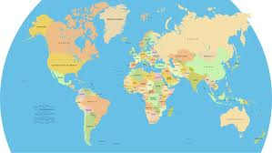

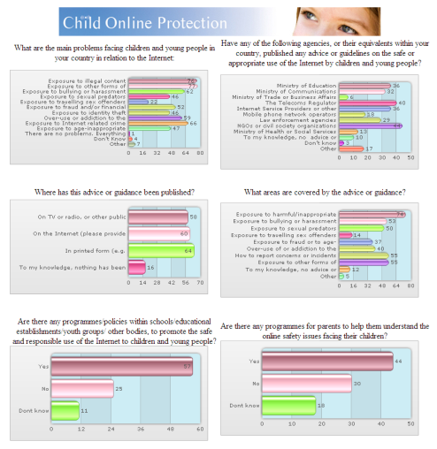

CYBERSECURITY
Child Online Protection (COP) Initiative
Knowledge base of
countries profiles
Guidelines for stakeholders
Data collection
Surveys with
policy makers
Case studies
In partnership with 34 intergovernmental, private sector, civil society and other organizations

Slide 12















CYBERSECURITY
Building a global multistakeholder partnership

Slide 13

CYBERSECURITY
UN-wide cooperation mechanisms
UN-wide Framework on Cybersecurity and Cybercrime (2013)
UN System Internal Coordination Plan on Cybersecurity and Cybercrime (2014)

Slide 14
CYBERSECURITY
Upcoming Cybersecurity ITU Events
CWGs
  CWG-COP: 30 September 2015
Cyberdrill
  Europe & CIS: Montenegro, 30 September - 2 October 2015
International Conference "Keeping Children and Young People Safe Online"
Warsaw, Poland, 22-23 September 2015
Telecom World 2015
Budapest, Hungary, 12-15 October 2015
  ITU Asia-Pacific training on Cybercrime Investigation and Forensics
  30 November - 3 December 2015
  Kaleidoscope 2015 - ​Trust in the Information Society, Barcelona, Spain, 9-11 December 2015

Slide 15
New initiative to assist you better
CYBERSECURITY
  Secretary-General’s Forthcoming Informal Consultations with ITU Member States
cybersecurity@itu.int

Slide 16
AGENDA
Cybersecurity @ ITU
ITU Telecom World 2015
WRC-2015
WTIS-2015
Other important events

Slide 17

ITU TELECOM WORLD 2015
12 – 15 October, Budapest, Hungary
The global platform for SMEs, corporates and government to exhibit solutions, share knowledge and network at the highest level
New focus on entrepreneurship, SMEs and innovation:
    ITU Telecom World Entrpreneurship Awards
    SMEs exhibiting within National Pavilions and independent pods
    Targeted networking including Government and SME Dialogue, Industry and SME Dialogue
    Dedicated Forum sessions
    Budapest Call to Action

Slide 18
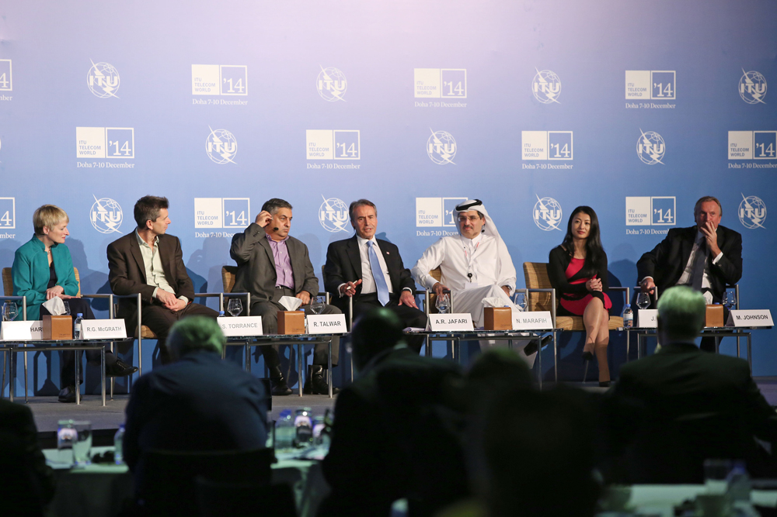
ITU TELECOM WORLD 2015
Forum
    Accelerating Innovation for Social Impact
Leadership Summit
2. Forum
  Keynotes & Panel sessions
  Government & SME Dialogue
  Industry & SME Dialogue
  Ministerial Roundtable
Three main tracks:
Accelerating Digital Transformation
Expanding Digital Opportunities
Building Trust for a Connected World

Slide 19
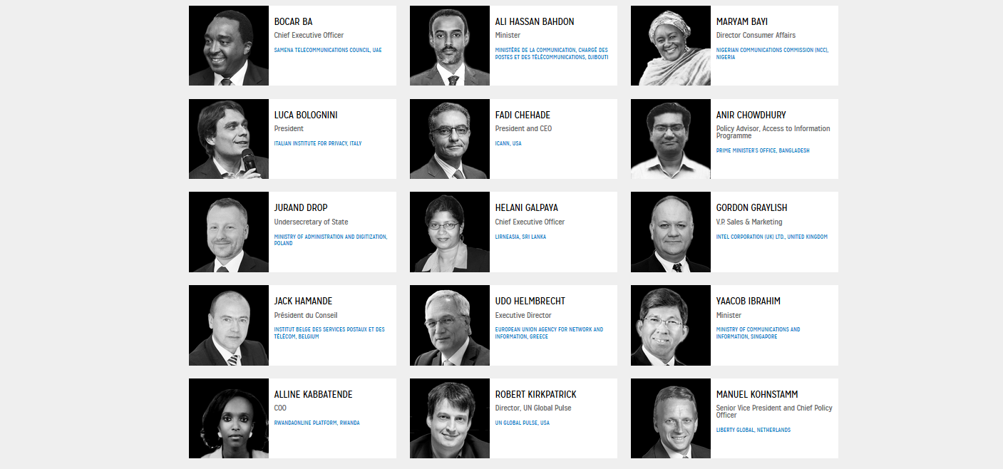
ITU TELECOM WORLD 2015
Speakers Snapshot
Full list of Speakers available online

Slide 20
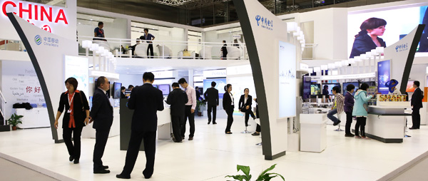
ITU TELECOM WORLD 2015
Exhibition
    National Pavilions with SME/innovation entities:
    Argentina, Azerbaijan, China, Djibouti, Hungary, Japan, Kenya, Republic of Korea, Malawi, Nigeria, Saudi Arabia, Senegal, Smart Africa Pavilion (Kenya, Rwanda, South Sudan and Uganda), Tanzania and Zimbabwe
    Independent Stands:
    ATDI, GEW Technologies, Huawei, Intel, LS telcom, Magyar Telekom, Microwave Vision Group, Rohde & Schwarz, TDIA, and ZTE
    SME pods:
    CRFS, Deverto Systems, Hakko Opto, Korea Innovation Centre Negete, Subah Infosolutions, Wavecontrol

Slide 21
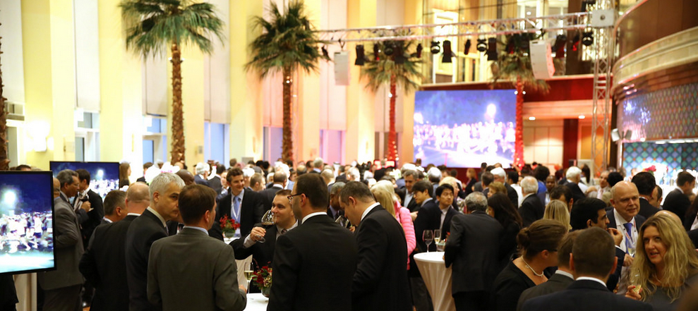
ITU TELECOM WORLD 2015
High-Level Networking
Networking Events, including:
  Leaders Lunch
  Leaders Dinner
  B2B Networking Lunch
  B2G Networking Lunch
  Enterprise Europe Network matchmaking day
  Hungarian Open Day
  Event Closing
Networking Spaces
Event App

Slide 22


ITU TELECOM WORLD 2015
We look forward to seeing you in Budapest, Hungary in October!
telecomworld.itu.int

Slide 23
AGENDA
Cybersecurity @ ITU
ITU Telecom World 2015
WRC-2015
WTIS-2015
Other important events

Slide 24


WRC-2015
WRC Purpose
Update the Radio Regulations
    Spectrum allocations
    Coordination and notification procedures
    Administrative and operational procedures
Adopt Resolutions
Held every 3-4 years (CS 90)
To be held in Geneva, 2-27 November 2015
ITU
Radio
Regulations
WRC

Slide 25



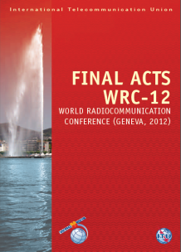




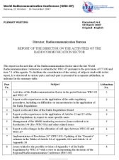

WRC-2015
WRC Process
Informal Group
(Structure & Chairmanship)
Proposals
Proposals
Coordinated
common proposals
Member States
Agenda: by previous WRC, finalized by ITU Council + PP-14 Res. 185
RA
WRC
Final Acts
CPM Report
Conference
Secretariat
(BR & GS)
Radio
Regulations
(CS89)
Director’s
Report
Regional preparation
Resolution 72 (Rev.WRC‑07)

Slide 26

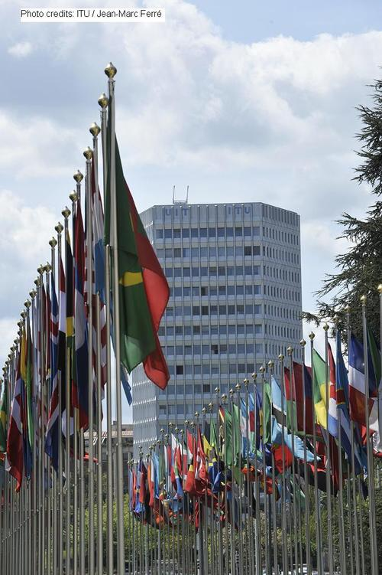

WRC-2015
Regional Preparations
Harmonization of regional positions
Collaborate in resolving differences in WRC agenda items
Plan for the following WRC

Slide 27
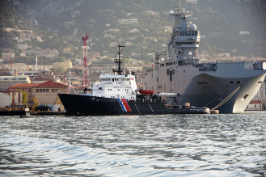

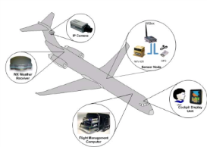


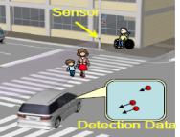
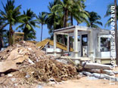
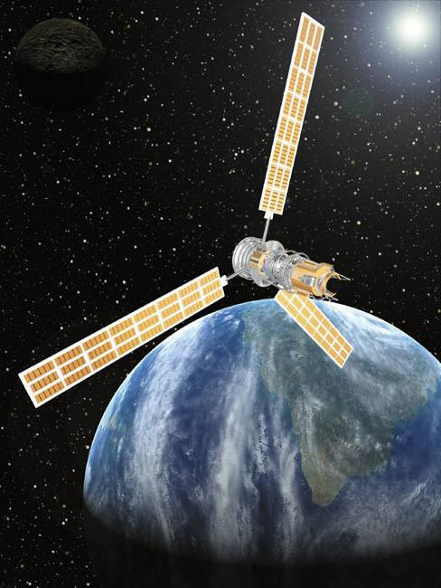


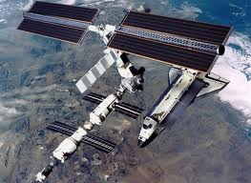
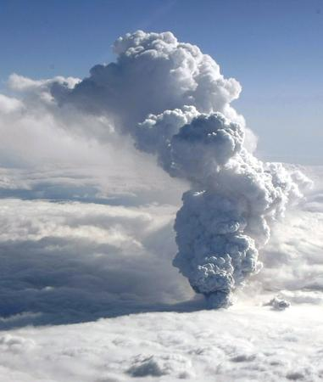
WRC-2015
Mobile
Broadband
(IMT < 6GHz,
UHF band,
PPDR)
Topics on WRC-15 Agenda
Maritime (AIS,
UHF On-board Coms)
Aeronautical
(UAS, WAIC, GFT)
Automotive Radar
(RLS@78Ghz)
Amateur radio
for emergency
@ 5 MHz
Satellite allocations
(FSS @ 10-17 GHz
FSS&MMSS @ 7/8GHz
MSS @ 22-26GHz)
UTC
leap
second
Climate
monitoring
Weather
forecast
Regulatory
(Sat. regulations,
harmonization of
spectrum use, etc.)
Space
Research
2

Slide 28
WRC-2015
Credentials
WRC-15 is a treaty-making Conference. Accordingly, in order for Member States to exercise their sovereign rights at the Conference, delegations should be properly accredited by means of instruments signed by the Head of State, by the Head of Government, by the Minister for Foreign Affairs or by the Minister responsible for radiocommunication matters.

Slide 29
WRC-2015
Credentials
The credentials submitted shall, moreover, fulfill one of the following criteria:
confer full powers on the delegation;
authorize the delegation to represent its government, without restrictions;
give the delegation, or certain members thereof, the right to sign the Final Acts.
For more information on how to submit the necessary credentials, please see the full text of Circular Letters No. 15/018 and 15/037, which is available on WRC-15 website.
For further clarification, please contact WRC-15 Credentials Committee secretariat at:
membership@itu.int

Slide 30
AGENDA
Cybersecurity @ ITU
ITU Telecom World 2015
WRC-2015
WTIS-2015
5. Other important events

Slide 31





WTIS-2015

Slide 32



WTIS-2015
Main global event on information society measurement
Bringing together the ICT policy and ICT data community
Ministerial Roundtable (So far more than 15 Ministers Confirmed)
Leaders’ Dialogue (Private Sector CEOs, Director Generals of Telecom Regulatory Authorities and National Statistics Offices)
Launch of the ICT Development Index (IDI) 2015
Launch of Measuring the Information Society Report 2015

Slide 33



WTIS-2015
Special events
Celebration of ITUs 150th Anniversary: Opening ceremony and Dinner including Memorial Speech by Professor Ken Sakamura
«Meet the Industry»: opportunities for interaction between VIPs and other Participants with leading Japanese ICT companies

Slide 34
AGENDA
Cybersecurity @ ITU
ITU Telecom World 2015
WRC-2015
WTIS-2015
5. Other important events

Slide 35




Other important events
Events
Broadband Commission for Sustainable Development, 26 September in NYC on the occasion of the SDG Summit
ITU 150 Gala celebration in NYC on 26 September, ICT in Sustainable Development Award
WSIS+10 High Level Meeting, 15-16 December
WSIS Forum, 2-6 May 2016, Pending the outcome of the UNGA overall review

Slide 36
THANK YOU!

