Slide 1
ITU Academia Member: University of the Basque Country (UPV-EHU)
Eva Ibarrola University of the Basque Country eva.ibarrola@ehu.es

Slide 2
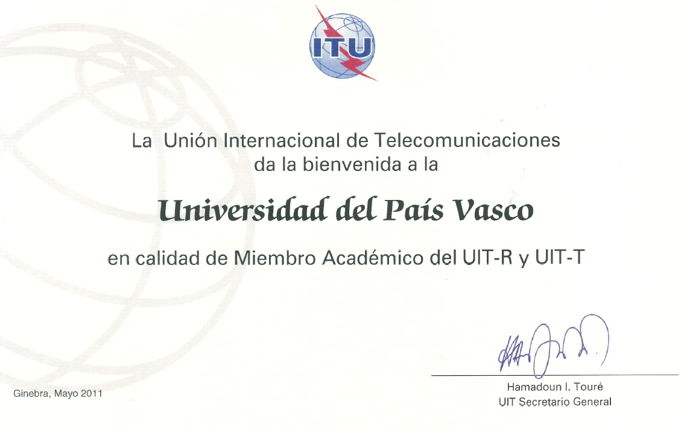
Roadmap
Academia member since May 2011
1

Slide 3
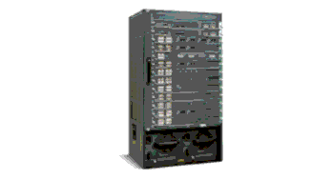
Roadmap
Cooperation back to a long time ago
Invited experts
Sectors members
As part of national delegations
ITU Sectors:
Radiocommunication (ITU-R)
Standardization (ITU-T)
2

Slide 4
ITU-R:
Since 2004
Digital Radio Mondiale Consortium
Sector member
Contributions to SG-3 and SG-6
Influence of wind turbines on Digital TV Services (2008)
Contributions to SG-3 and SG-6
National Spanish Delegation
3

Slide 5
ITU-R:
Handbooks
Coordinators in “Surface Wave Propagation Handbook” (SG3 WP3K)
Rapporteur Group for “Digital Terrestrial Television Broadcasting Handbook” (SG6 WP6A)
Contributions (SG3 & SG6)
Report BS.2144
Recommendation BT.1893
Report BT.2142
Chairman position in SWG
4

Slide 6
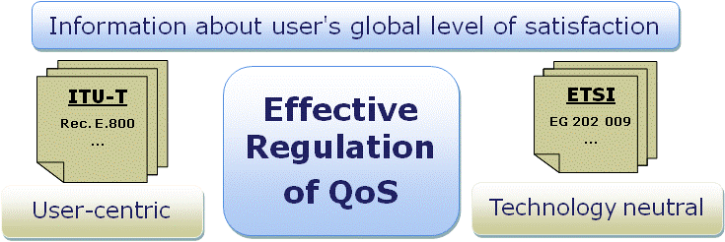
ITU-T:
Since 2006
Research activity related with SG-12
Presented in Kaleidoscope 2009
Since 2009
Ties from Spanish Regulator
Study Groups 2 and 12
Presented in Kaleidoscope 2010
Since 2010
Invited experts in ITU-T
5

Slide 7
A New Membership Category: ITU Academia Member
Resolution 169 - Plenipotentiary Conference (Guadalajara, 2010)
“Admission of academia, universities and their associated research establishments to participate in the work of the three Sectors of the Union”
6

Slide 8
UPV/EHU: Academia Member
Step forward in cooperation with ITU
Represent our own institution
Focus on the spread of knowledge
Support broader engagement of academia on standards-related matters
Education on standardization
New active participation in ITU-T
Give and spread it...
7

Slide 9
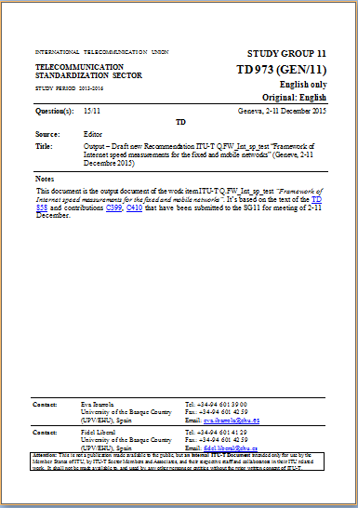
ITU Member: Active Participation
Contributions from UPV/EHU
To SG-12 Q7 & Q2
To SG-11 Q10 & Q15
Editors of recommendations
Rapporteur in Q15 at SG-11

Slide 10
Benefits to UPV/EHU research
Focus our research on areas where new advances are required
Innovation and new ideas for ITU-SG
Full access to ITU documentation
Aware of all technical, operational and regulatory work
New contacts and forums
SG comprise experts representing a broad range of interests
9

Slide 11
Benefits to academic UPV/EHU
Raise awareness of the importance of standardization
Instill consciousness of the importance of teaching about standards and the need to use them regularly
Use standards as vehicle for spreading knowledge and good practices
Students of today are the technology makers of tomorrow
Improve the position of standardization
Workshops, students internship
10

Slide 12
Nevertheless….
Many constraints
Recognition of this work in academia (SG-9)
JCR :
SJR:
Indexed in IEEExplore
Financial support to attend the meetings
Membership supported but not travelling
Not so many active financial aids right now
Cooperation in different SGs
11

Slide 13
Conclusions
Importance of academic participation in the study groups of ITU
Benefits to both our research and academic daily life
Extend this cooperation to the educational programs
Workshops
Visitor professors and students
Publications
Need of recognition and financial support
12

Slide 14
Thank you!
Eva Ibarrola University of the Basque Country eva.ibarrola@ehu.es
Consultation on ITU-Academia Collaboration
Barcelona, 8 December 2015

