Slide 1
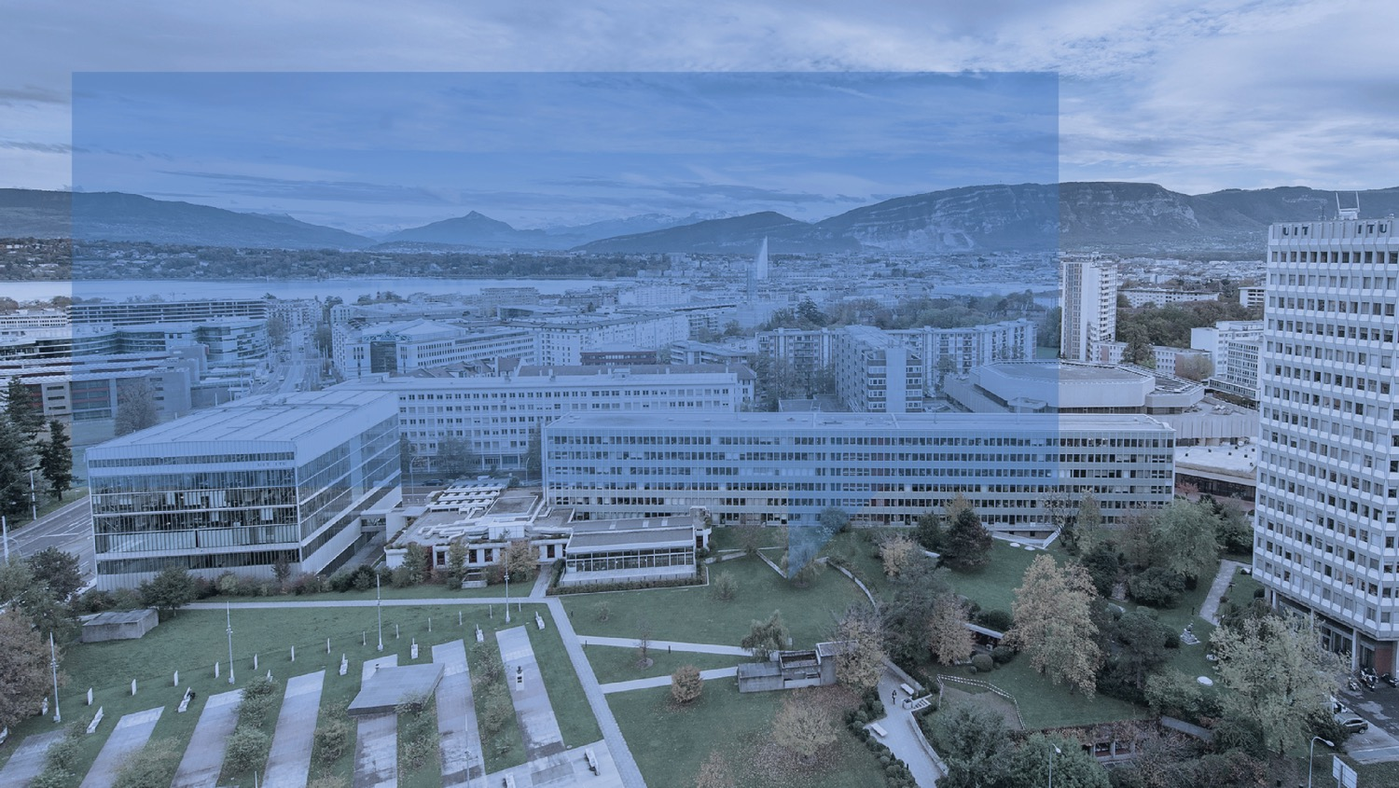
ITU and Academia
International Telecommunication Union
~ United Nations specialized agency for ICTs

Slide 2
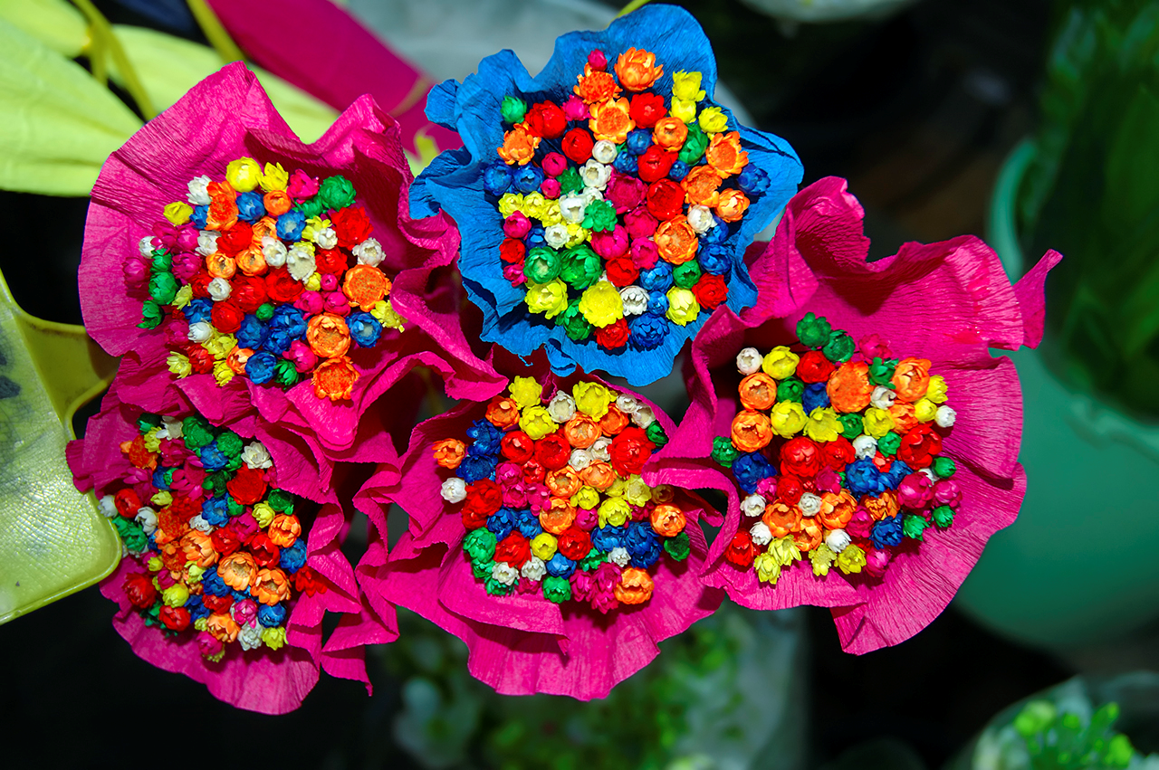
Welcome to Barcelona

Slide 3
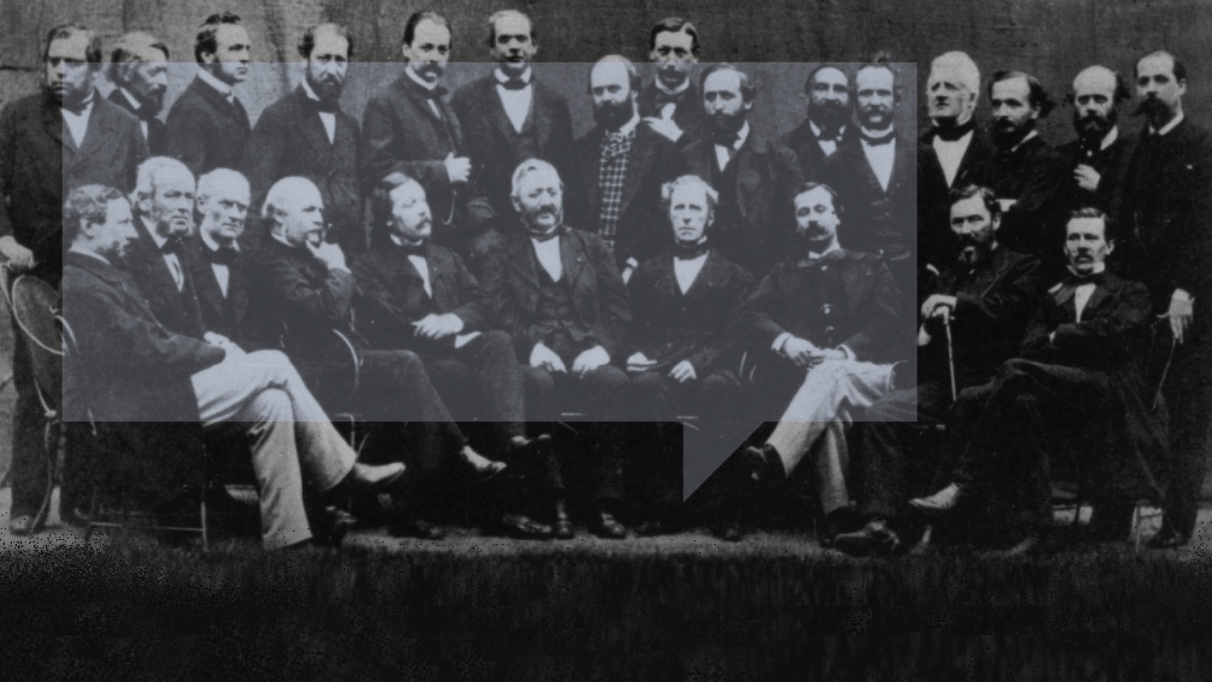
ITU-ACADEMIA CONSULTATION
We’ve come a long way…

Slide 4

ITU-ACADEMIA CONSULTATION
ITU: International Telecommunication Union
Our numbers
193
700+
100+
MEMBER STATES
PRIVATE-SECTOR
ORGANIZATIONS
ACADEMIA
MEMBERS

Slide 5


ITU-ACADEMIA CONSULTATION
ITU: International Telecommunication Union
Allocation of global radio spectrum and satellite orbits
Bridging the digital divide
‘Committed to Connecting the World’
Establishing international standards

Slide 6
ITU-ACADEMIA CONSULTATION
Standard/-ization
  Not an objective (target nor goal): A TOOL, Enabler, coordinator and facilitator
  A part of eco-environments movement: Market → Technology → Standard
  → Product → User needs → Market
Market Change
New Technology
New Standards
New
products
New
User
needs
New
Markets
Future required technology
Future required standards
Existing
Markets
Existing useful technology
Existing useful standards
문제분석·방향파악
Identify Issues
Develop Standards

Slide 7
ITU-ACADEMIA CONSULTATION
Academia and ITU
  Academia participate(d) as a delegation of MS or SM
  1st Academia and ITU Consultation: 2007 (ITU-T and Academia) → Kaleidoscope
  Brief History of Academia membership:
    Resolution 169 ITU Plenipotentiary Conference (PP-10), held in Guadalajara, Mexico, in October 2010 → 12 Members at 14 January 2011 (today 108 Members)
    PP-14: a single annual fee for three sectors (R, T and D)
  The first ITU–D Academia Network Meeting: 11.09.2015

Slide 8
ITU-ACADEMIA CONSULTATION
Features of standard development
value
Carefully analyze according to nature of the subject and moving trend
3 Cases: C1, C2, C3
3 Phases: P1, P2, P3
C1
C2
C3
P1
P2
P3
time

Slide 9
ITU-ACADEMIA CONSULTATION
Two stages for BSG
Teaching, Training
1st Stage
Teaching, Training
Industries and
Experts
(Developing regions)
Completed
Standards
Contributions
Industry and Experts
(Developed regions)
Standards development processes
2nd Stage
Standards
under
development
Contributions
Contributions

Slide 10
ITU-ACADEMIA CONSULTATION
Academia in the standards eco-system
Academia should take a role as a stakeholder
A way for BSG and stimulate new work in standards developments
Gov/Regulator
Industry
Provider
Customer
Academia

Slide 11

www.itu.int

