Slide 1
There’s an App 4 That Accommodating, limiting, leveraging mobile devices in the connected car
Roger C. Lanctot
Associate Director
Global Automotive Practice
March 2014

Slide 2
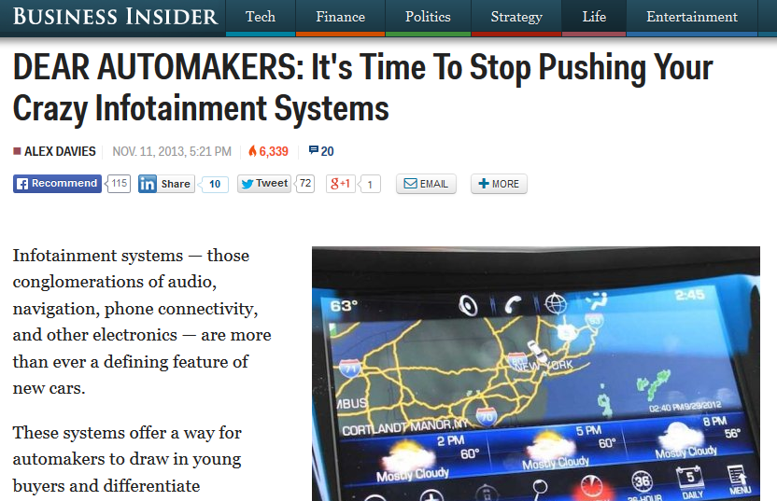
Infotainment Systems are Failing!

Slide 3
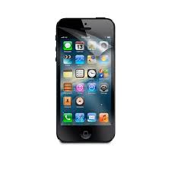
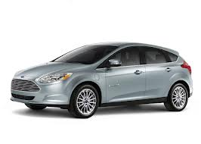
Smartphone Connectivity
+
=
Customer Acquisition

Slide 4
Embedded Modem
+
=
Customer Retention

Slide 5
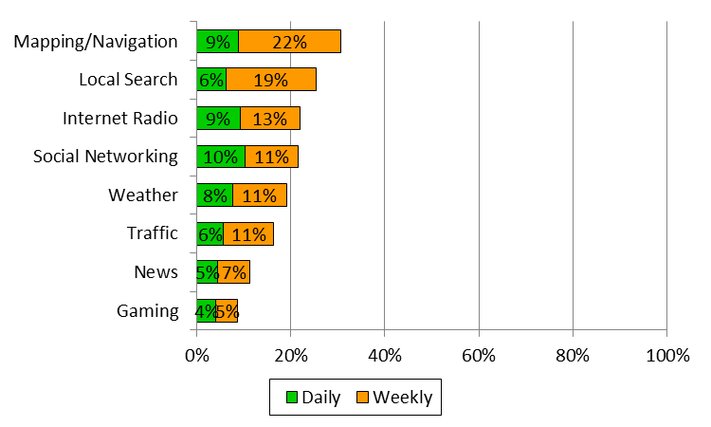
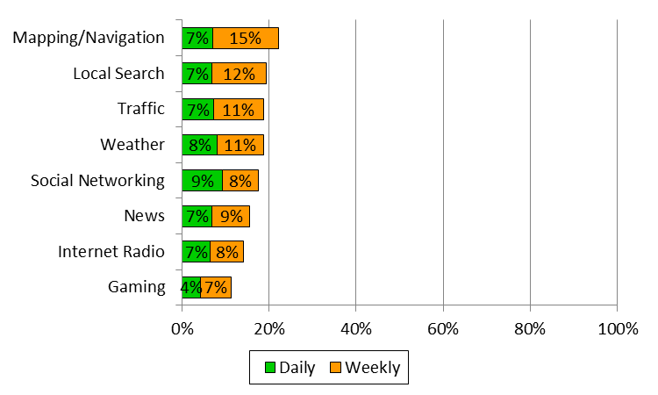
Smartphone Use while Driving
US
58% of smartphone owners in the US and 47% in Western Europe report using apps while driving.
However, on a weekly basis, usage is largely infrequent.
Each category of app is used on a daily basis by 10% or less of smartphone owners
Data from ACI survey of US and Western European vehicle owners, Feb 2013.
Western Europe

Slide 6
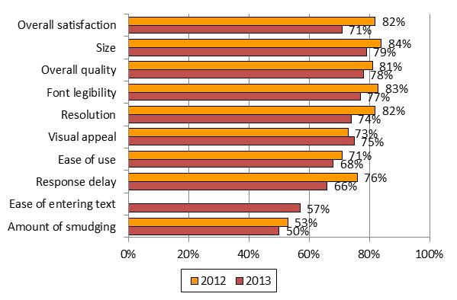
Touchscreen Satisfaction
Overall satisfaction with touchscreen UX has decreased since 2012.
Visual appeal only aspect of touchscreens for which satisfaction increased.
Satisfaction with system response fell from 76% to 66%.
% Satisfied or Very Satisfied (US)

Slide 7
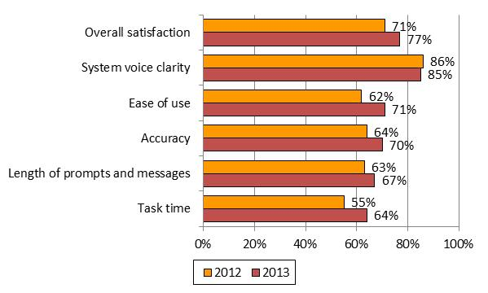
Speech Recognition Satisfaction
Satisfaction for speech recognition systems by frequent users has increased since 2012 across almost all areas.
Satisfaction of system voice clarity remained relatively constant (and high).
Overall satisfaction increased from 71% to 77%.
% Satisfied or Very Satisfied (US)

Slide 8
Impact of Distractions on Crash Risk
TASK | Odds Ratio | LCL | UCL
Text message on cell phone | 23.24* | 9.69 | 55.73
Look at map | 7.02* | 4.62 | 10.69
Dial cell phone | 5.93* | 4.57 | 7.69
Personal grooming | 4.48* | 2.01 | 9.97
Read book, newspaper, paperwork, etc. | 3.97* | 3.02 | 5.22
Reach for object in vehicle | 3.09* | 2.75 | 3.48
Look at left-side mirror/out left window | 1.09* | 1.01 | 1.17
Talk or listen to hand-held phone | 1.04 | 0.89 | 1.22
Eating | 1.01 | 0.83 | 1.21
Look at right-side mirror/out right window | 0.95 | 0.86 | 1.05
Smoking-related behavior—reaching, lighting, extinguishing | 0.60* | 0.40 | 0.89
Look at outside vehicle, animal, person, object, or undetermined | 0.54* | 0.50 | 0.60
Talk or listen to hands-free phone | 0.44* | 0.35 | 0.55
Interact with or look at other occupant(s) | 0.35* | 0.22 | 0.55
Check speedometer | 0.32* | 0.28 | 0.38
Source: DRIVER DISTRACTION IN COMMERCIAL VEHICLE OPERATIONS, US Department of Transportation, 2009
Visual-manual tasks increase crash risk
Talking on hand-held or hands-free cell phones do not significantly increase crash risk

Slide 9
Connected Vehicle UX Comparison
Data from ACI user experience benchmark studies and heuristic evaluations of infotainment systems.

Slide 10
We Need Some New Directions
Roger’s rules of smartphone connections

Slide 11
Roger’s Rule #1
Use smartphone to summon assistance, save lives

Slide 12
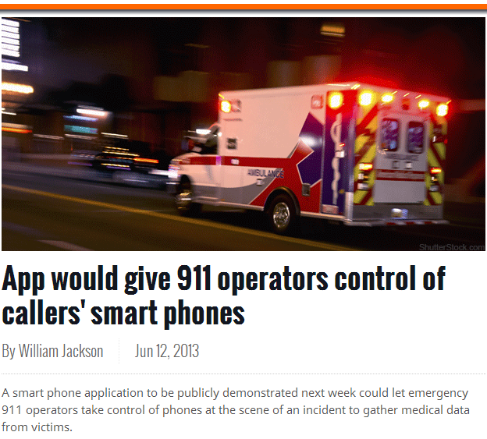
Crash Scene Assistance

Slide 13
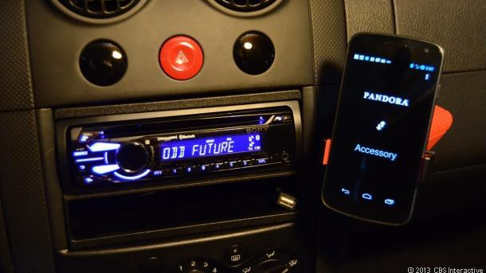
Roger’s Rule #2
Car controls phone, not the reverse

Slide 14
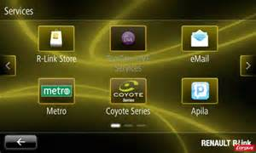
Roger’s Rule #3
Don’t charge the customer twice for the same app

Slide 15
Roger’s Rules #3.1
No in-car app store

Slide 16
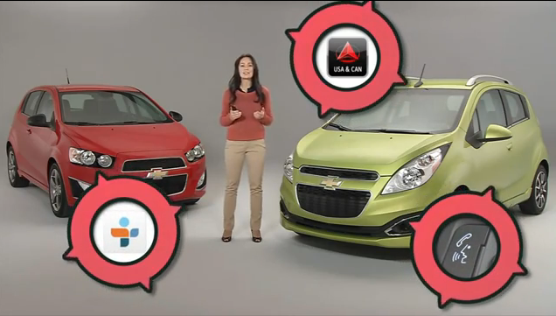
Roger’s Rules #4
No proprietary apps for non-auto functions

Slide 17
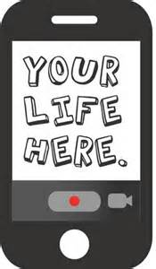
Roger’s Rules #5
Use phone for personalization, commerce, community

Slide 18
Roger’s Rules #6
Use customer’s phone for calls, not the embedded modem

Slide 19
Roger’s Rules #7
Auto-grade speech rec – not smartphone – Siri?

Slide 20
New Thinking
For New Connections

Slide 21
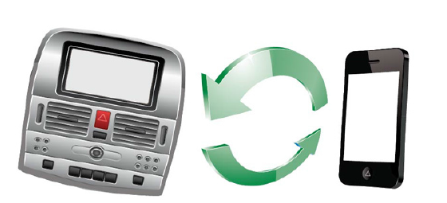
Map Updates

Slide 22
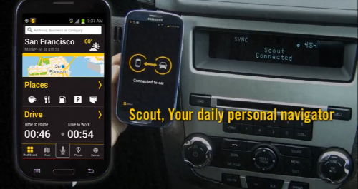
Hybrid Navigation

Slide 23
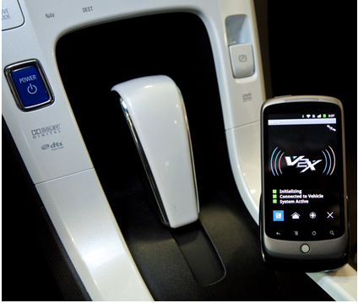
Use Phone for Car-2-Car Communication

Slide 24
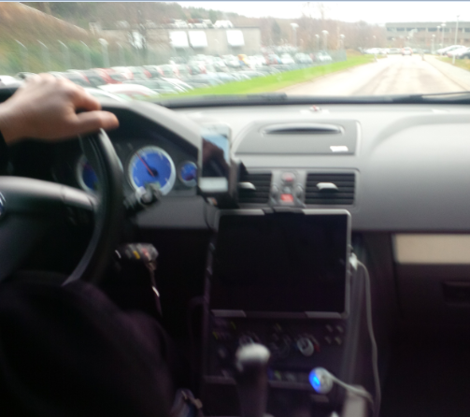
Replace the Radio w the Phone

Slide 25
Negative Implications of Apple CarPlay
Fragmentation of in-vehicle connections
Loss of OEM control of customer – eco-system
Use of non-auto grade speech rec – Siri vs. Nuance Dragon Drive
Loss of differentiation
UI homogeneity? Regional regulatory issues? US DOT guidelines?

Slide 26
Positive Implications of Apple CarPlay
Increased attention to smartphone-car connections
Promotion/adoption of natural language speech recognnition
Simplification of smartphone connection
Integration of smartphone apps via smartphone

Slide 27
Thank you!
Roger C. Lanctot
Associate Director
Global Automotive Practice
Strategy Analytics
rlanctot@strategyanalytics.com
+1 (617) 614-0714 m +1 703 860-2005
Twitter: @rogermud WeChat: rogermud

