Slide 1
Intelligibility vs Quality; what is the real need in an eCall situation?

Slide 2
Volvo Cars vison
Our vision is to design cars that do not crash
In the shorter perspective the aim is that by 2020 no-one should be killed or seriously injured in a new Volvo car

Slide 3
Brief history of e-call with Volvo Cars
Year 2000: Volvo On Call was introduced
Year 2008 Austria and Russia was added to include 14 supported countries
Year 2015 Volvo On Call will be available in 24 countries
Volvo Car Corporation has been an active partner through ERTICO participating in HeERO and contributing to define the standards in TC278, WG15
Volvo Car Corporation has also been supporting in the work group since beginning 2010 with NIS and Glonass Union, to produce the first GOST standards for ERA Glonass.

Slide 4
What is the need in an emergency situation?
To be able to establish a phone call
To be able to reproduce speech in both directions at a sufficient level
To be able to have a conversation with sufficient intelligibility after a crash

Slide 5
What does this mean for an OEM?
The system needs to be robust
The complexity of a modern infotainment system makes it a complex challenge to design it crash proof within reasonable cost
Modern infotainment systems usually have many dependencies and interconnections to elevate the customer experiance
Already in the year 2000 Volvo included a redundant back-up system in case the main audio system was damaged during a crash

Slide 6
What does this mean for an OEM?
During extensive crash testing Volvo has seen that complexity of an eCall system needs to be reduced to a minimum in order to survive as many crash situations as possible
This means a dedicated eCall system
With a dedicated battery, not connected to the main power supply
Dedicated speaker in a protected position
Dedicated microphone in a protected position
Short and protected cabling

Slide 7
Concerns for a crash proof e-Call solution
Must be low power since run on dedicated battery
Reasonably long speech time is vital to support and calm the customer
High wattage amplifier is hard to realize with a backup battery that is supposed to last for several hours
Heavy DSP processing is also hard to realize on a power budget
Must be cost effective, since standard in all vehicles
Customers do not wish to pay extra for a function they do not intend to use
To ensure survival of a number of crash cases, the system needs to have short connecting cables, a secure packaging position, and minimal dependencies to the rest of the infotainment system

Slide 8
From a customer and audio perspective; what is not important in an e-Call situation?
Extended low frequency range
Flat frequency response
Lowest possible latency
Perfect double talk
Perfect echo performance
Perfect noise reduction

Slide 9
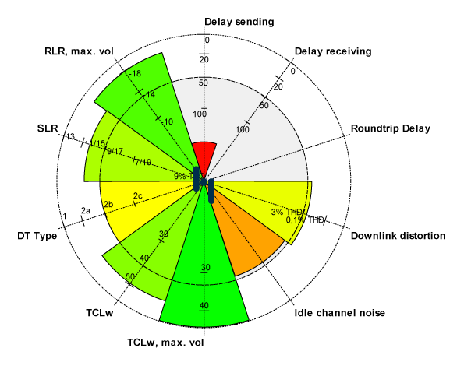
Pie Chart
Red area is fail
Outside red area is passed

Slide 10
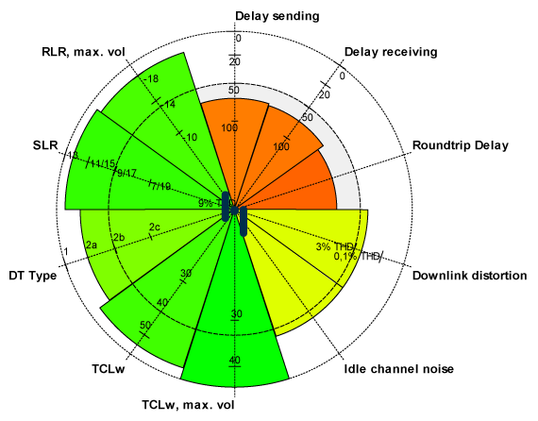
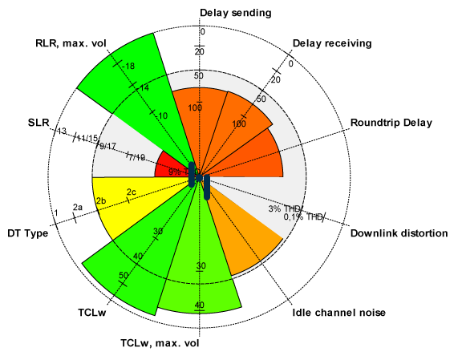
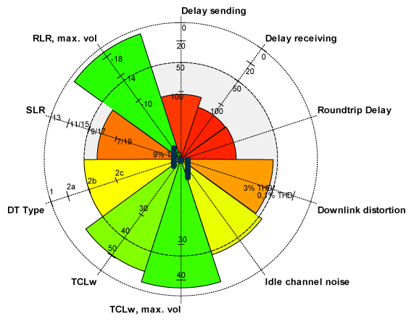
4 major oem

Slide 11
Benchmark analysis
Pie Charts represent main HF system of premium brands
None of these OEM:s fulfill ERA Glonass audio requirements or ITU-T P.1100 and P.1110 requirements on all parameters
A dedicated system designed to be crash proof will most likely have worse performance on most parameters

Slide 12
Benchmark analysis; the compromize
Good RLR (sound level) → worse distortion
Good echo performance → worse double talk
High fidelity → worse latency
Good noise reduction → worse latency
Natural sounding voice → worse latency
Low power → only basic processing possible, limited amplifier power
A crash proof system → worse audio performance, due to packaging constraints

Slide 13
Benchmark analysis; meeting standards
Is the ITU-T P.1100 and P.1110 designed to be used for certification puposes?
Are the audio requirements in GOST ERA Glonass, at a resonable level for certification?
Is it possible to design a system that meet above requirements that is still crash proof, and within a resonable budget?

Slide 14
Standardization work needed
There is a need for harmonization of international standards
These standards needs to focus on intelligibility, not sound quality
The standards needs to account for what is feasible to achieve with a system designed to be crash proof
Certification process needs to be clear and valid internationally

Slide 15
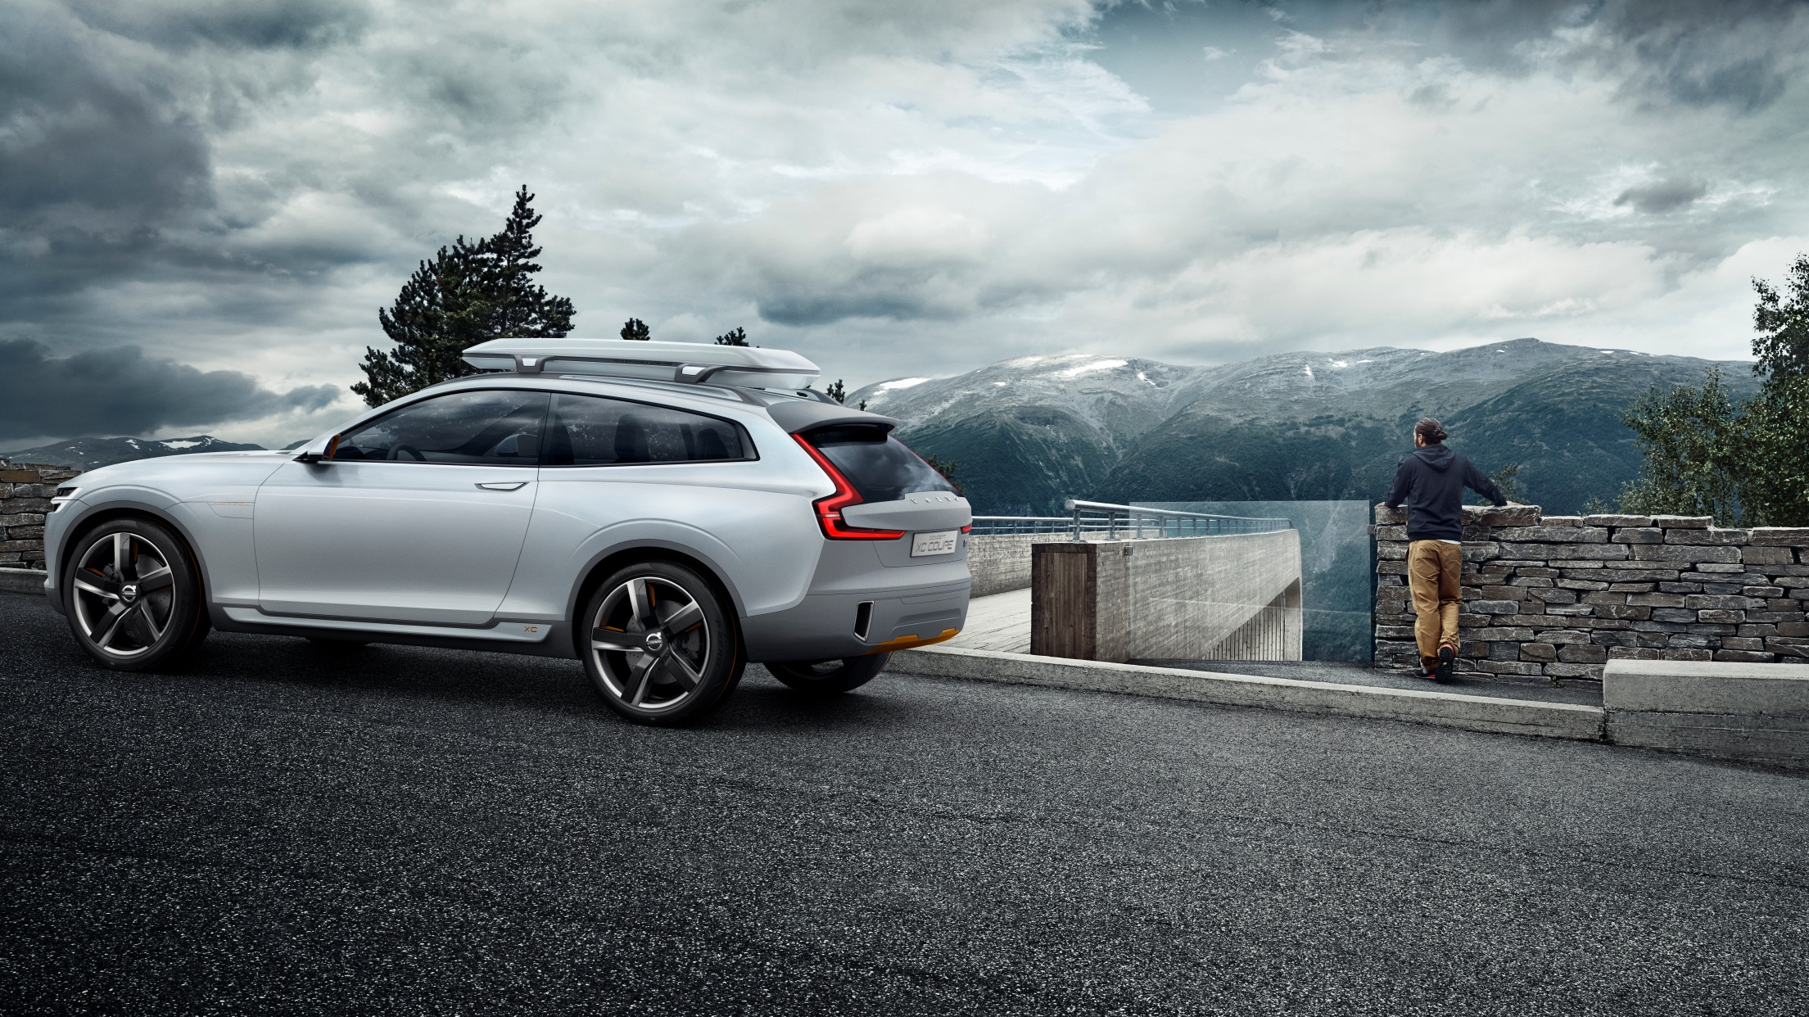
Thank you!
Jonatan Ewald
jonatan.ewald@volvocars.com www.volvocars.com
© Copyright Volvo Car Corporation

Slide 16
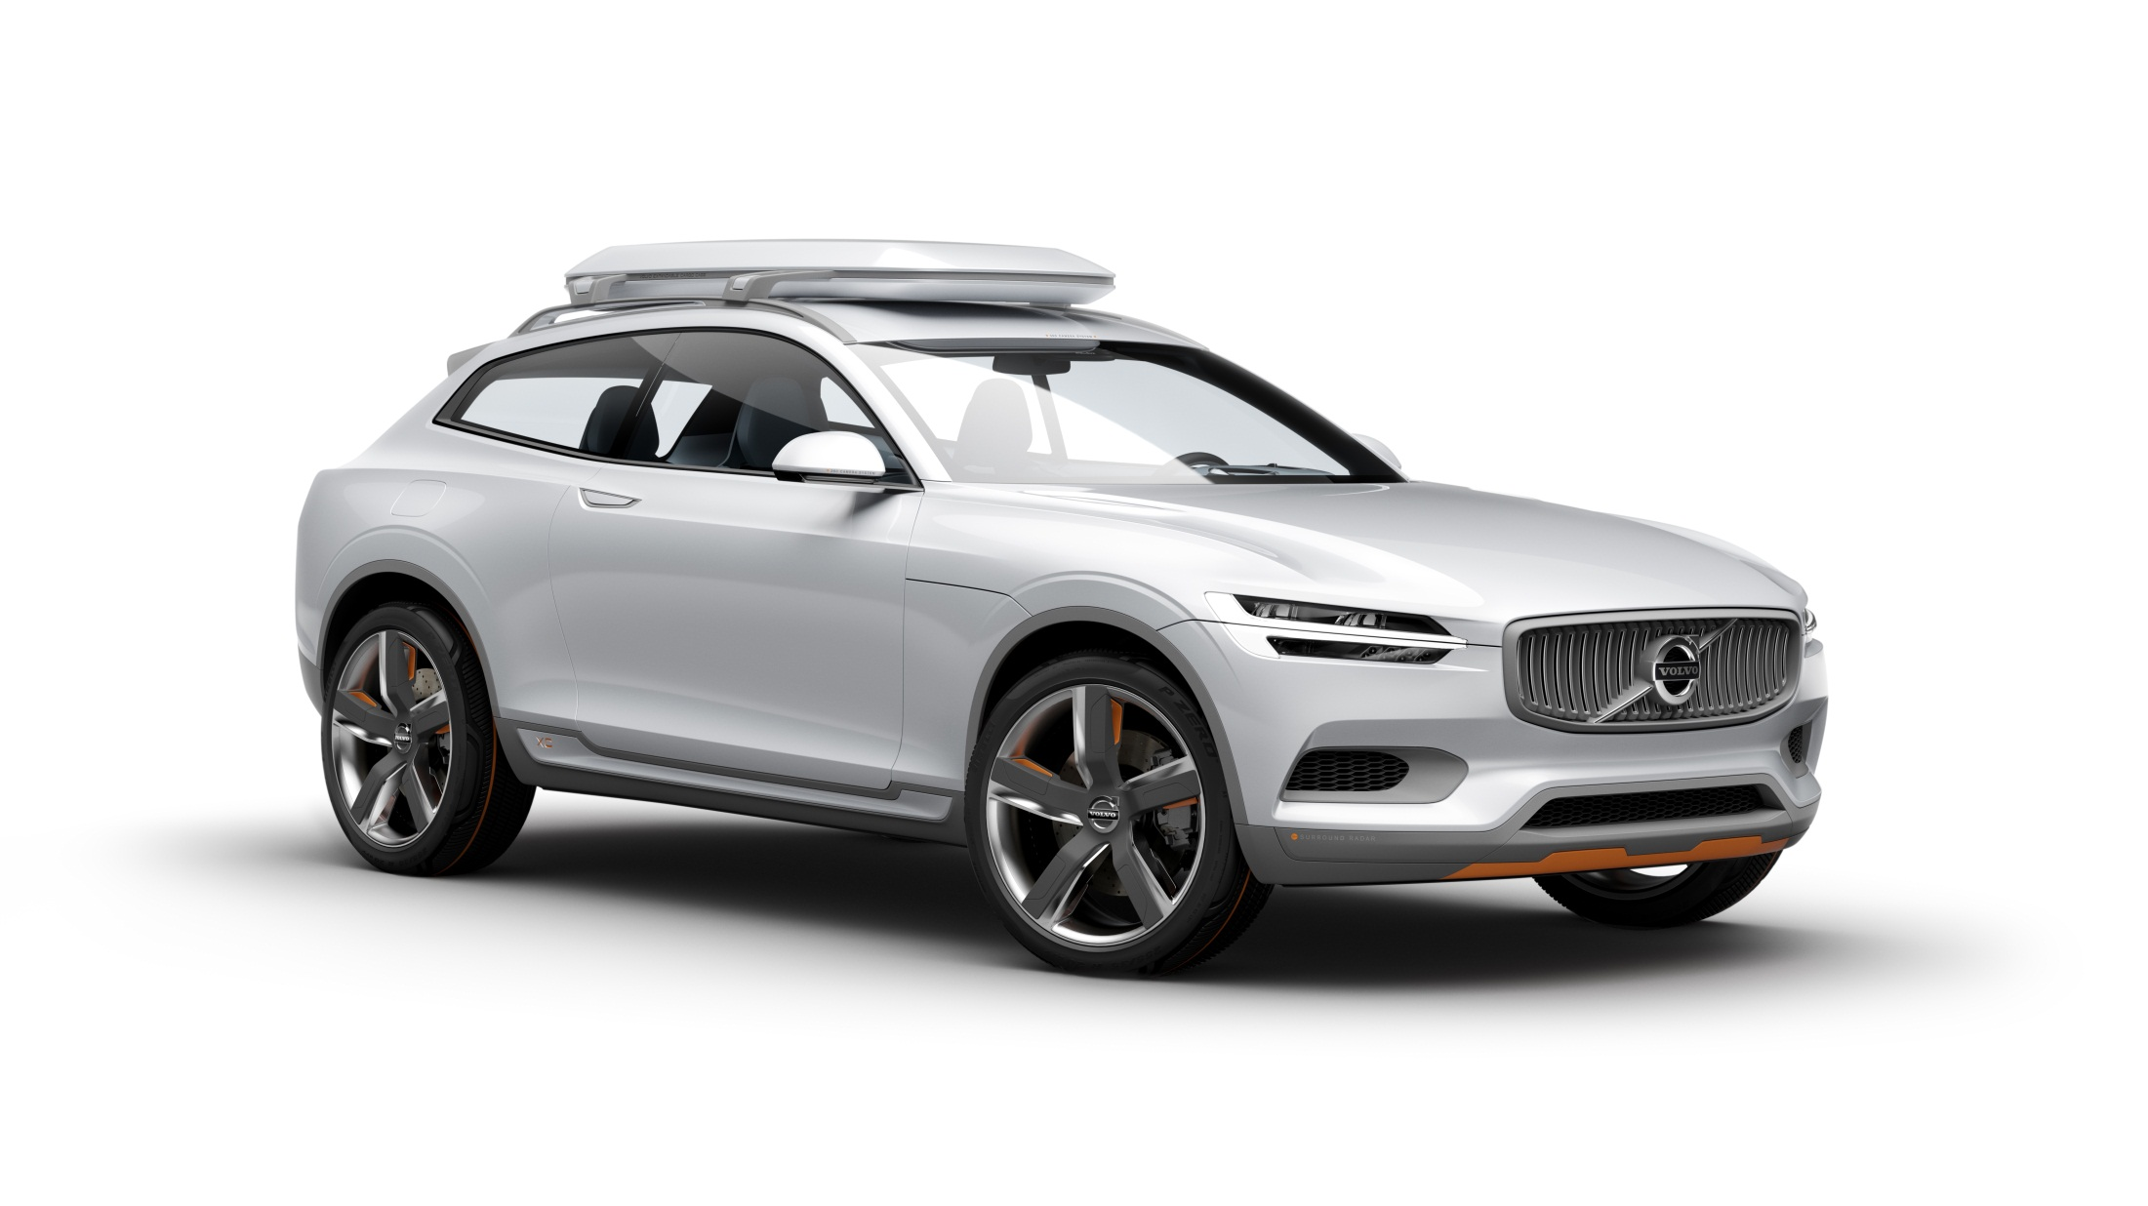
Questions?

