Slide 1



Active Safety Functions
Relations with Connected Car
Bernard NICLOT
Technical Director of the FIA
March 2014

Slide 2

  1.3 million people are killed each year worldwide in road accidents
  50 million are injured
  United Nations and the World Health Organization have launched in 2011 a
  Decade of Action for Road Safety
  In support of the Decade of Action, the FIA has launched the “FIA Action For Road Safety”
  designed to harness FIA assets at the service of this important cause.
  Europe : 40 000 killed each year
  Same magnitude in North america
  Solutions for emerging countries or developed countries can be quite different
  The goal of this presentation is to illustrate how connected car
  can contribute to road safety in developed countries. Target = zero fatality

Slide 3
Evolution of fatalities in Europe
Asymptotic behaviour
Number of people killed in Europe
per billion km
Big improvement in 35 years
An asymptot has been reached
Which technology breakthrough
in order to arrive at zero fatality ?
→ Connected car can realise this breakthrough

Slide 4
AGENDA
  A few facts about accident data analysis
  Illustration on a few examples of why and how the connected car can drammatically enhance active safety
  Conclusion
  WARNINGS
  The ideas I express here are based on personal engineering experience on active safety.
  I have often used different sources and simplified a lot in order to be able to present basic ideas in a very short time.
    Keep the ideas for further thinking
    Don’t keep the numbers or figures as an up to date reference.
  This is not about autonomous car
    Though these subjects have strong connections, autonomous car is a very ambitious program, an order of magnitude more complex than the ideas I present here

Slide 5
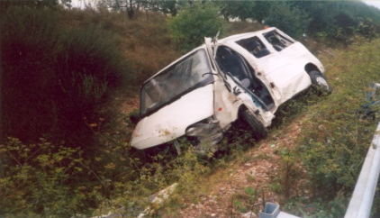
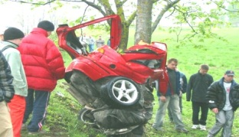
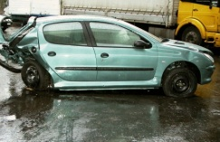
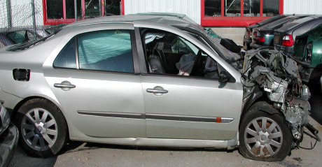
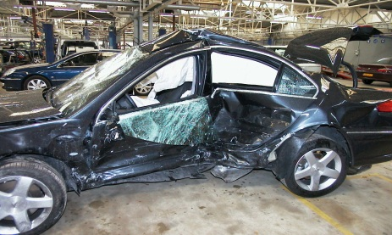
Type of shocks
% of deaths
7,0%
13,0%
44,9%
2,4%
32,7%

Slide 6
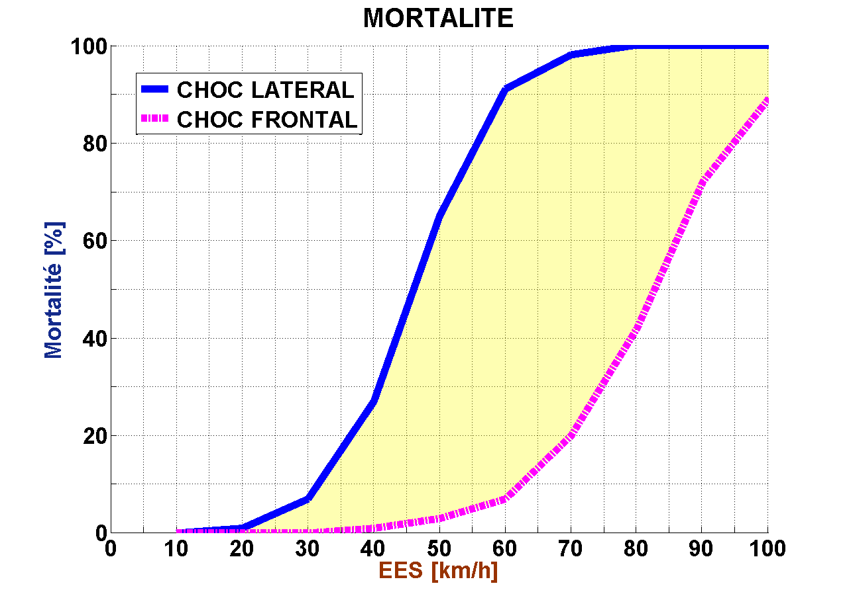
Fatality as a function of speed and type of shock
Side crash
Frontal crash
Death

Slide 7
To decrease Fatalities and Injuries
Reduce Speed
→ Automatic Braking Safety Functions
Side crash
Frontal crash
Death

Slide 8
To decrease Fatalities and Injuries
Change type of shock
→ Stability Control Systems
Side crash
Frontal crash
Death

Slide 9
To decrease Fatalities and Injuries
Avoid shock
→ INFORMATION FUNCTIONS

Slide 10
To decrease Fatalities and Injuries
Reduce Speed
→ Automatic Braking Safety Functions
Side crash
Frontal crash
Death

Slide 11
Automatic Braking – Scenario of Functions
Shock
Speed Reduced
!
Mid Level
Deceleration
Low level
Short brake impulse
Unavoidable collision
Time before collision
Risk identified
Alert
Automatic Limited Braking Action
Higher automatic braking action when collision is unavoidable
Reduce Speed
Active Braking Safety Functions

Slide 12
Automatic Braking – Improved Scenario of Functions
!
Mid Level
Deceleration
Low level
Short brake impulse
Unavoidable collision
Time before collision
Risk identified
Alert
Automatic Limited Braking Action
Reduce Speed
Active Braking Safety Functions

Slide 13
Automatic Braking – Improved Scenario of Functions
No Shock
High Level
!
Mid Level
Deceleration
Intermediate level
Short brake impulse
Collision avoidable
Time before collision
Unavoidable collision
Risk identified
Alert
Automatic Limited Braking Action
Anticipated automatic high level braking action when collision is still avoidable
Reduce Speed
Active Braking Safety Functions

Slide 14
Automatic Braking – Improved Scenario of Functions
If you can improve efficiency
Why don’t you do it ?
No Shock
High Level
!
Deceleration
Intermediate level
Basically because with the sensors you have on board
You are not confident enough to apply full action
Short brake impulse
Collision avoidable
Time before collision
Unavoidable collision
Risk identified
Alert
Automatic Limited Braking Action
Anticipated automatic high level braking action when collision is still avoidable
Reduce Speed
Active Braking Safety Functions

Slide 15

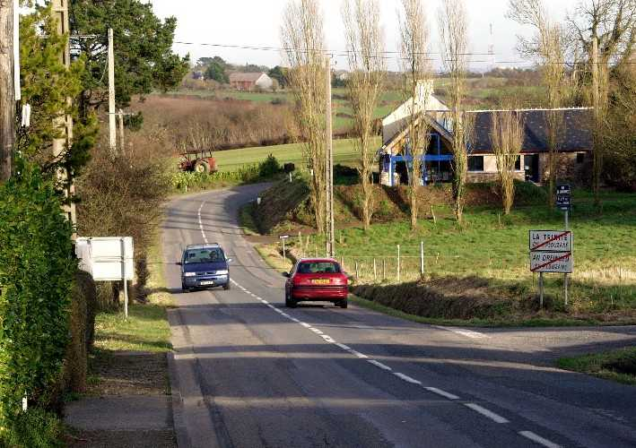
Limitations of on board sensors
What Does a Radar “See” ?
Limited Understanding of the environment
Limited Action
Reduce Speed
Active Braking Safety Functions

Slide 16
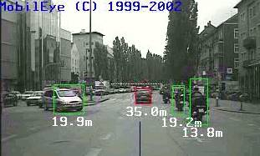
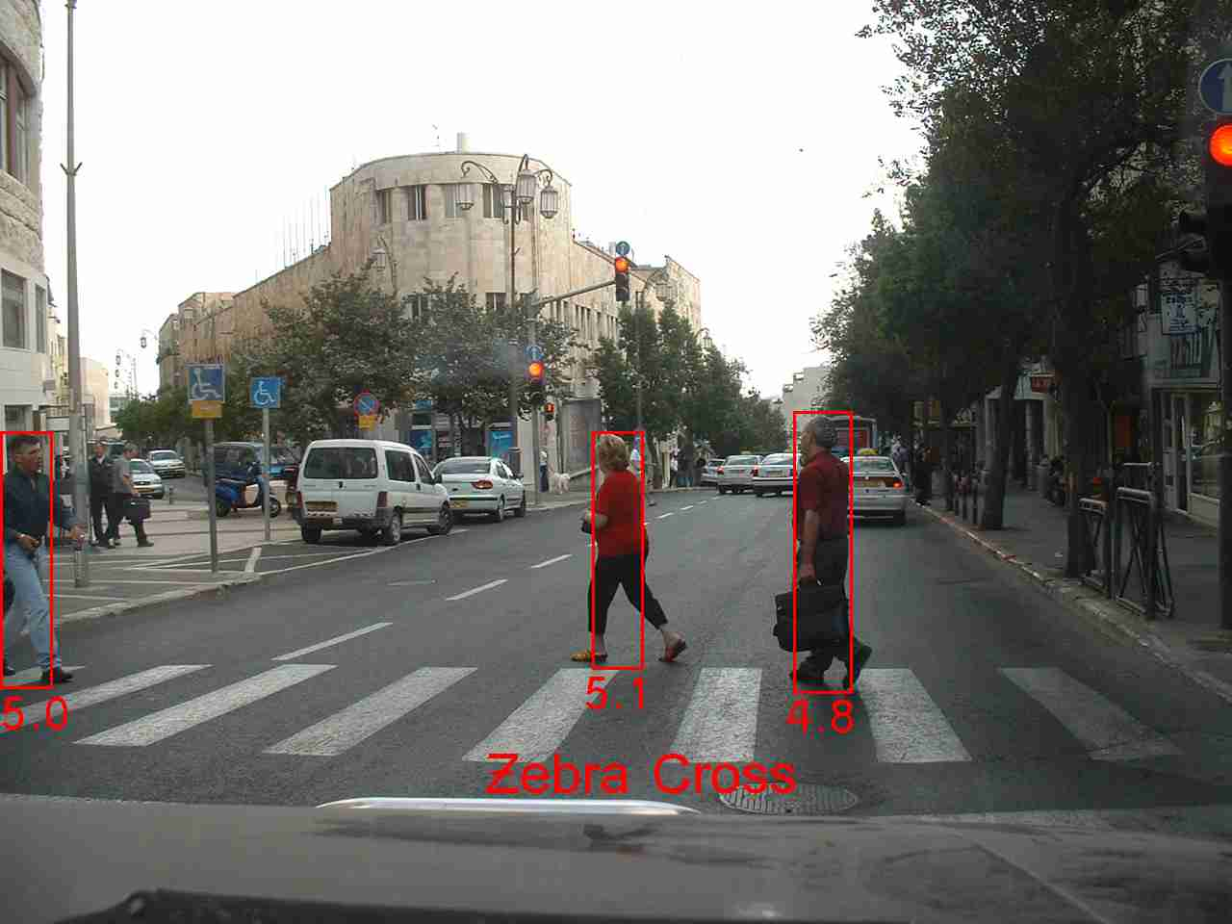
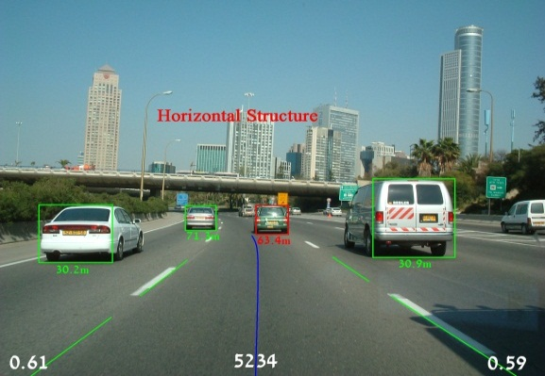
How can a camera extract data of interest ?
Limitations of on board sensors
Limited Understanding of a complex environment
Limited Action
Reduce Speed
Active Braking Safety Functions

Slide 17
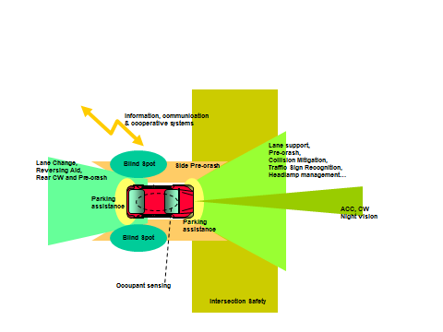
Limitations of on board sensors
Limited range and high cost of sensors
Reduce Speed
Active Braking Safety Functions

Slide 18

Limitations of on board sensors
…… Moreover
First car invisible
to the following one
Reduce Speed
Active Braking Safety Functions

Slide 19
Limitations of on board sensors
Limited Understanding of a complex environment
Limited Action
How to escape this equation ?
First car invisible
to the following one
Reduce Speed
Active Braking Safety Functions

Slide 20
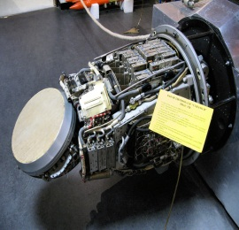
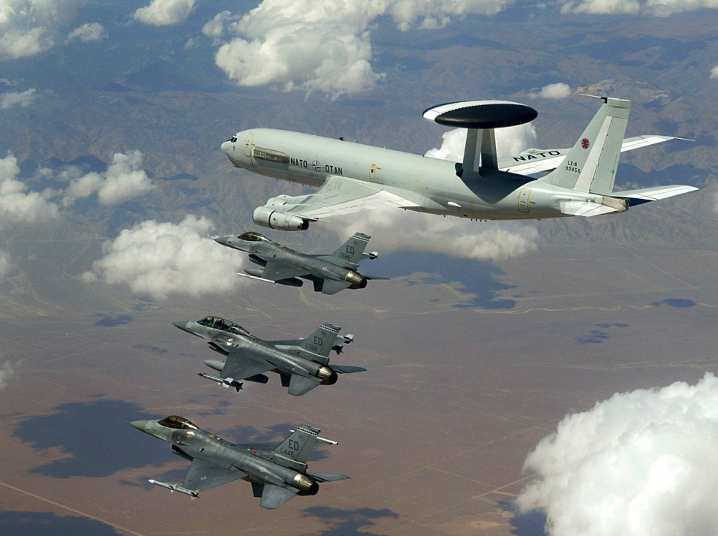
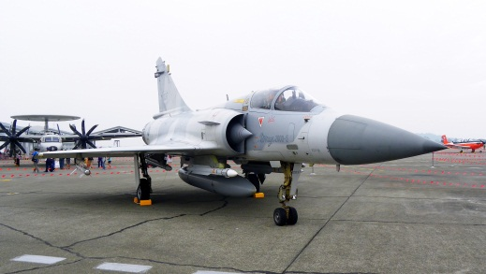
Analogy with Military Aircrafts
On board radar
Limited range
AWACS Large Range Radar
Shares information with the other planes

Slide 21
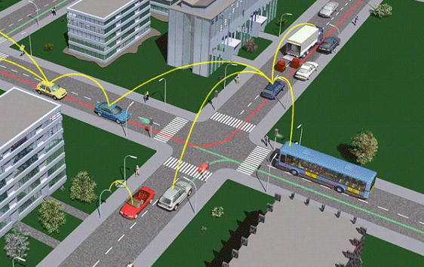
Application to ITS
On board sensors
Limited range
GPS + Infrastructure + onboard sensors
Share information with the other Cars

Slide 22
This is what ITS can do
Information shared in network → Redundancy
→ Robust information
Enhanced Action
Wide and good understanding of a complex environment

Slide 23
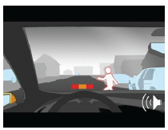
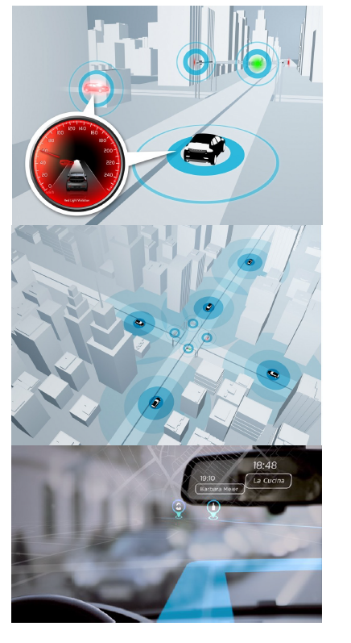
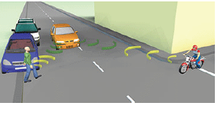
To decrease Fatalities and Injuries
Avoid shock
→ INFORMATION
Huge Potential for avoidance of lateral crash or shocks with other users

Slide 24
Efficiency of Safety Functions
Using Connected Car
  Automatic Braking Functions
    Using only on board sensors : a few % of efficiency for fatality reduction ( < 5%)
    ~ 1/3 of fatalities arise due to frontal collisions
    This shows the huge potential of high level automatic braking functions using connected car
  Lateral shock
    ~ 1/3 of fatalities
    This shows the huge potential of connected car able to alert or avoid side collision
  Loss of control situations
    Current ESP systems have ~ 16% of efficiency to reduce fatalities.
    Enhanced ESP systems using connected car and GPS could probably have the potential to raise significantly this overall efficiency.
  All these numbers are rough estimates, and they obviously don’t add each other. However they illustrate the potential of connected car to reduce fatalities.

Slide 25



CONCLUSION
  Connected Car, car 2 car and car to infrastucture communication can help develop very efficient safety functions that could achieve the zero death target.
  This « connectivity » could be extended to every road users, including pedestrians, motocyclists….
  Cost ?
    It seems that the development of 4G and higher standards of communications could soon make it a no problem.
    Moreover thinking to the very high global cost of road unsafety (Europe : 160 billion € ⬄ 2% GNP) , there are ways to handle cost issues.
  Connected car requires communication between different car brands → Necessity of standards of communication and International agreements.
    → +

Slide 26
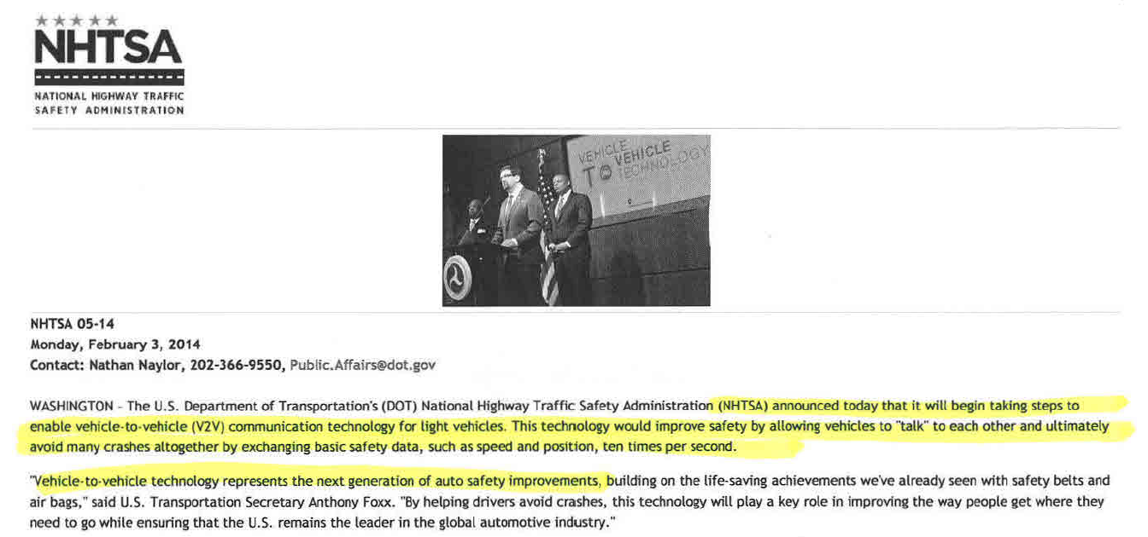
NHTSA
"V2V Crash Avoidance has game-changing potential to significantly reduce the number of crashes, injuries and deaths on our nation’s roads "
Connected Car - Safety

Slide 27
  THANK YOU !

Slide 28
Appendix

Slide 29
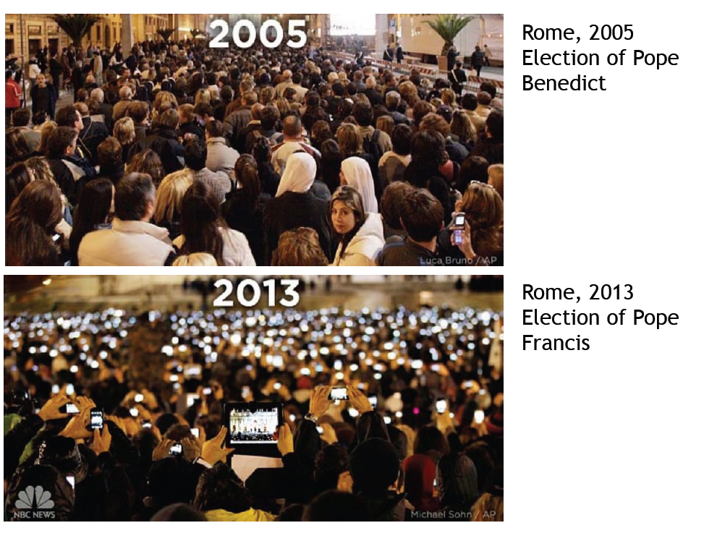
About Connectivity
Connected Car - Safety

Slide 30
Responsibility of driver / car ?
This question should be treated as a public health question
Even if one system fails one time, on the global, the benefit is huge
Like for medicine, we should define some quality and safety concept requirements for automatic safety systems to be approved, based on highly low probability failure occurrence.
We have to consider that a car has possibilities to react dynamically much quicker and in a way that is not accessible even for the best driver (e.g. possibilities of actions wheel per wheel, combined with anti-lock system..etc..)
Finally when we say today that the driver « drives » the car, we shouldn’t forget that it does so through a chain of mechanic/electronic equipments and links that can each have their own failures. So he is not in 100% control of his car, but 100%-probability of failure. At the end it is not so sure that the probability of failure in normal drive situations is lower than the probability of failure achievable with automatic active safety systems. At the end the situations are equivalent.
Connected Car - Safety

Slide 31


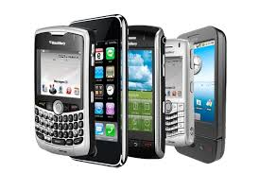
Business Model
The More you have users
The More value you have
for newcomers
Safety applications with connected cars
require enough cars to be equiped
Need to find some added value
to go into a « Credit card/mobile phone » business model
Connected Car - Safety

Slide 32
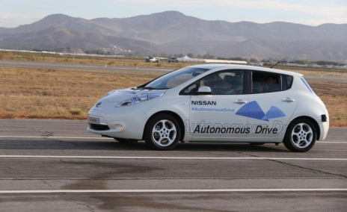
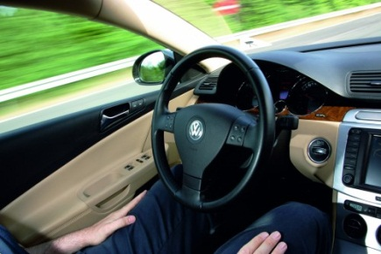
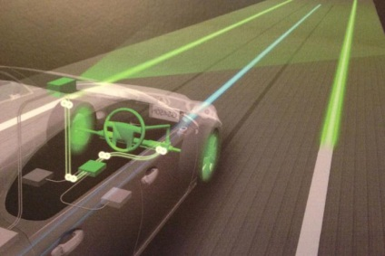
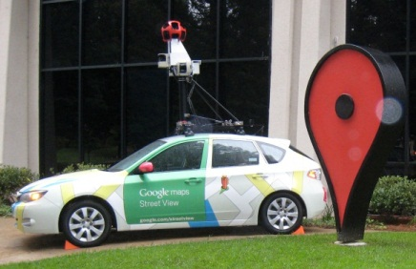
Autonomous cars : many announcements

