Slide 1
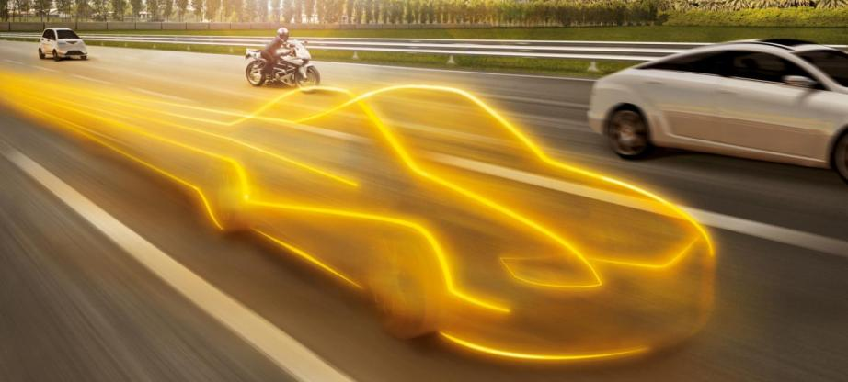
The future Networked Car
Interior Connectivity for Automated Driving
Gilles Mabire, Vice-President Infotainment & Connectivity
Geneva, March 5th, 2014
Interior IC

Slide 2

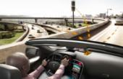


Division Interior Strategy
We Inform You Well, We Connect – All at Lower Cost
Human-machine interface (HMI) competence
Provide the expertise for superior comfort, ergonomics, and ease-of-use.
We inform you well
Connectivity
Connect the driver by wire or wireless
and provide value-add services.
We connect
Systems integration
Integration of components into
a superior system.
All at
lower cost
Most complete product portfolio
A necessary and unique selling proposition to establish us as systems integrator.
2
Notes:
Moving on to our strategy.
We base our strategy on our comprehensive product portfolio, which enables us to develop and produce integrated systems that provide customers with complete solutions. We do everything from gathering the information drivers and vehicles need, through constantly updating and expanding it, to displaying it in a clear, useable manner. All the time we keep to best costs.
The key elements of our strategy – We inform you well, we connect – all at lower cost – are derived from this role as a systems integrator and play to our strengths and all-round automotive expertise.
We differentiate ourselves in a number of ways:
Firstly: Our competence in the area of HMI (human-machine interface). This enables us to make all the necessary information easily available and useable. We do this through a variety of product areas such as head units, instrument clusters and secondary displays, more of which you will learn about shortly. We inform you well.
Secondly: We offer a number of solutions for connecting the driver and vehicle to the infrastructure, other vehicles and mobile devices. We also provide new functions that allow vehicle occupants to safely access the information that matters to them whilst on the move. These solutions mean that the driver always has access to the information that they need. We Connect.
Thirdly: The whole is greater than the sum of its parts. Through our integration of systems, solutions and components we are able to provide a superior system that not only reduces costs, but also offers optimized functionality and increases reliability. All at lower cost.

Slide 3
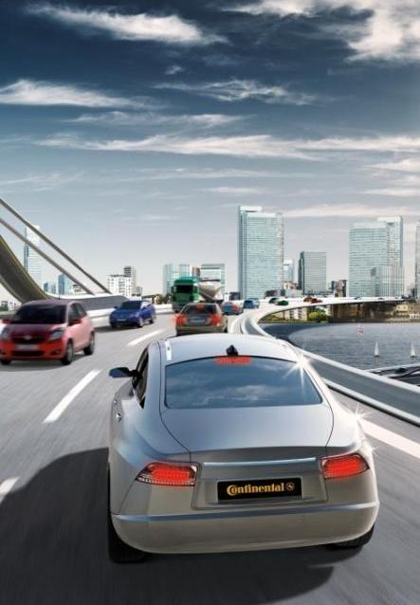
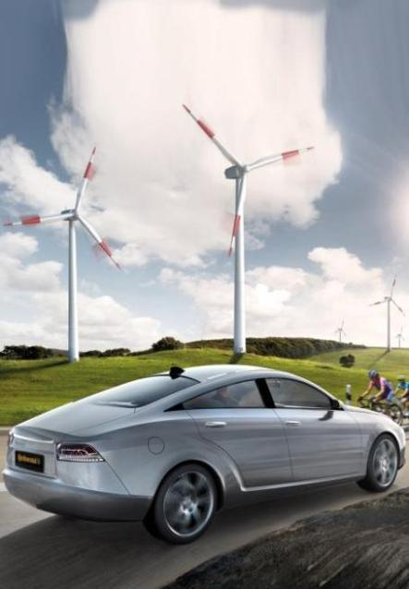
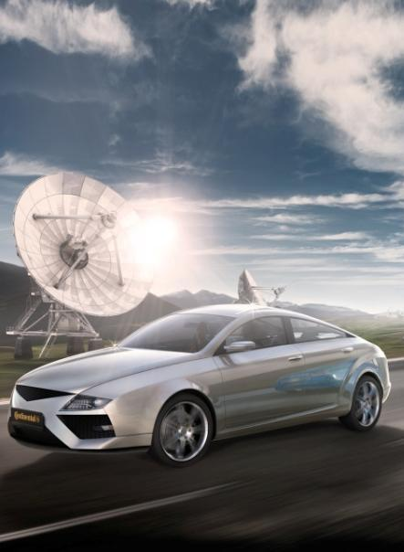
Why do We Connect the Vehicle?
Comfort
Safety
Efficiency
A driver in Germany spends about 1,5 Days in traffic jams each year.
The style of driving
can influence fuel consumption by up
to 20%.
90% of all accidents are due to human error.
Notes:
Komfort:
Autofahrer in Deutschland: in etwa 1,5 Tage im Stau
(INRIX: 36 Stunden für 2011)
Sicherheit:
90% aller Unfälle basieren auf Menschlichem Fehlverhalten.
Effizienz:
Der Fahrstil beeinflusst den Verbrauch eines Fahrzeugs um bis zu 20%.

Slide 4

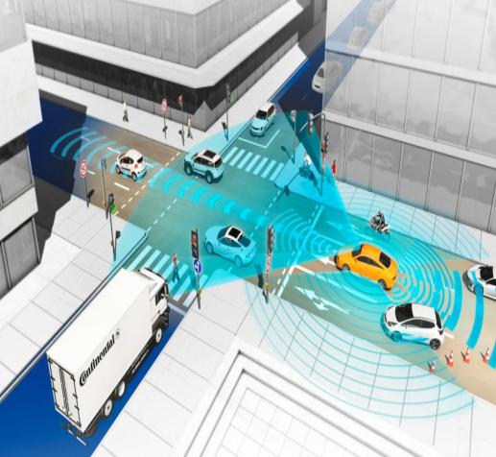
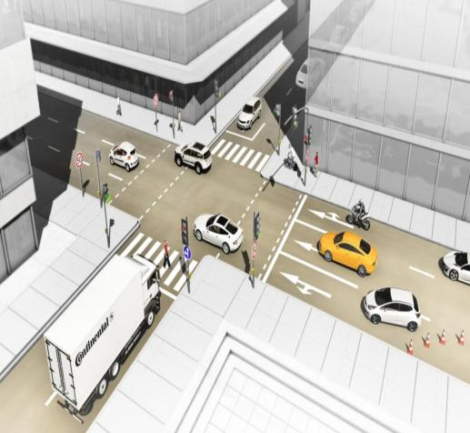




Connected Cars
Connectivity Enables Highly Automated Driving
Global stock of connected vehicles
(in mn. €)
CAGR 36%
2011-2016: Approx. 33 mn. connected vehicles per year
2016: Every second new vehicle is connected
2016: 18% of the global Light Vehicle stock is connected
Source: ATZ 12/2012, S. 131, based on Oliver Wymann‘s Study.
4

Slide 5



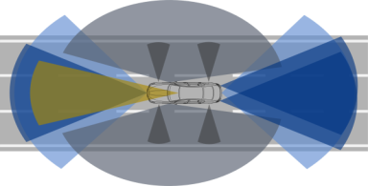

Connectivity increases the “visual range” beyond vehicle sensors
  Vehicle has a broader view
Road data along the route e.g.:
Weather
Road condition
Local vehicle data e.g.:
Wiper ⇒ Weather
ESP ⇒ road condition
Kamera
Radar
Lidar
Vehicle Sensor Visual range
Cloud-based Information
100-300m
5

Slide 6


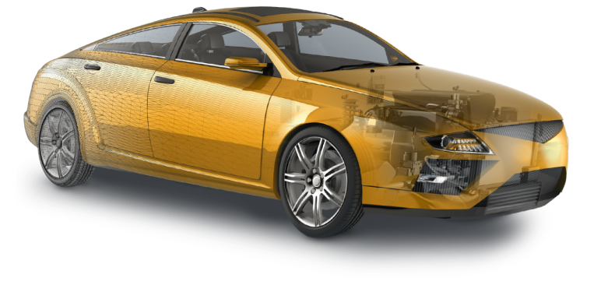

IT Car Structure Merged with Internet of Everything
The Connected Vehicle
Cloud
Classic Internet, Wireless Internet, Entertainment Internet, Social Internet
Content Networks
Communication Networks
Safety/eCall Networks
2.5/4G
Cellular
2.5/4G
Cellular
802.11
WiFi
LBS
GPS &
others
Broadcast
Data
Broadcast
Digital
Audio
Broadcast
Digital
Video
2.5/4G
Cellular
Connected Car 2020
Multiple communications links
Software platform architecture
Re-usable software components
Millions of lines of software code
Gigabytes of RAM, Flash & SSD
200+ sensors & actuators
Remote software upgrades
ECU domain clusters
Mobile Devices
Apps Integration
Smartphones
Tablets
USB
V2V
Other V2V Cars
Safety V2V Apps
Ad-hoc network
Bluetooth
WiFi
802.11P
& WAVE
Network
ITS
Intelligent
Transportation
Systems
Back
Haul
Network
V2I
802.11P & WAVE
Roadway Infrastructure & Information Network
Consumer/commercial Roadway info, events, warnings, guidance
Notes:
Was macht ein Automobilzulieferer

Slide 7
Prerequisites of Highly Automated Driving
HMI and Connectivity
System & Function Integration
Energy, Powertrain
Longitudinal control, lateral control
ADAS Sensorics
HMI
Connectivity
Vehicle knows what the driver does
Vehicle has increased visual range
Driver knows what the vehicle does
Vehicle offers new services
HMI = Human Machine Interface
7

Slide 8


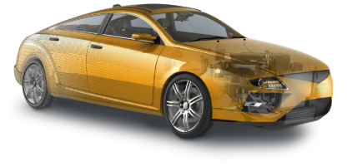
How to:
Technological Ingredients for the Connected Vehicle.
  Vehicle
  Backend
  Services
TRUSTED CONNEC-TIVITY
TRUSTED CONNEC-TIVITY
Connecting the vehicle requires specialized know how in different areas.

Slide 9



World Class…
Technological Ingredients for the Connected Vehicle.
  Vehicle
  Backend
  Services
TRUSTED CONNEC-TIVITY
TRUSTED CONNEC-TIVITY
Connecting the vehicle requires specialized know how in different areas.

Slide 10





Challenges for future HMI concepts
Need for a Holistic HMI Approach
  New Values
  Always on
  New Mobility
  Automated driving
Traditional
values
changed
Strong need
for seamless
communication
Driver experience
Driver in the loop
Car sharing
Driver experience
Car sharing,
Electrical Vehicles
+
+
+
  Becoming reality:
  Holistic HMI takes into account the environment, driver expectation, driver state and individual preferences
10

Slide 11
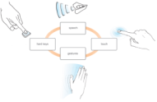


Basic HMI Trends
Simplicity
Not Shown
Natural interaction
Touch
Speech input / output
Tactile feedback
Gesture input
Larger display areas
Augmented reality HUD
3D Display
Direct, simple natural interaction by means of a multimodal access will encourage a high level of driver experience
Simplicity
Seamless connectivity
Cloud - Always on
APP´s
Communities
Integration of smart phones
Seamless connectivity approach is the enabler for the mobility lifestyle continuum
11

Slide 12
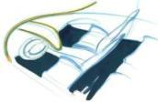




Driver experience
Vision “Guardian travel lounge”
Guardian travel lounge
Driver awareness
Personalization
Simplify your Drive
Central input concepts
Adaptation of Information & Assistances Systems
Vehicle as a companion
Simplicity
Seamless connectivity
Workload balancing
Mobility lifestyle continuum
Partial automation (Cooperative driving assistance)
Highly automated driving
Mechanical operator
...1970
…1990
…2010
…2020
Driver experience
12

