Slide 1
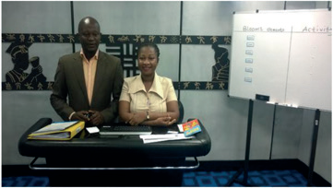
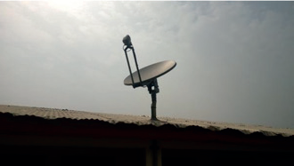
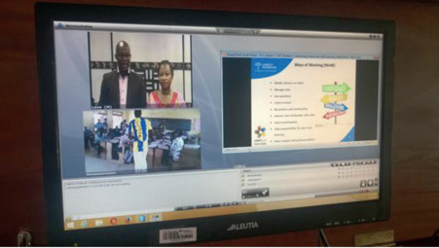
Teaching Master Teachers in Ghana
In order to
Teach remote teachers across the territory

Slide 2
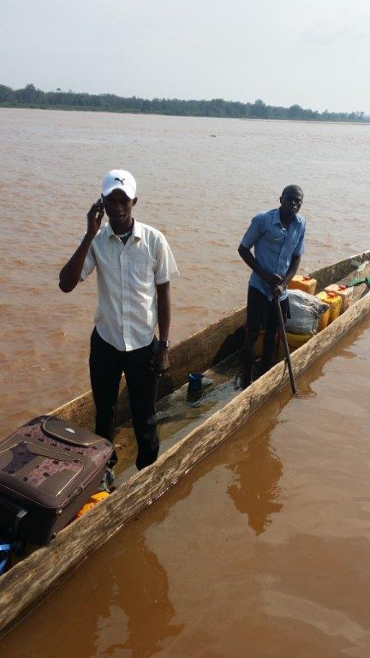
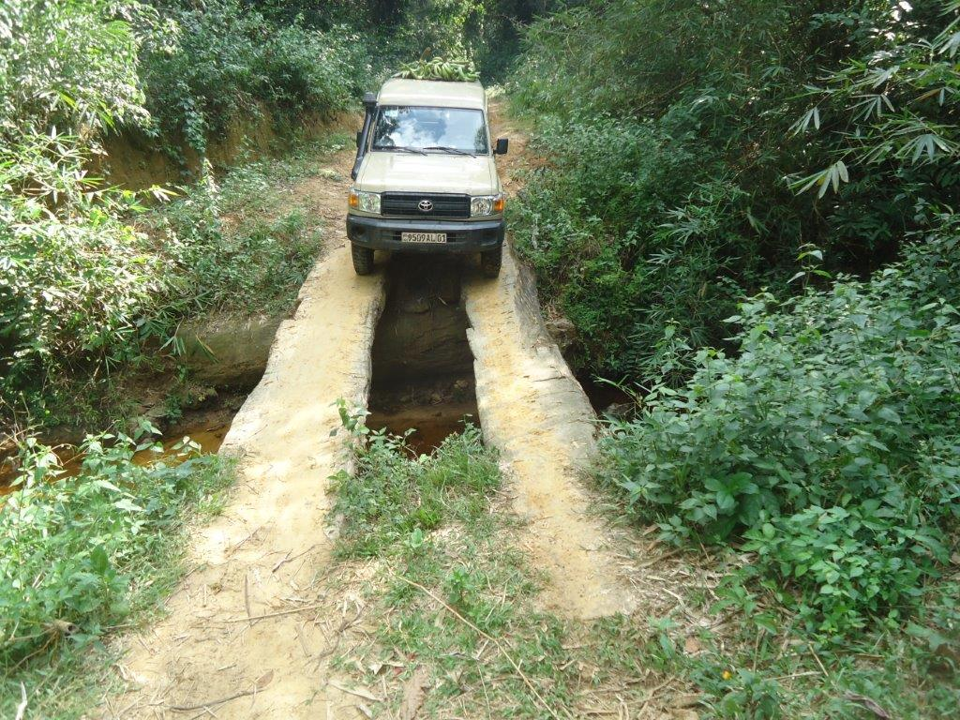
Bringing satellite equipment into DRC

Slide 3
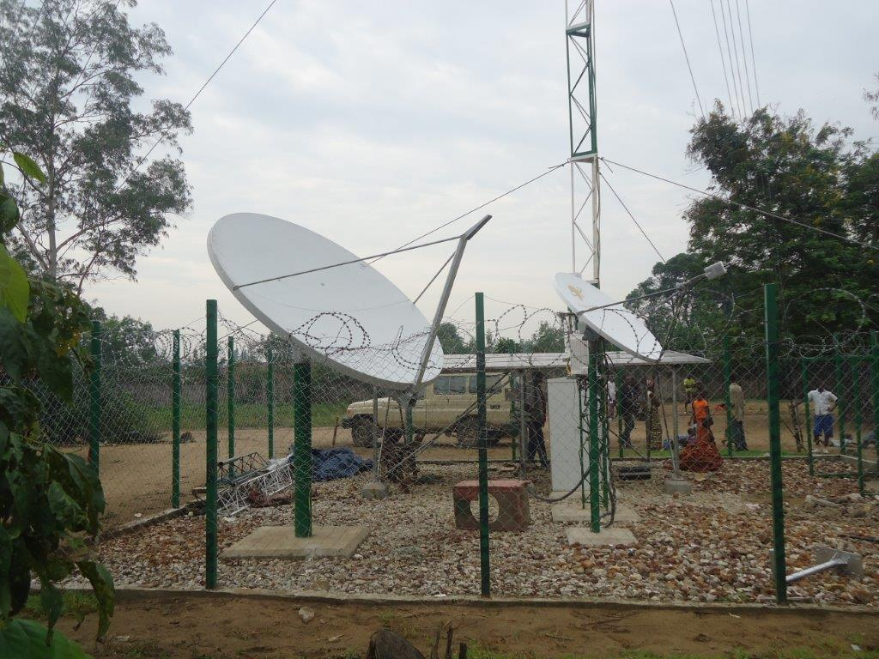
Establishment of remote site

Slide 4
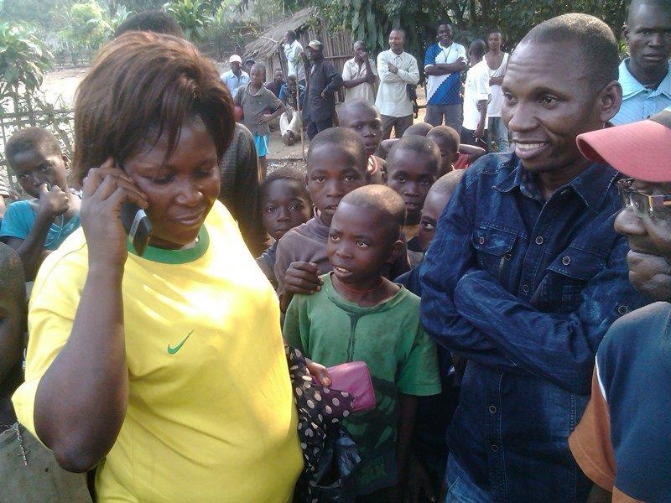
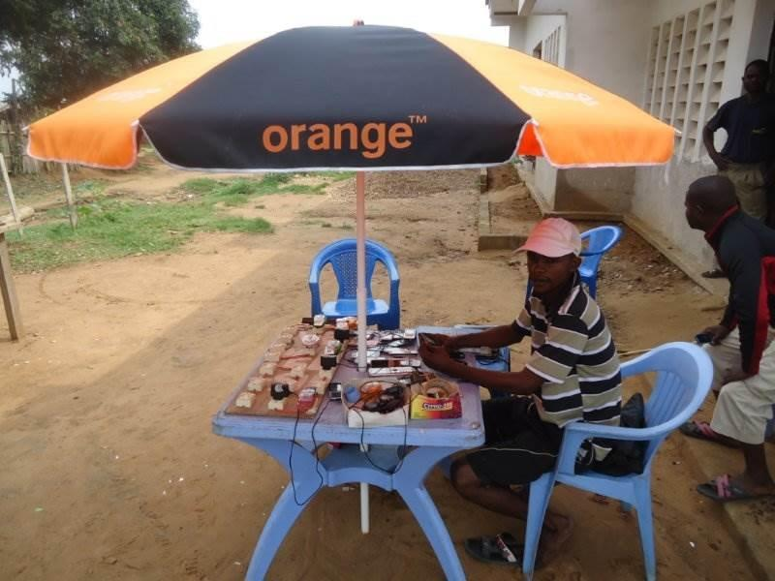
Enabling voice & data
In order to
Enabling Mobile Broadband

Slide 5
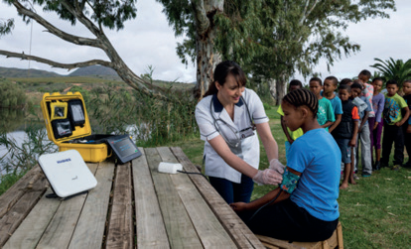
Remote Diagnostics & Data Transfer enabling Telemedicine in Nigeria

