Slide 1
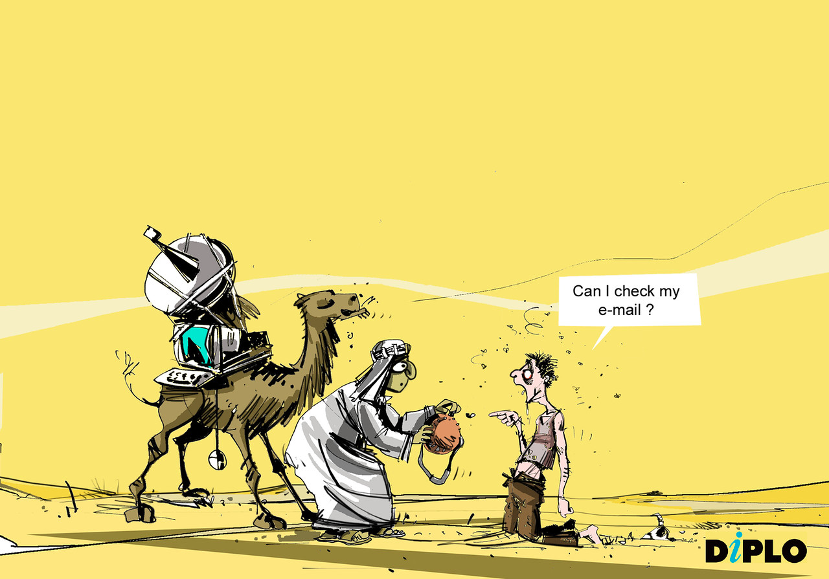

Slide 2
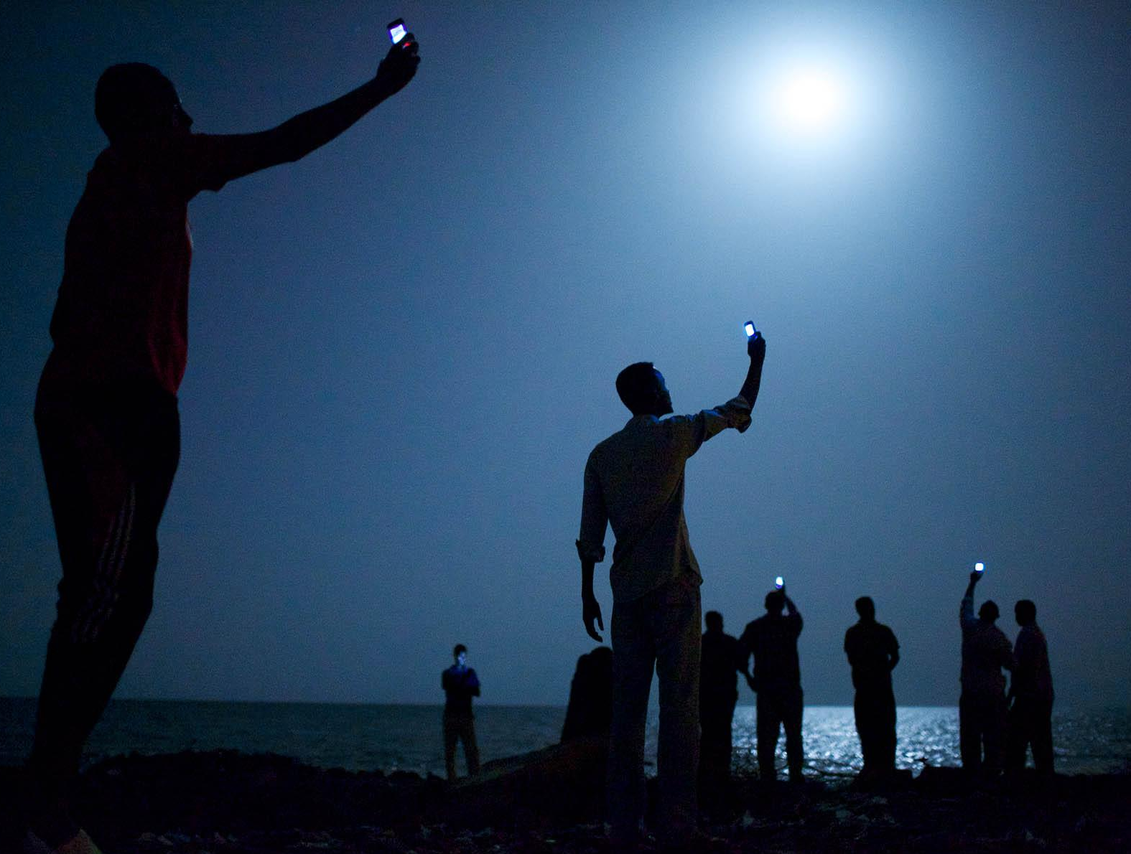



#wdr2016
www.worldbank.org/wdr2016

Slide 3
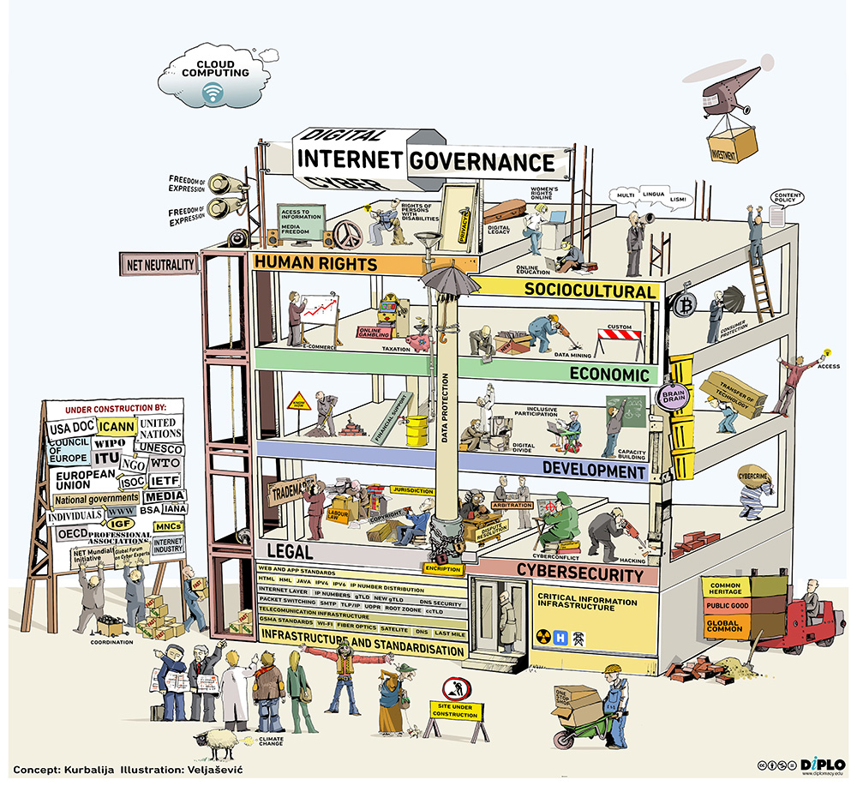

Slide 4
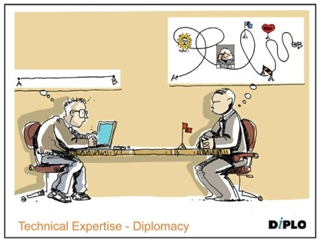

Overcoming ‘lost in translation’

Slide 5
