Slide 1
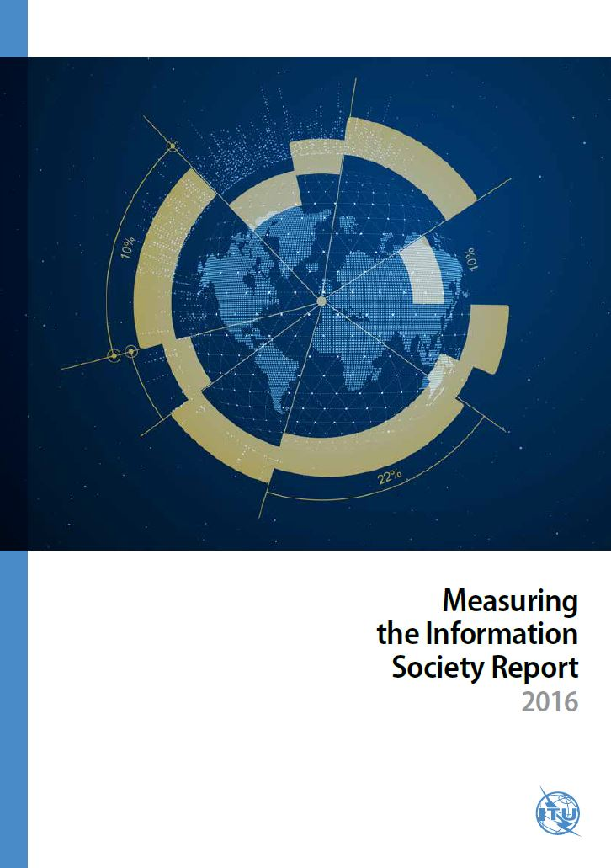
Council Working Group on International Internet-Related Policy Issues Geneva, 3 February 2017 Measuring the Information Society Report 2016 Esperanza Magpantay Senior Statistician ICT Data and Statistics Division International Telecommunication Union

Slide 2
Index
The ICT Development Index (IDI)
The role of ICTs in monitoring the SDGs
ICT prices
Measuring mobile uptake
Internet user and activity trends

Slide 3
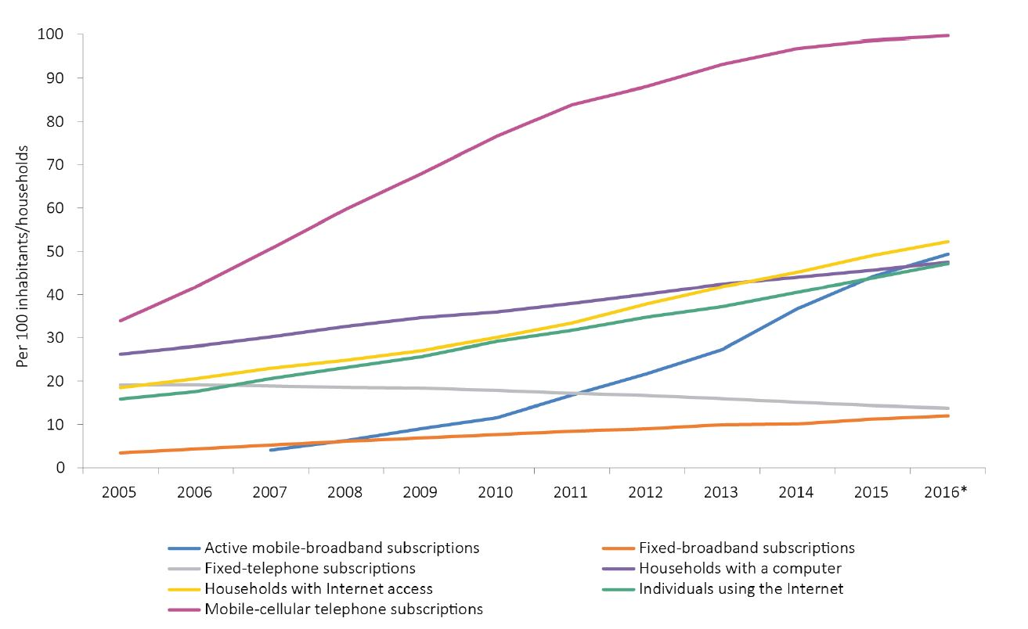
Key ICT indicators
Steep rise in mobile-cellular subscriptions and mobile broadband subscriptions
Mobile broadband networks reach 84% of global population, 67% of rural population
47 per cent of the world’s population online in 2016
Steady growth of fixed-broadband subscriptions
More than 50 per cent of households have Internet access at home
Substantial growth in global access to and use of ICTs
Source: ITU.

Slide 4
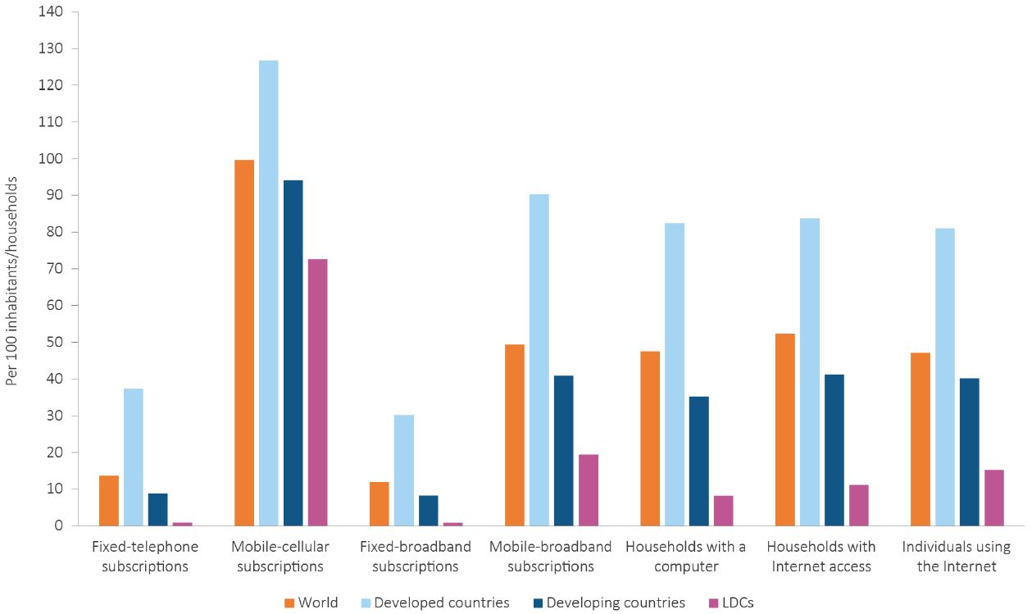
Significant digital divide exists
ICT penetration, 2016*, by level of development
Source: ITU.

Slide 5
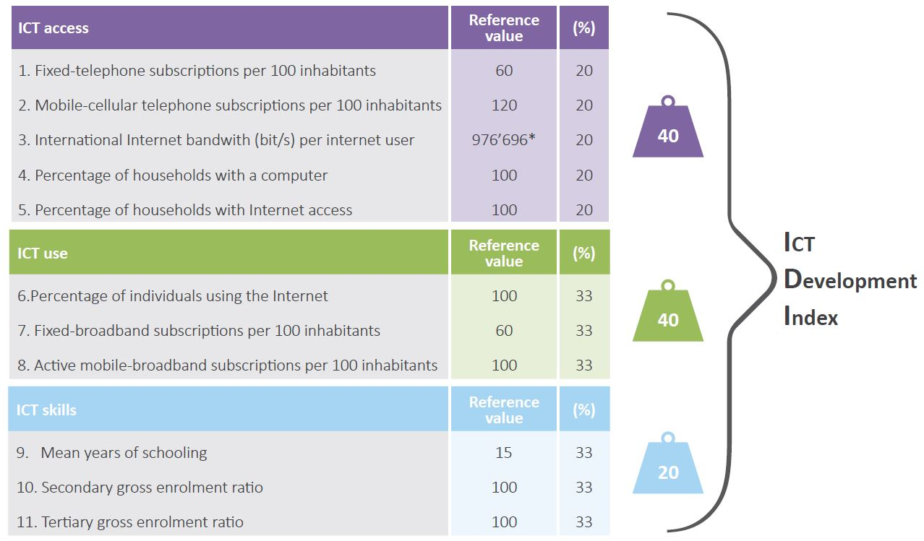
ICT Development Index

Slide 6
ICT Development Index (IDI) - 2016 top ten
Korea (Rep.)
Iceland
Denmark
Switzerland
United Kingdom
Hong Kong, China
Sweden
Netherlands
Norway
Japan
The Republic of Korea leads the IDI rankings for the second consecutive year
There is a strong association between economic and ICT development
Greater improvement in ICT use than ICT access

Slide 7
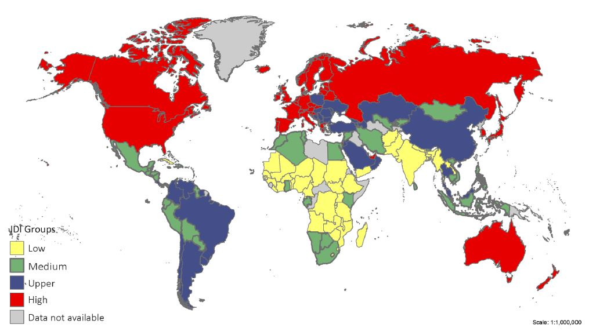
Disparities in IDI value remain
Geographical distribution of the IDI, 2016
Source: ITU.

Slide 8
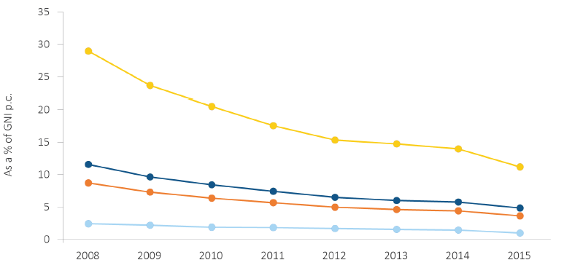
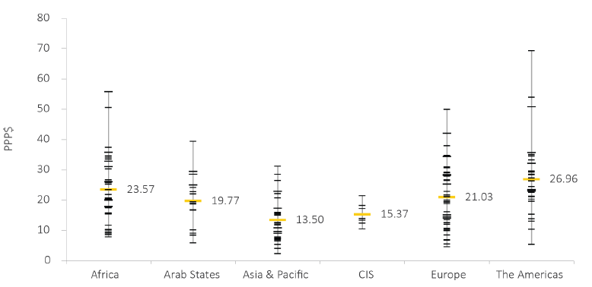
Mobile cellular prices
Mobile-cellular sub-basket
Continued to fall and more steeply than in previous year, linked to prepaid packages
Differences in mobile prices persist within and across regions, Asia-Pacific has the lowest average PPP$ price
Mobile-cellular sub-basket
Price in a country
Average region
Source: ITU.

Slide 9
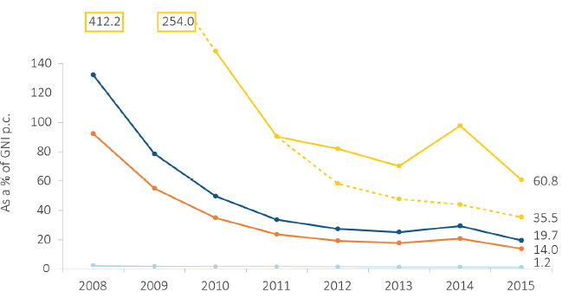
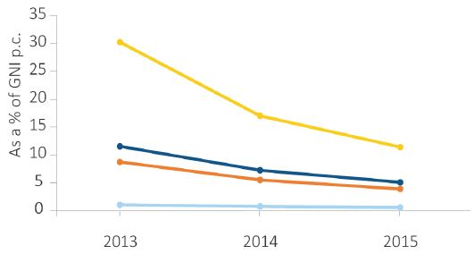
Broadband prices
Fixed broadband sub-basket
Fixed-broadband prices continued to drop but remained highest in LDCs
Mobile-broadband prices is cheaper and more widely available than fixed broadband, but is still not deployed in majority of LDCs
Mobile broadband, handset-based
Source: ITU.

Slide 10
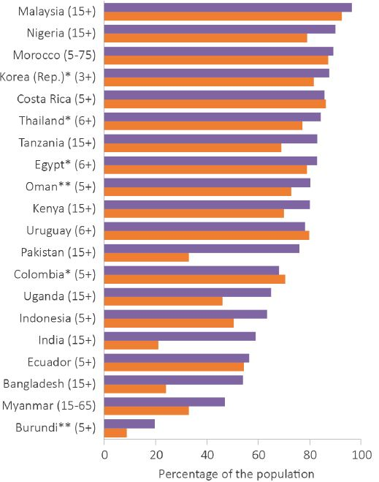
Measuring mobile uptake
Individuals who own a phone, 2015 or latest year
Many people still do not own or use a mobile phone
Significant gender gaps exist - gap is larger for mobile phone ownership than for mobile phone use
People living in rural areas are less likely to own or use a mobile phone than those living in urban areas
Affordability is the main barrier to mobile-phone ownership
Universal use of mobile-cellular services has not yet been achieved
Source: ITU.

Slide 11
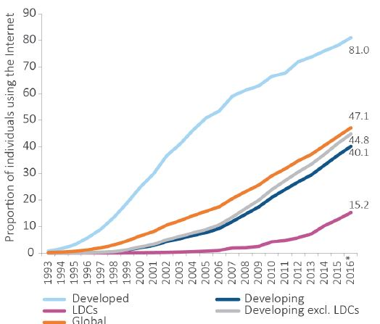
Internet user and activity trends
The benefits of the Internet are still unavailable to over half the world’s population
Most people have access to Internet services but many do not actually use them
The full potential of the Internet remains untapped, especially for low-income and less educated users
Access to the Internet is not enough, skills needed to take full advantage of the Internet
More data are needed!!!
Individuals using the Internet (%), by level of development

Slide 12
Thank you
For more information and data:
www.itu.int/en/ITU-D/statistics

