Slide 1
Policy Solutions
Dónal Rice
National Disability Authority, Ireland
Access to the Internet for Persons with disabilities and specific needs
15th February 2016

Slide 2




Introductions
Senior Design Advisor, ICT, Centre for Excellence in Universal Design, National Disability Authority Ireland
PhD student, Centre for Disability law and Policy, NUI Galway
Editor, ITU/G3ict e-Accessibility Policy Toolkit for Persons with Disabilities
Author, ITU Connect A School, Connect A Community module on ICTs for persons with disabilities
Co-author, ITU model ICT Accessibility Report –
  “Module 6: Accessible ICT public procurement policy framework “

Slide 3
Agenda
Some of NDA’s approaches
Looking outward to best practice
What’s happening in developing countries
Lessons for everyone to learn

Slide 4
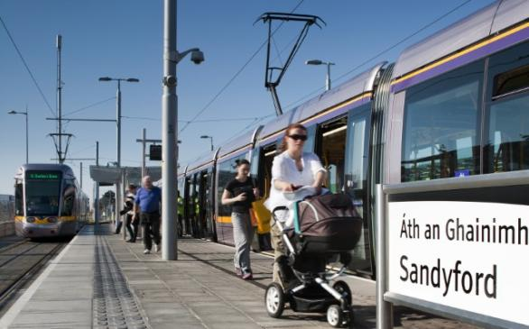
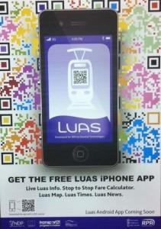
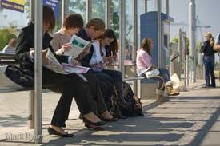
Ireland’s National
Disability Strategy launched in
September 2004
Disability Act 2005
Formation of;
Centre for Excellence
in Universal Design
(CEUD) January 2007
Built environment
Products & Services
ICT
3

Slide 5
National Disability Authority
Government agency on disability research and policy advice
Incorporates a Centre for Excellence in Universal Design
Work on web accessibility
  Guidance and standards development
  A Universal Design approach where practical
  Commission research into state of accessibility – and people’s lived experience of using online public services

Slide 6
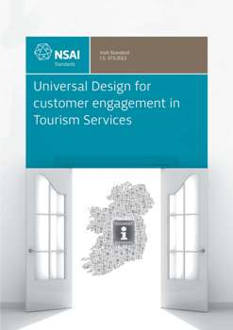
Universal Design for Customer Engagement in Tourism Services
This Irish Standard presents guidance for the use of Universal Designs to improve the engagement between tourism services providers and their customers, in:
1) Electronic based communications: e.g.
web, apps
2) Written communications:
eg billing, forms
3) Telephone communications: e.g IVRs
4) Face to face communications
SWiFT 9:2012: ‘Universal Design for
Energy Suppliers’

Slide 7


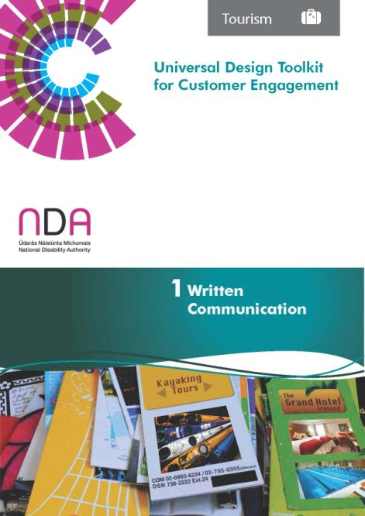
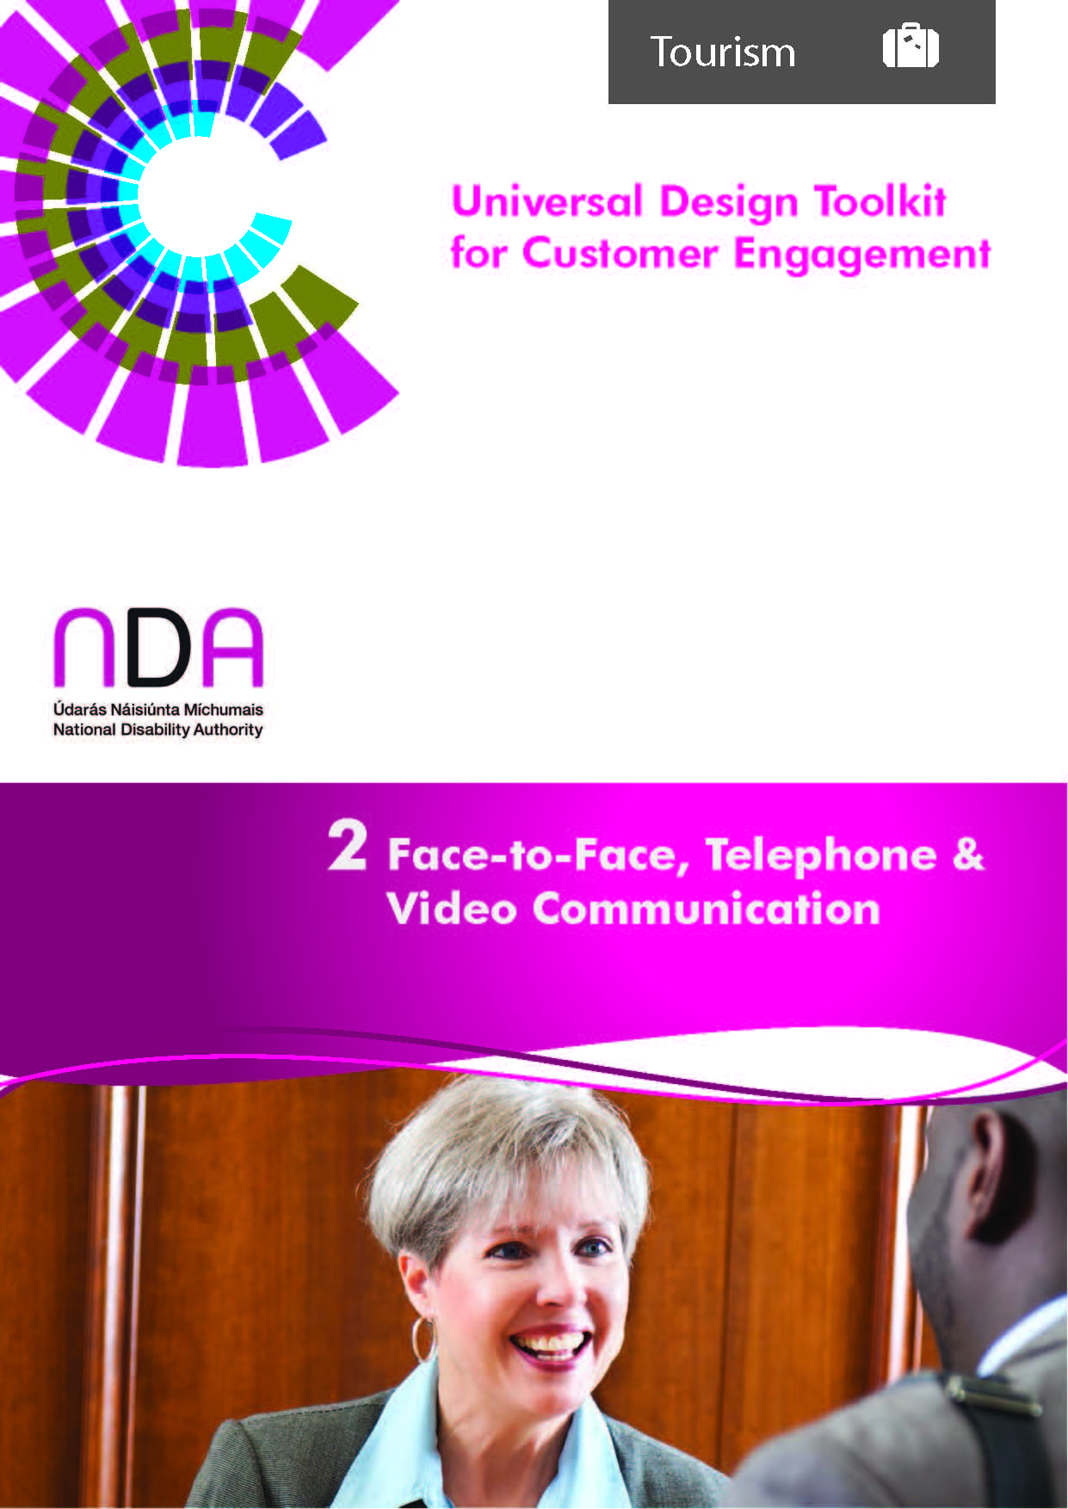
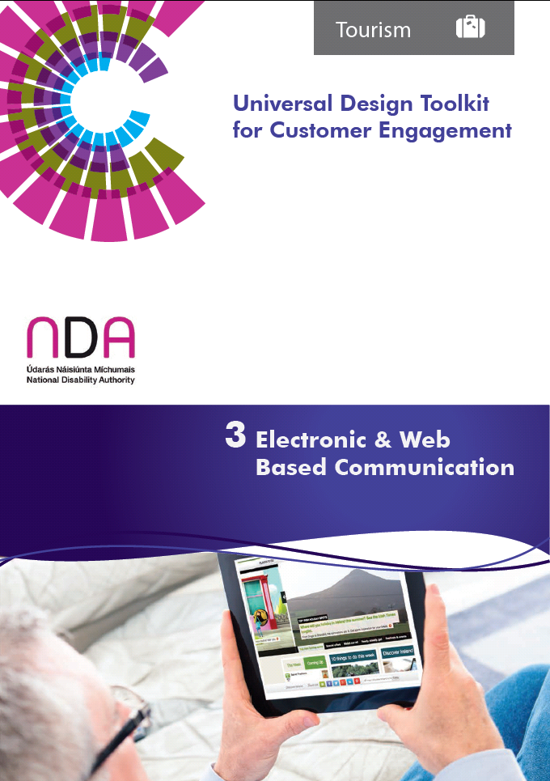

Slide 8
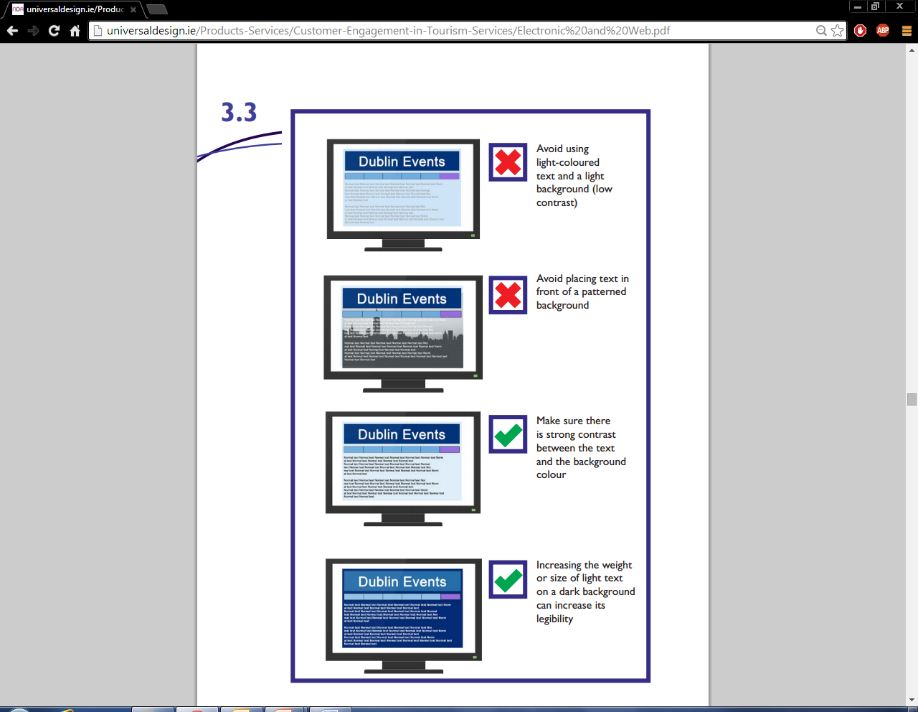

Universal Design Toolkit for Customer Engagement
What Was Addressed?
Writing Good Web Content
Designing and Developing
Usable Websites
Mobile Friendly Website
Toolkit guide

Slide 9
Business Outcomes
Better online customer engagement has resulted in increased online bookings for Purty Loft events.
 | Oct’ 13 | Oct’ 14
Number of online ticket sales | 147 | 301
Cost of online ticket sales(€) | €6000 | €12000
There has been an increase of 104% of tickets sold online for the month of October 2014 in comparison to October 2013.
This has resulted in a 100% increase for online sales since October last year.

Slide 10
Research
2012 – Peoples’ lived experience of using public sector websites
  Findings – 50% of respondents do not use e-government websites
  Some good examples of transitional websites e.g motor tax – but each has a very different look, feel and user experience
  No consistent use of branding, language or design approach across the sector
  Accessibility haphazard approach
2013 – “Measures to improve the accessibility of Public websites in Europe”
  Current levels remain low – but in many cases fixing issues would take little effort
  Accessibility drift – once accessible websites have inaccessible features, language in content or downloadable documents
  Main areas needing attention:
    Audio media content – e.g. videos with no captions
    Office documents e.g inaccessible content contained in spreadsheets and PDF documents and forms
Notes:
http://universaldesign.ie/Technology-ICT/Measures-to-Improve-Accessibility-of-Public-Websites-in-Europe/
http://universaldesign.ie/Technology-ICT/Guidance-for-Online-Public-Services/

Slide 11
Policy solutions 1 – Antidiscrimination measures
Many countries – including developing nations now include accessibility for websites in their antidiscrimination legislation and policy

Slide 12
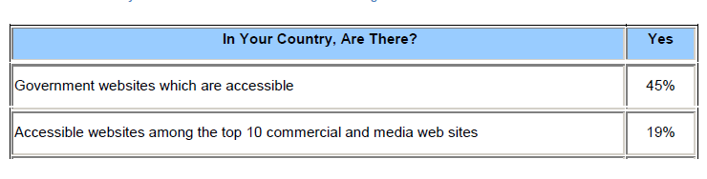
G3ict “UN CRPD 2013 ICT Accessibility Progress Report”
Notes:
http://g3ict.com/resource_center/G3ict_Publications

Slide 13
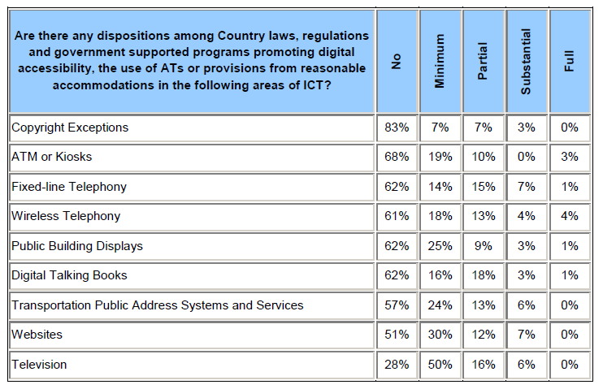

Slide 14








Examples of policies - Public websites
Italy (‘Stanca’ Law – dedicated ‘eAccessibilty’ legislation)
Austria (eGovernment Law)
Spain, UK, Germany, France (Equality/Anti-discrimination/Accessibility Law)
Netherlands, Portugal (Cabinet Decision, Ministerial Resolution, etc.)

Slide 15



Examples of policies - Business websites
Germany (BITV – gives rights of negotiation to disability organisations)
Austria, Malta, Australia, US (Equality/Anti-discrimination; legal cases taken….)
Notes:
Slide courtesy of Kevin Cullen WRC – “Existing and Emerging e-Accessibility Legislation and Regulation for Telecommunications, the Internet, Broadcasting and Beyond”
Data from Measuring eAccessibility 2011. Empirica and WRC: MeAC- Measuring Progress of eAccessibility in Europe. Assessment of the Status of eAccessibility in Europe. Main Report (2007) and eAccessibility status follow-up (2008).

Slide 16
Policy solution 2 –public procurement
USA Federal procurement regulation – Section 508 of the Rehabilitation Act
Specifies accessibility requirements for public procurement
Significant impact on availability of accessible ICT on global market
Significant influence on capacity of web design industry in USA to develop accessible websites

Slide 17
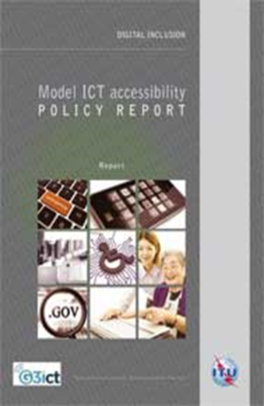
Model ICT Accessibility Policy Report: Module 5: WEB ACCESSIBILITY
Model ICT Accessibility Policy Report: Module 5: WEB ACCESSIBILITY
Provides:
  Guidance on incorporating web accessibility requirements into existing policies
  A model, stand alone web accessibility policy

Slide 18
Model ICT Accessibility Policy Report: Module 5: WEB ACCESSIBILITY
Looks at :
  Who: responsible agencies
  What: relevant policies and regulations
  How: standards to use: WCAG 2.0
  When: timelines for implementation, monitoring compliance and reporting
Notes:
http://www.itu.int/en/ITU-D/Digital-Inclusion/Persons-with-Disabilities/Documents/ICT%20Accessibility%20Policy%20Report.pdf

