Slide 1
www.iwf.org.uk
Fred Langford, Director of Global Operations & Deputy CEO

Slide 2
Overview
About the IWF
Online Child Sexual Abuse Reporting Portal (OCSARP)
IWF/ITU Countrywide Assessment of Republic of Uganda

Slide 3
Who are the IWF?
IWF is the UK Hotline for reporting (www.iwf.org.uk)
  Child sexual abuse content hosted anywhere in the world
  Criminally obscene adult content hosted in the UK
  Non-photographic child sexual abuse images hosted in the UK
A child is any person under the age of 18 (source: UN Convention on the Rights of the Child (CRC) 1989)
Charity (not for profit), founded in 1996 by the UK internet industry
Self Regulatory with over 100 industry members

Slide 4
What do the IWF do?
Notice and takedown in the UK
A URL list for industry to block/filter content hosted outside of the UK to disrupt the availability of this content
Removal of criminal content hosted outside the UK by sending details of the content to the INHOPE Hotline or to law enforcement in that country
A keywords list of search terms used to find criminal content
Monitoring of newsgroups and issuing of takedown notices for individual postings where child sexual abuse content is identified

Slide 5
What the IWF have achieved
In 2012 The IWF assisted with the removal of 9,696 URLs child sexual abuse hosted worldwide (only 35 notices issued in UK)
  Over 390,000 web pages assessed in 16 years
100,000 URLs removed for containing criminal content
Less than 1% of child sexual abuse content is hosted in the UK since 2003, down from 18% in 1996
Child sexual abuse content is removed in the UK typically within 60 minutes
Time taken to remove child sexual abuse content hosted outside the UK halved to 10 days in 2011.
12 children identified and rescued in the past two years in partnership with UK Police.

Slide 6
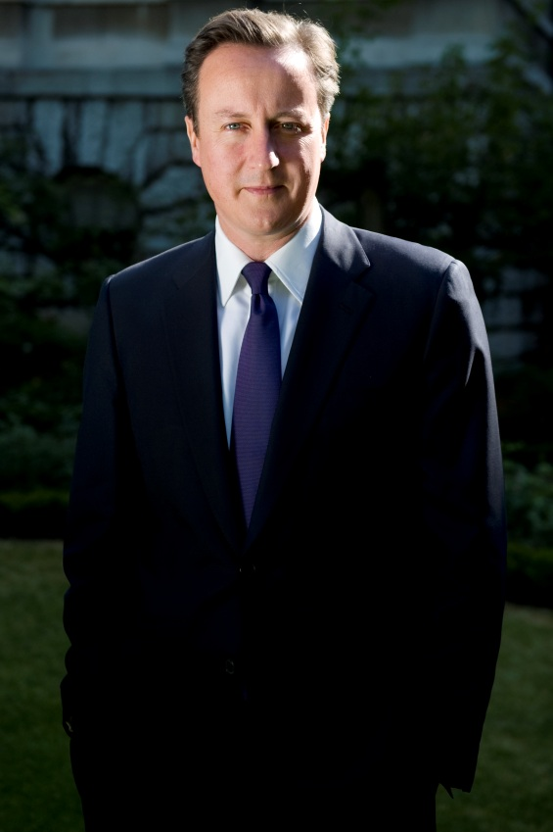
What we have achieved
“The Internet Watch Foundation has again done an outstanding job in tackling images of child sexual abuse online.
“The organisation plays a key role in international efforts to end this criminality, protecting children and continuing to block access to child sexual abuse images wherever they are based.
“As a direct result of the Internet Watch Foundation’s work, three children were rescued from their abusers last year.”
Prime Minister
David Cameron
Notes:
And finally, The Home Office Minister for Crime and Security provided a comment for our press release when we marked our 15th anniversary. This outlines our strong relationship and the importance of all parties uniting behind our work.
“Over the last 15 years the IWF has done fantastic work to help rid the web of large amounts of illegal and deeply disturbing content. As the IWF’s figures show we can never be complacent.
“The strength of the IWF approach is working in partnership with the internet industry, government, the police, the Child Exploitation and Online Protection Centre and, most importantly, the public themselves.
We must continue that work together.”

Slide 7
What is OCSARP?
(Online Child Sexual Abuse Portal)
Outsourced Hotline/Back office service
OCSARP enables citizens to report online child sexual abuse content for assessment by IWF experts.
It is a cost effective solution that is easy to implement with back up support from acknowledged world experts in the field.
IWF takes appropriate action, including tracing the location the content is hosted, alerting the host country to the content, issuing notices for removal (Notice and Takedown) and informing police.

Slide 8
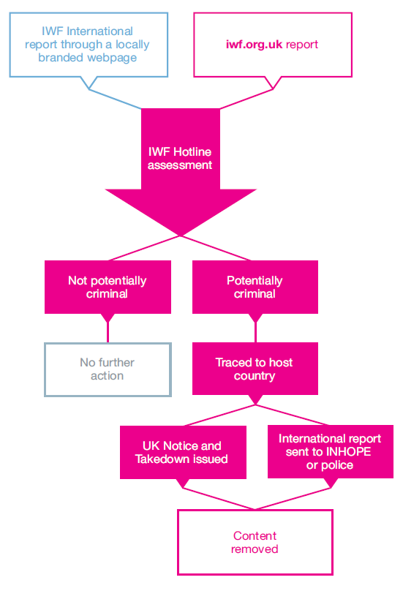
Report Process

Slide 9
Why OCSARP?
Quick to set up by IWF experts
Countries retain their own locally branded reporting page.
Cost effective (to set up a stand alone hotline will cost EU100,000 in first year of operation, INHOPE Foundation)
Fully scalable
Access to IWF team and other international Hotlines via IWF (INHOPE)
Immediate protection for citizens and peace of mind
Evidence to citizens that you are part of the global battle to eliminate online child sexual abuse content

Slide 10
Benefits
Funding via industry through IWF international membership
IWF membership will provide access to full suite of services (dependant of licensing agreements for URL list)
Access to best practice in field
Shows commitment to combating CSAM online
Part of the global solution
Access to INHOPE network of hotlines by virtue of IWF membership
Monthly progress reports

Slide 11
IWF/ITU Countrywide Assessment of Republic of Uganda
Countrywide Assessment – IWF commissioned by ITU in Republic of Uganda using the agreed ITU/IWF template
Desk and onsite gap analysis of current reporting provision within Uganda:
  Interviews and discussions with law enforcement agencies, private sector,Executive’s government representatives and relevant Civil Society/NGO/Child Protection specialists.
  Discussions with local and global industry operating in the participating country (particularly ISPs, Mobile Operators, filtering companies, social networking and search engines)
  Online research to review key websites with information related to the industry landscape and child protection
  Current level of the problem either hosting or accessing
  A review of relevant documents, past reports, policies, strategies and plans relating to the availability/consumption and action of online child sexual abuse content that were provided by the stakeholders during the interview stage.

Slide 12
Assessment of Republic of Uganda - Findings
Currently no independent reporting solution for citizens of Uganda in place
The correct laws are in place to investigate and prosecute
Support for a reporting solution across all key stakeholders within Uganda
Internet access and local hosting are growing rapidly within Uganda (currently 13% of population of 33.6 million are online)
Some cultural anxieties currently exist regarding reporting
Awareness of the issues
Identification of key partners

Slide 13
Assessment of Republic of Uganda - Recommendations
IWF were tasked with recommending and implementation plan for Uganda. (13 recommendations in assessment report)
Depending on the response of the Ugandan representatives further discussions will need to take place regarding the correct financial model to adopt
Identified partners are NITA-U, ISOC.ug, Ugandan Police Cybercrime Unit and relevant industry (fixed and mobile providers)
NITA-U to act as primary contact in Uganda, links to other Ugandan government departments, initiate national awareness campaign,
That Ugandan ISP’s become IWF Ugandan chapter members to gain access to full suite of IWF services
Awareness raising suggestions supplied

Slide 14
Assessment of Republic of Uganda – Next Steps
Secure agreement from Ugandan representative to implement recommendations
Contact all identified preferred partners to establish roles
Agree terms and conditions with NITA-U to engage with IWF to implement the OCSARP reporting solution.
Implement OCSARP solution on NITA-U servers to ensure local hosting
Agree with all parties a proposed ‘go-live’ date
Complete a full year evaluation of the service

Slide 15

Thank you for listening

Slide 16
Contact us
Internet Watch Foundation
Suite 7310
First Floor, Building 7300
Cambridge Research Park
Waterbeach
Cambridge
CB25 9TN
United Kingdom
E: media@iwf.org.uk
T: +44 (0) 1223 20 30 30
F: +44 (0) 1223 86 12 15
Internet Watch Foundation
@IWFhotline
Internet Watch Foundation

