Slide 1


Slide 2
THREE STRATEGIES – FROM SAFER to BETTER
Insafe was created in 2004 by the European Commission and is today constituted of 31national centres, each comprising an awareness and youth participation teams and a helpline.
Explore emerging technology and issues to maintain a deeper understanding of the online context
Build evidence-based actions drawing on input from youth, parents, industry, public authorities and the civil sector to create highly relevant tools and services
Transform awareness raising into peer-led education, evolving from a “tips and messages” culture to foster behavioural change through reflection

Slide 3





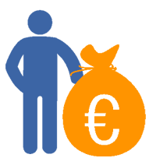
SAFER INTERNET DAY 2014
106+
SID 2014 messages focused on positivity, empowerment and positive content
Number of countries involved in
Safer Internet Day 2014
46.6K
Number of tweets with
the #SID2014 hashtag
25.2M
Number of people reached by the #SID2014 hashtag
SID 2014: Let’s create a better internet together
328,830
⇒
Safer Internet Day would not be possible without the support of the
European Commission. Find out more about the EC’s ‘European Strategy for a Better Internet for Children’ on the Digital Agenda website:
http://ec.europa.eu/digital-agenda/en/creating-better-internet-kids.
Number of people reached by the SID 2014 Thunderclap

Slide 4

EUROPEAN AWARD FOR BEST CONTENT FOR KIDS
The award aims to highlight existing quality content for 4-12 year-old children and encourages the production of new content that will offer young people online opportunities to learn, play, discover and invent.
The competition ran throughout much of 2013 in 26 European countries.
There were four categories of entry: Young individuals or teams; School classes and youth groups; Adult non-professionals; Adult professionals.
More than 1,100 entries were received in total, many from young people themselves.
National winners were put forward to a European-level competition.
European winners were awarded by Commissioner Neelie Kroes at a high-level event in Brussels on Safer Internet Day 2014.

Slide 5
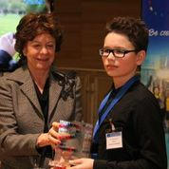
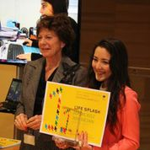
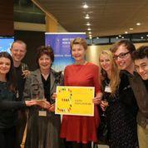
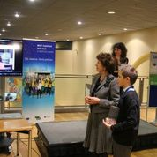
EUROPEAN AWARD FOR BEST CONTENT FOR KIDS

Slide 6
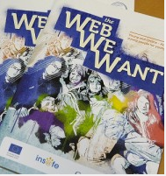
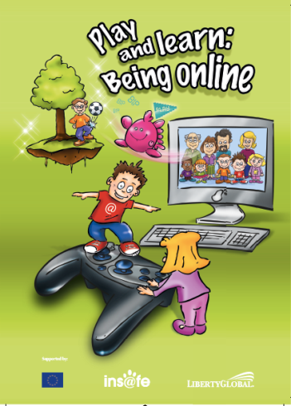
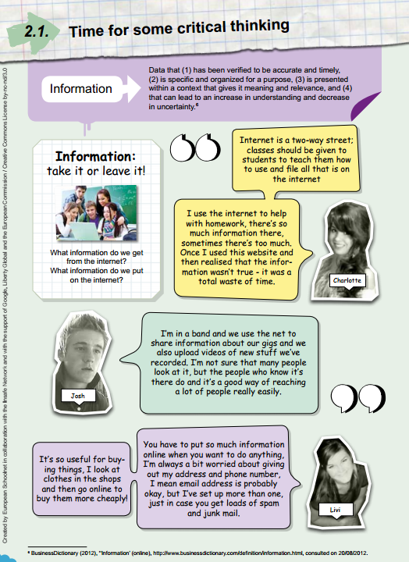
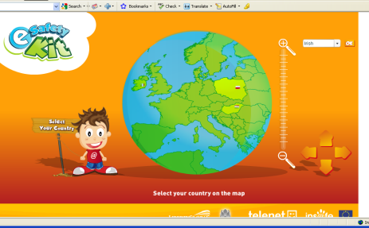
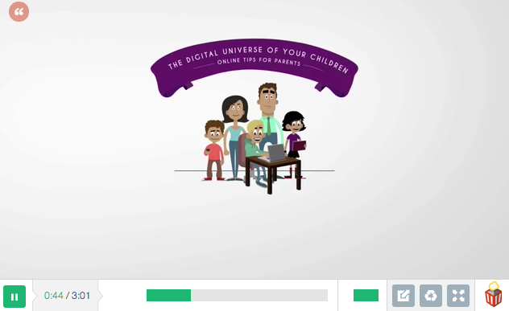
SID – POSITIVE CONTENT FOR KIDS

Slide 7
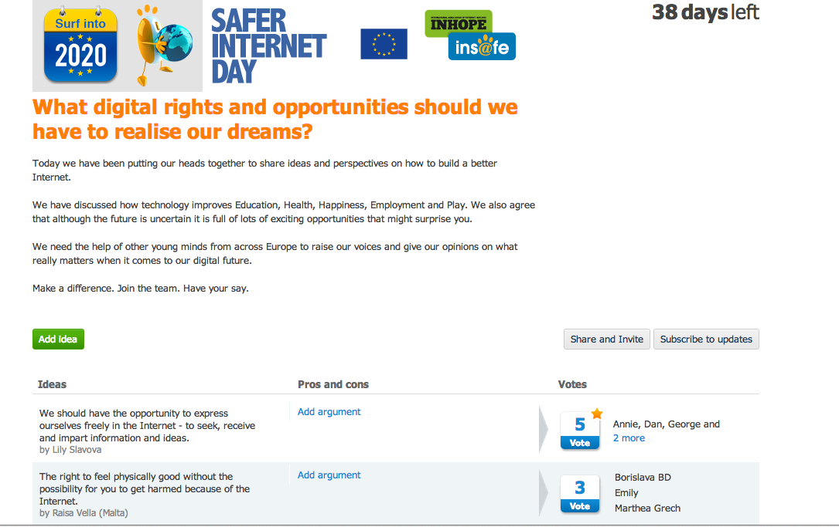
EUROPEAN LAUNCH OF YOUTH MANIFESTO
https://tricider.com/en/brainstorming/1NgYq
www.youthmanifesto.eu

