Slide 1
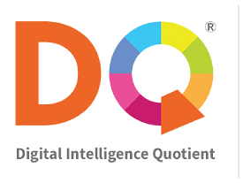

Slide 2
Notes:
The future of human intelligence and digital citizenship
The collection of social, emotional, and cognitive abilities that enable children to deal with the challenges and demands of digital life.
DQ or Digital Intelligence Quotient is the collection of social, emotional, and cognitive abilities that enable individuals to deal with the challenges and demands of digital life.
The collection of social, emotional, and cognitive abilities that enable individuals to deal with the challenges and demands of 21st Century digital life.

Slide 3
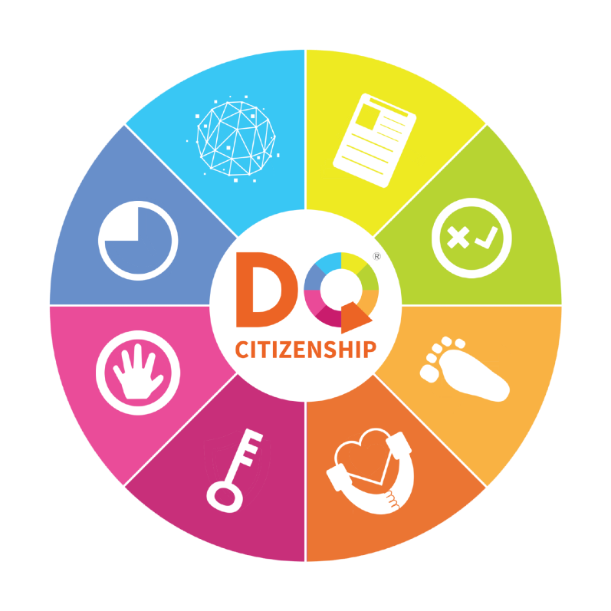
Without DQ
With DQ
Technology Overuse
Digital Citizen
Identity
Privacy Management
Cyber
Bullying
Online
Grooming
Screen Time
Management
Critical
Thinking
Cyber
Crimes &
Threats
19
Violent &
Inappropriate
Materials
Cyberbullying
Management
Digital
Footprints
False
Information
Privacy
Invasion
Cyber Security
Management
Digital Empathy

Slide 4
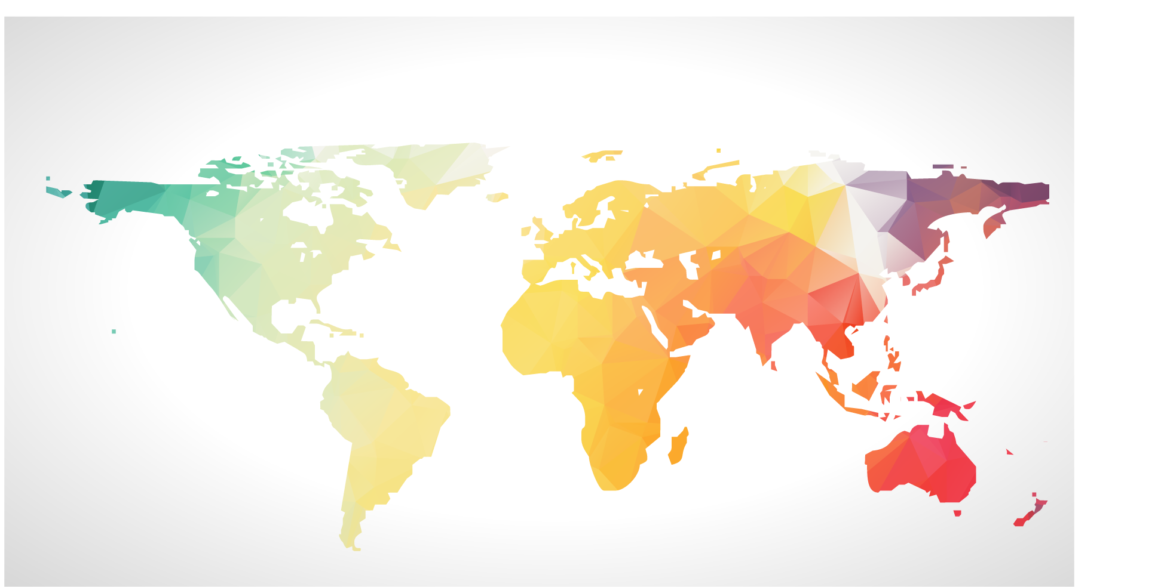
Our 20/20 Goal
Empower Every Child with DQ
20
Million
Children
by 2020

Slide 5
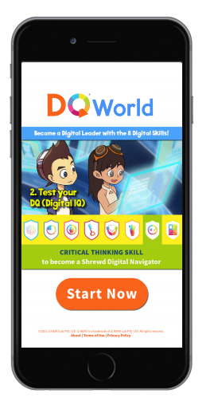
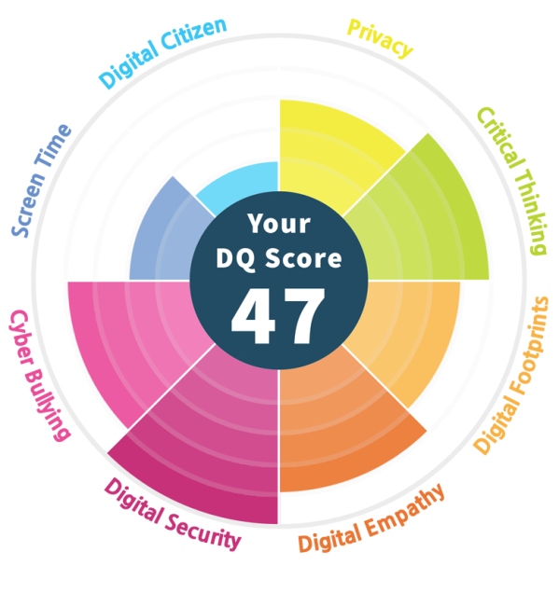
1 year curriculum for children
8–11 years old
15 hours of digital education
Self-Learning and Flipped Classroom Model
Research-Backed, Real-Time Assessment
DQ Impact
Reports
International Award-Winning
Learning Format

Slide 6
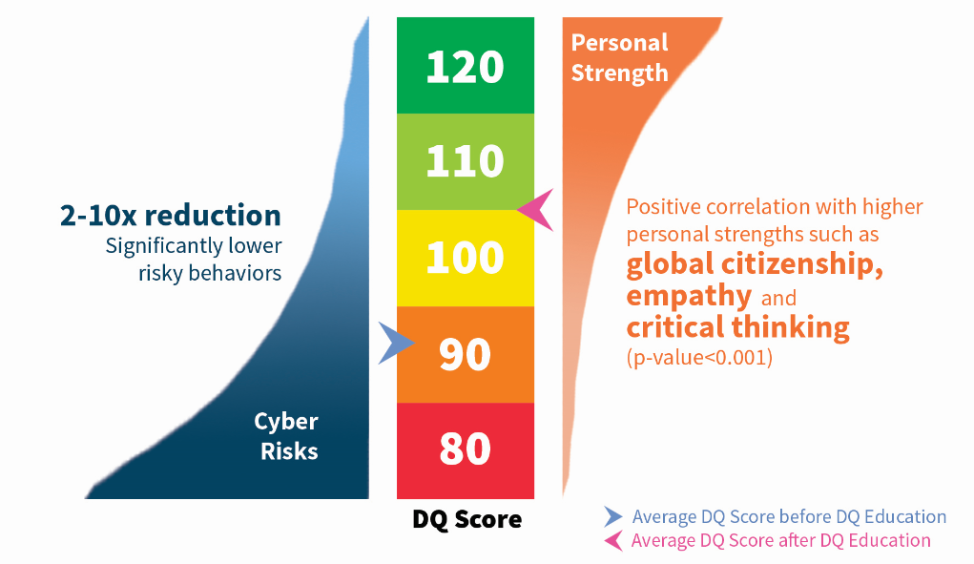
Key Impact Finding from 2016 Singapore DQ Study

Slide 7
2017 Timeline for #DQEveryChild
2017
2018
Q1
Q2
Q3
Q4
Q1
Challenge Starts
on March 19, 2017
School Outreach
Challenge Ends on Nov 30, 2017
Data Research For Global, National, State, School Reports
Global DQ Index Report
Asia Pacific
Singapore
Korea
Malaysia
Indonesia
Taiwan
China
India
Pakistan
Philippine
Myanmar
Nepal
Australia
New Zealand
America
US
Canada
Argentina
Mexico
Costa Rica
Africa and Middle East
South Africa
Kenya
Rwanda
UAE

Slide 8
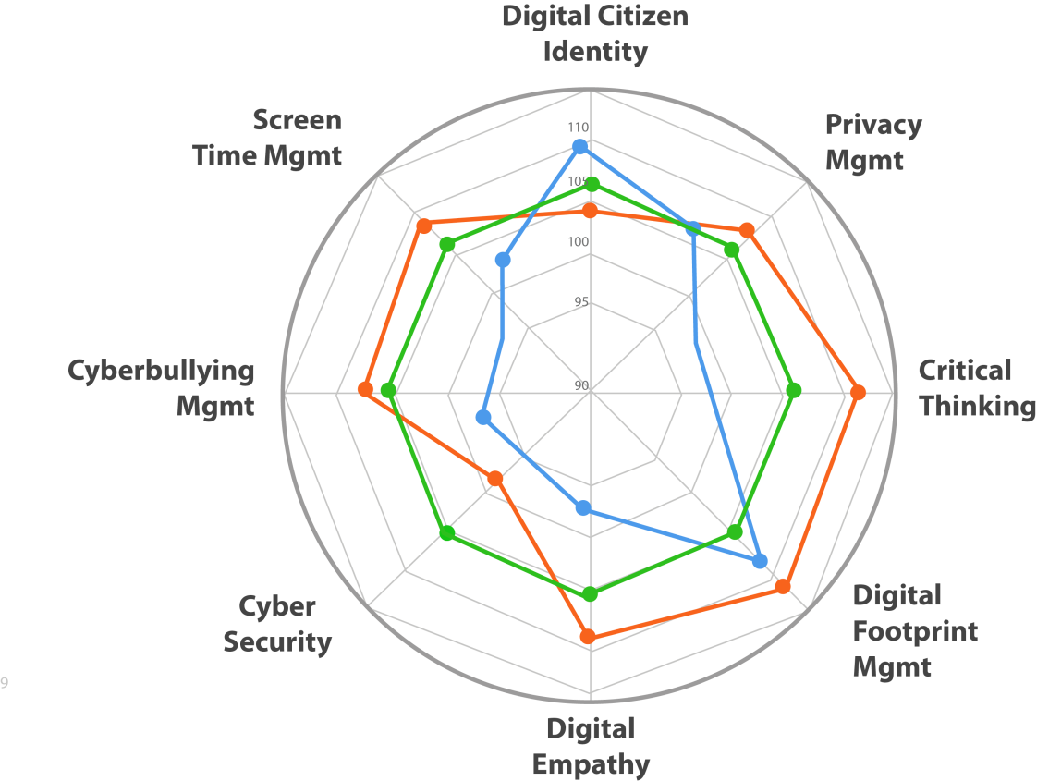
State, National and Global DQ Index
Notes:
Assessment of digital competencies, level of cyber risk exposure and other online behaviour of children at a national level and provide insight and evidence-based recommendations to build a safe and effective digital education ecosystem.

Slide 9
Easy to Implement Nationwide
Government Ministry of Education or Ministry of ICT
Provide a ready-to-use online tool to schools
Global DQ Index Report and DQ National Report measures the DQ improvement and state of cyber-risks for children in your country.
Companies
Provide sponsorship that covers local outreach
Branding opportunities
Logo recognition on the DQ Global, National and School Reports
Co-branded e-Newsletters for parents and educators
Logo recognition on the localized web and mobile sites, media and collaterals
Recognition in national or regional events

Slide 10
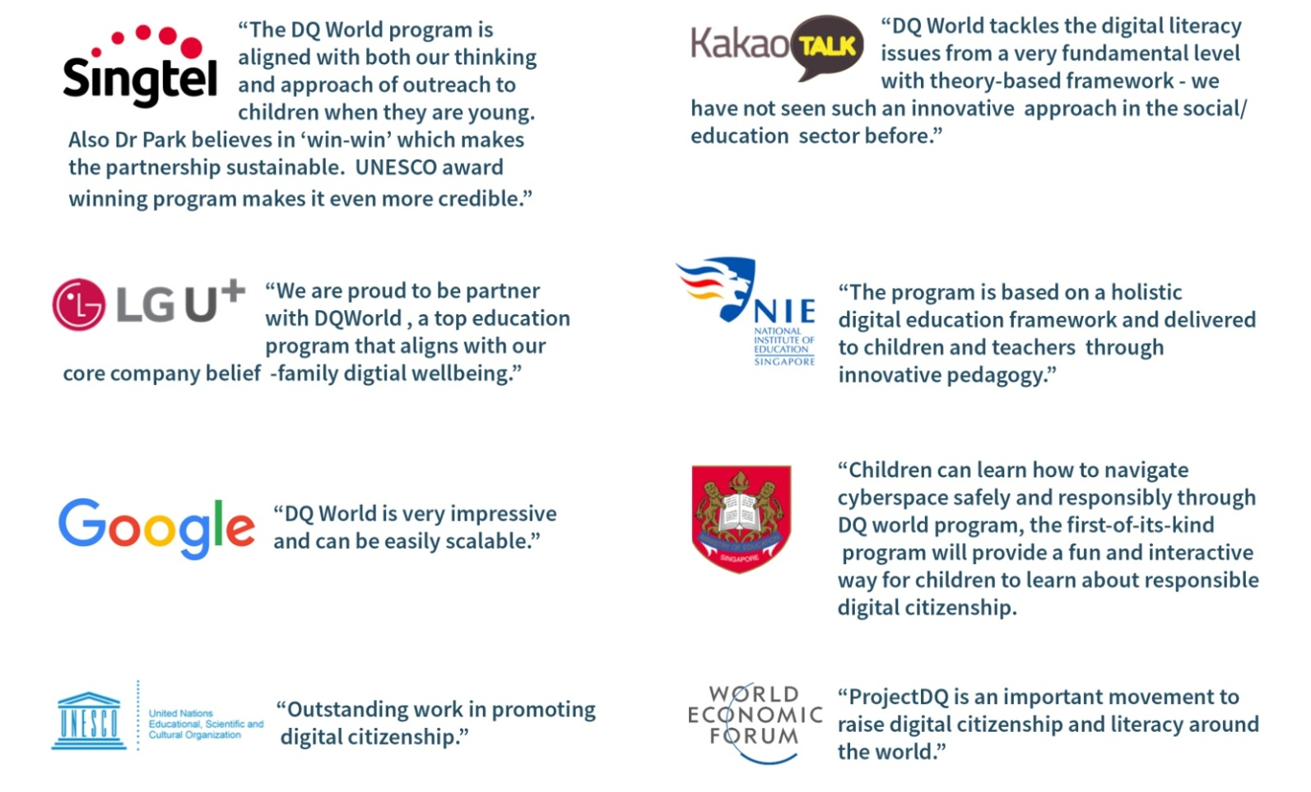
Pioneering DQ Partners
Notes:
Empowering children to be future ready

Slide 11
Raise Your Country’s
Marsali Hancock
mhancock@DQinstitute.org
703 678.3848
Notes:
Accelerated national implementation of DQ education and risk assessment for children at age 9-12 across countries utilizing an innovative online platform that can be easily in-built into any public education system.

