Slide 1
Project VIC
Presenter: John Hancock
Technical Advisor, Project VIC
CEO, Hubstream Inc

Slide 2
Project VIC is…
a partnership between government agencies, technology companies and not-for-profits to respond to the online sexual exploitation of children

Slide 3
Project VIC’s vision
Stop leaving victims in evidence rooms

Slide 4
The data deluge

Slide 5
Technology ecosystem

Slide 6
Technology ecosystem
VICS (Video and Image Classification Standard)
Based on the Open Data Protocol (OASIS standard)
Project VIC GitHub repository
Currently at version 1.3

Slide 7
Crowdsourced data set
Contributions from trained law enforcement agencies
Data set allows law enforcement to keep up with the massive volume of new child abuse images and videos
Hubstream provides an encrypted cloud-based data sharing and analytics service

Slide 8
Metrics
1000+
35
16
Participating Agencies
Supported Products
Countries Participating
2,000+
2,600,000+
1,700+
Users
Categorized Files
Officially Trained

Slide 9
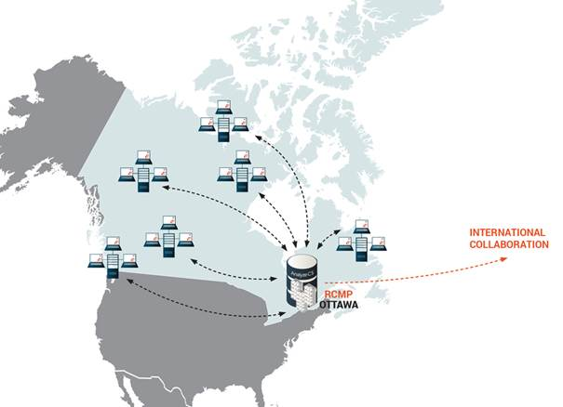
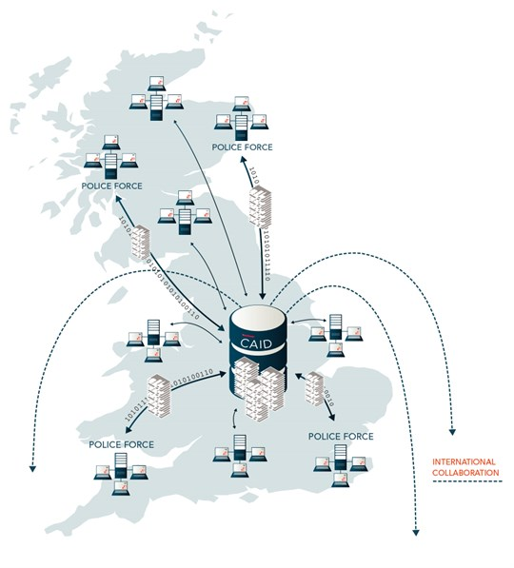
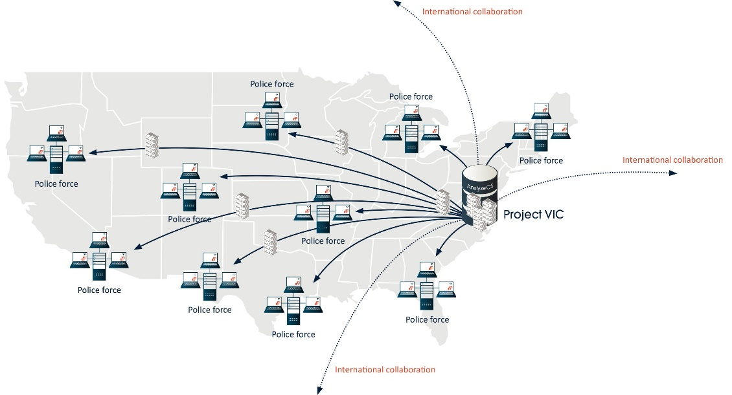
International Deployments

Slide 10
95% of respondents found that Project VIC saved them time
“Due to the large numbers of files, culling the home security content away from the pool of otherwise possibly relevant data would have taken weeks if not months using older methods. With Analyze DI, this was finished in a few days time.”
- Survey Respondent
Based on 192 respondents

Slide 11
Project VIC summary
A victim-centric methodology
A technology ecosystem
Crowdsourced data sets
A framework to effect change

Slide 12
New projects

Slide 13
Prioritization
Data Visualization
Timelines
Network Analysis
Hubstream Intelligence helps you use data to solve crimes faster.
John Hancock, CEO
john.hancock@hubstream.net
solve crimes faster
Cloud and on-premise intelligence solutions.
Applied crime analytics to improve every phase of your investigations.

