Slide 1
Regional Initiatives for Europe Child Online Protection
16 February 2016 CWG-COP, ITU Headquarters
Jaroslaw K. PONDER Europe Coordinator EURregion@itu.int

Slide 2
Regional Initiatives Adopted by WTDC-14
EUR1 Spectrum management and transition to digital broadcasting
EUR2 Development of broadband access and adoption of broadband
EUR3 Ensuring access to telecommunications/ICTs, in particular for persons with disabilities
EUR4 Building confidence and security in using telecommunications/ICTs
EUR5 Entrepreneurship, innovation and youth

Slide 3
Building Blocks and Impact of Regional Initiatives
Building R. Community (Platforms / Workshops / Conferences / Expert Grups)
Building R. Capacities (Banchmarks/Studies/Roadmaps)
Regional Initiatives for Europe
Building Human Capacities (Trainings / ITU Academy / Centres of Excellence)
Addressing N./R. Needs (Assistance / Transfer of Knowledge / Twinnings)
Fostering Regional Coordination and Cross-R. Coop. (Know-how exchange with other R.)
Prop. 1
Prop. 2
Prop. 3
Prop. 4
Prop. 6
Prop. 5
Prop. ….
Programmes
Projects
Study Groups
ITU Academy
Academia
Membership
WSIS Action Lines

Slide 4
EUROPE - RI-EUR4: Building confidence and security in the use of telecommunications/ICTs 2015-2017 IMPLEMENTATION PLAN

Slide 5
RI-EUR4 - Building confidence and security in the use of telecommunications/ICTs / WTDC-14 Outcomes
Objective: To build trust and confidence in the use of ICTs among children and young people in Europe.
Expected results: Assistance to the countries in need in the following:
Utilizing the existing knowledge on risk and vulnerabilities to which children are exposed in cyberspace and providing best practices
Providing a platform to raise awareness on child online protection (COP) and safety issues
Developing and implementing roadmaps for national or regional COP initiatives.

Slide 6
RI-EUR4: Building confidence and security in the use of telecommunications/ICTs / 2015-2017 IMPLEMENTATION PLAN
Sept: - International Conference for Europe on “Keeping children and young people safe online”, Poland - Conference on "Central European Cybersecurity public-private dialogue platform", Sibiu, Romania
Sept/Oct: - ITU ALERT International Cyber Drill Exercise 2015 for the Europe Region, Budva, Montenegro - Assistance and Coordination: Albania, Bosnia & Herzegovina, Serbia on CIRT
October: - October Awareness Month (Contribution of ITU to ENISA event in Brussels)
Oct/Dec: - Coordination of preparation of national communication campaigns on COP at the national level: Serbia, Montenegro, Croatia, Bosnia and Herzegovina, Romania…
Oct: - Twinning between Poland and Romania on transfer of materials for national campaigns to be rolled out in the school targeting children and teachers
November: - Preparation of 2015 updates of - guidelines for parents & educators - guidelines for parents & educators
December: - Kick off: Preparation of benchmark of national initiatives on COP in Central Eastern Europe

Slide 7
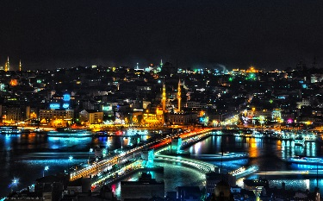
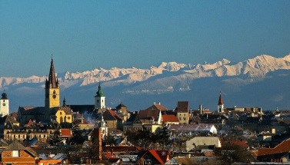
RI-EUR4: Building confidence and security in the use of telecommunications/ICTs / 2016 IMPLEMENTATION
Istanbul
Jan/March: Benchmark of national initiatives on COP in the CEE
February: Celebration of the Safer Internet Day (support to the national campaigns)
25-26 April: Workshop: Child Online Protection, Istanbul, Turkey
Q3/4: Elaboration of model national strategy for COP
Sept/Oct: - International Conference for Europe on COP, Poland - Conference on "Central European Cybersecurity public-private dialogue platform", Sibiu, Romania
October: October Awareness Month
November: ITU-[ENISA] Regional Cybersecurity Forum for Europe and CIS
Sibiu, Romania
Warsaw
Sofia

Slide 8
Thank You
We Call for Collaboration at Regional Level
Jaroslaw K. PONDER Europe Coordinator EURregion@itu.int
Regional Development Forum for Europe
12-13 September 2016 / Belgrade, Serbia

Slide 9
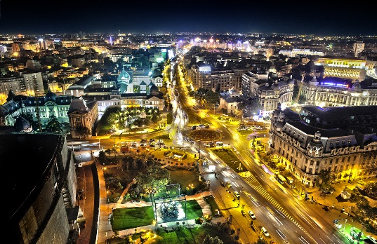
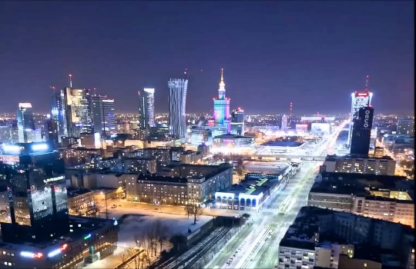
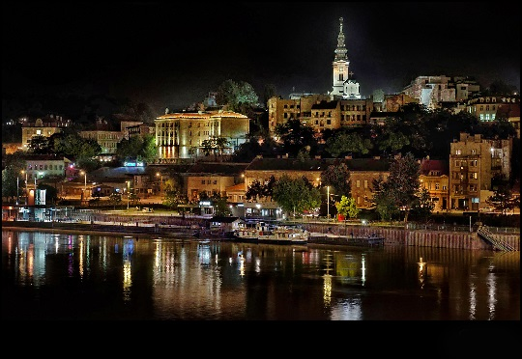
Upcoming meetings for EUR
Bucharest
21-23 March 2016, Romania ITU Regional Seminar on Spectrum Management and Broadcasting
Organized in partnership with ANACOM and Ministry of Communication and Information Society
11-12 April 2016, Poland ITU-EU Regional Conference on Mapping Broadband Infrastructure and Services
Organized in partnership with UKE
25-26 April 2016, Istanbul, Turkey ITU Regional Seminar on Child Online Protection
Organized in Partnership with BTK
12-13 September 2016, Belgrade, Serbia ITU Regional Development Forum for Europe
Organized in Partnership with Ministry of Trade, Tourism and Telecommunications
Warsaw
Istanbul
Serbia

