Slide 1

The Internet Safety Program at a glance
ITU - Council Working Group on Child Online Protection
Seventh meeting - 9 October 2013
Yomna Omran
Internet Safety Section Head
International Relations Division
  Ministry of Communications and Information Technology - Egypt

Slide 2
Table of Contents
National Child Online Safety Committee
Internet Safety Program website
Arab IGF 2013 - Algeria
Children’s use of mobile phones – An international comparison 2012

Slide 3
National Child Online Safety Committee
Aim:
Activating a national strategy for protecting and empowering children online with the belief that empowerment is the key to online protection.
Creation June 2013
Successor of the previously formed NeSWG

Slide 4
National Child Online Safety Committee
Objectives:
Dissemination and awareness raising of safe Internet usages at homes, in the educational institutions, and NGOs
evaluation of the current situation of child online safety, and recommendations to adopt new specific policies in the field of child online protection that suit the nature of the Egyptian society and the latest technological developments
creation of a safe environment for children online
Working with similar regional and international organizations active in the same field.

Slide 5
National Child Online Safety Committee
Membership:
The Ministry of Communications and Information Technology MCIT
The Ministry of Justice
The Ministry of Interior (General Administration for Information and Documentation)
The Ministry of Education
The Ministry of Information
The Ministry of Higher Education
The National Council for Youth
The National Council for Childhood and Motherhood (NCCM)
The National Telecommunications Regulatory Authority (NTRA)
ICT Chamber
Etisal Association
Internet Masr
A number of data and mobile and ICT companies
Computer and Software Department at Federation of Egyptian Chambers of Commerce.

Slide 6
Sub- Working Groups
Research and Studies
Awareness and Media
Technology Solutions
Laws and Legislations
Capacity Building and Education

Slide 7
Research and Studies
  Objectives:
Executing a number of researches and studies focusing on Child Online Protection and avail it to other sub working groups and also to make it accessible to everyone else.
Creation of a Digital Repository for all researches and studies related to Child online safety and avail it on the Egyptian Information Network.

Slide 8
Capacity Building and Education
  Objectives:
Creating Online Safety educational material and curricula for different educational stages in Egypt.
Redirecting Children’s use of technology from a mere “user” to a “creator” through studies and motivational ideas.

Slide 9
Laws and Legislations
  Objectives:
Adoption and implementation of a training plan for judges, prosecutors and police officers on online risks and cybercrimes
Re-assessment of legislations and its enforcement mechanisms on both national and international levels
Raising awareness of cyber crimes

Slide 10
Technology Solutions
Objectives:
Identify and recommend key technology solutions critical to enhancing child online protection
inappropriate content
fraud
unsolicited messaging
potential harassment

Slide 11
Awareness and Media
  Objectives:
Introducing to the community the importance of the Internet as an open channel to the world for cultures, information and relationships exchange
Raising society awareness of the improper use of ICT
Raising community awareness of the legal proceedings taken against the misuse of the internet
Raising society awareness about cyber crimes and risks they may face online and how to legally protect themselves
Dissemination of the culture of internet safety among the Egyptian society

Slide 12
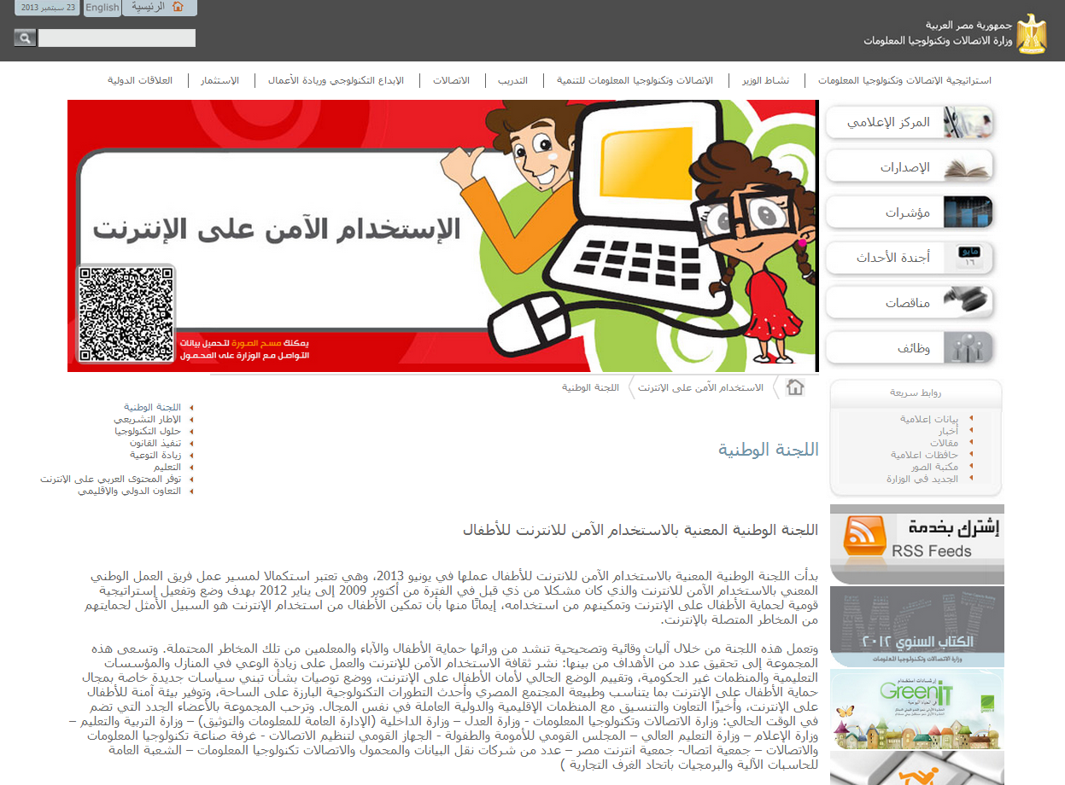
Internet Safety Program website

Slide 13
Arab IGF 2013 - Algeria
Workshop Proposal :
“Online Child Protection in the Arab Region: Studies and Legislations”
Organizers:
Ministry of Communications and Information Technology – Egypt
United Nations Economic and Social Commission for Western Asia ESCWA
ITU Arab Regional Office
Algérie Télécom - Algeria
University of al-Jazirah - Sudan

Slide 14

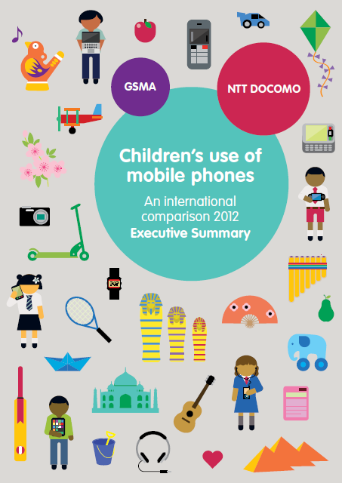
Participated in the GSMA – Ntt Docomo Study on Children’s use of mobile phones (phase II) in cooperation with Mobinil Egypt.
This [second] phase of the project covered a wider scope than previously. 12 different regions were selected:
Phase I (2011) | Phase II (2012)
Cairo | Alexandria – Alexandria
Alexandria | Assuit – Assuit City
Assuit | Beheira – Rashid. Damanhur
Al - Arish | Cairo – Metropolis
 | Giza – Giza City
 | Ismailia – Ismailia City
 | Port Said – Port Said City
 | Kalioubia – Banha. Shoubra K
 | Qena – Qena City
 | Red Sea – Hurghada
 | Sohag – Sohag City
 | Suez – Suez City

Slide 15
Children’s use of mobile phones – An international comparison 2012
Provides a detailed picture of children’s mobile phone behavior across five different countries
The 2012 study surveyed 4,500 pairs of children and their parents/guardians.
It built on work previously conducted in India, Japan and Egypt, and features Indonesia and Chile for the first time.
Japan, India, Indonesia, Egypt and Chile.

Slide 16
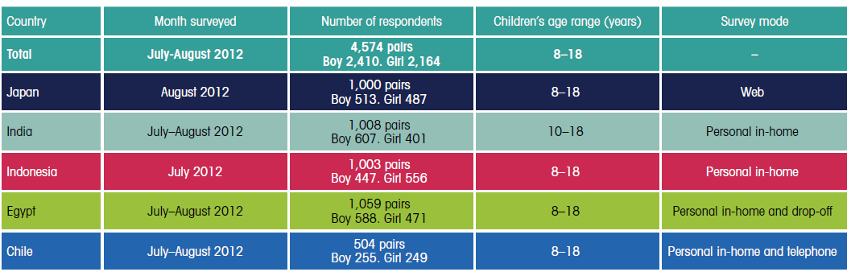
Survey summaries

Slide 17

Egypt
Face-to-Face interviews with 1,030 pairs of children and guardians living across 12 geographic locations.
1,050 pairs of valid responses representing an 81 % success rate.
Children between the ages of 8 - 18 were surveyed. Chosen randomly and provided with a 15-minute briefing about the survey’s purpose and were then left to answer the questions.
Field survey conducted by 4 partner NGOs which had experience in the selected {Suez Canal, Cairo, Alexandria, Upper Egypt and North Delta regions}
12 regions were selected to represent the Egyptian community as closely as possible, both geographically and demographically.
2 of the chosen locations were major metropolitan areas and the remainder were medium-size urban areas.

Slide 18
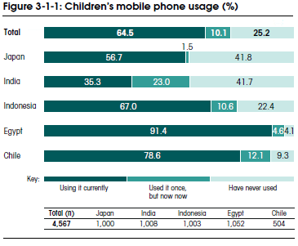
Egypt had the highest proportion of children using a mobile phone (91%)

Slide 19
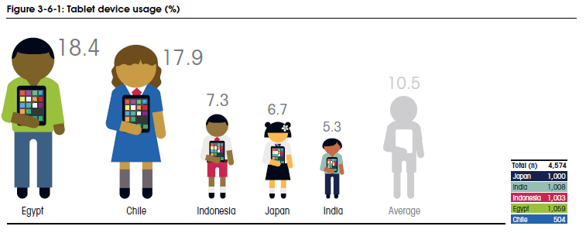
Tablet use
largest percentage of children using tablets is in Egypt and Chile, followed Indonesia, Japan and India.

Slide 20
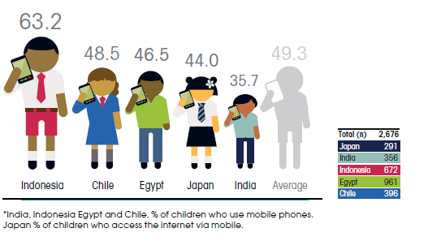
Children’s access to Social networking on mobile phones

Slide 21
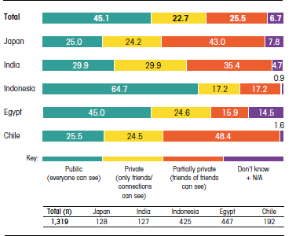

Children’s social networking services privacy settings (% of children who access SNS via their mobile phone)

Slide 22
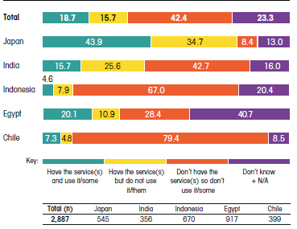

Parental control services on a child’s mobile phone
Full text of GSMA Study can be found at:
http://www.gsma.com/publicpolicy/wp-content/uploads/2012/03/GSMA_ChildrensMobilePhones2012WEB.pdf

Slide 23
Thank You…

