Slide 1


Slide 2

Operation Uncool: Online Youth Consultation on Cyberbullying
Council Working Group on Child Online Protection
Progress Update
2 February 2017

Slide 3
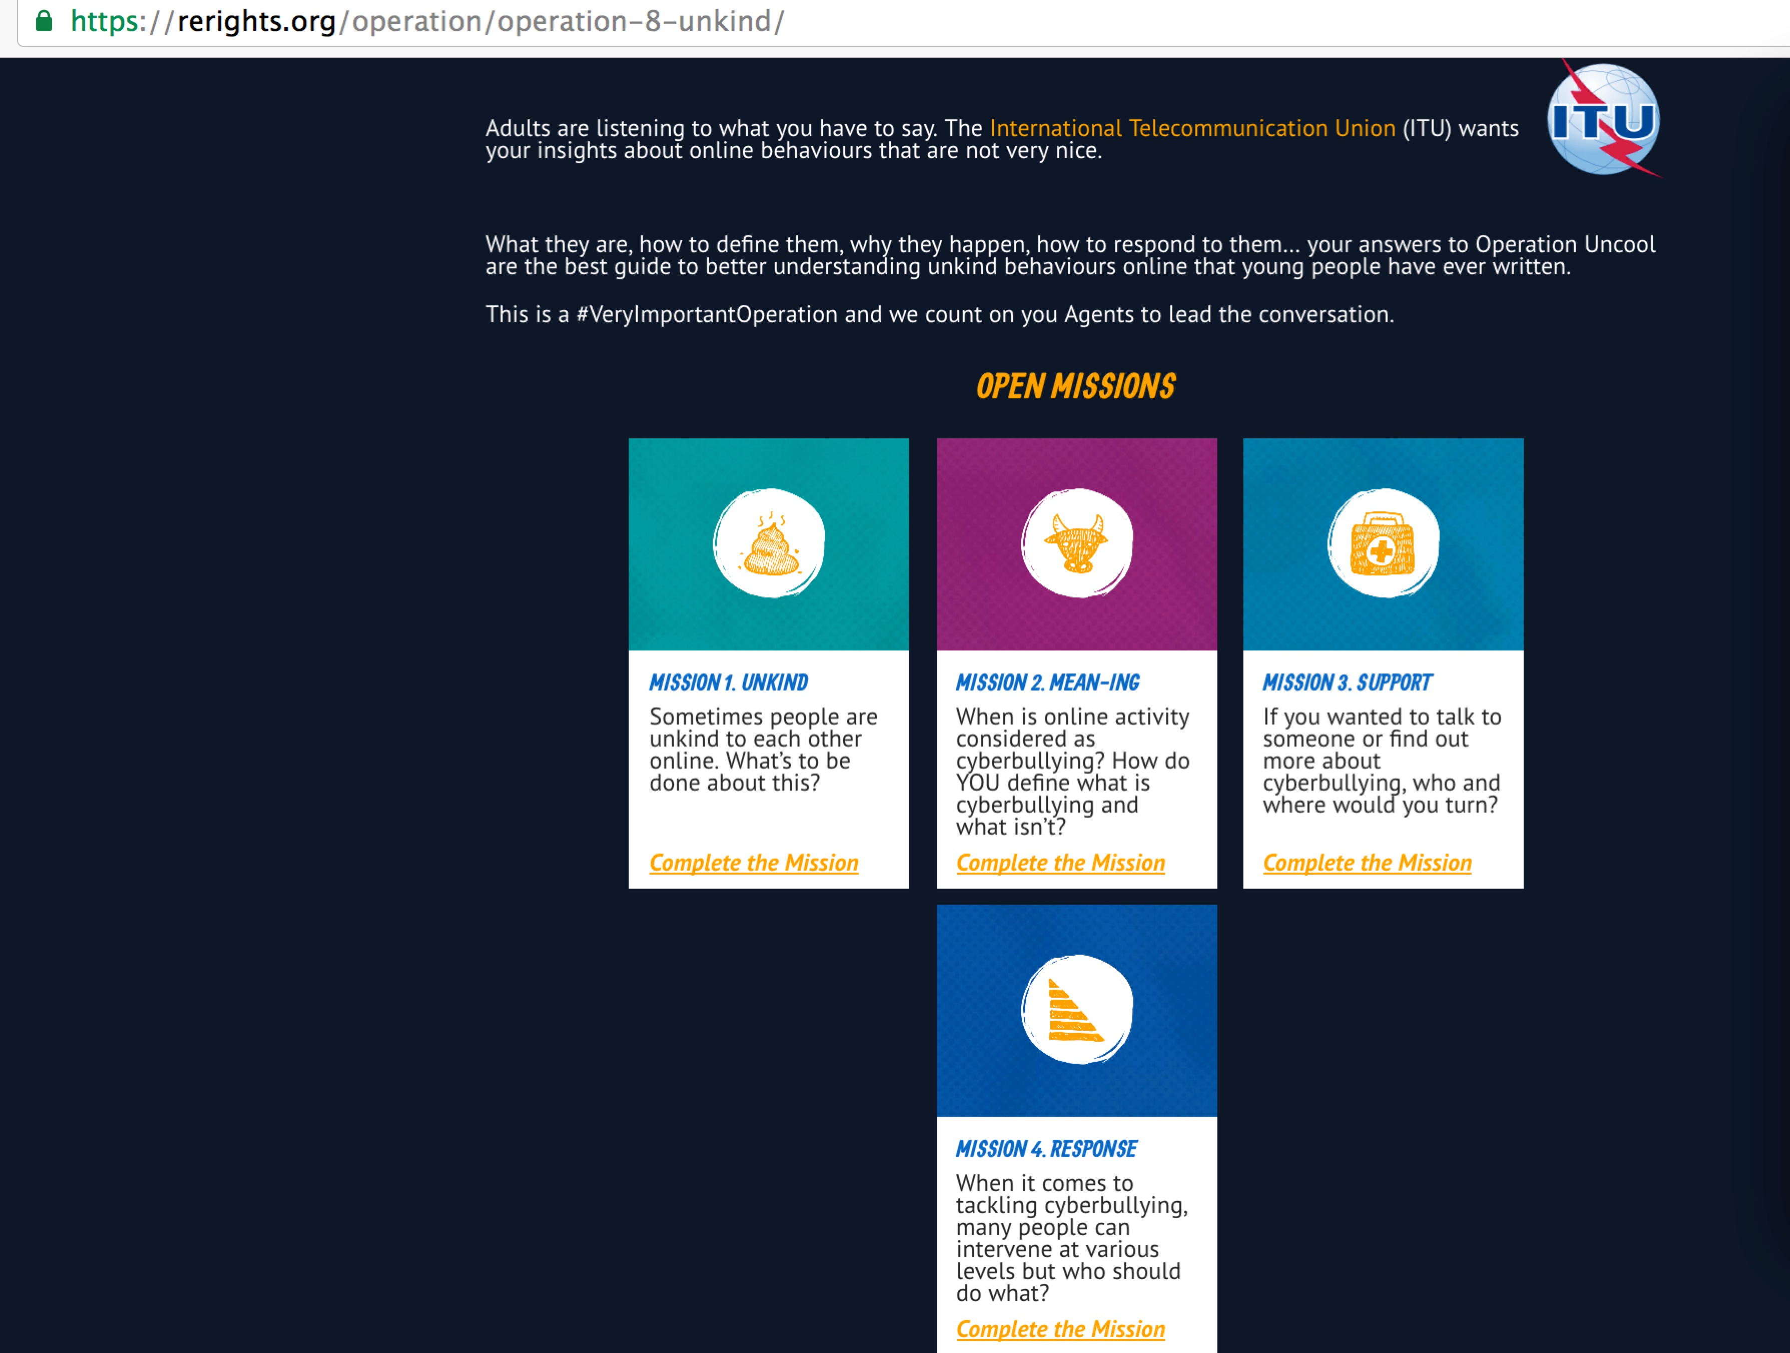
Background
As per Resolution 179, the Group recommended conducting one-day online consultations for youth, prior to its meetings to allow the Group to be more inclusive and agile in responding to current and emerging technical and policy needs.
We are now present the second update on our live online consultation using the RErights platform: https://rerights.org/operation-uncool

Slide 4
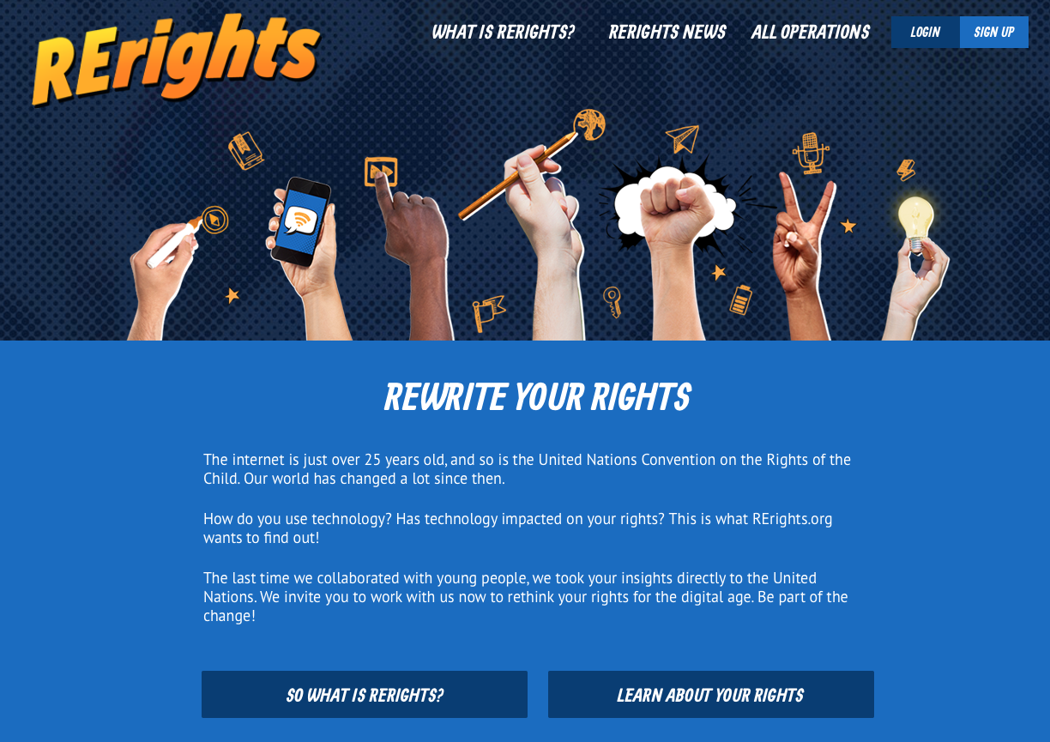
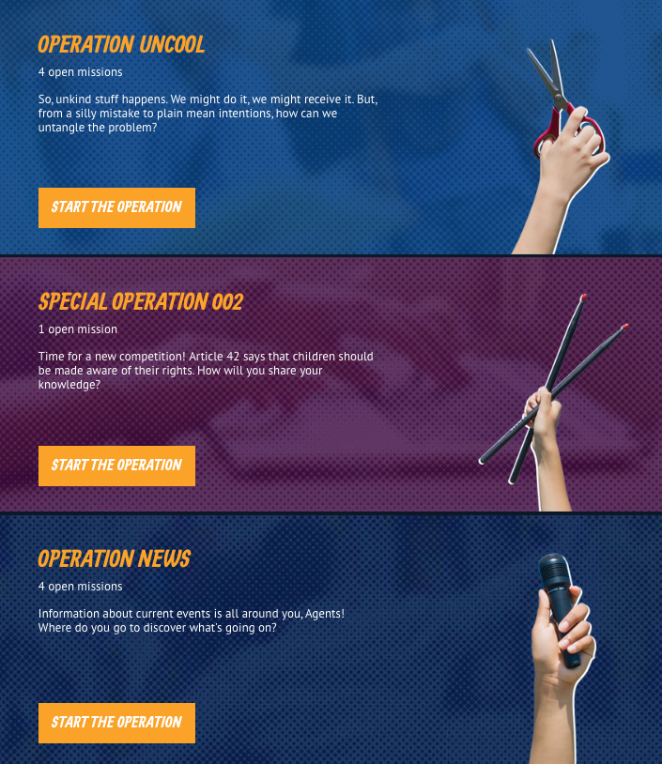
What is RErights?
Young people aged 12-17 submit content (e.g. surveys, text, photos, videos, artwork) to complete activities – “Missions” and “Operations” – exploring important themes and issues
An online community where young people around the world share their ideas and opinions about digital technology and their rights in the digital age

Slide 5
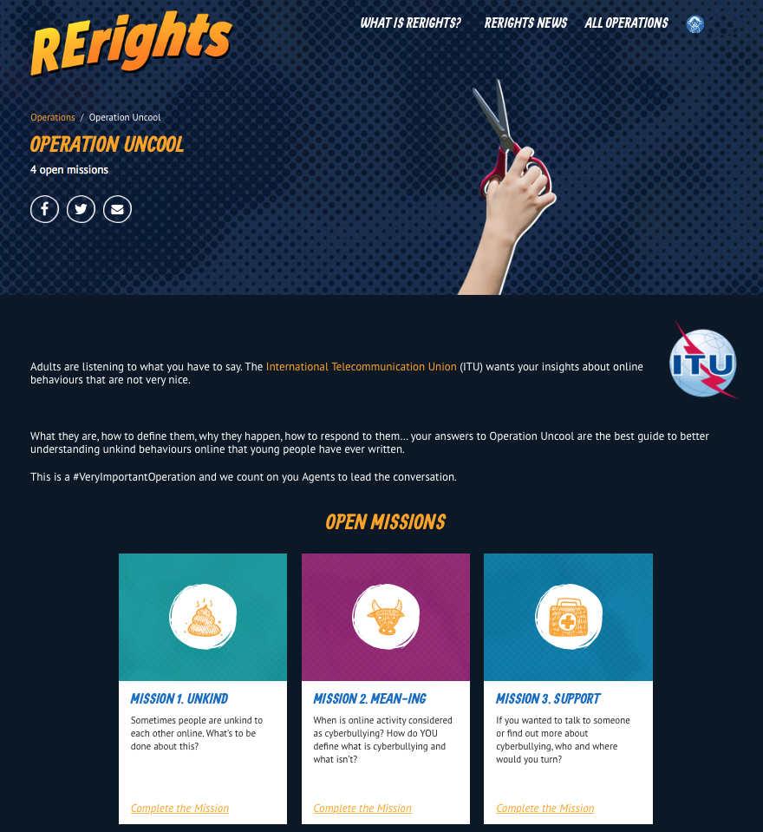
Operation Uncool
RErights Operations are designed to gather data about particular themes and issues. Each Operation contains 3-5 Missions that ask specific questions/set tasks for participants to complete
Operation Uncool invites young people to tell us what they think about cyberbullying – we want to find out what young people have to say in their own words…

Slide 6
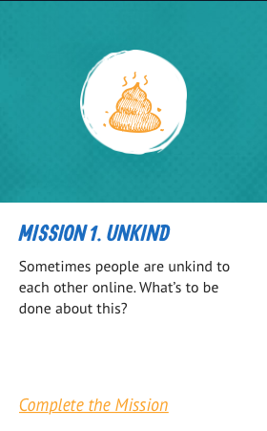
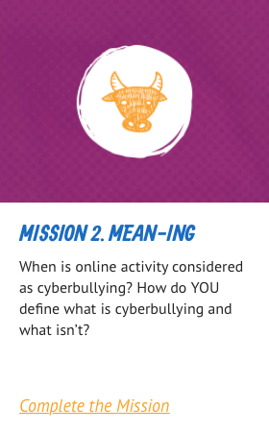
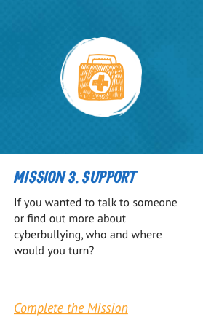
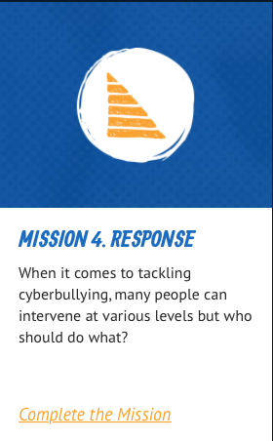
Four Missions…
Operation Uncool contains Missions about four important themes – definition, resolution, response, support…
“Unkind”
How can we resolve it?
“Mean-ing”
What is cyberbullying?
“Response”
Who should help?
“Support”
What support is there?
Rerights reaches out to individual young people, as well
as inviting educators to run workshops for organised groups. The data we gather is presented online in the form of infographics, blog
posts, email updates and social media releases

Slide 7
Outreach and Results
ITU
COP partners
Personal network
RErights
Social media
ITU Blog and Newsletter
Social media, blogs, infographics
Newsletters to RErights agents
Mobilised the project’s Critical Friends and Project Advisory Board
Existing networks
Active support received by INSAFE through newsletters, social media messages, engagement of youth ambassadors platform
Very recent activity on the site has been encouraging – for example, 41 young people from Kenya, Burkina Faso, and Samoa have completed missions online within the past five days
However, despite all the outreach efforts, so far the overall youth participation rate remains relatively low and this puts a significant constraint on our current analysis.

Slide 8
Preliminary Results
Belgium
Brazil
Bulgaria
Burkina Faso
Colombia
Costa Rica
France
Indonesia
Ireland
Italy
Kenya
Morocco
Samoa
Sweden
 | Participants | Countries
Mission 1. Unkind | 65 | 14
Mission 2. Mean-ing | 64 | 12
Mission 3. Support | 44 | 10
Mission 4. Response | 47 | 10
To date, up to 65 young people from 14 countries have already participated in at least one Mission.
The majority are from Kenya where they were told about the consultation through school and participated in small groups.

Slide 9
Preliminary Results
Which of the following actions might be part of cyberbullying? | %
Making fun of someone within an online group by using code or acronyms the person doesn't understand | 97%
Spreading rumours about someone online | 92%
Sending a mean message about one person to many other people | 89%
Sending a mean message to one person | 82%
Pretending to be someone else online | 68%
Posting a video of someone without their permission | 42%
Deliberately excluding someone from an online forum or group | 39%
Writing a status on someone else's Facebook | 32%
As data is being gathered through the series of Missions, young people’s answers help us better understand what cyberbullying means to them.

Slide 10
What young people told us
About Bullying…
“There is no concrete definition [of cyberbullying], as is the case for other concepts like violence or psychology (…). It all depends on the person’s lived experience.” (France, male, 16)
“Bullying is bullying no matter how many times its done.” (Kenya, female, 15)
“The more it happens the more people who are receiving them will withdraw from the world.” (Indonesia, female, 16)
“Yes [the number of witnesses makes a difference] because when many people witness it, it is more humiliating and embarrassing for the victim.” (Kenya, female, 15)
“Yes [the number of witnesses makes a difference] because they have more proof about incident and more people to help with the problem.” (Kenya, male, 15)

Slide 11
What young people told us
When asked if adults and young people define cyberbullying the same way
“I don’t think so because adults and children have different point of view.” (Kenya, male, 16)
“No, adults never got the chance to experience social media in their teenage stages so they do not understand how critical the pain is.” (Kenya, group, females, average age 15)
“No, Since young people are more susceptible to criticism and jokes on the contrary adults are more mature and can take these cases in a better way.” (Costa Rica, female, 17)
“Yes because cyberbullying will forever be bullying online.” (Kenya, male, 14)
“I think adults would not see that people sometimes are just joking.” (Ireland, female, 12)
“Adults often underestimate the problem.” (Italy, female, 14)

Slide 12
Lessons Learned
Network: Engage a wider network of partners to implement and run the consultation. We encourage Member States to allocate more resources or provide greater access to relevant local networks/entities.
Workshop: Engage different platforms and partners could help to run consultations in groups and not only at the individual level.
Topic: Consider different approaches to choose the topics in order to be sure that the youth are interested and comfortable to contribute.
Language: The consultation language is English and we have workshop guidance in English, Chinese, Russian, French and Spanish. Including other major language in our consultation could help raise response rate and geographical reach.

